Slide 1
ECG Signal processing (2)
ECE, UA

Slide 2
ECG signal processing - Case [1]
Diagnosis of Cardiovascular Abnormalities From Compressed ECG: A Data Mining-Based Approach[1]
IEEE TRANSACTIONS ON INFORMATION TECHNOLOGY IN BIOMEDICINE, VOL. 15, NO. 1, JANUARY 2011

Slide 3
Contents
Introduction
Application Scenario
System and Method
Implementation & Results
Conclusion

Slide 4
Introduction
Home monitoring and real-time diagnosis of CVD is important
ECG signals are enormous in size
Decomposing ECG produces time delay
High algorithm complex and hard to maintain

Slide 5
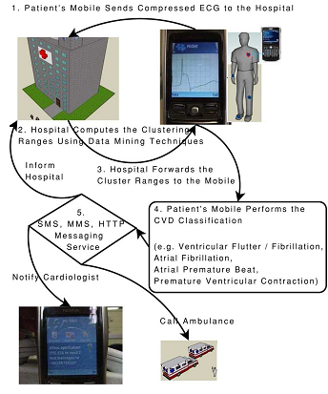
Application Scenario
Real time CVD
diagnosis
Processing on
compressed ECG
Efficient data
mining method
Simple to implement

Slide 6
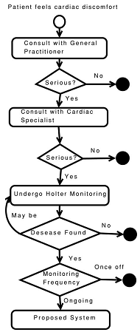
Application Scenario
The work ﬂow
till our proposed
CVD recognition system is being utilized

Slide 7
System and Method
Mobile phone compress the ECG signal
Transmit by blue-tooth to hospital server
Use data mining methods to extract the attributes and get the cluster range
Detect and classify the CVD and make alert by the SMS system

Slide 8
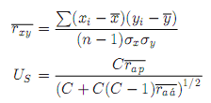
System and Method
Attribute Subset Selection on Hospital Server
a correlation-based feature subset (CFS) selection technique:
extract relevant attributes
Reduce redundant attributes

Slide 9
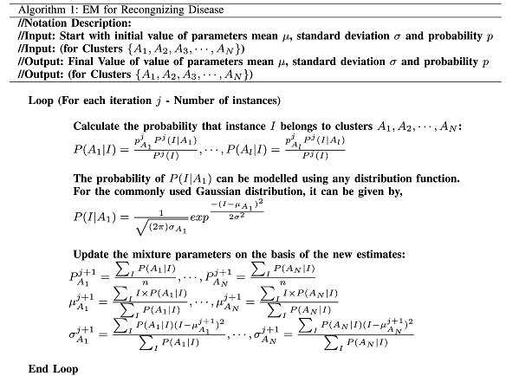
System and Method
B. Cluster Formation on Hospital Server

Slide 10
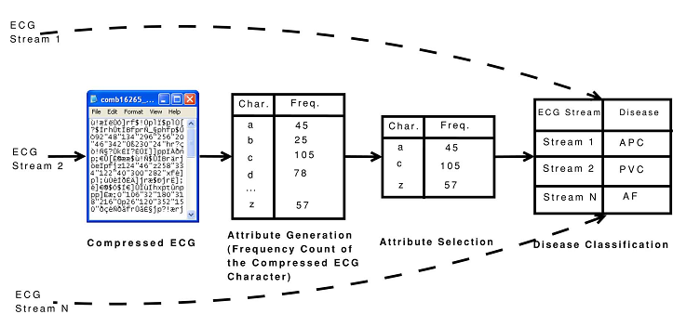
System and Method
C. Rule-Based System on a Mobile Phone

Slide 11
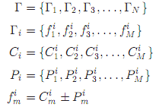
System and Method
C. Rule-Based System on a Mobile Phone

Slide 12
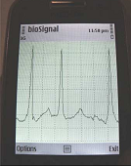
Implementation & Results
Implementation
programmed with J2EE using the Weka library
Use NetBeans Interface to develop a system on mobile phone as Nokia E55
Java Wireless Messaging API
Java Bluetooth API

Slide 13
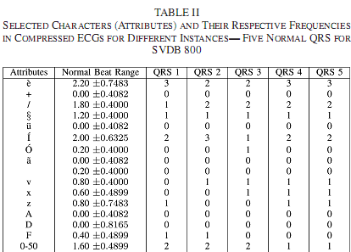
Implementation & Results
Results

Slide 14
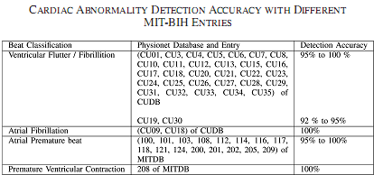
Implementation & Results
Results

Slide 15
Conclusion
Faster diagnosis is absolutely crucial for patient’s survival
CVD detection mechanism directly from compressed ECG
Using data mining techniques CFS,EM
A rule-based system was implemented on mobile platform

Slide 16
Case (2)
Multiscale Recurrence Quantiﬁcation Analysis of Spatial Cardiac Vectorcardiogram Signals
IEEE TRANSACTIONS ON BIOMEDICAL ENGINEERING, VOL. 58, NO. 2, FEBRUARY 2011

Slide 17
Content
Introduction
Research Methods
Experimental Design
Results
Discussion and Conclusion

Slide 18
Introduction
MI (Myocardial Infarction) is one single leading cause of mortality in America.
The standard clinical method is an analysis the waveform pattern of ECG.
12-lead ECG(location) and 3-lead vectorcardiogram (VCG), are designed for a multidirectional view of the cardiacelectrical activity.

Slide 19
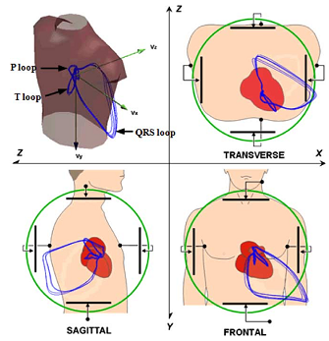
Introduction
VCG
signals monitor the cardiac electrical activity along three orthogonal X, Y , Z planes of the body,
frontal
transverse
sagittal

Slide 20
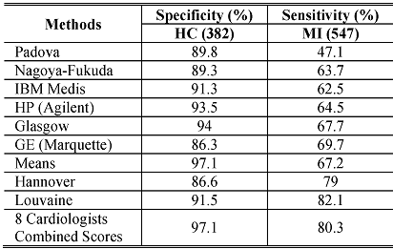
Introduction
3-lead VCG surmounts loss in one lead ECG and the redundant in 12-lead ECG.
Few of traditional automated MI diagnostic algorithms exceeding 90% in both speciﬁcity and sensitivity.

Slide 21
Introduction
The multiscale RQA analysis of more intuitive three-lead VCG signals.
VCG loops between healthy control (HC) versus MI subjects
Explore hidden recurrence patterns
Develop a novel classiﬁcation methodology

Slide 22
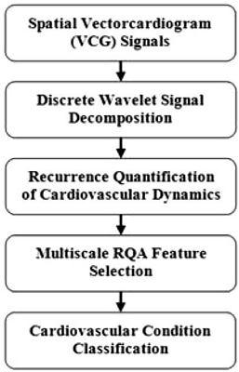
Research Methods
A. Wavelet Signal Representation
Daubechies wavelets db4 is selected in this present investigation since its wavelet function has a very similar shape to the ECG signal pattern.

Slide 23
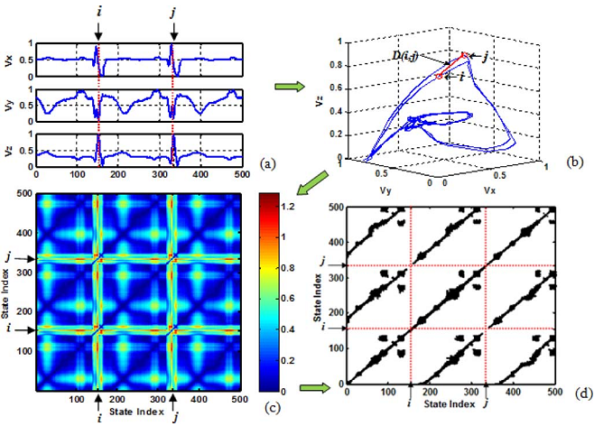
Research Methods
B. Recurrence Quantiﬁcation of Cardiovascular Dynamics

Slide 24
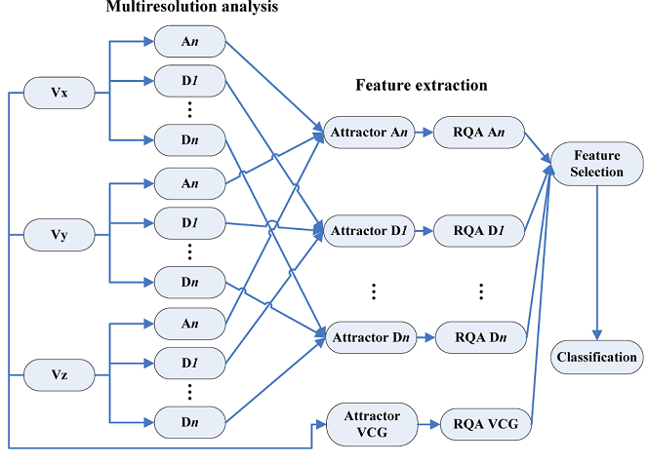
Research Methods
C. Multiscale RQA

Slide 25
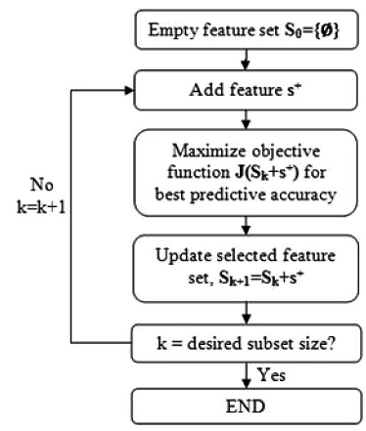
Research Methods
D. Feature Selection
To search the space of all feature subsets for the best predictive accuracy.

Slide 26
Research Methods
E. Classiﬁcation
Linear discriminant analysis (LDA)
Quadratic discriminant analysis (QDA)
K nearest neighbor (KNN) rule
The present paper uses the Euclidean metric to measure “closeness” in the KNN classiﬁcation model

Slide 27
Experimental Design
Database
PTB Database
54 healthy
368MI recordings
148 patients
B. Cross-Validation and Performance Evaluation
K-fold cross-validation
Random subsampling methods

Slide 28
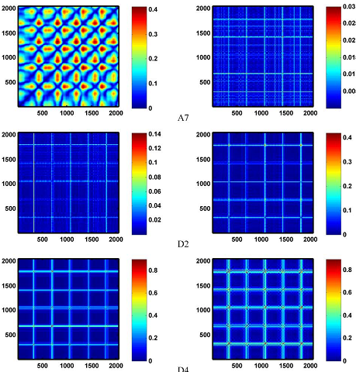
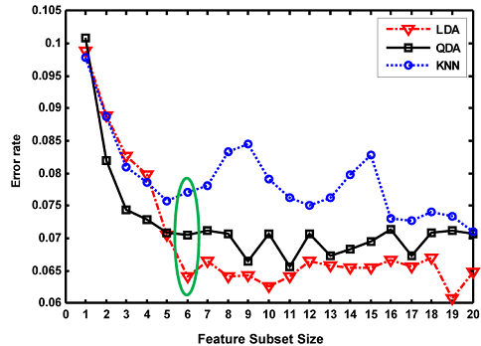
Results

Slide 29
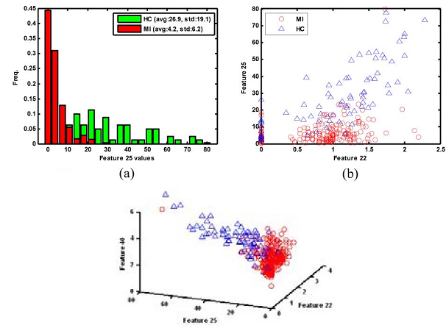
Results

Slide 30
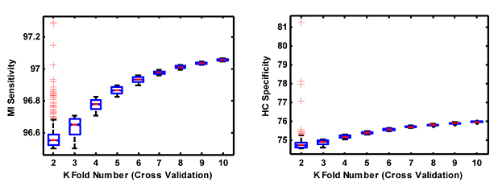
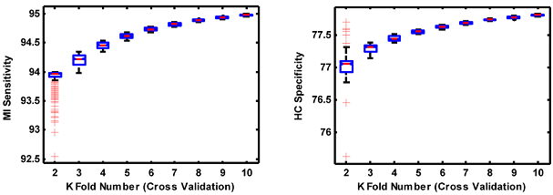
Results

Slide 31
Discussion and conclusion
Due to the various nidus locations, it is challenging to characterize and identify the ECG signal pathological patterns of MI.
ECG or VCG signals from MI are shown to have signiﬁcantly complex patterns under a different combination of MI conditions.
This method present a much better performance than other standard methods

Slide 32
Case (3)
Robust Detection of Premature Ventricular Contractions Using a Wave-Based Bayesian Framework
IEEE TRANSACTIONS ON BIOMEDICAL ENGINEERING, VOL. 57, NO. 2, FEBRUARY 2010

Slide 33
Content
Introduction
Wave-based ECG Dynamical Model
Bayesian State Estimation Through EKF
Bayesian Detection of PVC
Results
Discussion and Conclusion

Slide 34
Introduction
Accurate detection of premature ventricular contractions (PVCs) is particularly important.
Introduce a model-based dynamic algorithm
Extended Kalman ﬁlter
Bayesian estimations of the state variables
The method can contribute to, and enhance the performance of clinical PVC detection.

Slide 35
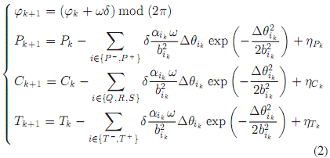
Wave-based ECG Dynamical Model
model every heart beat as a combination of ﬁnite characteristic.
sum of Gaussian kernels.

Slide 36
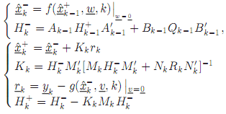
Bayesian State Estimation Through EKF
The observed noisy phase and noisy amplitude:
Nonlinear EKF is required for estimating the state vector
linearize the nonlinear system model

Slide 37
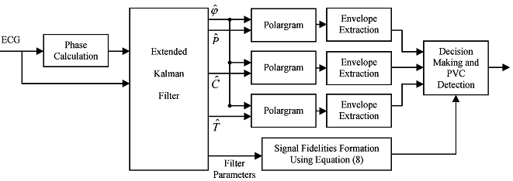
Bayesian Detection of PVC
Monitoring Signal Fidelity

Slide 38
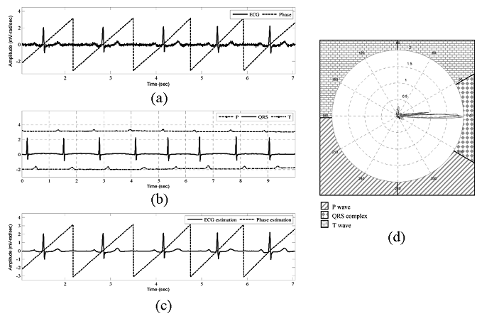
Bayesian Detection of PVC
B.Polargram Formation and Envelope Extraction

Slide 39
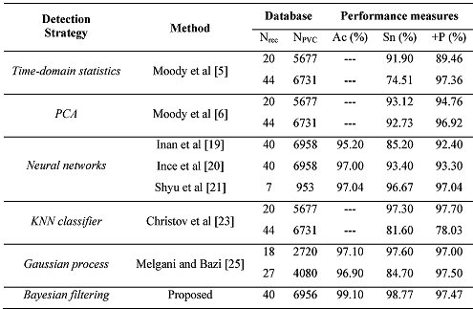
Results
in MATLAB, MIT-BIH

Slide 40
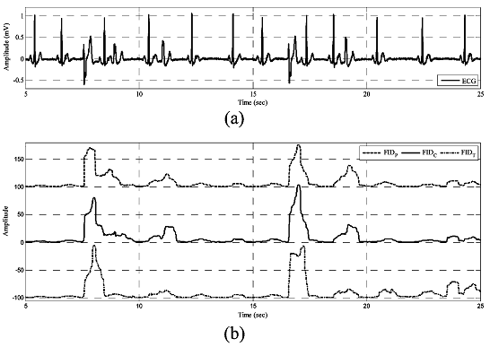
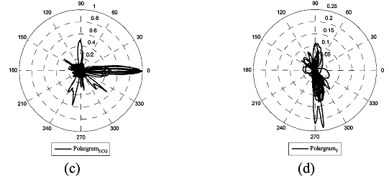
Results

Slide 41
Discussion and Conclusion
A wave-based Bayesian framework was presented and validated for PVC beat detection.
KFs can be thought of as adaptive ﬁlters
Performance evaluation results showed that the developed method provides a reliable and accurate PVC detection
The initial value will infect the estimation
Computationally tractable and of special interest for real-time applications

Slide 42
Case (4)
Active Learning Methods for Electrocardiographic Signal Classiﬁcation
IEEE TRANSACTIONS ON INFORMATION TECHNOLOGY IN BIOMEDICINE, VOL. 14, NO. 6, NOVEMBER 2010

Slide 43
Content
Introduction
Support Vector Machines
Active Learning Methods
Experiments & Results
Conclusion

Slide 44
Introduction
ECG signals represent a useful information source about the rhythm and functioning of the heart.
To obtain an efﬁcient and robust ECG classiﬁcation system
SVM classiﬁer has a good generalization capability and is less sensitive to the curse of dimensionality.
Automatic construction of the set of training samples – active learning

Slide 45
Support Vector Machines
the classifier is said to assign a feature vector x to class w_{i} if
For two-category case,
An example we’ve learned before:
Minimum-Error-Rate Classifier

Slide 46
Discriminant Function
It can be arbitrary functions of x, such as:
Nearest
Neighbor
Decision
Tree
Linear
Functions
Nonlinear
Functions

Slide 47
Linear Discriminant Function
g(x) is a linear function:
x₂
w^{T} x + b > 0
A hyper-plane in the feature space
w^{T} x + b = 0
n
(Unit-length) normal vector of the hyper-plane:
w^{T} x + b < 0
x₁

Slide 48
Linear Discriminant Function
denotes +1
denotes -1
How would you classify these points using a linear discriminant function in order to minimize the error rate?
x₂
Infinite number of answers!
x₁

Slide 49
Linear Discriminant Function
denotes +1
denotes -1
How would you classify these points using a linear discriminant function in order to minimize the error rate?
x₂
Infinite number of answers!
x₁

Slide 50
Linear Discriminant Function
denotes +1
denotes -1
How would you classify these points using a linear discriminant function in order to minimize the error rate?
x₂
Infinite number of answers!
x₁

Slide 51
Linear Discriminant Function
denotes +1
denotes -1
How would you classify these points using a linear discriminant function in order to minimize the error rate?
x₂
Infinite number of answers!
Which one is the best?
x₁

Slide 52
Large Margin Linear Classifier
denotes +1
denotes -1
The linear discriminant function (classifier) with the maximum margin is the best
x₂
Margin
“safe zone”
Margin is defined as the width that the boundary could be increased by before hitting a data point
Why it is the best?
Robust to outliners and thus strong generalization ability
x₁

Slide 53
Large Margin Linear Classifier
denotes +1
denotes -1
Given a set of data points:
x₂
, where
With a scale transformation on both w and b, the above is equivalent to
x₁

Slide 54
Large Margin Linear Classifier
denotes +1
denotes -1
We know that
x₂
Margin
x⁺
w^{T} x + b = 1
x⁺
w^{T} x + b = 0
w^{T} x + b = -1
The margin width is:
n
x⁻
Support Vectors
x₁

Slide 55
Large Margin Linear Classifier
denotes +1
denotes -1
Formulation:
x₂
Margin
x⁺
w^{T} x + b = 1
such that
x⁺
w^{T} x + b = 0
w^{T} x + b = -1
n
x⁻
x₁

Slide 56
Large Margin Linear Classifier
denotes +1
denotes -1
Formulation:
x₂
Margin
x⁺
w^{T} x + b = 1
such that
x⁺
w^{T} x + b = 0
w^{T} x + b = -1
n
x⁻
x₁

Slide 57
Large Margin Linear Classifier
denotes +1
denotes -1
Formulation:
x₂
Margin
x⁺
w^{T} x + b = 1
such that
x⁺
w^{T} x + b = 0
w^{T} x + b = -1
n
x⁻
x₁

Slide 58
Solving the Optimization Problem
Quadratic programming
with linear constraints
s.t.
Lagrangian
Function
s.t.

Slide 59
Solving the Optimization Problem
s.t.

Slide 60
Solving the Optimization Problem
s.t.
Lagrangian Dual
Problem
s.t.
, and

Slide 61
Solving the Optimization Problem
From KKT condition, we know:
x₂
x⁺
w^{T} x + b = 1
w^{T} x + b = 0
Thus, only support vectors have
x⁺
w^{T} x + b = -1
x⁻
The solution has the form:
Support Vectors
x₁

Slide 62
Solving the Optimization Problem
The linear discriminant function is:
Notice it relies on a dot product between the test point x and the support vectors x_{i}
Also keep in mind that solving the optimization problem involved computing the dot products x_{i}^{T}x_{j} between all pairs of training points

Slide 63
Large Margin Linear Classifier
denotes +1
denotes -1
What if data is not linear separable? (noisy data, outliers, etc.)
x₂
Slack variables ξ_{i} can be added to allow mis-classification of difficult or noisy data points
w^{T} x + b = 1
w^{T} x + b = 0
w^{T} x + b = -1
x₁

Slide 64
Large Margin Linear Classifier
Formulation:
such that
Parameter C can be viewed as a way to control over-fitting.

Slide 65
Large Margin Linear Classifier
Formulation: (Lagrangian Dual Problem)
such that

Slide 66
Non-linear SVMs
Datasets that are linearly separable with noise work out great:
0
x
But what are we going to do if the dataset is just too hard?
0
x
How about… mapping data to a higher-dimensional space:
x²
0
x
This slide is courtesy of www.iro.umontreal.ca/~pift6080/documents/papers/svm_tutorial.ppt

Slide 67
Non-linear SVMs: Feature Space
General idea: the original input space can be mapped to some higher-dimensional feature space where the training set is separable:
Φ: x → φ(x)
This slide is courtesy of www.iro.umontreal.ca/~pift6080/documents/papers/svm_tutorial.ppt

Slide 68
Nonlinear SVMs: The Kernel Trick
With this mapping, our discriminant function is now:
No need to know this mapping explicitly, because we only use the dot product of feature vectors in both the training and test.
A kernel function is defined as a function that corresponds to a dot product of two feature vectors in some expanded feature space:

Slide 69
Nonlinear SVMs: The Kernel Trick
An example:
2-dimensional vectors x=[x₁ x₂];
let K(x_{i},x_{j})=(1 + x_{i}^{T}x_{j})²,
Need to show that K(x_{i},x_{j}) = φ(x_{i}) ^{T}φ(x_{j}):
K(x_{i},x_{j})=(1 + x_{i}^{T}x_{j})²,
= 1+ x_{i1}²x_{j1}² + 2 x_{i1}x_{j1} x_{i2}x_{j2}+ x_{i2}²x_{j2}² + 2x_{i1}x_{j1} + 2x_{i2}x_{j2}
= [1 x_{i1}² √2 x_{i1}x_{i2} x_{i2}² √2x_{i1} √2x_{i2}]^{T} [1 x_{j1}² √2 x_{j1}x_{j2} x_{j2}² √2x_{j1} √2x_{j2}]
= φ(x_{i}) ^{T}φ(x_{j}), where φ(x) = [1 x₁² √2 x₁x₂ x₂² √2x₁ √2x₂]
This slide is courtesy of www.iro.umontreal.ca/~pift6080/documents/papers/svm_tutorial.ppt

Slide 70
Nonlinear SVMs: The Kernel Trick
Examples of commonly-used kernel functions:
Linear kernel:
Polynomial kernel:
Gaussian (Radial-Basis Function (RBF) ) kernel:
Sigmoid:
In general, functions that satisfy Mercer’s condition can be kernel functions.

Slide 71
Nonlinear SVM: Optimization
Formulation: (Lagrangian Dual Problem)
such that
The solution of the discriminant function is
The optimization technique is the same.

Slide 72
Support Vector Machine: Algorithm
1. Choose a kernel function
2. Choose a value for C
3. Solve the quadratic programming problem (many software packages available)
4. Construct the discriminant function from the support vectors

Slide 73
Some Issues
Choice of kernel
- Gaussian or polynomial kernel is default
- if ineffective, more elaborate kernels are needed
- domain experts can give assistance in formulating appropriate similarity measures
Choice of kernel parameters
- e.g. σ in Gaussian kernel
- σ is the distance between closest points with different classifications
- In the absence of reliable criteria, applications rely on the use of a validation set or cross-validation to set such parameters.
Optimization criterion – Hard margin v.s. Soft margin
- a lengthy series of experiments in which various parameters are tested
This slide is courtesy of www.iro.umontreal.ca/~pift6080/documents/papers/svm_tutorial.ppt

Slide 74
Summary: Support Vector Machine
1. Large Margin Classifier
Better generalization ability & less over-fitting
2. The Kernel Trick
Map data points to higher dimensional space in order to make them linearly separable.
Since only dot product is used, we do not need to represent the mapping explicitly.

Slide 75
Active Learning Methods
Choosing samples properly so that to maximize the accuracy of the classiﬁcation process
Margin Sampling
Posterior Probability Sampling
Query by Committee

Slide 76
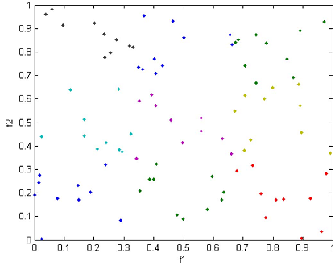
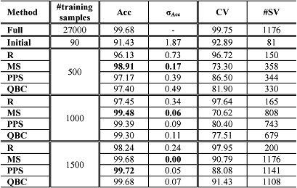
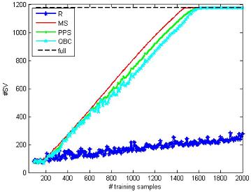
Experiments & Results
Simulated Data
chessboard problem
linear and radial basis
function (RBF) kernels

Slide 77
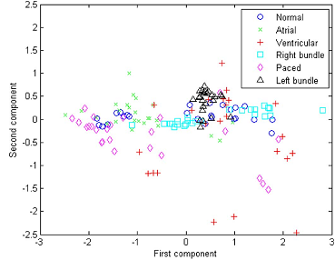
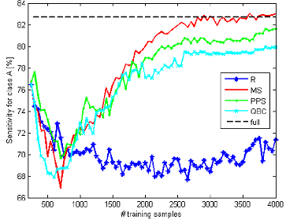
Experiments & Results
B. Real Data
MIT-BIH, morphology three ECG temporal features

Slide 78
Conclusion
Three active learning strategies for the SVM classiﬁcation of electrocardiogram (ECG) signals have been presented.
Strategy based on the MS principle seems the best as it quickly selects the most informative samples.
A further increase of the accuracies could be achieved by feeding the classiﬁer with other kinds of features

Slide 79
Case (5)
Depolarization Changes During Acute Myocardial Ischemia by Evaluation of QRS Slopes: Standard Lead and Vectorial Approach
IEEE TRANSACTIONS ON BIOMEDICAL ENGINEERING, VOL. 58, NO. 1, JANUARY 2011

Slide 80
Content
Introduction
Materials and Methods
Results
Conclusion

Slide 81
Introduction
Early diagnosis of patients with acute myocardial ischemia is essential to optimize treatment
Variability of the QRS slopes
Aims:
evaluate the normal variation of the QRS slopes
better quantiﬁcation of pathophysiologically signiﬁcant changes

Slide 82
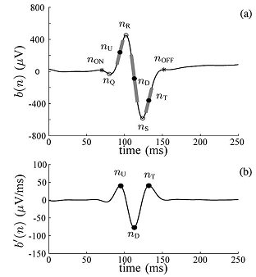
Materials and Methods
Population(large)
1) ECG Acquisition
2) PCI Recordings
B. Preprocessing
C. QRS Slopes in a Single ECG Lead
1) IUS : Upward slope of the R wave.
2) IDS : Downward slope of the R wave.
3) ITS : Upward slope of the S wave (in leads V1–V3).

Slide 83
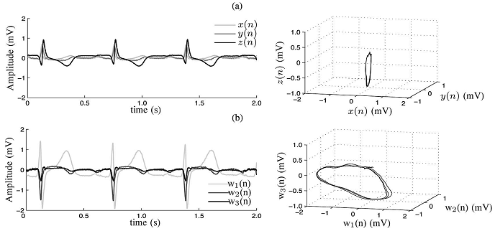
Materials and Methods
D. QRS Slopes From the Spatial QRS Loops
1) QRS Loop From the Vectorcardiogram(a)
2) QRS Loop Using Principal Component Analysis(b)

Slide 84
Materials and Methods
E. Quantiﬁcation of Ischemic Changes
F. ECG normalization

Slide 85
Materials and Methods
G.Normal Variations of the QRS Slopes
Intraindividual Variability Analysis
Interindividual Variability Analysis
H.Time Course of QRS Slope Changes During Ischemia
I. Calculation of ST-Segment Change

Slide 86
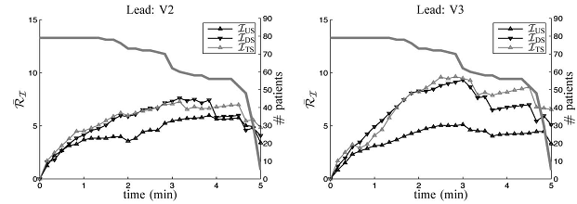
Results

Slide 87
Results

Slide 88
Conclusion
We measured the slopes of the QRS complex and assessed their performances for evaluation of myocardial ischemia induced by coronary occlusion during prolonged PCI.
The downward slope of the R with the most marked changes due to ischemia.
Results based on the QRS-loop approaches seem to be more sensitive
QRS-slope analysis could act as a robust method for changes in acute ischemia.

