Slide 1
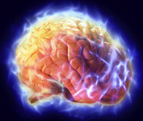
EEG CIRCUIT DESIGN
ECE, UA

Slide 2
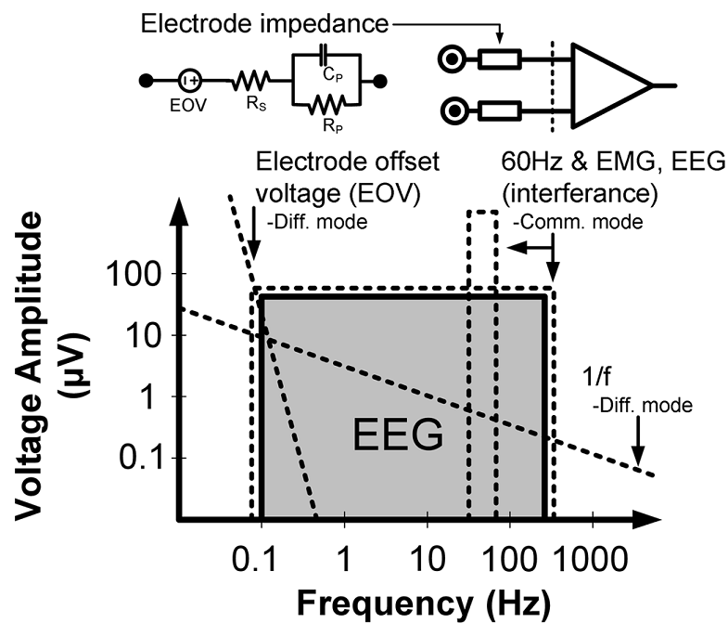
Micro-Power EEG Acquisition SoC[10]
Electrode circuit
EEG sensing
Interference

Slide 3
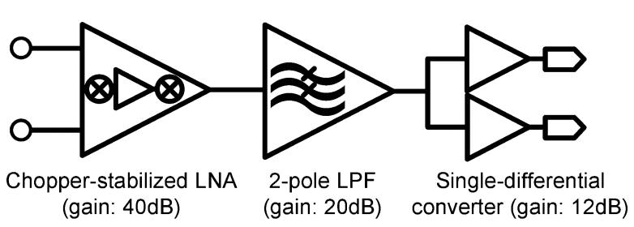
Instrumentation ampliﬁer block diagram
Amplifier & Filter

Slide 4
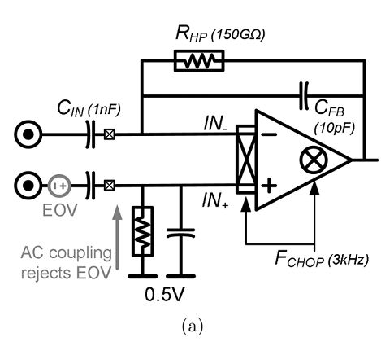
Chopper stabilized LNA (a) core topology and (b) complete topology

Slide 5
Two-stage op-amp with embedded chopper-modulators used in CS-LNA

Slide 6
Equivalent circuit model for CS-LNA

Slide 7
EEG recordings in man
Examples of records and results of analysis made by Braintune (St. Petersbuurg) hardware/software.

Slide 8
EEG Probe System
Hardware Block Diagram
Lo1
Chan 1
AM Mod
Gain
XFMR
Sum
To
PC
Chan 1
Gain
AM Mod
Ref
DRL
Lo2
Gnd
Dual Channel
Low Noise Amplifier
Board
Dual Channel
AM Modulator
Board

Slide 9
Nyquist Theorem
The highest frequency which can be accurately represented is one-half of the sampling rate.
The sampling rate here is below the Nyquist frequency, so the result of sampling is nothing like the input:aliasing.
For practical purposes the sampling rate should be 10 higher than the highest frequency in the signal.

Slide 10
EEG is a difference in potential between two electrodes
If two electrodes are “active”, it is called “bipolar” recording.
If one electrode is “silent”, it is called “monopolar” recording. The reference sites: ear lobe, mastoid, nose.

Slide 11
Bipolar vs. monopolar recordings
Monopolar recording is used in research, because it enables the researcher to localize the event of interest.
Bipolar recording is used in BF, because it reduces shared artifacts. Electrodes should be placed on the sites with the strongest gradients of the potentials under training.

Slide 12
EMG and eye blink artifacts in EEG
These types of artifacts can be detected by visual inspection.
Eye blinks can be excluded from data analysis.
EMG should be taken into account during spectral analysis.

Slide 13
EEG recorded at Cz
EEG is a mixture of waves at different frequencies and amplitudes.

Slide 14
EEG recorded at T5
At each time interval several sine-waves at different frequencies may be present in the signal.

Slide 15
Quality control of EEG recording
1) EEG amplifies must be calibrated with daily checks
2) acquisition parameters must be checked daily and keep the same
3) the same procedures must be employed in all individuals
4) all artifacts must be eliminated or taken into account prior to spectral analysis.

Slide 16
EMG Artifact
EMG artifact starts as low as 12 Hz and ranges to 300 Hz. Most of the spectrum lies between 30-150 Hz.
Sites F3, F4, T3, T4, P3, P4 can pick up EMG the massester and temporalis muscles.
Posterior electrodes can pick up EMG from occipitalis, trapezius and supraspinal muscles.
To avoid this type of artifact one can relax or position the head properly or change slightly the position of electrode.
Fz, Cz, Pz can give a relatively pure EEG signal.

Slide 17
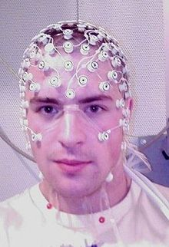
EKG artifact
ECG artifacts occur from the electrodes that pick up activity from underlying pulsating blood vessels in the scalp.
EKG artifact gets more prevalent with aging.

Slide 18
The noise from the standard AC electrical line current
This noise can be diminished by the proper grounding of the equipment (both computer and amplifies).
It could be also eliminated by a so called notch filter which selectively removes 50 (60 for the US) Hz activity from the signal.
This noise could be attenuated by obtaining good contact of electrodes with the scalp. The electrode impedance less than 10 kOhms is desirable.

Slide 19
EEG recording in man
Eyes opened condition.
Examples of different waves.

Slide 20
Reviewing EEG
EEG is characterized by:
1) voltage
2) frequency (is used for BF)
3) spatial location (is used for BF)
4) inter-hemispheric symmetries
5) reactivity (reaction to state change)
6) character of waveform occurrence (random, serial, continuous)
6) morphology of transient events

Slide 21
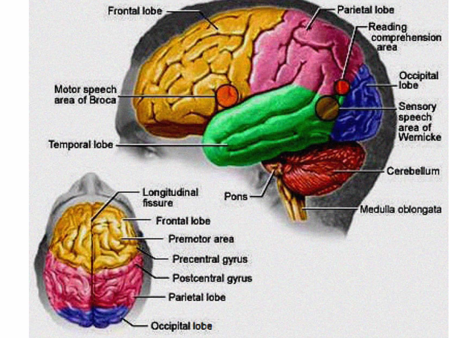
Reviewing EEG: voltage
Amplitude is the voltage in microvolts measured from the peak of the wave to the trough of the wave. Varies from 10 mcV to 100 mcV with average around 20-50 mcV.

Slide 22
Reviewing EEG: frequency
Spectrums reflect the amount of energy in a certain frequency range of EEG.
Term monorhythmic means that a particular portion of EEG shows a rhythmic component in a singular frequency.
Term polyrhythmic means that several rhythmic frequencies are present in EEG.
The presence of large-amplitude delta-activity may indicate infarct or other lesion.

Slide 23
Reviewing EEG: frequency
Slow (0-4 Hz) and high (more 20 Hz) frequency bands of EEG may pick up artifacts, such as eye movements and muscle activity, and therefore should be evaluated with caution.
Despite the use of artifact rejection algorithms, the failure to accurately distinguish true physiological rhythmicity from the artifacts is a serious shortcoming of current software systems and requires the expert assessment.

Slide 24
Reviewing EEG: transient events
A transient is an isolated form or feature that stands out from the background activity.
It is called a spike if it has the duration less than 70 msec.
It is called a sharp wave if it has the duration between 70 and 200 msec.
The presence of large amplitude spikes and waves may indicate the presence of epilepsy.

Slide 25
Maps of EEG spectrums in standards bands
Eyes opened condition.

Slide 26
EEG recording in man
Eyes closed condition.
Enhancement of alpha waves.

Slide 27
Maps of EEG spectrums
Eyes closed condition

Slide 28
EEG spectrums
Three conditions (EC, R, M) are compared to Eyes Opened condition.
Two peaks (in theta and alpha band) with different scalp distribution are observed.
Reading and math produce big (but different) changes in alpha band and small changes in theta and beta bands.
Note that alpha activities are different for all four conditions both in distribution and frequency.

Slide 29
EEG spectrums in individual bands
Regular theta - idling rhythm
Irregular theta - working activity
Reading and math produce alpha rhythms that are different in frequency and location.

Slide 30
EEG as a sequence of micro-states
EEG consists of series of short-lasting quasi-stationary epochs corresponding to what Lehmann et al. (1987) have called brain functional micro-states.
EEG reflects the changes in the state of neuronal networks rather than specific aspects of information processing.

Slide 31
Normal distribution
When many independent random factors act in an additive manner to create variability, data will follow a bell-shaped distribution called the Gaussian distribution. This distribution is also called a Normal distribution.
Although no data follows that mathematical ideal, many kinds of data follow a distribution that is approximately Gaussian

Slide 32
Dysfunction as a deviation from normal distribution
If we measure some parameter in the population with some brain dysfunction, then this parameter must has a different, not Gaussian distribution.
There are statistical tests that measure this difference.

Slide 33
Bimodal distribution in ADHD?
Clinicians who diagnose this disorder have been criticized for merely taking a percentage of the normal population who have the most evidence of inattention and continuous activity and labeling them as having a disease. In fact, it is unclear whether the signs of ADHD represent a bimodal distribution in the population or one end of a continuum of characteristics. This is not unique to ADHD as other medical diagnoses, such as essential hypertension and hyperlipidemia, are continuous in the general population, yet the utility of diagnosis and treatment have been proven. Nevertheless, related problems of diagnosis include differentiating this entity from other behavioral problems and determining the appropriate boundary between the normal population and those with ADHD.

Slide 34
Life span normative EEG database (LNDB)
There are at least four eyes-closed LNDB:
1) E. Roy John et al. (1977)
2) Frank Duffy et al. (1994)
3) Robert Thatcher et al. (1987)
4) Barry Sterman et al. (199?)

Slide 35
Three goals of LNDB
1) to assess the neurological basis for the patient’s complains (the issue of organicity)
2) to identify the weakness of electrophysiological organization of the brain (the issue of neurotherapy design)
3) to evaluate the efficacy of treatment ( the issue of treatment evaluation)
Thatcher, 1999

Slide 36
Active and “passive” conditions for NDB
1) Eyes opened and eyes closed conditions are often used in NDB, because of simplicity and relative uniformity of recording conditions.
2) Active tasks depend of many uncontrolled factors, such as intensity of stimuli, the subject’s involvement, the distance from stimuli, etc. There are no standards for active conditions.

Slide 37
What is an EEG?
EEG stands for electroencephalogram
EEG signals are created by measuring the difference in electrical currents across neuron membranes
Electrodes attached to the body pick up these signals
There can be a only a few electrodes or many attached to the head

Slide 38
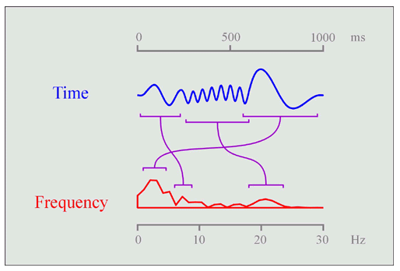
EEG signals
Many naturally occurring signals in the human body effect EEG signals
Frequency Analysis helps to separate the different signals

Slide 39
Types of EEG signals
EEG signals have been classified into 4 categories:
Delta 0.3 to 4 Hz
Dreamless sleep
Theta 4 to 8 Hz
Associated with thoughts which produce dreams
Alpha 8 to 13 Hz
Result of unfocused thoughts
Beta above 13 Hz
Result of interactions with environment

Slide 40
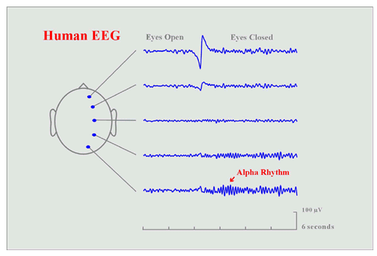
Electrode placement
Electrode placement can effect signals received

Slide 41
Related Research
Creating a Brain Computer Interface (BCI) has been a goal for researchers since computers were first introduced
BCI’s could help patients with motor disabilities use computers or mobility platforms
What is necessary:
Amplification
Filtering
Classification
Control

Slide 42
Related Research (cont.)
Large programs researching BCI’s:
Wadsworth Center in Albany
Graz University of Technology in Austria
Problems facing the programs:
Data transfer rate
Efficiency
Differences between test subjects
Learning curve for new users

Slide 43
Design Block Diagram
Adrian Smith, Daniel Shinn,Ken Grove,
Project ECE 4006 - Group N1

Slide 44
Amplifier Board
Built in previous semester
Based on Thomas Collura’s design, founder of Brainmaster
Two stage amplifier
7805 voltage regulator power supply
Can use 9V battery or 6V-35V DC power supply

Slide 45
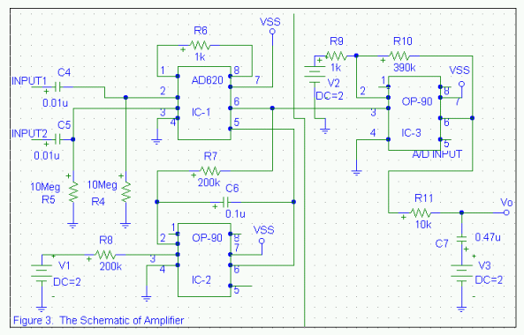
Amplifier Schematic

Slide 46
Amplifier Design
Stage 1
Gain of 50
Common Mode Rejection Ratio
Provides noise reduction and signal centering
Stage 2
Gain of 390
Capacitors stabilize power supply

Slide 47
Amplifier Parts List
Resistors:
(1) 10K 1/4W 5%
(2) 1K 1/4W 5%
(3) 130K 1/4W 5%
(2) 200K 1/4W 5%
(2) 10M 1/4W 5%
(2) 200K 1/4W 5%
(1) 51K 1/4W 5%
Integrated Circuits:
(3) OP-90 amplifiers
(1) 620AN amplifier
(1) LM7805C voltage regulator
Capacitors:
(1) 0.47uF 400V polypropylene (P474J)
(3) 0.1uF 400V polypropylene (P104J)
(2) 0.001uF 400V polypropylene (P103J)
(1) 10uF 6.3VDC Tantalum
Other:
(1) Set of 3 conductor signal leads

Slide 48
Analog-Digital Converter
Current board is a Keithley DAS-1701ST
Installed in borrowed computer
Must be moved but face PCI interface problem
Keithley KPCI-1307 card is the proposed solution

Slide 49
Keithley KPCI-1307
100k samples/sec
16 single ended or 8 differential inputs
AutoZero capability filters out drift
32 digital I/O
3 clock/timer
drivers included
VHDL program or DriverLINX software options
Price : $680

Slide 50
VHDL Implementation
Download code to Flex10k20 chip on Altera board
Board receives signals from the KPCI-1307 and controls mechanical devices

Slide 51
DriverLINX Implementation
Create DLLs for data acquisition and signal routing
Interface can be programmed in
C
C++
Visual Basic
Active X

Slide 52
Overview of Completed Objectives
EEG Amplifier
Order parts
Assembly
Testing
Data Acquisition Board
Order board
Installation of board
Installation of drivers and software

Slide 53
EEG Amplifier (Parts)
Resistors:
(1) 10K 1/4W 5%
(2) 1K 1/4W 5%
(3) 130K 1/4W 5%
(2) 200K 1/4W 5%
(2) 10M 1/4W 5%
(2) 200K 1/4W 5%
(1) 51K 1/4W 5%
Capacitors:
(1) 0.47uF polypropylene (P474J) [$1.62]
(3) 0.1uF polypropylene (P104J) [$0.74]
(2) 0.001uF polypropylene (P103J) [$0.45]
(1) 10uF 6.3VDC Tantalum [$0.52]
Integrated Circuits:
(3) OP-90 amplifiers [$2.35]
(DIP package was not available when placing orders so SOIC package was substituted with
the use of an 8-pin SOIC to DIP adapter. Price reflects cost of DIP package, as this should be
ordered in future semesters.)
(1) 620AN amplifier [$5.92]
(1) LM7805C voltage regulator [$0.43]
Other:
(1) Set of 3 conductor signal leads [$14.40]
(3) Disposable electrodes for each testing session [$0.24]
(1) Pre-holed circuit board [$8.49]

Slide 54
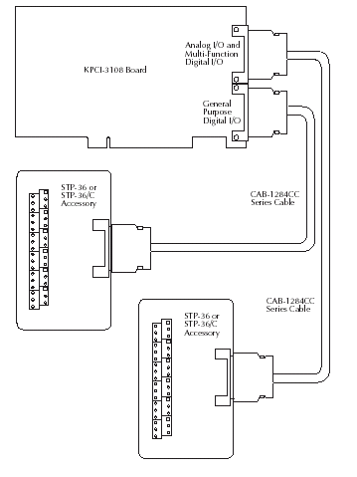
Data Acquisition Board - Installation
KPCI-3107
16 analog single-ended or 8 analog differential.
32 digital outputs
PCI interface
CAB-1284CC-2
STP-36

Slide 55
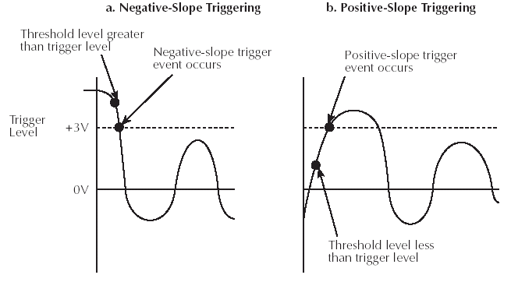
KPCI-3107 (DriverLINX software)
Real-time data acquisition (with test panels)
Analog/Digital I/O programming
uses C++, VB, and Active X
Real-time Triggering via driver
allows user to specify trigger voltage and action to take after device is triggered.

Slide 56
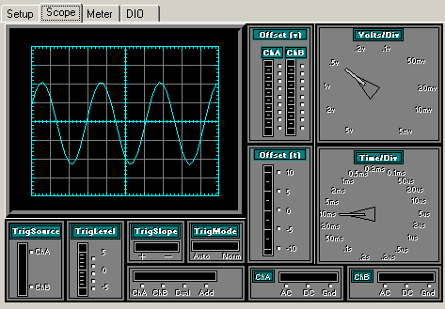
Final Testing Waveforms
AIO Test Panel with Sine Wave input to Channel A
The test panel allowed for verification that the acquisition board was functioning correctly
Eyebrow and eye blinks were recorded and graphed using the A/D board.

Slide 57
Final Testing Waveforms

Slide 58
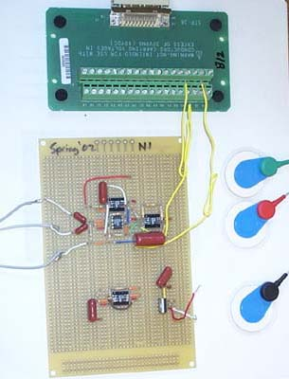
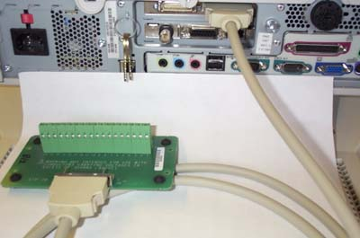
Board at End of Semester – A/D Board
A/D board connected to Computer
Amplifier connected to A/D board with electrodes

Slide 59
Ideas for Continuing the Project
Build a low-noise case for STP-36 break-out boards.
Calibrate gain for the EEG Amp input signal into an analog differential input channel.
Research and learn how to use programming knowledge into a DriverLINX program.
Program driver for KPCI-3107 board to output needed digital signal.

Slide 60
Block diagram of the system

Slide 61
EEG Signal Acquisition Module
Where to place the electrodes?
The electrodes are placed according to the international standard 10-20 system.
The electrode position of 16 channels placed as shown in Fig. of frontal area (F3 and F4), central area (C3, Cz and C4), parietal area(P3, Pz and P4)
The grounding electrode and referencing electrode are placed at forehead and right ear lobe respectively.
EEG signal are digitized at 1024 samples/sec, resolution 16bit/sample.
Signal were analog bandpass filtered between 1.5 and 100 Hz.

Slide 62
FPGA Architeture
FPGA- Field-programmable gate-array

Slide 63
Designer’s Choice
Digital designer has various options
SSI (small scale integrated circuits) or MSI (medium scale integrated circuits) components
Difficulties arises as design size increases
Interconnections grow with complexity resulting in a prolonged testing phase
Simple programmable logic devices
PALs (programmable array logic)
PLAs (programmable logic array)
Architecture not scalable; Power consumption and delays play an important role in extending the architecture to complex designs
Implementation of larger designs leads to same difficulty as that of discrete components

Slide 64
Designer’s Choice
Quest for high capacity; Two choices available
MPGA (Masked Programmable Logic Devices)
Customized during fabrication
Low volume expensive
Prolonged time-to-market and high financial risk
FPGA (Field Programmable Logic Devices)
Customized by end user
Implements multi-level logic function
Fast time to market and low risk

Slide 65
FPGA – A Quick Look
Two dimensional array of customizable logic block placed in an interconnect array
Like PLDs programmable at users site
Like MPGAs, implements thousands of gates of logic in a single device
Employs logic and interconnect structure capable of implementing multi-level logic
Scalable in proportion with logic removing many of the size limitations of PLD derived two level architecture
FPGAs offer the benefit of both MPGAs and PLDs!

Slide 66
FPGA – A Detailed Look
Based on the principle of functional completeness
FPGA: Functionally complete elements (Logic Blocks) placed in an interconnect framework
Interconnection framework comprises of wire segments and switches; Provide a means to interconnect logic blocks
Circuits are partitioned to logic block size, mapped and routed

Slide 67
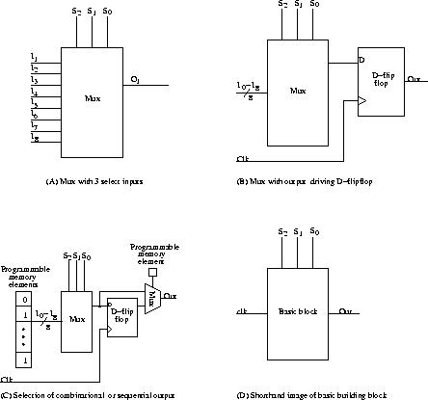
A Fictitious FPGA Architecture (With Multiplexer As Functionally Complete Cell)
Basic building block

Slide 68
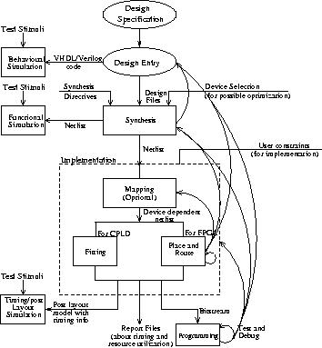
Design Steps Involved in Designing With FPGAs
Understand and define design requirements
Design description
Behavioural simulation (Source code interpretation)
Synthesis
Functional or Gate level simulation
Implementation
Fitting
Place and Route
Timing or Post layout simulation
Programming, Test and Debug

Slide 69
Field Programmability
Field programmability is achieved through switches (Transistors controlled by memory elements or fuses)
Switches control the following aspects
Interconnection among wire segments
Configuration of logic blocks
Distributed memory elements controlling the switches and configuration of logic blocks are together called “Configuration Memory”

Slide 70
Technology of Programmable Elements
Vary from vendor to vendor. All share the common property: Configurable in one of the two positions – ‘ON’ or ‘OFF’
Can be classified into three categories:
SRAM based
Fuse based
EPROM/EEPROM/Flash based
Desired properties:
Minimum area consumption
Low on resistance; High off resistance
Low parasitic capacitance to the attached wire
Reliability in volume production

Slide 71
Product – FPGA vs ASIC
Comparison:
FPGA benefits vs ASICs: - Design time: 9 month design cycle vs 2-3 years - Cost: No $3-5 M upfront (NRE) design cost. No $100-500K mask-set cost - Volume: High initial ASIC cost recovered only in very high volume products
Due to Moore’s law, many ASIC market requirements now met by FPGAs - Eg. Virtex II Pro has 4 processors, 10 Mb memory, IO
Resulting Market Shift:
Dramatic decline in number of ASIC design starts: - 11,000 in ’97 - 1,500 in ’02
FPGAs as a % of Logic market: - Increase from 10 to 22% in past 3-4 years
FPGAs (or programmable logic) is the fastest growing segment of the semiconductor industry!!

Slide 72
FPGA/ASIC Crossover Changes
90nm / 300mm ASICs
Cost
150nm / 200mm ASICs
90nm / 300mm FPGAs
150nm / 200mm FPGAs
FPGA Cost Advantage
FPGA Cost Advantage
FPGA Cost Advantage
ASIC Cost Advantage
ASIC Cost Advantage
Production Volume
Notes:
This graph shows the impact of the rapid technology evolution… (click)
The significant saving in silicon cost helps closing the gap in unit cost between ASICs and FPGAs, moving the crossover towards higher volume (click)
In addition, the starting cost for each generation of silicon technology skyrockets, which further moves out the crossover.

Slide 73
Taxonomy of FPGAs

Slide 74
Development of a Low-Cost FPGA-Based SSVEP BCI Multimedia Control System
IEEE TRANSACTIONS ON BIOMEDICAL CIRCUITS AND SYSTEMS, VOL. 4, NO. 2, APRIL 2010

Slide 75
FPGA-Based
low-cost ﬁeld-programmable gate-array (FPGA)-based brain–computer interface (BCI) multi-media control system
Low cost
Small size
Flexible
Real-time control
Use their brainwave to communicate with or control multimedia devices

Slide 76
Customized stimulation panel
a light-emitting diode stimulation panel instead of cathode ray tube or liquid-crystal display
stronger steady-state visual evoked potential (SSVEP)
SSVEP-based BCI multimedia control system

Slide 77
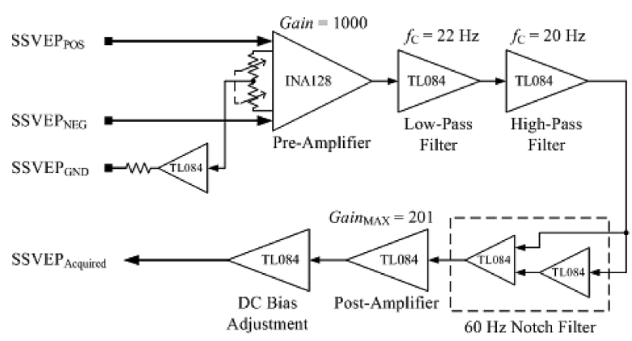
Brainwave-acquisition circuit
SSVEP acquisition

Slide 78
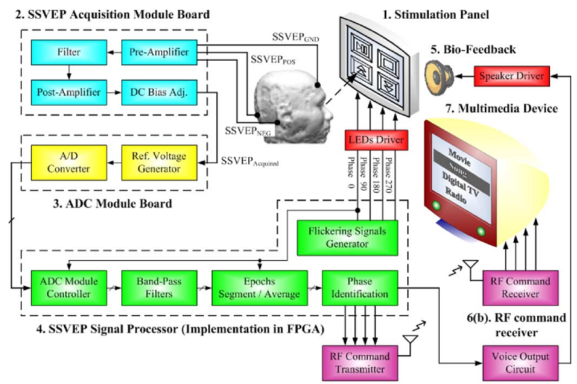
System Schema

Slide 79
Block diagram

Slide 80
Simulation panel

Slide 81
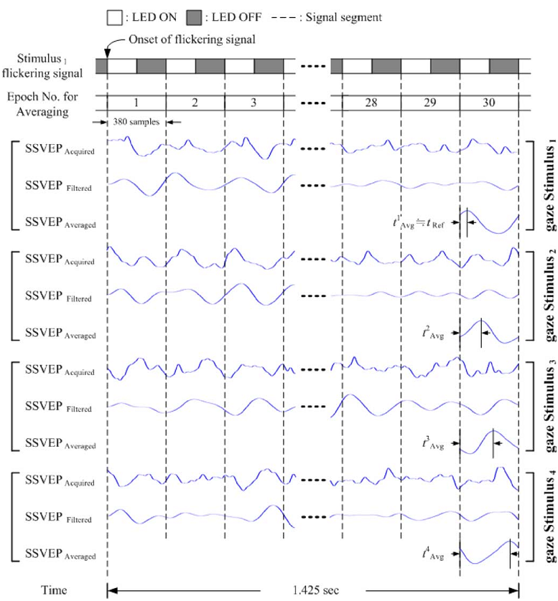
Implement and results

Slide 82
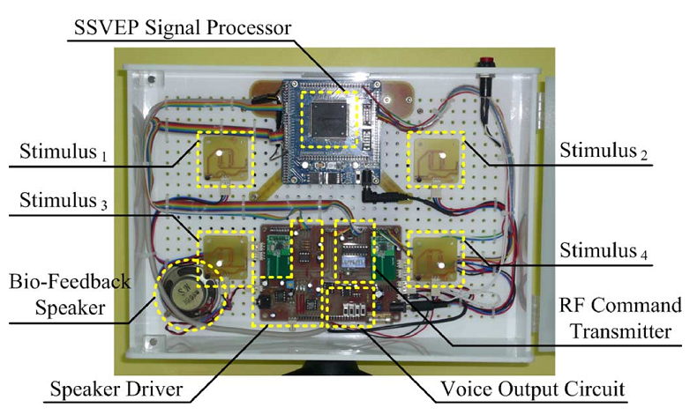
Implement and results

Slide 83
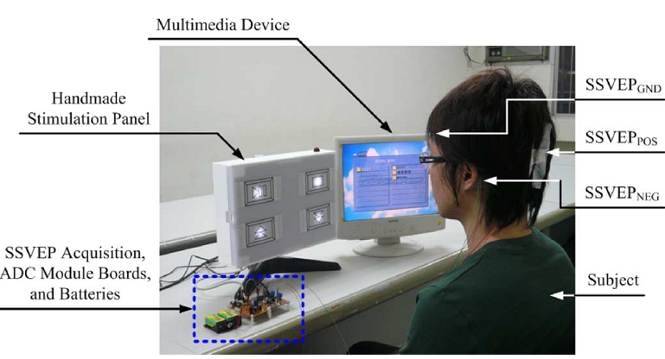
Implement and results

Slide 84
a Capacitively Coupled Sensor Readout Circuit [5]
Contact-less
Capacitively coupled sensor
Without any need for gel
Electronic readout circuit

Slide 85
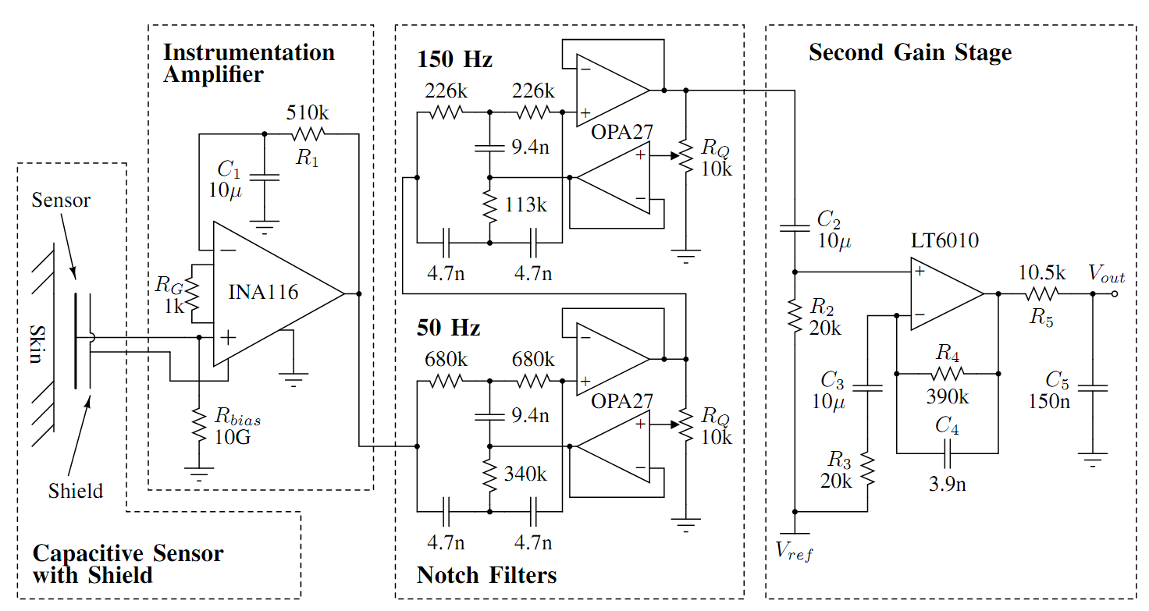
Circuit design

Slide 86
Circuit design
Capacitive Sensor
Instrumentation Ampliﬁer
Notch FiltersSecond
Ampliﬁcation Stage
PCB Layout

Slide 87
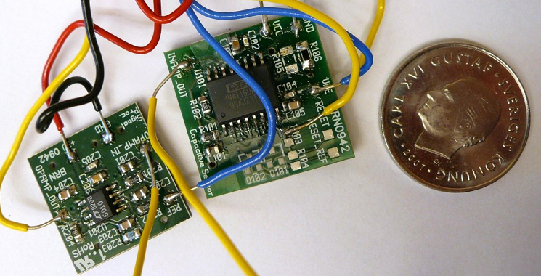
Circuit design

Slide 88
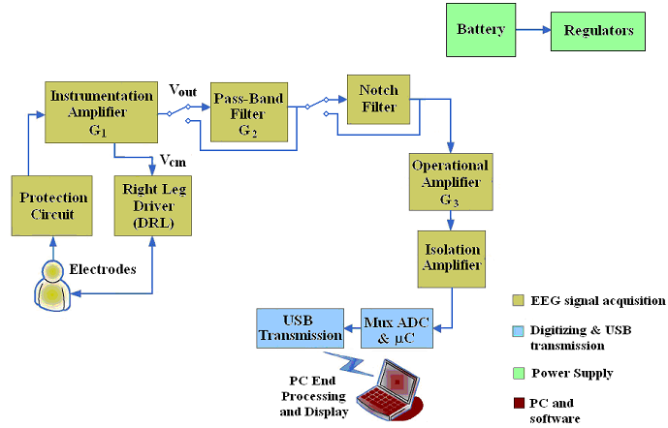
Design Of An Electronic Device for bci [4]
Describes the single electronic stage for the conditioning of the analog acquired signal.

Slide 89
Circuit design
Power supply
Acquisition and signal conditioning
Processing and transmission of digital data to PC.

Slide 90
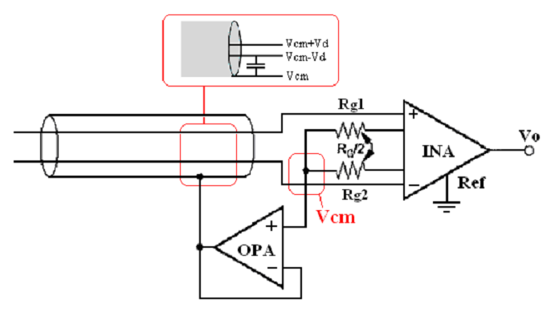
Circiut design
Input Guarding Configuration

Slide 91
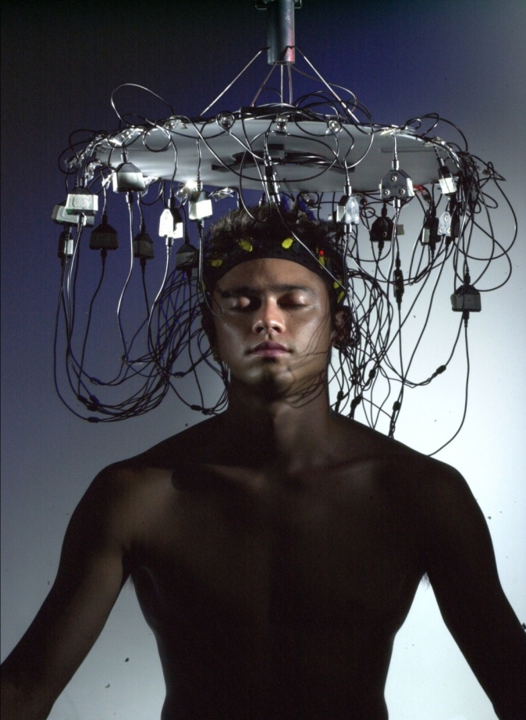
EEG Machine
By
The All-American Boys Featuring Slo-Mo
Motaz Alturayef
Shawn Arni
Adam Bierman
Jon Ohman

Slide 92
Goals and Perspective
Goals:
Design an EEG (Electroencephalography) machine to promote the generation of user selected brainwave frequencies
Accesible Frequency ranges (Theta, Alpha, Beta)
Using Audio and Video Feedback to synchronize brain

Slide 93
Block Diagram Description

Slide 94
Physiology and Input Design

Slide 95
Physiology of Neurofeedback
Brain waves divided into distinct frequency bands:
Delta: 0-3 Hz, Associated with slow wave sleep
Theta: 4-7 Hz, Associated with drowsiness or arousal
Alpha: 8-13 Hz, Associated with relaxed concentration or contentment
Beta: 14-30 Hz, Associated with intense concentration, high levels of thought activity

Slide 96
Physiology Continued
Synchronization of Brain waves is possible
External stimuli used to synchronize brain wave frequencies
Our project will use both audio and video stimuli to synchronize waves
Can be used to train an individual to put themselves in desired state

Slide 97
Electrode Input Design
Five electrode two channel EEG headband for signal monitoring
Design compiled from multiple schematics
Using active electrodes
Powered either with lithium batteries or hard line to main board
Small voltage values require ultra low noise devices

Slide 98
Amplification, Filtering, and A/D
Done at main board
Amplifier strengthens microvolt signals to usable levels
Signal passes through low-pass and high pass filters to remove DC components and higher frequency noise and brain waves
Possibly sent through band-pass filters as well
Digitized using low noise A/D converter

Slide 99
Design Aspects
Low signal levels require very low noise devices
Battery powering could introduce too much signal noise unless properly shielded
Two channels sufficient to measure frequency content
Differential voltage measurements
Fifth electrode along scalp midline to create unbiased ground

Slide 100
Risks
Too much noise in system
Will distort signal and render it useless
Can use commercial electrodes, conductive paste
Filters should assist in removing noise, also use shielding techniques for battery and twisted pairs for wires
Two channels insufficient for measurement
Possible to build more channels
Filters drop off too shallowly to isolate bands
Only a problem if band-pass filtering is employed (Additional Feature)

Slide 101
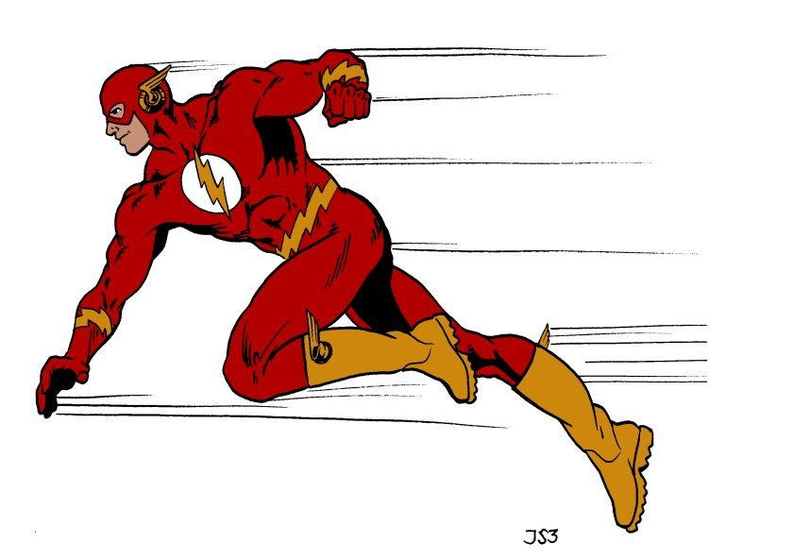
Flash Memory and System Outputs

Slide 102
Physiological Effects of Outputs
Alter brain frequency through external stimulus
Auditory stimulus is most effective
Produce a stimulating frequency equal to that of the desired brain frequency state
Binaural beats: Auditory processing artifacts, the perception of which arises in the brain independent of physical stimuli
Visual stimulus is another common option
A screen or monitor flashes an image at the rate of the desired brain frequency state

Slide 103
Memory Options
Two types
RAM (Volitile)
ROM (Non-Volitile)
SD Card Flash
Easy to load
Board Mounted Flash
More permanent

Slide 104
Spansion Memory
8 MBIT Storage
3.0V Supply
No Bus Contention
Memory controller in Altera FPGA
Controller allows access to program and read data from memory
Controller will also transfer data to audio/video controller for output

Slide 105
Output Flow

Slide 106
Risks
Not enough room in Flash for both audio and video signals
Can revert to SD Card where more space is available
High risk of epileptic seizures with a flashing monitor
Warning must be presented
Auditory signal can be used exclusively

Slide 107
PC : (Matlab or LabView)
Analyze the brainwave for frequency content and find the dominant frequency.
Two Approaches of doing this:
Signal as a whole and do Power Spectral Density (PSD) analysis.
Divide the signal into 4 frequency bands then do PSD.
Risks
Not being able to debug the code with real brainwave signals.
Synchronising the PC output with the whole system.

Slide 108
Processor Flow Diagram
Notes:
Store User Input in memory
Sample Analog Input
Nyquist: 100 Hz but faster
Convert A2D
Store Digital Input (DI) in memory
Memory size – 5 seconds at 500 Hz sampling rate with sample size 32 bits -> approx 80kb
Pull DI from memory
Send DI to PC
Receive Dominant Frequency (DF) from PC
Store DF in memory
Compare User Input to DF
Acquire memory address for Audio and Visual effects
Output Audio address to Audio controller
Output Video address to Video controller
Restart process & WAIT time
It takes minutes to affect brainwave change so will rerun every minute

Slide 109
Altera DE2 Development Board
I/O needs
Readily available
32-bit Nios II embedded processor & SOPC Builder – configuration & integration
Quartus II - Scalable environment

Slide 110
DE2 Risks
Risks
Too much reliance on built-in features
Input data usable? (ADC conversion)
Potential usage of development board’s many options may spread team too thin
Alternate choice – MSP430

Slide 111
Processor Testing
Input Signals
User Input on LEDs
Verify Electrode/ADC sample and store, as audio output
Check DF result and store using 7-segment displays/LEDs
Show difference between UI and DF on LED/7 segment

Slide 112
Processor Testing
Output Signal
Stored Electrode/ADC signal to PC, output as audio on PC
Wait State
Between samples illuminate LED

Slide 113
Budget

Slide 114
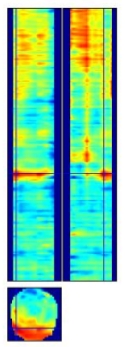
Topics[9]
Exp. design and ERPs
SPM for EEG-MEG
2D interpolation
1st level analysis
2nd level analysis
Time as another dimension
Time-frequency analysis
Conclusion

Slide 115
Popular approaches to M/EEG Data
Event-Related Potentials (ERP) &
Event-Related Fields (ERF)
ERP/F Quantification Approaches
Peaks, latency, area-under-curve
Spectral Analysis (a.k.a. time-frequency)
Connectivity

Slide 116
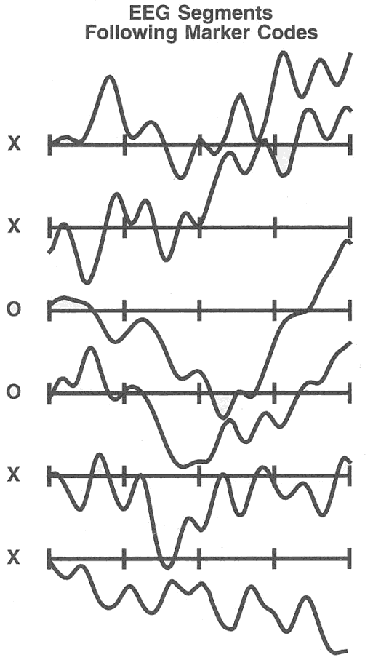
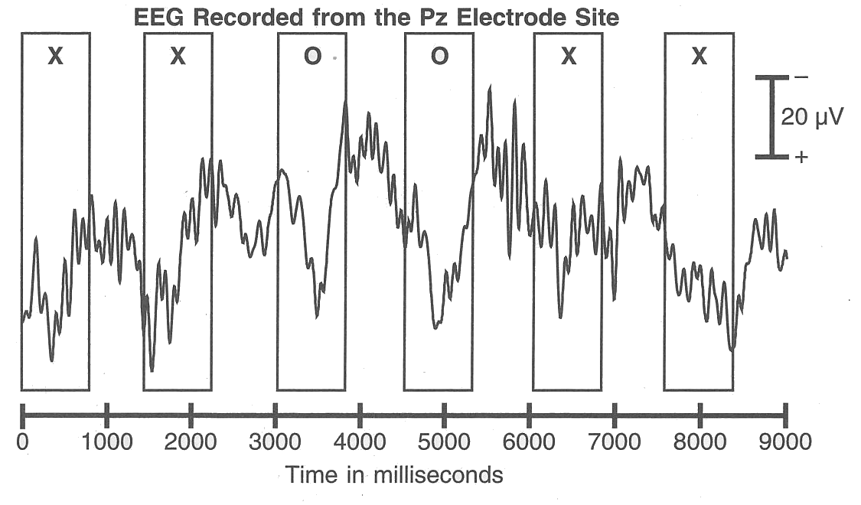
What is the ERP/ERF?
Def: the average (across trials/subjects) potential/field at the scalp relative to some specific event in time
Stimulus/Event
Onset

Slide 117
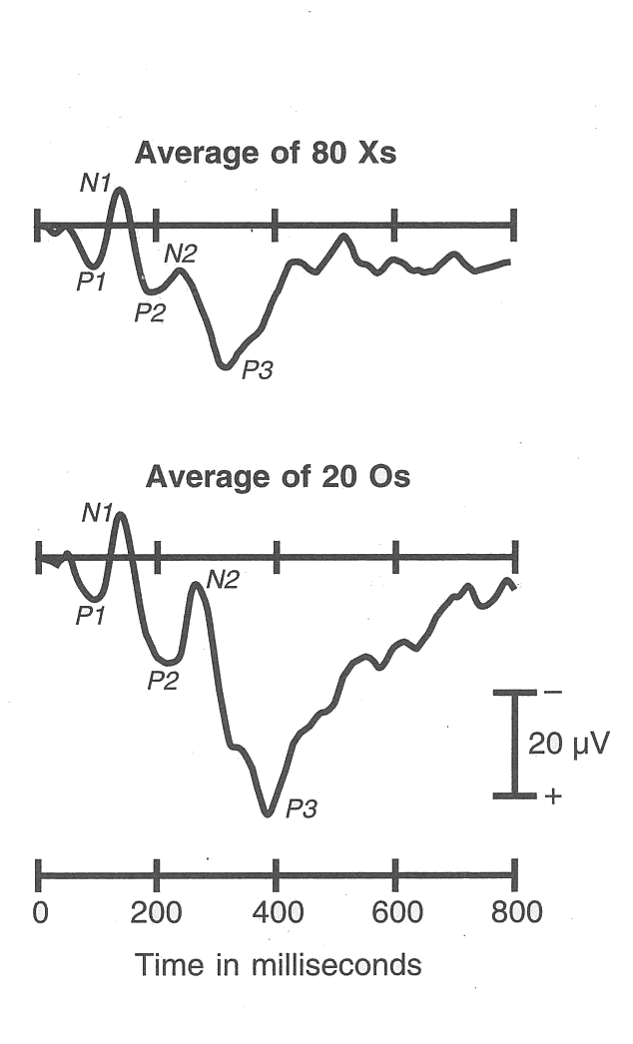
What is the ERP/ERF?
Def: the average (across trials/subjects) potential at the scalp relative to some specific event in time
Averaging

Slide 118
What is the ERP/ERF?
Def: the average (across trials/subjects) potential at the scalp relative to some specific event in time
Reflects reliable changes in potential that are strongly time-locked to stimulus onset (i.e. are synchronous over trials)
Non-time-locked activity is lost to averaging

Slide 119
Interpreting ERP/ERF Waveforms
ERP/ERF waveforms are often interpreted in terms of their constituent components
Component (def) - Scalp-recorded electrical activity that is generated by a given patch of cortex engaged in a specific computational operation
+
sensor
+
+
+
+
-
+
-
-
-
-
-

Slide 120
A Real-Time Wireless Brain–Computer Interface System for Drowsiness Detection
Chin-Teng Lin
Che-Jui Chang
Shao-Hang Hung
Chih-Feng Chao
IEEE TRANSACTIONS ON BIOMEDICAL CIRCUITS AND SYSTEMS, VOL. 4, NO. 4, AUGUST 2010

Slide 121
Application
Drowsy level detection
Safe car driving to alert tired drivers
real-time drowsiness monitoring can prevent trafﬁc accidents effectively

Slide 122
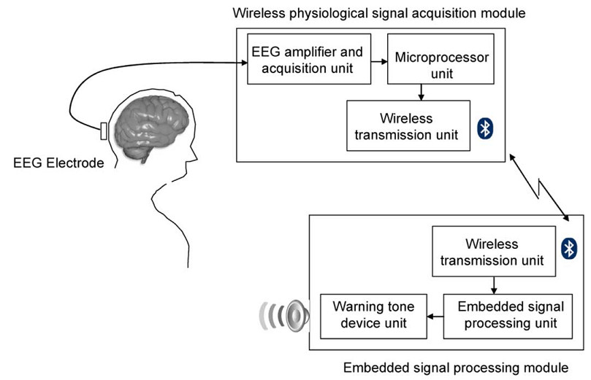
System

Slide 123
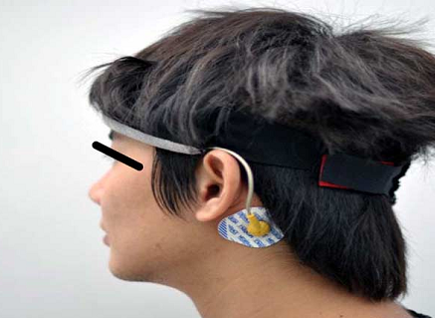
Convenience wearable

Slide 124
Circuit design
A preampliﬁer,
A band-pass ﬁlter
An analog-to-digital converter (ADC)
Designed to amplify and ﬁlter the EEG signal
The gain of the EEG ampliﬁer and acquisition unit was set to about 5040 times with the frequency band of 0.1–100 Hz.

Slide 125
Procedure of EEG preprocessing

Slide 126
Design of a Compact Amplifier [11]
DESIGN CONSIDERATIONS
A. Effects of Interference
B. Amplifier requirements

Slide 127
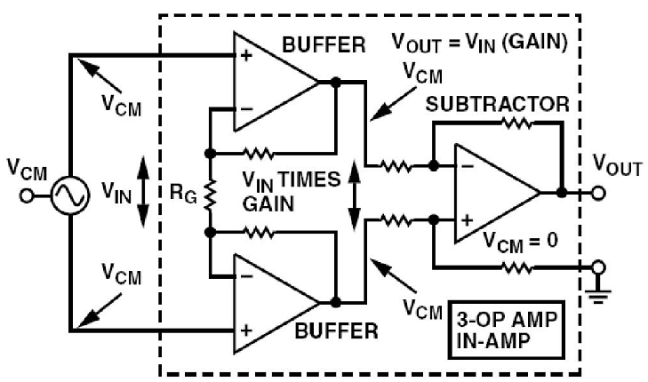
System design

Slide 128
System design
A. Amplifier design
B. Filter Stages
C. Driven right leg circuit
D. Power Supply design
E. Construction of the system

Slide 129
Design on Sampling Circuit [12]
A sampling circuit of EEG signal based on AT89C2051 single-chip is designed
signal condition,
signal acquisition
serial communication interface

Slide 130
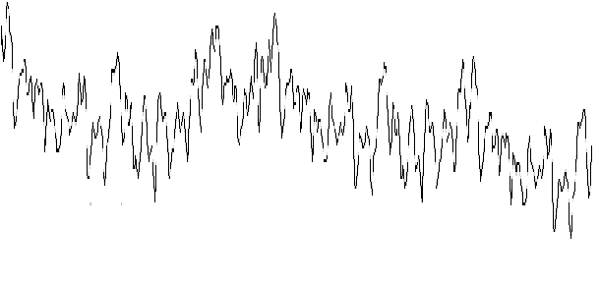
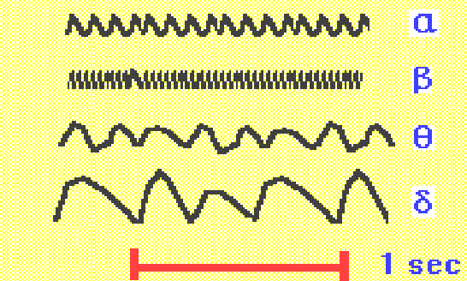
BASIC CHARACTERISTICS OF EEG

Slide 131
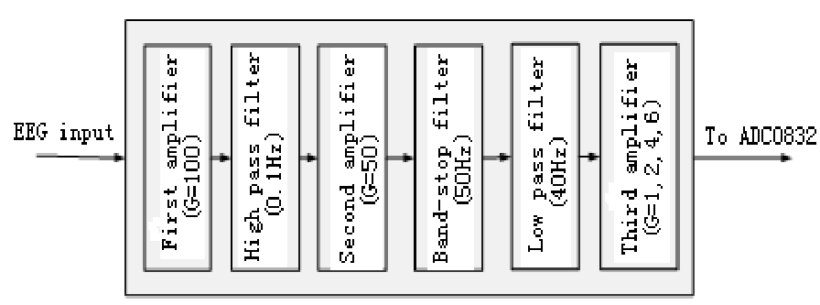
SAMPLING CIRCUIT
A. Signal Condition

Slide 132
Circuit

Slide 133
Ciucuit

Slide 134
Performances
1) Amplifier gain is variable with 5000, 10000, 20000, or 30000.
2) Common mode rejection ratio is 102dB.
3) Pass-band frequency is with 0.12Hz-35.4Hz.
4) Input impedance is 113MΩ.

Slide 135
References
[1] http://en.wikipedia.org/wiki/EEG
[2] Design of a Compact Amplifier and Signal Conditioning Module for Wireless EEG Monitoring, Ashwin K. Whitchurch Member, IEEE, Jose K. Abraham
[3] Novel Hydrogel-Based Preparation-Free EEG Electrode, Nicolas Alexander Alba, Robert J. Sclabassi, Mingui Sun, IEEE TRANSACTIONS ON NEURAL SYSTEMS AND REHABILITATION ENGINEERING, VOL. 18, NO. 4, AUGUST 2010
[4] Design Of An Electronic Device For Brain Computer Interface Applications, . Palumbo,P. Vizza,P. Veltri, MeMeA 2009 - International Workshop on Medical Measurements and Applications
[5] Design and Evaluation of a Capacitively Coupled Sensor Readout Circuit, toward Contact-less ECG and EEG, Daniel Sard, Andrzej Cichockiand Atila Alvandpour, 2010 IEEE
[6] Design of Portable Multi-Channel EEG Signal Acquisition System , Lin ZHU, Haifeng CHEN, Xu ZHANG, IEEE

Slide 136
References
[7] Design and Implementation of a Wireless Multi-Channel EEG Recording, R. Dilmaghani, M. Ghavami, K. Cumar, A Dualeh, S. Gomes Da Sousa, R. Salleh Mohd, CSNDSP 2010
[8] Development of a Low-Cost FPGA-Based SSVEP BCI Multimedia Control System, Kuo-Kai Shyu, Member, IEEE, Po-Lei Lee, Ming-Huan Lee, Student Member, IEEE, IEEE TRANSACTIONS ON BIOMEDICAL CIRCUITS AND SYSTEMS, VOL. 4, NO. 2, APRIL 2010
[9] Joseph Brooks (ICN)Maria Joao (FIL) Methods for Dummies 2007Wellcome Department For Neuroimaging
[10] A Micro-Power EEG Acquisition SoC With Integrated Feature Extraction Processor for a Chronic Seizure Detection System, Naveen Verma, Ali Shoeb, Jose Bohorquez, IEEE JOURNAL OF SOLID-STATE CIRCUITS, VOL. 45, NO. 4, APRIL 2010
[11]Design of a Compact Amplifier and Signal Conditioning Module for Wireless EEG Monitoring, Ashwin K. Whitchurch (a), Member, IEEE, Jose K.Abraham (a), Senior Member, IEEE, Meghana A. Lonkar , 2007 IEEE Region 5 Technical Conference, April 20-21, Fayetteville, AR
[12]Design on Sampling Circuit of EEG Signal Based on AT89C2051 Single-chip, Xiao-dong Zhang,Zhen-hai Zhang, 2009 Fourth International Conference on Innovative Computing, Information and Control

