Slide 1
Week 3 Lecture 1
Mobile Health (M-Health)

Slide 2
What is Mobile Health (M-Health)?
One way to achieve tele-healthcare
[WiKi definition] mHealth (also written as m-health or mobile health) is a term used for the practice of medicine and public health, supported by mobile devices. The term is most commonly used in reference to using mobile communication devices, such as mobile phones, tablet computers and PDAs, for health services and information.
It is based on Wireless & Mobile technologies (such as Wireless LAN, WiMax, Cellular networks, Satellite, Sensor Networks, Ad hoc Networks, etc.)

Slide 3
Thinking: How to monitor a patient whenever he/she goes to?
When the patient is at home
-- can use telephone (dial-up) – too slow
-- Comcast – Cable Modem - Fast
-- ADSL (Asymmetric Digital Subscriber Line) from AT & T
-- Bluetooth + Internet (the above 3 also need Internet)
When the patient is in a building
-- Wireless LAN (also called WiFi)
-- Wired LAN (high speed!)
When the patient is driving /walking
-- Cell phone
-- WiMax
-- Mobile Ad hoc Network, Vehicle Ad hoc Network, etc.

Slide 4
What wireless & mobile networks can be used?
Wireless is convenient – anywhere, anytime
No cable needed
However, in the backbone networks, to achieve high-speed, long-distance transmission, in many times we may still use Internet with wires (most likely optical fiber)
Wireless Networks are much slower (most times) than wired ones (especially optical fiber); But WiMax can achieve >100Mbps in good conditions.
Wireless also brings much higher data transmission errors or data loss due to noise / interference
In the remaining contents we will discuss popular wireless

Slide 5
Wireless networks
Access computing/communication services, on the move
Wireless WANs
  Cellular Networks: GSM, CDMA
  Satellite Networks: Iridium
Wireless LANs
  WiFi Networks: 802.11
  Personal Area Networks: Bluetooth
Wireless MANs
  WiMaX Networks: 802.16
  Mesh Networks: Multi-hop WiFi
  Adhoc Networks: useful when infrastructure not available

Slide 6
Mobile communication
Wireless vs. mobile Examples
✗ ✗ stationary computer
✗ ✓ laptop in a hotel (portable)
✓ ✗ wireless LAN in historic buildings
✓ ✓ Personal Digital Assistant (PDA)
Integration of wireless into existing fixed networks:
  Local area networks: IEEE 802.11, ETSI (HIPERLAN)
  Wide area networks: Cellular 3G, IEEE 802.16
  Internet: Mobile IP extension

Slide 7
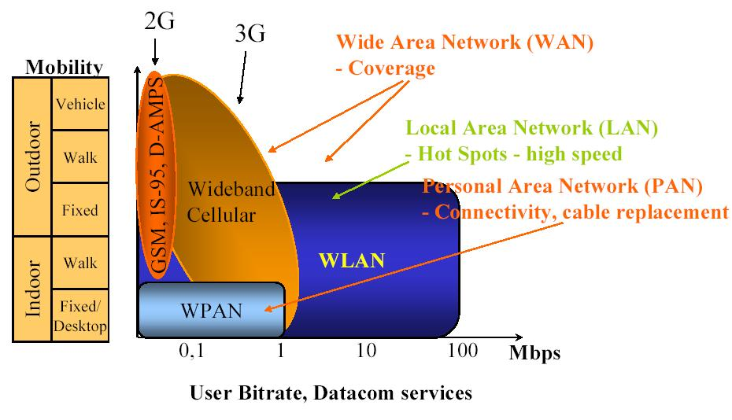
Summary
Relative coverage, mobility, and data rates of generations of cellular systems
and local broadband and ad hoc networks.

Slide 8
Waves

Slide 9
EM Spectrum Allocation
Infrared
Gamma
rays
Visible
UV
X rays
1 KHz
1 MHz
1 GHz
1 THz
1 PHz
1 EHz
Freq.
(AM radio)
MF
(SW radio)
HF
(FM radio - TV)
VHF
(TV – Cell.)
UHF
LF
SHF
30 KHz
300 KHz
3 MHz
30 MHz
300 MHz
3 GHz
30 GHz
Freq.
ISM
UNII
902 MHz
928 MHz
2.4 GHz
2.4835 GHz
5.725 GHz
5.785 GHz
Freq.
Cordless phones
Baby monitors
(old) Wireless LANs
IEEE 802.11b, g
Bluetooth
Microwave ovens
IEEE 802.11a
HiperLAN II

Slide 10
Wireless frequency allocation
Radio frequencies range from 9KHz to 400GHZ (ITU)
Microwave frequency range
  1 GHz to 40 GHz
  Directional beams possible
  Suitable for point-to-point transmission
  Used for satellite communications
Radio frequency range
  30 MHz to 1 GHz
  Suitable for omnidirectional applications
Infrared frequency range
  Roughly, 3x10¹¹ to 2x10¹⁴ Hz
  Useful in local point-to-point multipoint applications within confined areas

Slide 11
Frequency regulations
Frequencies from 9KHz to 300 MHZ in high demand (especially VHF: 30-300MHZ)
Two unlicensed bands
  Industrial, Science, and Medicine (ISM): 2.4 GHz
  Unlicensed National Information Infrastructure (UNII): 5.2 GHz
Different agencies license and regulate
  www.fcc.gov - US
  www.etsi.org - Europe
  www.wpc.dot.gov.in - India
  www.itu.org - International co-ordination
Regional, national, and international issues
Procedures for military, emergency, air traffic control, etc

Slide 12
Communication Process
Information Source
Transmitter
Communication Channel
Receiver
Destination
Noise
Source
Source
Data:
0 1 0 0 1 1 0 0 1 0
Input
Signal:
S
Noise:
N
Source
Data:
0 1 0 0 1 1 0 0 1 0
Output
Signal:
S+N
Data
Received:
1 1 0 0 1 1 1 0 1 0
Decision
threshold
Sampling
Times:
Bits in error

Slide 13
Wireless Transmission and Receiving System
Communication
Channel
Modulator
Demodulator
Transmitter
Receiver
Error Control Encoder
Error Control Decoder
Source Encoder (Compress)
Source Decoder (Decompress)
Information
Source
Destination

Slide 14
Antennas
An antenna is an electrical conductor or system of conductors to send/receive RF signals
  Transmission - radiates electromagnetic energy into space
  Reception - collects electromagnetic energy from space
In two-way communication, the same antenna can be used for transmission and reception
Omnidirectional Antenna
(lower frequency)
Directional Antenna (higher frequency)

Slide 15
Signal propagation
Propagation in free space always like light (straight line)
Receiving power proportional to 1/d²
(d = distance between sender and receiver)
Receiving power additionally influenced by
  fading (frequency dependent)
  shadowing
  reflection at large obstacles
  refraction depending on the density of a medium
  scattering at small obstacles
  diffraction at edges
shadowing
reflection
refraction
scattering
diffraction

Slide 16
Bandwidth
Amount of data that can be transmitted per unit time
  expressed in cycles per second, or Hertz (Hz) for analog devices
  expressed in bits per second (bps) for digital devices
  KB = 2^10 bytes; Mbps = 10^6 bps
Link v/s End-to-End

Slide 17
Latency (delay)
Time it takes to send message from point A to point B
  Latency = Propagation + Transmit + Queue
  Propagation = Distance / SpeedOfLight
  Transmit = Size / Bandwidth
Queueing not relevant for direct links
Bandwidth not relevant if Size = 1 bit
Software overhead can dominate when Distance is small
RTT: round-trip time

Slide 18
802.11 (WiFi) Overview

Slide 19
Wireless LANs
Infrared (IrDA) or radio links (Wavelan)
Advantages
  very flexible within the reception area
  Ad-hoc networks possible
  (almost) no wiring difficulties
Disadvantages
  low bandwidth compared to wired networks
  many proprietary solutions
Infrastructure v/s ad-hoc networks (802.11)

Slide 20
802.11 variants
802.11i
security
LLC
WEP
MAC
Mgmt
802.11f
Inter Access Point Protocol
MAC
MIB
802.11e
QoS enhancements
PHY
DSSS
FH
IR
OFDM
802.11b
5,11 Mbps
802.11a
6,9,12,18,24
36,48,54 Mbps
802.11g
20+ Mbps

Slide 21
Infrastructure vs. Ad hoc networks
infrastructure
network
AP: Access Point
AP
AP
wired network
AP
ad-hoc network
Source: Schiller

Slide 22
Components of IEEE 802.11 architecture
The basic service set (BSS) is the basic building block of an IEEE 802.11 LAN
The ovals can be thought of as the coverage area within which member stations can directly communicate
The Independent BSS (IBSS) is the simplest LAN. It may consist of as few as two stations
ad-hoc network
BSS1
BSS2

Slide 23
802.11 - infrastructure network (PCF)
Station (STA)
  terminal with access mechanisms to the wireless medium and radio contact to the access point
Basic Service Set (BSS)
  group of stations using the same radio frequency
Access Point
  station integrated into the wireless LAN and the distribution system
Portal
  bridge to other (wired) networks
Distribution System
  interconnection network to form one logical network (EES: Extended Service Set) based
  on several BSS
802.11 LAN
802.x LAN
STA₁
BSS₁
Access
Point
Portal
Distribution System
ESS
Access
Point
BSS₂
STA₂
802.11 LAN
STA₃
Source: Schiller
Notes:
9

Slide 24
W-LAN Transmission Rates
11 Mbps ⇔ 8 % of coverage area
1 Mbps ⇔ 47 % of coverage area
⇒ Low probability of having good link!!
Lucent ORiNICO 802.11b
outdoors, no obstruction—ideal conditions!

Slide 25
802.16 (WiMaX) Overview

Slide 26
Motivation for 802.16
Broadband:
  A transmission facility having a bandwidth sufficient to carry multiple voice, video or data, simultaneously.
  High-capacity fiber to every user is expensive.
Broadband Wireless Access:
  provides “First-mile” network access to buildings.
  Cost effective and easy deployment.

Slide 27
IEEE 802.16
WirelessMAN air interface
  for fixed point to multi-point BWA
Broad bandwidth: 10-66 GHz
  Channel as wide as 28 MHz and
  Data rate upto 134 Mbps
MAC designed for efficient use of spectrum
  Bandwidth on demand
  QoS Support

Slide 28
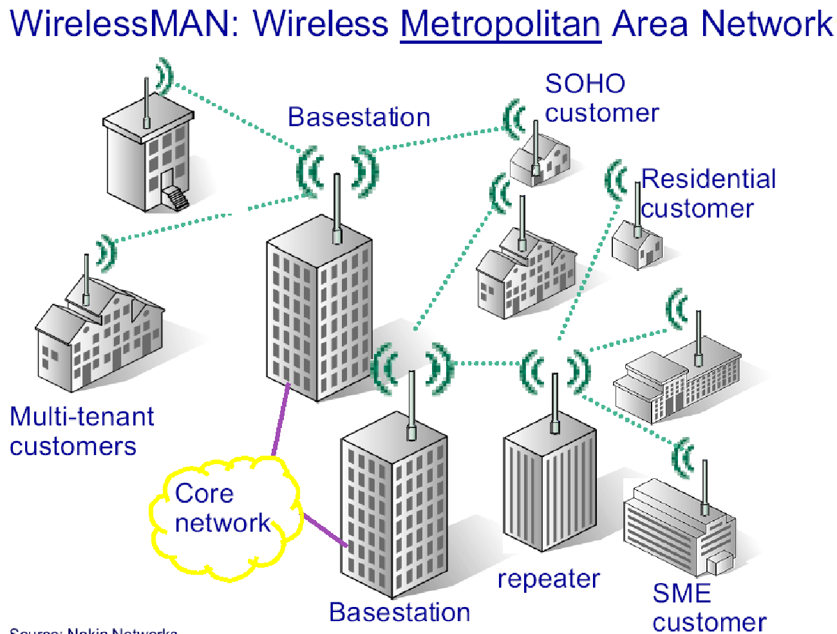
802.16 Architecture

Slide 29
802.16: Summary
Higher throughput at longer ranges (up to 50 km)
  Better bits/second/Hz at longer ranges
Scalable system capacity
  Easy addition of channels maximizes cell capacity
  Flexible channel bandwidths accommodate allocations for both licensed and license-exempt spectrums
Coverage
  Standards-based mesh and smart antenna support
  Adaptive modulation enables tradeoff of bandwidth for range
Quality of Service
  Grant / request MAC supports voice and video
  Differentiated service levels: E1/T1 for business, best effort for residential

Slide 30
Mesh and Adhoc Networks

Slide 31
Multi-Hop Wireless
May need to traverse multiple links to reach destination
Mobility causes route changes

Slide 32

Route discovery
Y
Z
S
E
[S,E]
F
B
C
M
L
J
A
[S,C]
G
H
D
K
I
N
Node H receives packet RREQ from two neighbors:
potential for collision

Slide 33
Cellular Networks (cell phone)

Slide 34
Heterogeneous Cellular Networks
Satellite
Regional Area
Low-tier
High-tier
Local Area
Wide Area
High Mobility
Low Mobility
Seamless mobility across diverse overlay networks
    “vertical” hand-offs
    software “agents” for heterogeneity management
    IP as the common denominator?

Slide 35
BASIC ARCHITECTURE
Home Location Register
(HLR)
BACKBONE TELEPHONE NETWORK
Visitor Location Register
(VLR)
Mobile Switching Center
(MSC)
MSC
VLR
Mobile Terminal
(MT)
Local Signaling
Long Distance Signaling

Slide 36
Cellular Concept
The most important factor is the size and the shape of a CELL.
A cell is the radio coverage area by a transmitting station or a BS.
Ideally, the area covered a by a cell could be represented by a circular cell with a radius R from the center of a BS.
Many factors may cause reflections and refractions of the signals, e.g., elevation of the terrain, presence of a hill or a valley or a tall building and presence in the surrounding area.
The actual shape of the cell is determined by the received signal strength.
Thus, the coverage area may be a little distorted.
We need an appropriate model of a cell for the analysis and evaluation.
Many posible models: HEXAGON, SQUARE, EQUILATERAL TRIANGLE.

Slide 37
Cell Shape
R
R
R
Cell
R
R
(a) Ideal Cell
(b) Actual Cell
(c) Different Cell Models

Slide 38
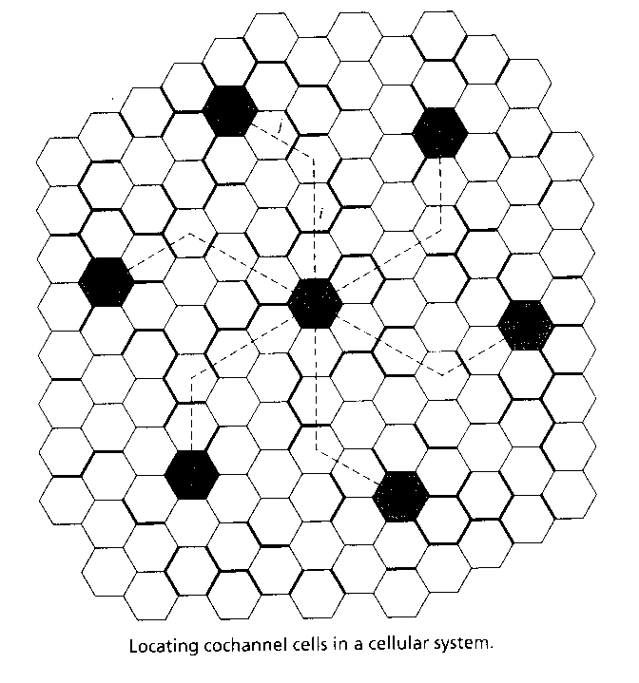

Slide 39
Community Mesh Network

