Slide 1
Week 2 Lecture 1
Overview: Medical Signal Processing

Slide 2
Why Medical Signal Processing?
Purposes:
- Raw medical signals: Difficult to diagnosis
- After transform, easier to find features
- In many times, we need to use Machine Learning to further find “patient symptoms” from those features. This is called “Signal Learning”.
- Sometimes we compress signals to save storage overhead.
- Many times we need to remove noise from signals.
- Use filters to remove high or low frequency components.
- Many other signal processing purposes …

Slide 3
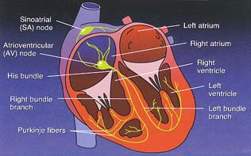
Example: ECG signal analysis
How do we know a patient has heart disease?
Note: a cardiac doctor is not present – Thus we can only use computer to automatically recognize heart disease
Today people use ECG sensor to collect heart beat signals
Given an ECG sensor signal, how do we know if it is normal or not?
From a textbook on cardiology

Slide 4
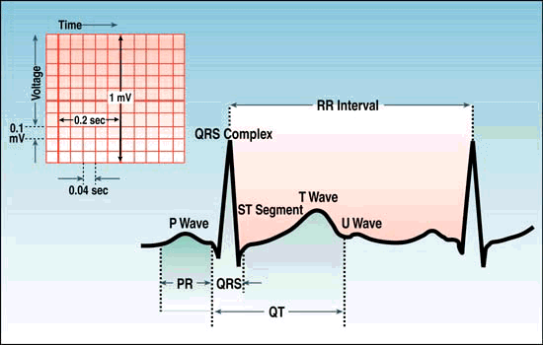
Clinically Relevant Parameters
QRS duration Bundle brand block depolarization
ST segment ischemia
QT interval ventricular fibrillation
PR interval SA → ventricles
Notes:
Ischemia [is’kE mie] ventricular [ven’tri ke ler] fibrillation [fi bre ’lei tion]

Slide 5
Rhythm example
Rate?
70 bpm
Regularity?
occasionally irreg.
P waves?
2/7 different contour
PR interval?
0.14 s (except 2/7)
QRS duration?
0.08 s
Interpretation?
NSR with Premature Atrial Contractions

Slide 6
Classification of ECG signals
E. Classification
Linear discriminate analysis (LDA)
Quadratic discriminate analysis (QDA)
K nearest neighbor (KNN) rule
We can use the Euclidean metric to measure “closeness” in the KNN classiﬁcation model

Slide 7
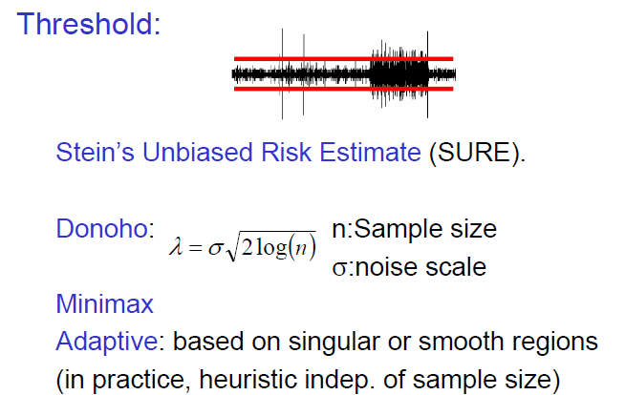
Denoising

Slide 8
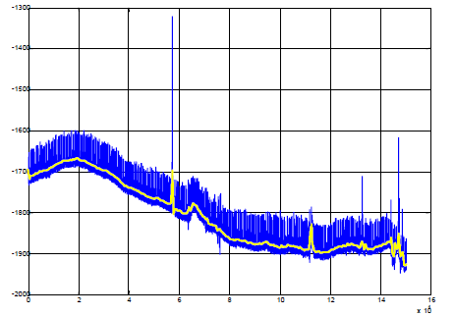
Long-Term ECG Evolution
Application: Electrocardiogram baseline wandering reduction

Slide 9
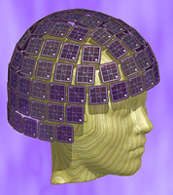
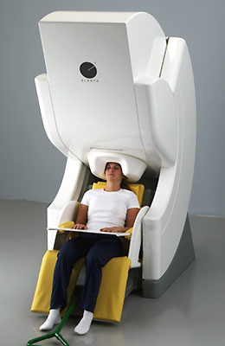
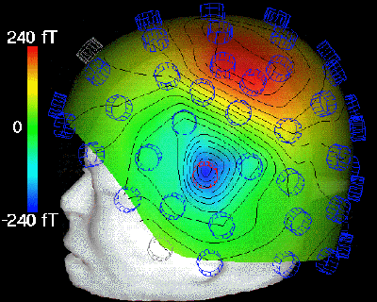
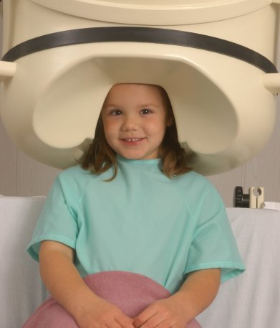
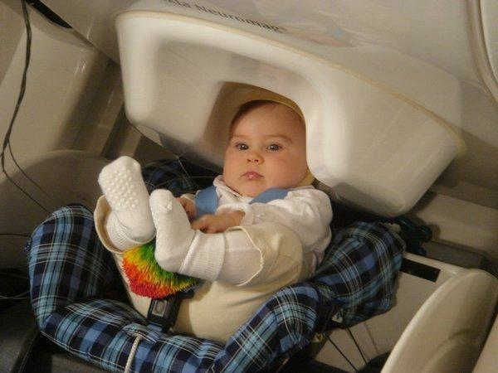
Magne to ‘en ‘ce pha lo ‘graphy (MEG, googled images)

Slide 10
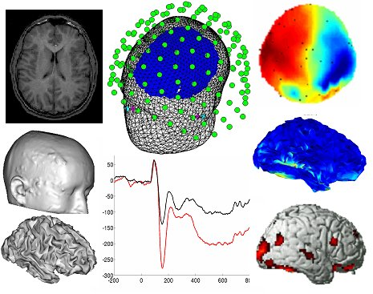
Multimodal Imaging
Combining MEG data with FMRI results in a hybrid image which has both good temporal
and spatial resolution.

Slide 12
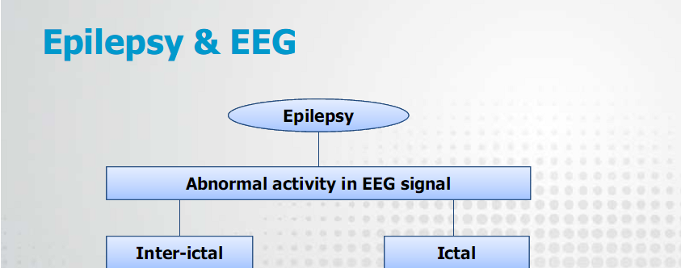
Focal
Generalized
Multi-local
Spike
+
Wave complex

Slide 15
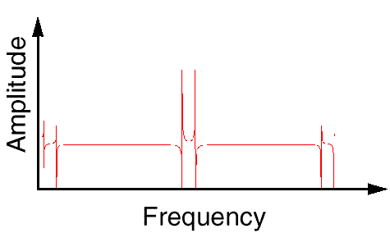
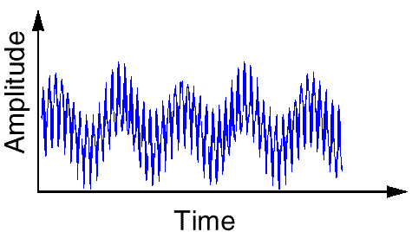
Tool example: Fourier Analysis
Breaks down a signal into constituent sinusoids of different frequencies
In other words: Transform the view of the signal from time-base to frequency-base.

Slide 16
Can we improve Fourier tool?
By using Fourier Transform , we loose the time information : WHEN did a particular event take place ?
FT can not locate drift, trends, abrupt changes, beginning and ends of events, etc.

Slide 17
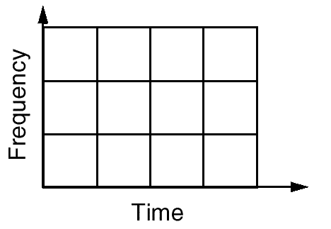
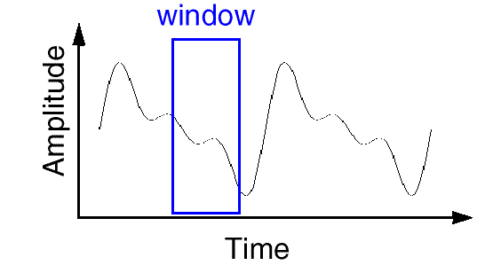
Short Time Fourier Analysis
In order to analyze small section of a signal, Denis Gabor (1946), developed a technique, based on the FT and using windowing : STFT

Slide 18
What is Wavelet Analysis ?
And…what is a wavelet…?
A wavelet is a waveform of effectively limited duration that has an average value of zero.

Slide 19
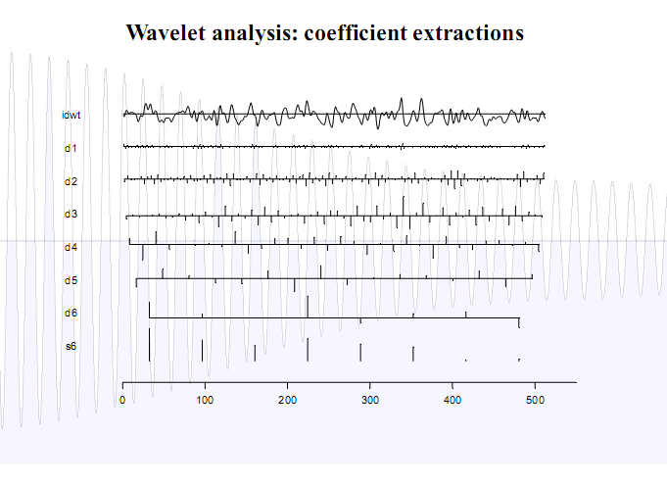

Slide 20
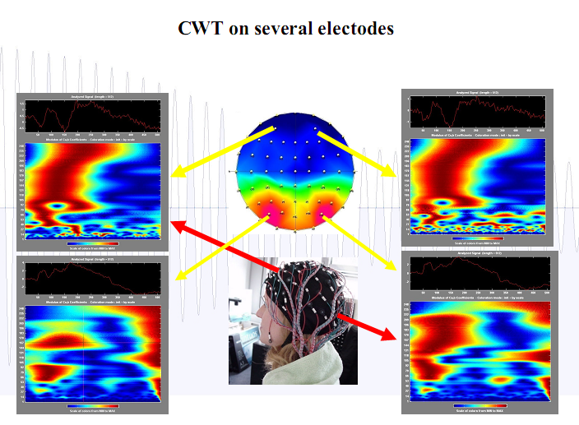
Use Wavelet to analyze brain images

Slide 21
Machine Learning – A promising signal analysis tool
Types of Problems Solved using ML
1. Classification (class labels)
– OCR, Handwritten digit recognition
2. Regression (continuous values)
– Ranking web pages using human or click data
3. Clustering
- No-label data classification
4. Modeling - Inferring a Probability
– seek probability distribution parameters

Slide 22
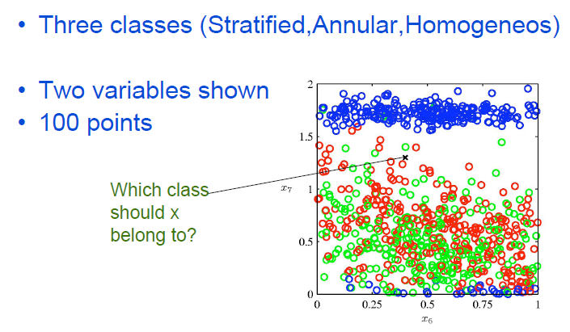
Classification example

Slide 23
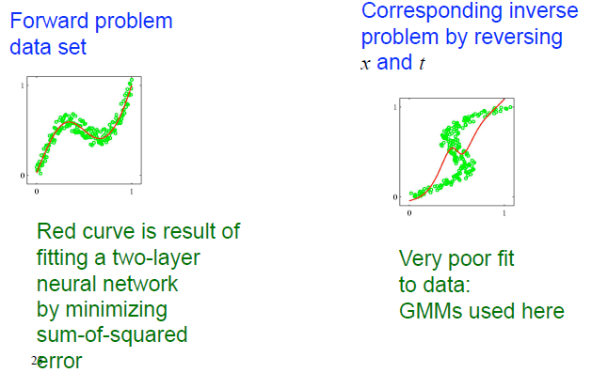
Regression problem

Slide 24
Clustering problem

Slide 25
Example Successful Application of Machine Learning

Slide 26
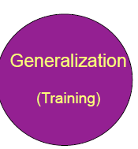
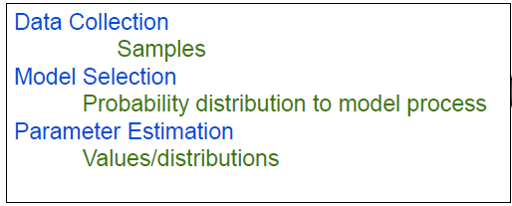
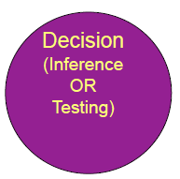
The ML Approach

