Slide 1

Implantable Medical Devices
ECE, UA

Slide 2
IMD
Implant:
Replace a missing biological structure
Support a damaged biological structure
Enhance an existing biological structure
Man-made Medical Devices

Slide 3
IMD
Active implant electronics
Transplanted Biomedical Tissue
Biomedical Material Tissue

Slide 4

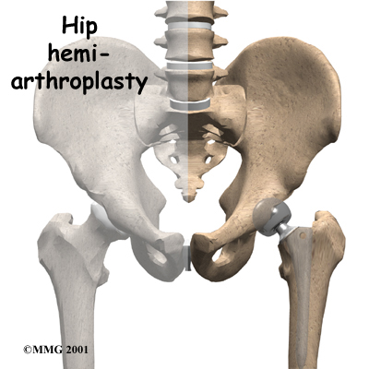
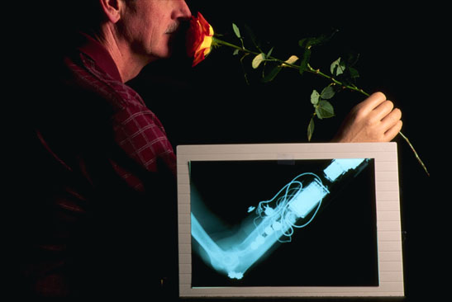
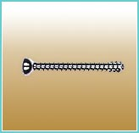
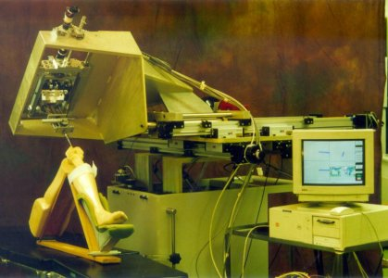
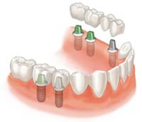
Prosthetic Devices - Implants
Robotic device for knee prosthesis implantation

Slide 5
IMD
Electrically-powered implants
Active implants: Pacemaker…
Bio-implants
Biomaterial tissues: skin cornea…
Dental implants
Artificial tooth
Orthopedic implants
Correct the affected joint …
Applications

Slide 6
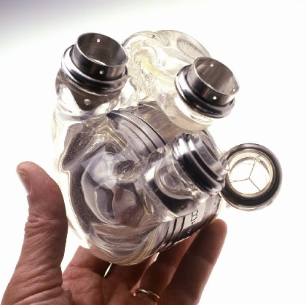
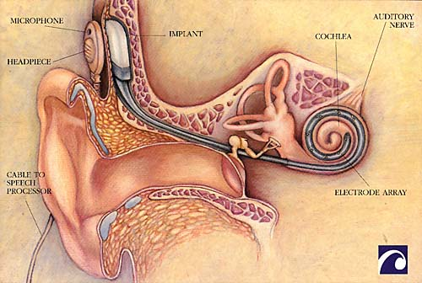
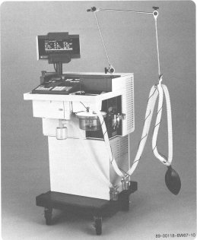
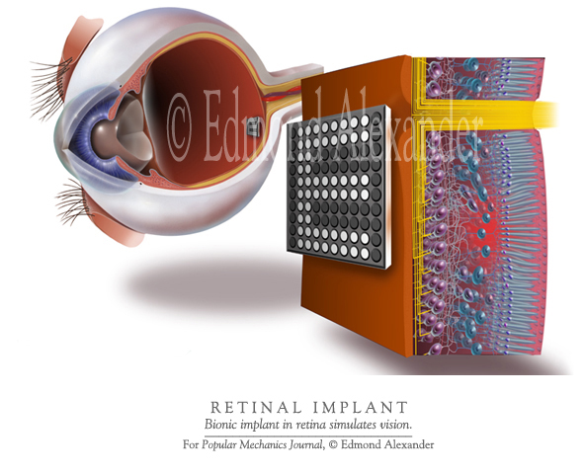
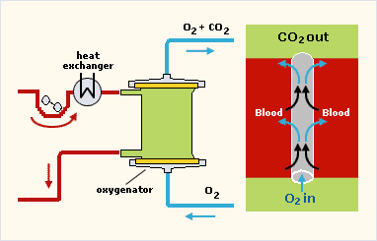
Prosthetic Devices – „Artificial Organs“
Artificial heart
Cochlear implant
Ventilator
Cardiopul-monary bypass
Retinal implant

Slide 7
IMD
Medical Device Definition
An instrument, apparatus, implement, machine, contrivance, implant, in vitro reagent, or other similar or related article, including a component part, or accessory which is:
  -Recognized in the official National Formulary
  -Intended for use in the diagnosis of disease or other conditions
  -Intended to affect the structure or any function of the body of man or other animals

Slide 8
IMD
Classification:
  Class I: General controls
  Class II: General controls with special controls (infusion pumps, and surgical drapes…)
  Class III: General controls and premarket approval (implantable pacemaker, pulse generators, automated external defibrillators…)

Slide 9
IMD
Four components of information security
CIAA
Confidentiality
Integrity
Availability
Accountability

Slide 10
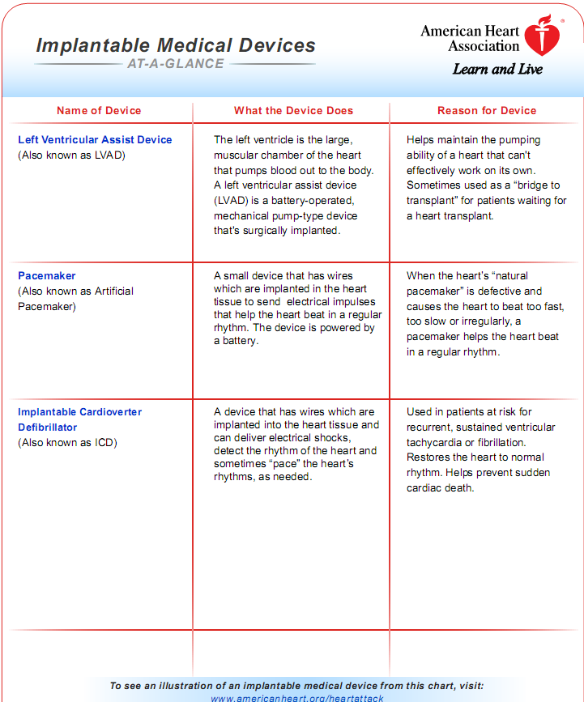

Slide 11
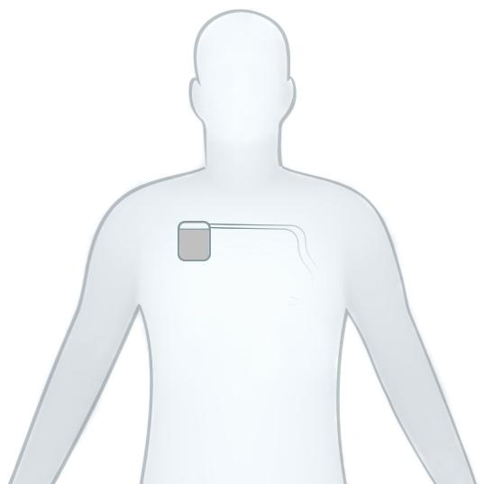
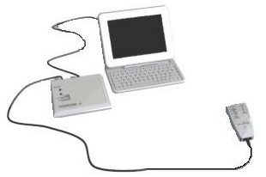
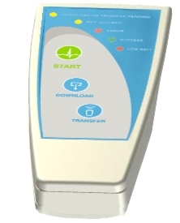
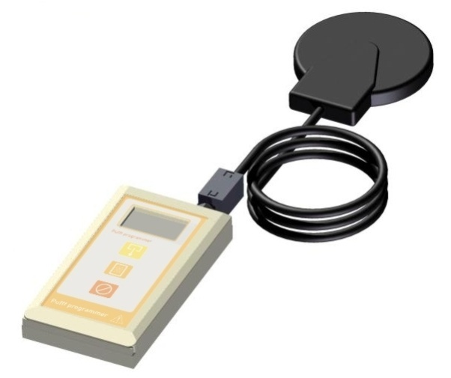
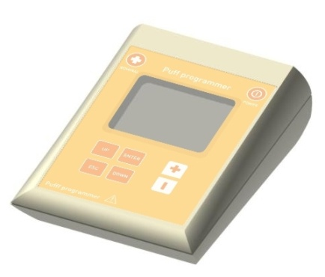
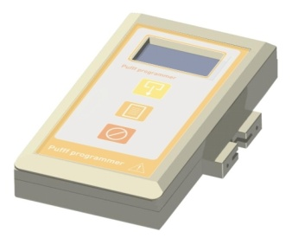
Implantable Medical System
Patient
wand
ID Leads
Programmer System
Logger
PSA
Battery
charger

Slide 12
Implantable Devices (ID)
They have two main functions:
  Applying a therapy, usually by delivering electrical signals to some organs or tissues.
  Monitoring relevant parameters or signals in order to avoid risks to the patient or to optimize his treatment.
They usually are capable of measuring and analyzing electrical and mechanical physiological signals. They transmit this information (monitoring function) or use it as input data for the therapy.

Slide 13
Development Platform
Communication protocols and modules
Sensing modules
Pacing modules
Wireless battery recharge module
Lead impedance measurement modules
Accelerometer modules
FW download module
RTC module

Slide 14

Design Process
Customer
Idea / Concept
Research
Validation
Large Production
Design Review
Specification
Design
Prototype / Product
Verification
Small Production
Technology Transfer

Slide 15
Application Fields of Some Systems Developed by CCC
Heart Failure
Obesity
Diabetes
Neurostimulation
Blood pressure control
Foot drop correction
Urinary incontinence
Patient monitoring
Sleep apnea

Slide 16
Implantable Systems Market
5 big companies:
  share more than 98% of the market (mainly pacemakers and ICDs).
  design and manufacture their products but do not act as contract designers or manufacturers.
  buy patents and technology from small companies in the field or eventually buy the companies.
Start –up companies created to check the feasibility of treating a disease using an implantable device implementing a therapy conceived by themselves:
  few per year, mainly from US, Israel and Canada
  without capacity to develop and manufacture the devices

Slide 17
EMC for Active Implantable Medical Devices

Slide 18
Active implantable medical devices
Types
Implantable cardiac pacemakers
Implantable defibrillators
Cochlear implants
Implantable nerve stimulators (FES)
  Limb function stimulation
  Bladder stimulators
  Sphincter stimulators
  Diaphragm stimulators
  Analgesia
Implantable infusion pumps
Implantable active monitoring devices

Slide 19
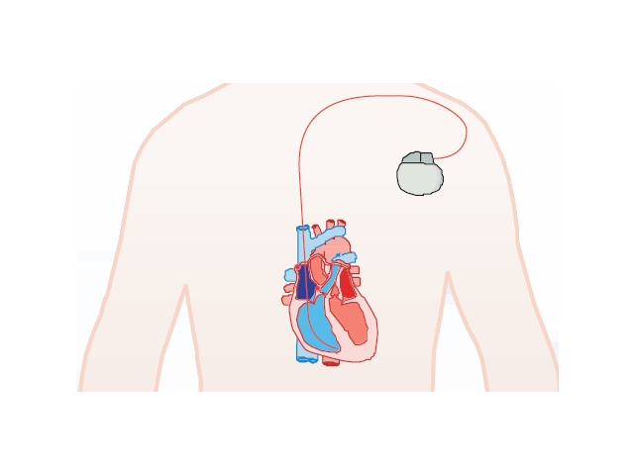

Active implantable medical devices
Implantable cardiac pacemaker

Slide 20
History
On February 3, 1960, Dr. Orestes Fiandra performed the first effective pacemaker implant to a human being in the world.
In 1970, Dr. Orestes Fiandra founded CCC, to develop and manufacture pacemakers.
So up to date this means 48 years working with implantable medical devices 38 years of experience in manufacturing.

Slide 21
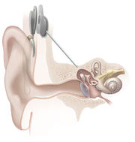
Active implantable medical devices
Cochlear Implant

Slide 22
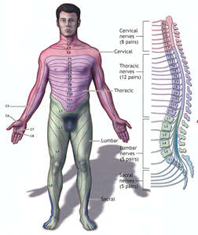
Active implantable medical devices
Functional Electrical Stimulation

Slide 23
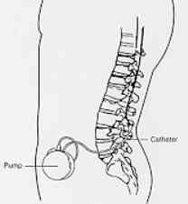
Active implantable medical devices
Implantable infusion pump

Slide 24
EMC Background - Definitions
Electromagnetic Compatibility (EMC) -
the condition which exists when equipment is
performing its designed functions without causing
or suffering unacceptable degradation due to
electromagnetic interference to or from other
equipment.
Notes:
Electromagnetic compatibility refers to a kind of environmental equilibrium. In this case, the environment is an electromagnetic one - consisting of invisible disturbances which travel through the air or through metal cabinets or wires.
Most electrical and electronic devices generate such disturbances. And, as we have seen, many electronic devices can be upset by these disturbances.
When a particular equipment is not generating excessive disturbances, and when it is operating correctly in the presence of such disturbnces, the condition of electromagnetic compatibility is satisfied.

Slide 25
Background – Sources of interference
intentional radiators
  radio/TV stations
  remote controls
  paging, cell phones
unintentional radiators
  digital electronics
  microwave ovens
  appliances
  lamp dimmers
Notes:
Radiated emissions are essential for the operation of broadcast radio and TV, public telecommunications such as cellular telephony and paging, and private uses such as walkie-talkies, remote controls and wireless car door keys. Each of these intentional radiators is subject to rules for preventing interference and maximizing the efficient use of limited spectrum. In the US, the majority of the FCC’s rules address intentional radiators. This is a big area, and we won’t get into the details here.
Unintentional radiators, such as digital electronics and microwave ovens, are also governed by standards which limit the permitted emissions. These are products which are not designed to generate RF energy, but do so anyway.
As a result, they can interfere with broadcast reception or the operation of other nearby electronic devices.
Let’s look at the key concepts which apply to the limits and methods of measurement of radiated emissions from unintentional radiators.

Slide 26
Background - Definitions
Electromagnetic
compatibility
Electromagnetic
emissions
Electromagnetic
susceptibility

Slide 27
Background - Definitions
radiated emission RF immunity
limits fields
residential 100-500 μV/m 3 V/m
Class B (3m)
industrial 300-700 μV/m 10 V/m
Class A (3m)

Slide 28
EMC Standards & Regulations – History
    1844 Morse, telegraph
    1892 Law of telegraph in Germany (EMC)
  1895 Marconi, first radio transmission
  1927 German Hochfrequenzgerätegesetz
  1933 CISPR founded
  1934 USA Communications Act, FCC
  1972 Altair 8800, first PC
  1979 FCC Part 15, subpart J (ITE)
1985 IEC CISPR 22 (ITE)
  1989 EMC Directive, EU

Slide 29
Standards – Res/Comm/Ind. Immunity
Electrostatic discharge IEC 61000-4-2
RF radiated immunity IEC 61000-4-3
Fast transient burst (EFT/B) IEC 61000-4-4
Lightning induced surge IEC 61000-4-5
RF conducted immunity IEC 61000-4-6
Harmonics/interharmonics* IEC 61000-4-7
Radiated magnetic immunity IEC 61000-4-8
Pulsed magnetic immunity IEC 61000-4-9
Damped oscillatory magnetic IEC 61000-4-10
Voltage dips/interrupts IEC 61000-4-11
* a guide, not a standard

Slide 30
Medical Standards & Regulations – History
      1895 X-ray, by Röntgen
    1903 Electrocardiograph
    1906 USA Pure Food & Drug Act (FDA)
    1930 FDA name formalized
    1958 Implanted pacemaker
    1967 Cochlear implant
    1979 FDA MDS-201-0004 (EMC)
    1990 AIMD 90/385/EEC
    1993 MDD 93/42/EEC
    1993 IEC 60601-1-2 1st edition
    1997 Brain pacemaker

Slide 31
Standards – Medical equipment Immunity
(IEC 60601-1-2 2nd edition)
Electrostatic discharge IEC 61000-4-2
RF radiated immunity IEC 61000-4-3
Fast transient burst (EFT/B) IEC 61000-4-4
Lightning induced surge IEC 61000-4-5
RF conducted immunity IEC 61000-4-6
Radiated magnetic immunity IEC 61000-4-8
Voltage dips/interrupts IEC 61000-4-11

Slide 32
Standards – Implant Immunity
RF radiated immunity IEC 61000-4-3
Radiated magnetic immunity IEC 61000-4-8

Slide 33

Active implantable medical devices
Environments - general

Slide 34
Active implantable medical devices
EMC threats - general

Slide 35

Active implantable medical devices
Environments - special

Slide 36
Active implantable medical devices
EMC threats – EAS samples (HC survey)

Slide 37
Active implantable medical devices
EMC threats – RFID*
Carrier frequency peak field modulation
134 kHz 65 A/m 10 – 14 Hz
13.56 MHz 7 A/m 2 – 11 Hz
915 MHz - 56 kHz
*ISO/IEC JTC1 SC31 study January 2006

Slide 38
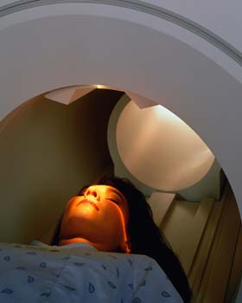
Active implantable medical devices
Environments - special

Slide 39
Active implantable medical devices
EMC threats – MRI
Agence française de sécurité sanitaire des produits de santé (AFSSAPS)(1995) as adopted by Health Canada.

Slide 40
Active implantable medical devices
EMC threats – MRI
Magnetic field strengths of 0.3T to 3T (earth’s magnetic field is ~ 50 μT).
Magnetic field gradients of 20 mT/m to 100 mT/m.
Pulse repetition time 16 – 500 ms.

Slide 41
Active implantable medical devices
EMC threats – MRI
2006 classification for implant and ancillary device safety (ASTM/FDA):
MR-Safe – device or implant is completely non-magnetic, non-electrically conductive, and non-RF reactive.
MR-conditional – may contain magnetic, electrically-conductive or RF-reactive components found safe in tested conditions (“tested safe to 1.5T”)
MR-unsafe

Slide 42
Active implantable medical devices
EMC standards in place
USA FDA EU MDD/AIMD
Cochlear implants IEC 60601-1-2 EN 60118-13 (MDD)
ANSI C63.19
FDA Guidance 8-1-03
Cardiac pacemakers IEC 60601-1-2 EN 45502-2-1 (AIMD)
AAMI PC69 ISO 14708-2
Infusion pumps

Slide 43
Active implantable medical devices
EMC draft standards
USA FDA EU MDD/AIMD
Cochlear implants IEC 60601-1-2 EN 60118-13 (MDD)
ANSI C63.19 prEN 45502-2-3 (AIMD)
FDA Guidance 8-1-03
Cardiac pacemakers IEC 60601-1-2 EN 45502-2-1 (AIMD)
AAMI PC69 ISO 14708-2
Infusion pumps dr ISO 14708-4 dr ISO 14708-4 (AAMI)

Slide 44
Active implantable medical devices
EMC standards – cochlear implants
From: EN 60118-13

Slide 45
Active implantable medical devices
EMC standards – cochlear implants
USA FDA EU
ANSI C63.19 EN 60118-13
frequency range 835-1880 MHz 800 – 2000 MHz
Field strengths E: 31.6 – 177.7 V/m E: 50 – 75 V/m
H: 0.071 – 0.4 A/m

Slide 46
Active implantable medical devices
EMC standards – cardiac pacemaker
From: AAMI PC69

Slide 47
Active implantable medical devices
EMC standards – cardiac pacemaker
USA FDA EU and international
AAMI PC69 ISO 14708-2/EN 45502-2-1
frequency range 450 – 3000 MHz E: 16.6 Hz – 3000 MHz
H: 1 – 140 kHz
Field strengths 40 mW (~ 10 V/m no fluid) 1 – 10 V p-p*
optional 2W and 8W 107 – 150 A/m
*For ISO 14708-2/EN 45502-2-1, applied through a tissue equivalent interface circuit.

Slide 48
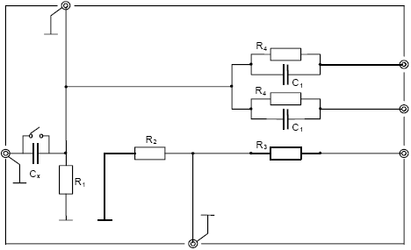
Active implantable medical devices
EMC standards – cardiac pacemaker
ISO 14708-2/EN 45502-2-1 Connection of tissue equivalent interface
circuit (left) and multichannel bipolar cardiac pacemaker (right).
Testing 450 MHz – 3 GHz is deleted if feed-through insertion loss is
30 dB or greater.

Slide 49
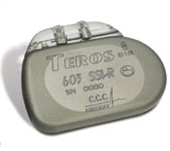
Pacemakers
Products:
  TEROS pacemakers
  ALUS Programming System
  Leads
  Circuits & Parts

Slide 50
Active implantable medical devices
EMC standards – infusion pump
parameter USA FDA and EU
draft ISO 14708-4
Static magnetic fields 1 mT (10 G)
Magnetic fields, A: 795 – 0.053 A/m (1 mT – 0.067 μT)
10 Hz – 30 MHz B: 159 – 0.53 A/m (0.2 mT – 0.67 μT)
30 MHz – 450 MHz A: 16 V/m, swept
B: 140 V/m, spot
450 MHz – 3000 MHz A: 40 mW, per AAMI PC69
Performance criteria
A: during test, operates as intended; no degradation
B: during test, may be loss of function; lost functions are self-
recoverable after test.

Slide 51

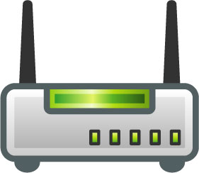
Active implantable medical devices
EMC – how much field attenuation does the human body provide?

Slide 52
Active implantable medical devices
EMC standards – SAR measurement
From: EN 62209-1

Slide 53
Active implantable medical devices
EMC standards

Slide 54
Active implantable medical devices
Radio standards – programming the implant

Slide 55
Active implantable medical devices
Radio standards – programming the implant
Global Category Comments
Frequency bands
9 – 315 kHz EU medical implant not so allocated outside EU
13.56 MHz ISM and SRD RFID frequency*
27.12 MHz ISM and R/C congested
40.68 MHz ISM and SRD protocol restrictions
in USA
402 – 405 MHz Medical Implant Comm. Reserved for implants
2.45 GHz ISM and SRD and 802.11b/g (BT, Wi-Fi)
microwave oven
5.8 GHz ISM 802.11a
* See FDA Guidance 12-10-2004 on RFID transponders for patient ID.

Slide 56
Active implantable medical devices
Radio standards – programming the implant
Global FCC regulation EU regulation
Frequency bands
9 – 315 kHz 15.209 general EN 302 195-1, -2 (radio)
(not 90-110 kHz) EN 301 489-1, -31 (EMC)
13.56 MHz 15.225 general EN 300 330-1, -2 (radio)
EN 302 291-1, -2 (inductive)
27.12 MHz 15.227 and 95C EN 300 220-1, -2 (radio)
EN 301 489-1, -3 (EMC)
40.68 MHz 15.231 EN 300 220-1, -2 (radio)
EN 301 489-1, -3 (EMC)
402 – 405 MHz 95I EN 301 839-1, -2
2.45 GHz 14.247, 15.249 EN 300 440-1, -2; EN 300 328
5.8 GHz 15.247; 15.407 EN 300 440-1, -2; EN 301 893

Slide 57
Active implantable medical devices
Radio standards – Medical Implant Communications (MICS),
402 – 405 MHz
Jurisdiction Regulation
USA 47 CFR Part 95 subpart I
EU EN 301 839-1, -2
EMC per EN 301 489-1, -27
Japan Ordinance regulating radio equipment, article 49.14
Australia Radiocommunications (Low Interference
Potential) Class License, item 48

Slide 58
Active implantable medical devices
Radio standards – Medical Implant Communications (MICS)
Key parameters
Frequency band 402 – 405 MHz.
Transmitter power 25 μW or 9.1 mV/m at 3m on anechoic site (if implant, measured in torso simulator.
Bandwidth 300 kHz maximum.
Frequency stability 100 ppm.
Programmer access listen-before-talk.
protocol

Slide 59
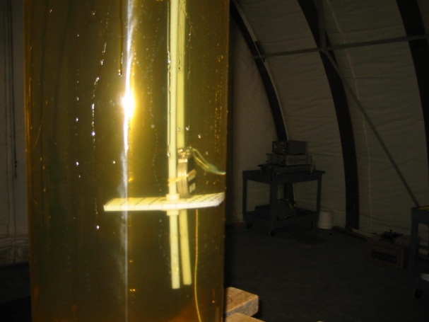
Active implantable medical devices
Radio standards – Medical Implant Communications (MICS)
Torso simulator
From FCC 95I and EN 301 489-27

Slide 60
Active implantable medical devices
EMC design considerations
EM disturbances for implants are much more severe than non-medical industrial ones - but there may be some mitigation of high-frequency RF fields owing to body attenuation.
EM disturbances are limited in type to RF electric and magnetic fields, DC and suitably modulated. (Be careful: EN 45502-2-1/ISO 14708-2 for pacemakers use special coupling networks).
Influence of MRI on patients can arise from presence of implant leads, separate from any direct effect on implant.

Slide 61
Active implantable medical devices
EMC design considerations (continued)
In many cases, the recognized EMC tests for a given active implant will differ between jurisdictions. Be careful to cover all tests, or obtain prior regulatory assent to a single method of testing.
RF communications with implants takes place with lowest loss at lowest RF frequencies – but operation at these frequencies is also most susceptible to ambient disturbances such as RFID. Therefore, a robust protocol is needed. See FDA draft guidance “Radio-Frequency Wireless Technology in Medical Devices” to augment IEC 60601-1-2 compliance testing.

Slide 62
Implant circuit design
Wireless Power and Data Transmission with ASK Demodulator and Power Regulator for a Biomedical Implantable SOC
Chen-Hua Kao, Kea-Tiong Tang 2009 IEEE

Slide 63
Implant circuit design
Outline
  Abstract
  Introduction
  ASK Structure
  Power Regulator
  Results
  Conclusion

Slide 64
Implant circuit design
Abstract
Bio-medical implantable devices have appeared for more than fifty years.
Wireless implantable devices could transmit power and data by magnetic coupling.
This paper presents an efficient power and data transmission- LDO & ASK

Slide 65
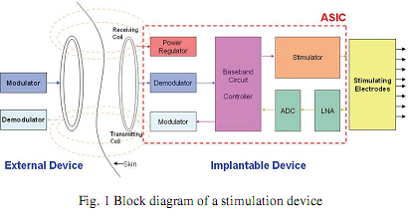
Implant circuit design
Introduction

Slide 66
Implant circuit design
Introduction
Widely used implantable stimulator:
→cochlea implant, pacemaker, auditory brainstem …
Size and Power consumption is much concerned
→ wireless power and data combining transmission
Power regulator
ASK

Slide 67
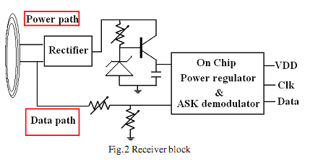
Implant circuit design
ASK Demodulation Structure
<low power, small area, high efficiency, low cost and feasibility>

Slide 68
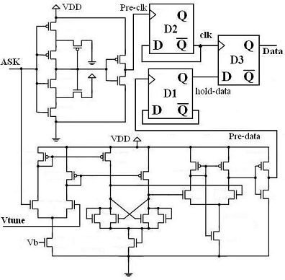
Implant circuit design
ASK Demodulation Structure
self-sampling
50% modulation rate
tunable modulation index

Slide 69
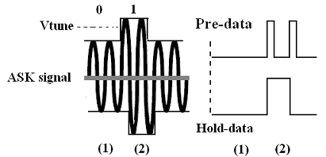
Implant circuit design
ASK Demodulation Structure
  (1)Low level sensing
  (2)High level sensing

Slide 70


Implant circuit design
Power Regulator
Variable Voltage
Stable DC voltage supply

Slide 71

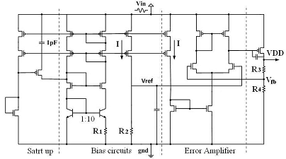
Implant circuit design
Power Regulator

Slide 72
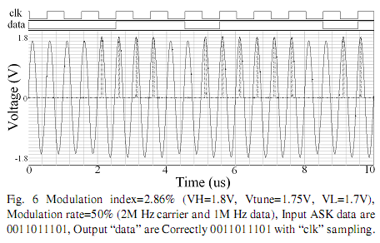
Implant circuit design
Results
// carrier is set as 2M Hz with a 1M Hz
random binary data rate
// 2.86% modulation index 1.8V supply

Slide 73
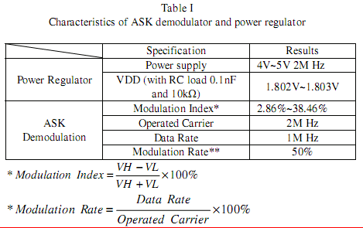
Implant circuit design
Results

Slide 74
Implant circuit design
Conclusion
This work presents a new ASK demodulator structure with a regulated power supply.
we find this ASK demodulator having better modulation rate and controllable modulation index.
This architecture is flexible for biomedical applications.
Simulation results of this work are very appealing to these applications.

Slide 75
Implant circuit design
Using Pulse Width Modulation for Wireless Transmission of Neural Signals in Multichannel Neural Recording Systems
Ming Yin, Maysam Ghovanloo
IEEE Transactions on Neural Systems and Rehabilitation engineering, august2009

Slide 76
Implant circuit design
Outline
  Introduction
  WINER System Architecture
  Evaluation of the wireless PWM technique
  Simulation and Measurement Results
  Conclusion

Slide 77
Implant circuit design
Introduction
  The accelerating pace of research has created a considerable demand for data acquisition systems
  Commutator is a delicate mechanical component and one of the most expensive items in the system
  Size, power consumption, robustness, input referred noise,and bandwidth are the main concerns in developing WNR system

Slide 78
Implant circuit design
Introduction
  neural signal spectrum 0.1 Hz -10 kHz
  50 to 1 mV, supply range of 1.5V
  > 10 uV of background noise
  resolution of 8–10 bits
  160 kb/s of bandwidth is needed
PWM of TDM signal in WINeR system

Slide 79
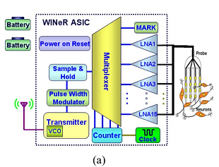
Implant circuit design
  WINER System Architecture
A. Implantable Transmitter Unit
a. gain of 100 amplifier
b. 0.1 Hz to 10 kHz using an array of LNA
c. 16:1 TDM combines 15 channels

Slide 80
Implant circuit design
  WINER System Architecture
  PWM (Pulse width modulator)
  A sample and hold (S/H) circuit follows the TDM to stabilize samples for PWM.
  The PWM block compares the S/H output with a triangular waveform generator (TWG) output through a high speed rail-to-rail comparator C, resulting in a PWM-TDM signal
  PWM-TDM duty cycle is robust against noise and interference (ATC)
  Complexity and power consumption of a single comparator is far less than ADC

Slide 81
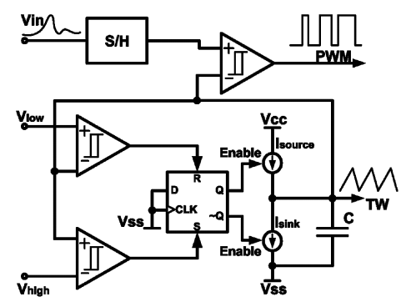
Implant circuit design
  WINER System Architecture
  PWM (Pulse width modulator)

Slide 82
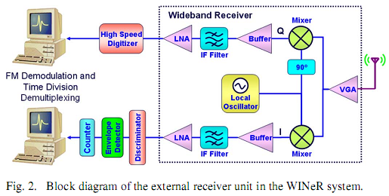
Implant circuit design
  WINER System Architecture
B. External Receiver Unit
IF-PWM-FSK

Slide 83

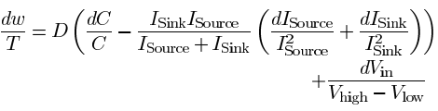
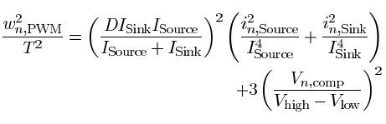
Implant circuit design
  Evaluation of the wireless PWM technique
A. Implantable Transmitter Errors
1) PWM Noise:

Slide 84
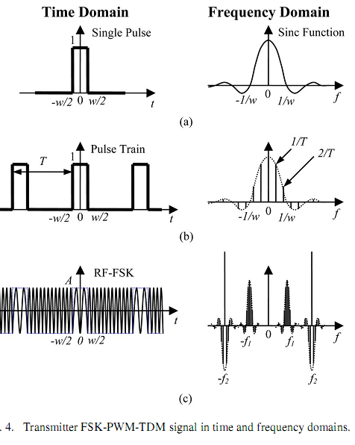
Implant circuit design
  Evaluation of the wireless PWM technique
A. Implantable Transmitter Errors
2) VCO Noise:

Slide 85
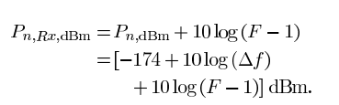

Implant circuit design
  Evaluation of the wireless PWM technique
B. External Receiver Errors
Maximum noise power transfer happens when there is impedance matching between successive blocks.
1) Receiver Thermal Noise:

Slide 86
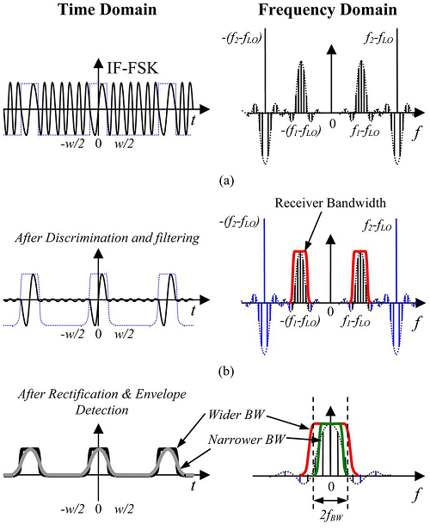
Implant circuit design
  Evaluation of the wireless PWM technique
B. External Receiver Errors
2) Local Oscillator Phase Noise:
3) RBW Limitation:

Slide 87
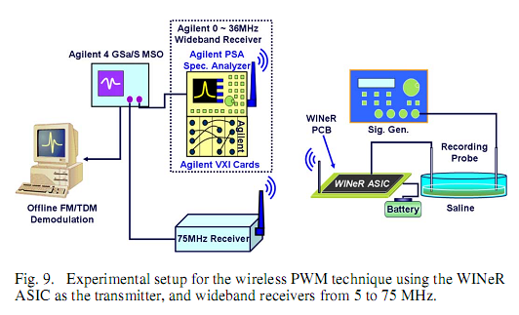
Implant circuit design
  Simulation and Measurement Results

Slide 88

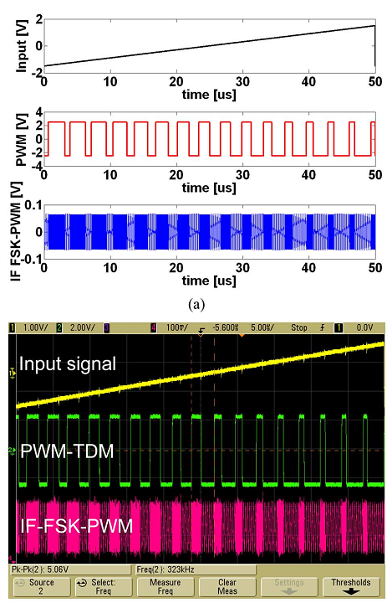
Implant circuit design
  Simulation and Measurement Results

Slide 89
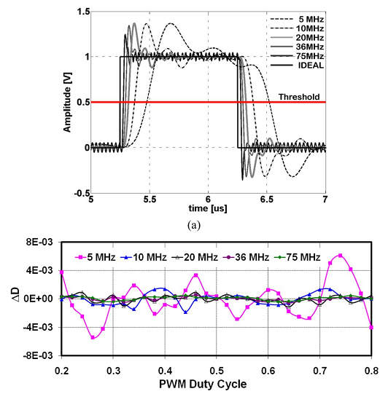
Implant circuit design
  Simulation and Measurement Results
  1) Comparator Error
  2) TWG Error
  3) VCO Error
  4) Receiver Thermal Noise
  5) Receiver Bandwidth Limitation Error
B. Measurements

Slide 90
Implant circuit design
Conclusion
  Presented an effective architecture for simultaneously acquiring wideband neural signals from a large number of sites.
  WINeR operates based on pulse width modulation of time division multiplexed samples (PWM-TDM)
  Identiﬁed various sources of error in the proposed architecture
  It turns out that the receiver bandwidth limitation is the dominant source of inaccuracy followed by SNR at the receiver RF front-end output.

Slide 91
Implant circuit design (antenna)
Design of Implantable Microstrip Antenna for Communication With Medical Implants
Pichitpong Soontornpipit, Cynthia M. Furse
IEEE TRANSACTIONS ON MICROWAVE THEORY AND TECHNIQUES, AUG 2004

Slide 92
Implant circuit design
Outline
  Introduction
  Method of analysis and evaluation
  Parametric Study
  Analysis of the antenna in the realistic shoulder
  Conclusion

Slide 93
Implant circuit design
Introduction
  where the antennas are “embedded” in lossy material reduced antenna efficiency
  the need to reduce antenna size, and the very strong effect of multipath losses.
  This paper provides a better understanding of
  microstrip antennas embedded in lossy environments.

Slide 94
Implant circuit design
Intruduction
  Coaxial antennas
  wire antennas
  arrays embedded in various lossy materials
Embedded microstrip antennas

Slide 95
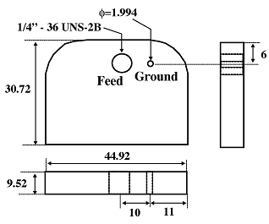
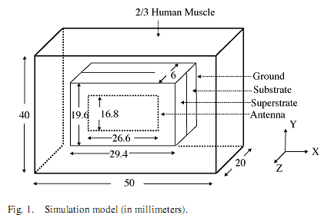
Implant circuit design
Embedded microstrip antennas

Slide 96
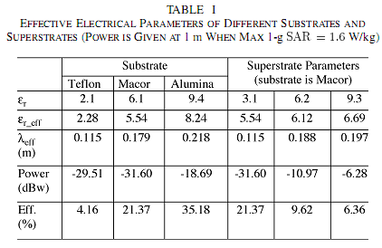
Implant circuit design
  Method of analysis and evaluation

Slide 97
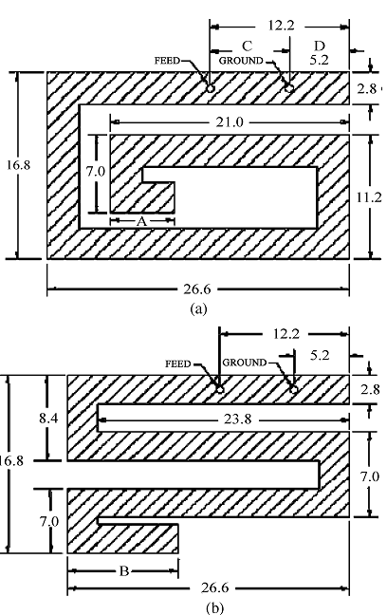
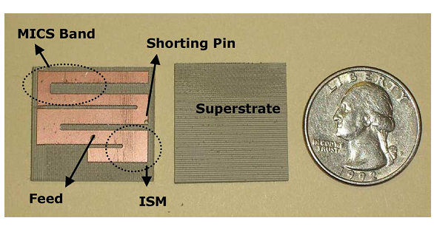
Implant circuit design
Parametric Study
  A. Effect of Shape

Slide 98
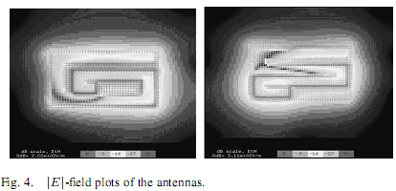


Implant circuit design
Parametric Study
  B. Effect of Length

Slide 99

Implant circuit design
C. Effect of Feed and Ground Point Locations
D. Effect of Substrate and Superstrate Materials
E. Effect of Substrate and Superstrate Thickness
F. Effect of Nonuniform Superstrate

Slide 100


Implant circuit design
In realistic shoulder

Slide 101
Implant circuit design
Conclusion
Spiral and serpentine microstrip antennas that can be used or communication with medical devices have been analyzed.
The spiral design was the smaller of the two designs and both were significantly smaller
The best design can be found by first choosing the substrate and superstrate materials, then optimizing the length to provide approximately the size
Finally, the antenna should be tuned by varying the location of the feed point with the ground point fixed very near one end of the antenna.

Slide 102

Implant circuit design

Slide 103

Implant circuit design

Slide 104

Implant circuit design

Slide 105

Implant circuit design

Slide 106

Implant circuit design

Slide 107

Implant circuit design

Slide 108

Implant circuit design

Slide 109

Implant circuit design

Slide 110
References
[1] Roland Gubisch, Intertek ETL SEMKO,
EMC for active implantable medical devices
[2]http://en.wikipedia.org/wiki/Implant_(medicine)
[3] http://en.wikipedia.org/wiki/Medical_device
[4] http://en.wikipedia.org/wiki/VeriChip
[5] “American Innovation Forum” , March 31^{st,} 2008

Slide 111
Reference
[6] www.americanhear t.org/heartattack
[7] Chen-Hua Kao, Kea-Tiong Tang , Wireless Power and Data Transmission with ASK Demodulator and Power Regulator for a Biomedical Implantable SOC, 2009 IEEE
[8] Ming Yin, Maysam Ghovanloo , Using Pulse Width Modulation for Wireless Transmission of Neural Signals in Multichannel Neural Recording System, IEEE Transactions on Neural Systems and Rehabilitation engineering, august2009
[9] Pichitpong Soontornpipit, Cynthia M. Furse, ,Design of Implantable Microstrip Antenna for Communication With Medical Implants, IEEE Transactions on Microwave theory and techniques 2004
[10] Rizwan Bashirullah , Wireless Implants
[11] Mohamad Sawan, Yamu Hu, and Jonathan Coulombe , Wireless Smart Implants Dedicated to Multichannel Monitoring and Microstimulation

