Slide 1

lecture 2
Tele-healthcare Engineering: System Overview

Slide 2
Some Jargon
Telemedicine is the use of telecommunication and information technologies in order to provide clinical health care at a distance. It involves secure transmission of medical data and information, for the prevention, diagnosis, treatment and follow-up of patients.
Telehealthcare [From WiKi] is an expansion of telemedicine, and unlike telemedicine (which more narrowly focuses on the curative aspect), it encompasses preventative, promotive and curative aspects. Originally used to describe administrative or educational functions related to telemedicine, today telehealth stresses a myriad of technology solutions. For example, physicians use email to communicate with patients, order drug prescriptions and provide other health services.
Notes:
Source: WiKi

Slide 3
This course
This course is called TeleHealthcare Engineering (THE)
That means – we will focus on “engineering” design of telehealthcare technologies. It is unlike other schools that talk about telehealthcare from “info science” viewpoint. Here we target:
- Medical sensor hardware;
- Medical signal processing;
- Medical signal transmission;
- Medical security and privacy, etc.

Slide 4
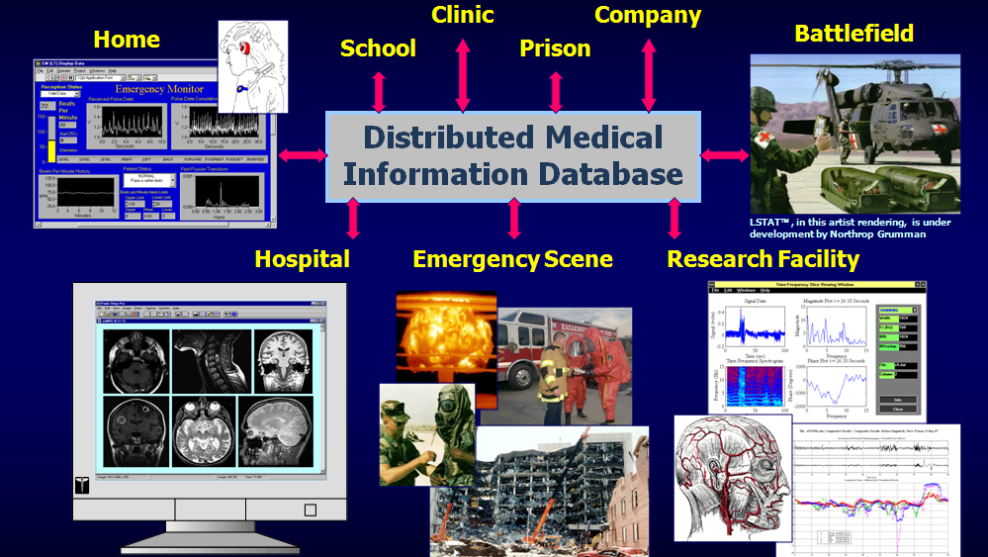
WHY Tele-healthcare?
Notes:
Picture from Kansus State Univ

Slide 5

Target ECE students
ECE Topics –
- Signal Processing
- Communications
- Sensor hardware
- Pattern Recognition

Slide 6
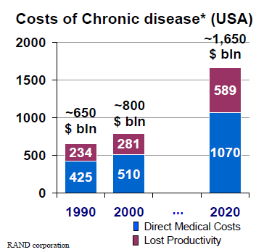
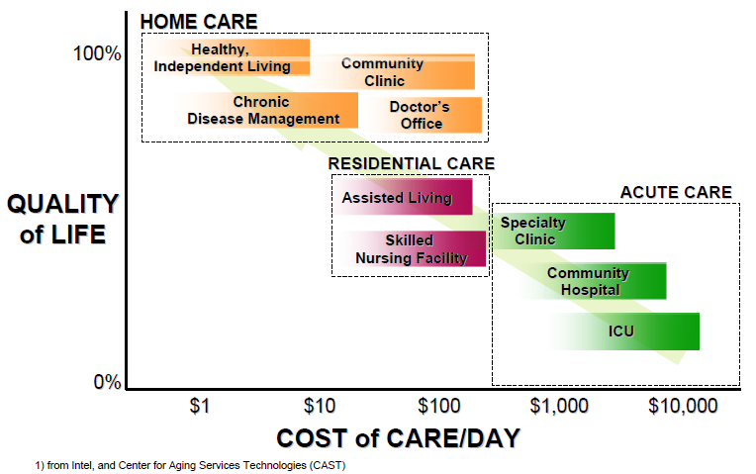
Increased demand and cost
Chronic Diseases* include: cancer, diabetes, alzheimer and other dementias, parkinson, multiple sclerosis (MS), cardio-vascular disease (CVD), chronic obstructive pulmonary disease (COPD), asthma, benign prostatic hypertrophy, rheumatoid arthritis, and osteoarthritis.

Slide 7
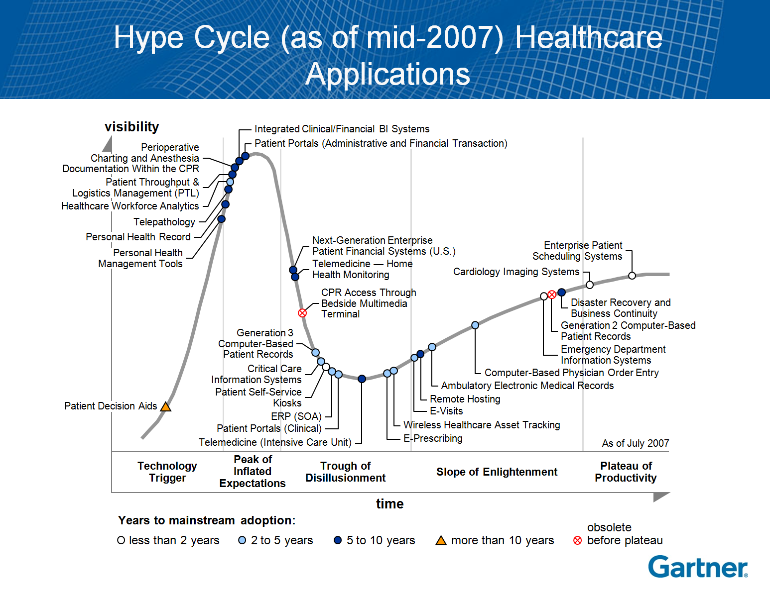

Slide 8
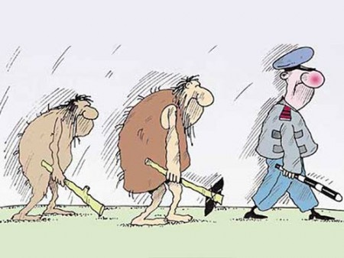
Communications for telehealthcare: Trend
Telesurgery
Telepathology
Remote ICU
Teleradiology [Outsourcing]
Teleretinal imaging
Teledermatology (store&fwd)
Teledermatology [video]
Simple Solution complexity Complex
Video visit
Call Center
Clinical Kiosk
ECG monitoring
Mobile/Home Health monitoring
E-visit
Satellite potential span
Low Bandwidth requirements High
14.4K
128K
512K
1M
2M
10M
100M
Dial-up
2.5G
GPRS/EDGE
VSAT
3G
UMTS/HSPA
E1
WiMAX
DSL
LTE
E-UTRA
T3
Fiber
Notes:
VSAT: from narrow band to 4Mbps
ICU: Intensive Care Unit

Slide 9
Mobile Health Monitoring (Part of system)
Definition: Mobile health monitoring is the use of IT and mobile telecommunications to monitor the health of patients remotely, and to help ensure that appropriate action is taken.
Patients are given devices that measure variables such as blood pressure, pulse, blood oxygen level and weight and that transmit the data to clinicians.
Other devices are used for messaging — gathering information from patients on their symptoms and behaviors, and sending them information and advice.
As opposed to home health monitoring, which typically uses devices that plug into the wall and transmit data through a fixed telephone line, mobile health monitoring uses devices that communicate wirelessly, and that have a battery life at least that of a mobile phone.
In mobile health monitoring, as with home health monitoring, it is essential that the devices send data to an intelligent system that can check for abnormal ranges and alert clinicians. The clinician who receives the alert uses it to take appropriate action, such as telephoning the patient to schedule a clinic appointment or to offer advice. Sometimes, the devices can take action without human intervention. For example, electronic medication containers can alert patients if they did not take their medication.
Solution: wireless medical devices, connecting to IP either directly, or through a base station. A remote station collects vital signs for analysis.
Bandwidth requirements: > 56Kbps

Slide 10
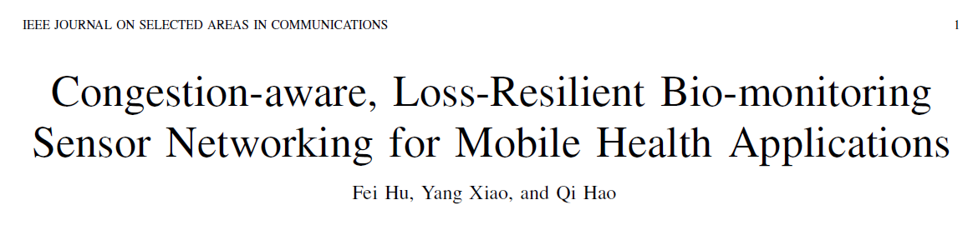
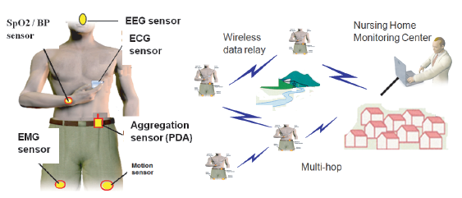
My own paper in top journal

Slide 11
Telecommunications for Healthcare
radio streamer
satellite channel
medium & standard
converter
(MODEM)
telephone, GSM, internet
Ethernet to telemedicine set-up
Internet barebone

Slide 12
Remote ICU
Definition: The remote intensive care unit is a system that combines audio, video, patient records and image access with customized decision support. The remote ICU is an application that enables remote critical care specialists (intensivists and nurses) to sit in a central command center, from where they can monitor and direct the care of critically and acutely ill patients in multiple ICUs.
Solution: audio/video communication system, centralized patient record, image access, decision support system.
Bandwidth requirements: > 1MBbps (5Mbps for TP version)
Networking components:
  VPN (on public nw)
  WAN router
  UC with Vide Conference unit (TV quality) or TP (high end)
Notes:
http://www.visicu.com/products/index.html
ICU® Integrated Healthcare Solution for Critical Care
The patented eICU® Program allows hospitals to create a system-wide critical care program, built on a powerful technology infrastructure that improves quality, operating efficiency, and economic performance. View Diagram
The eICU Program is sold to hospital health systems that want to improve the quality of their intensive care unit (ICU) care. If you can understand how air traffic controllers and onboard technology for pilots keeps fliers safe, you'll be able to understand how an eICU facility keeps patients safe.
ICU patients require around-the-clock specialized care, however most ICUs don't have the specially trained physicians (intensivists) available to provide this. With an eICU facility linked via telemedicine and computer monitors to their hospital ICU rooms they now can. An eICU Program is staffed with an intensivist-led care team that can monitor and care for hundreds of patients much like air traffic controllers monitor hundreds of planes. In an airplane pilots also use on board sensors to identify problems and intervene to maintain a safe flight. Likewise, the eICU care team uses software alerts to track patient vital trends and intervene earlier-before complications occur. Studies show that this type of care model can reduce ICU mortality by 25% and save costs. The keys are constant surveillance, providing the patient with immediate physician access and arming the physician with the patient information needed to make the right decisions, quickly.
VISICU provides the hospital/healthcare system with the eCareManager™ technology system training and implementation which includes:
Remote Care Tools
Proprietary software
System Architecture
Care Delivery
The hospital/health system provides the personnel to staff the eICU center.
A VISICU team works with the hospital/health system every step of the way, forging a lasting partnership for critical care excellence. Our eICU Success Guide identifies the pitfalls and provides the blueprint for a successful program; following contract signing our clinical and technical implementation team will have you up and operational in 120 to 180 days. Following go-live, our clinical operations team will provide the necessary on-going support and our account managers and technicians will ensure timely response and customer satisfaction.

Slide 13
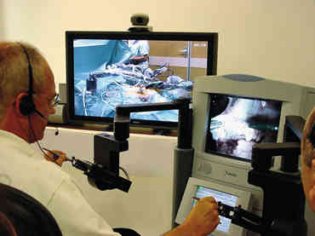
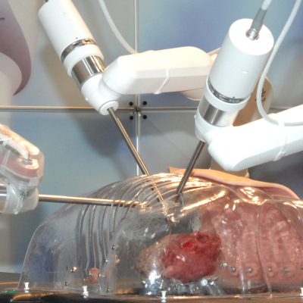
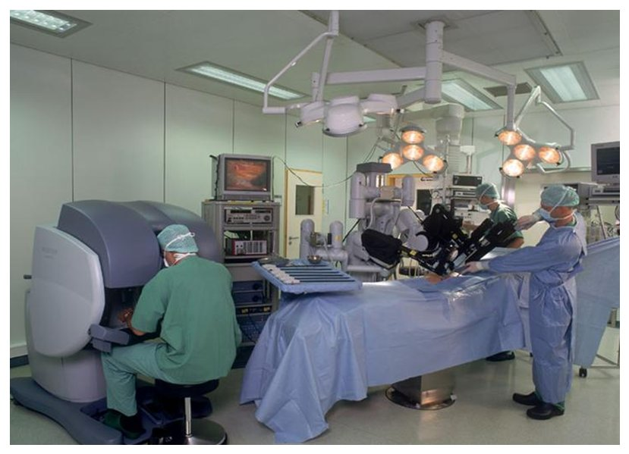
Remote surgery

Slide 14
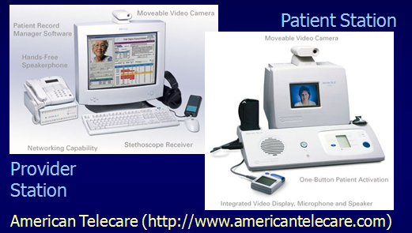
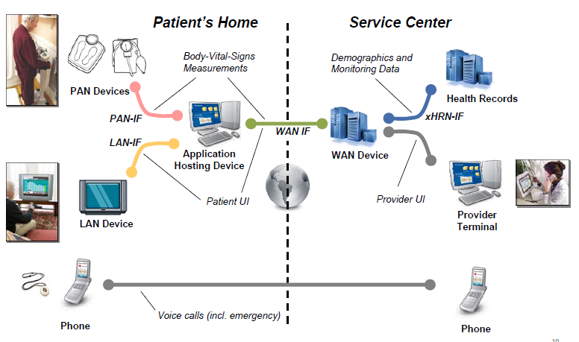
Home tele-health

Slide 15
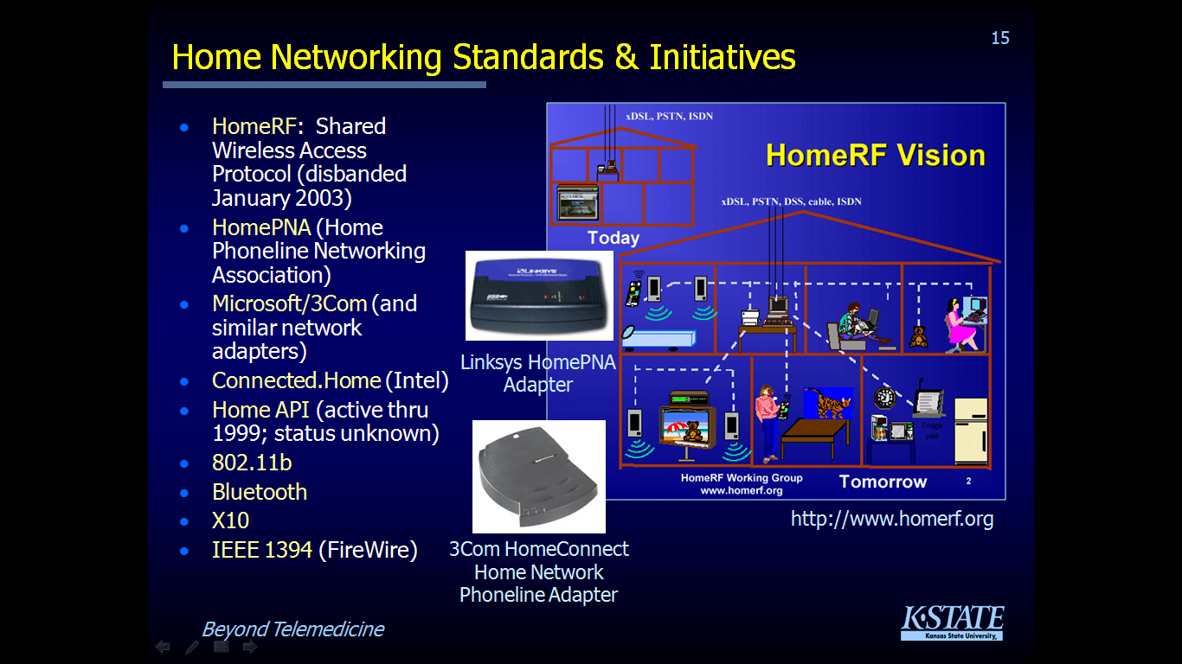
HOME – Networking technologies

Slide 16
TeleHealth Applications and devices
Applications
Medical, surgical, diagnostic
Emergency care
Disaster management
Homecare
Rehabilitation
Tele-Education
EMR
E-prescribing
Health 2.0 social media function
Devices
Digital ECG
Electronic Stethoscope
[High Resolution] Camera
Retina Scanner
Tele-pathology Microscope
X-Ray Digitizer
Fetal Heart Rate Monitor
Pulmonary Function Test Machine
Glucose meter
Blood pressure cuff
Pulse oximeter
Cholesterol meter
Weight scales

Slide 17
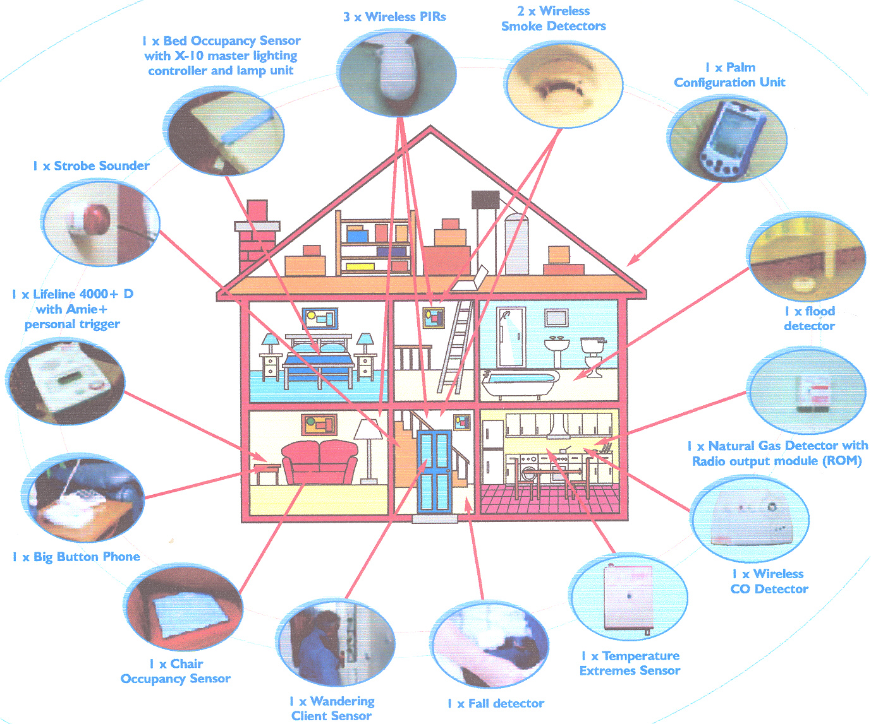
Home
Notes:
POSSIBLE TODAY
? LOSS OF AUTONOMY
W lOTHIAN PROJECTS – bt

Slide 18
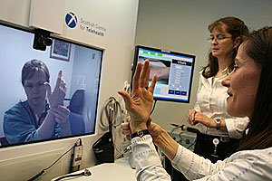
Infrastructure value
Endpoints and medical devices play an important role in Telemedicine solution, as they are the ones sending the requested information (data, voice, video).
But most of the value is provided by intelligent call control to video collaboration. Voice and video endpoints, presence, contact center must be integrated and supported by call control (using SIP). The integration of video endpoints, directory services and presence, plus required QoS and security provides telemedicine solutions that effect business process and could not have been offered just few years ago, without the progress made towards this integration.
QoS - Security
Directory svcs
Presence svcs
Call control svcs

Slide 19
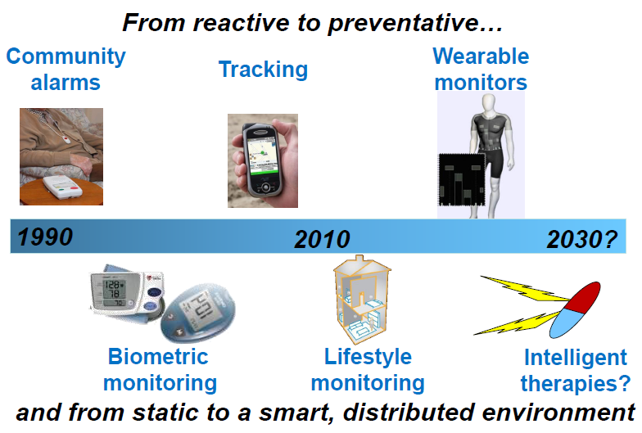
trend

Slide 20
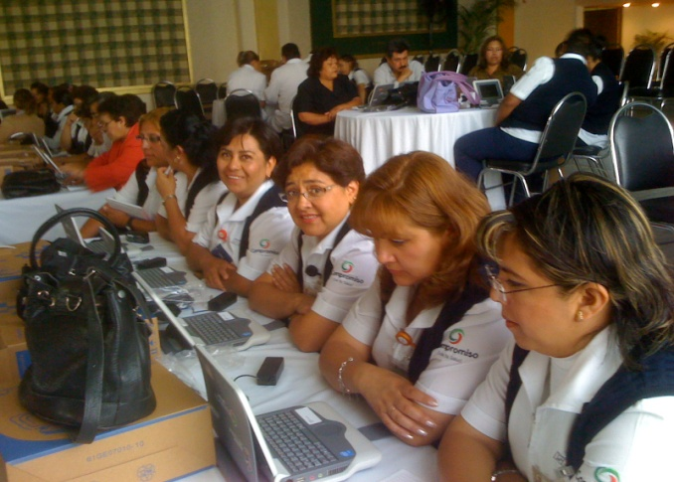
Case 1: New Usage Model - Mexico
Remote Health Consultation
  Bridge the Healthcare Divide
  Access for all @ Healthcare (Telemedicine)
  Tele-Pharmacy
Doctor & Nurse Training
  Continuous education
  Enhance quality of Healthcare Professional
Community Healthcare Survey
  Proactive & preventive Healthcare Services
  Rural reach

Slide 21
Case 2: Denmark - MedCom
MedCom is a non-profit co-operation between authorities, healthcare professionals and IT vendors, working to create a market for electronic communication in the Danish Health Care sector.
In a three year project, an number of telemedicine development and implementations projects have been carried out within:
– Cardiology (included in a Intentional project Health Optimum)
– Diabetes: both home-monitoring and treatment over video conference
– Alcohol treatment over video conference
– Physiotherapy
– Tele radiology
– Preparation of surgery over video conference
– Home-hospital for children
– Home-hospital for COPD patients
Notes:
TM for MedCom is part of a large effort to standardize on HC communication, saving money and time. They promoted effective data transfer
between several actors of the health service, including stakeholders of the community-based social care system. This national network allows
fast information flow in form of reliable data exchange of EDIFACT or XML-based messages among the respective software systems of the
participating healthcare providers.
Electronic data interchange (EDI) is used for the messaging process, including:
• GP referrals to hospitals
• GP prescriptions
• GP requests for diagnostic tests
• Test reports
• Discharge letters to GPs
• Notifications of discharges to community and home care services
• Reimbursements.
The focus of the economic assessment of this unique nationwide eHealth system has been on the direct impacts from improved message exchange. Benefits for citizens are derived from faster, more reliable and more efficient communication between healthcare and social care professionals. GPs’ benefits include costs savings on secretarial and clerical services in preparing and sending information to other healthcare services. Pharmacists can receive prescriptions directly and electronically from GPs, a faster and more reliable process than paper prescriptions transferred by hand.

Slide 22
Case 3: University of Miami - Center on Aging
Business Challenge:
Help family members serve as an extension of the medical system
Network Solution:
Provided video-based counseling and skills training, support groups, and educational seminars on Cisco Unified IP Phone 7985G
Created text-based tips and resource lists displayed on IP phone screen
Business Results:
Enabled caregivers to access formal and informal support and resources without leaving family member
Provided cost-effective training and information
Helped reduce self-reports of isolation, loneliness, burden, and distress
Notes:
University of Miami Center on Aging Deploys Cisco Unified IP Phones to Assist Caregivers
Video Phones Convert Homes into Workspaces for Alzheimer's Patient Care
SAN JOSE, Calif. - January 8, 2008 - The University of Miami's Center on Aging today announced a pilot program that will help enable Alzheimer's patients' caregivers to reduce their stress, isolation, and likelihood of depression through video access to resources such as online support groups and care tips. The program, "A Computer Integrated System for Telephones", uses the Cisco® Unified IP Phone 7985G to help caregivers gain access to educational seminars and individual counseling sessions. With its video capabilities, caregivers use the phones to convert the home into a workspace for finding resources and obtaining quick solutions at the point of care.
The Center on Aging selected Cisco Unified IP Phone 7985G because of the large, easy-to-read display area, buttons that caregivers can use to select different options, and the ease of displaying text based on caregivers' menu selections. Through the program, caregivers' homes are equipped with the Cisco Unified IP Phone 7985G, a broadband connection, and a Cisco 871 Integrated Services Router that connects them to the Center on Aging network and is capable of providing the quality of service (QoS) needed to send high-quality video over the Internet. Caregivers can also make and receive calls exactly as they would with any other phone.
"We're working hard to develop innovative programs to help family members care for their relatives with Alzheimer's disease," says Sara Czaja, Ph.D., co-director of the Center on Aging. "The trend now is to keep patients in their homes instead of sending them to long-term care facilities. The primary caregiver is typically a family member, who becomes an extension of the medical system, using the home as the workspace. The Cisco video phones are a very valuable resource because even though family caregivers experience rewards while providing care, they also experience negative consequences, like stress, depression, and loneliness. These phones offer access to formal and informal support without caregivers having to leave their homes."
The pilot study focuses on support for minority caregivers and currently includes three groups; African-American, Hispanic, and Haitian. Menus, resources, and counseling sessions are either in English, Spanish or Creole, depending upon need. In the future, this could be implemented in communities throughout the United States to help family members act as extensions of the medical system.
"We're proud to see how the Center on Aging is using video with the Cisco Unified IP Phone 7985G," said Brian Dal Bello, director of marketing for Cisco's IP communications business unit. "With research expertise and outreach experience, the program is going to benefit a group of people that needs assistance and is often overlooked."
The worldwide population is aging, which creates new challenges for the healthcare community. The University of Miami's Center on Aging uses research, education, and community outreach to find ways to prevent disability, increase independence, and help older people lead active and rewarding lives. Faculty conduct research on diseases such as Alzheimer's and also offer programs for the elderly and their caregivers.

Slide 23
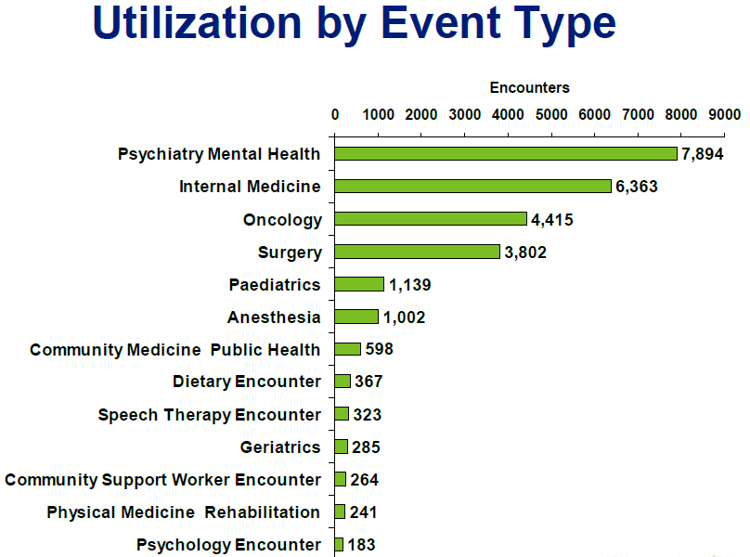
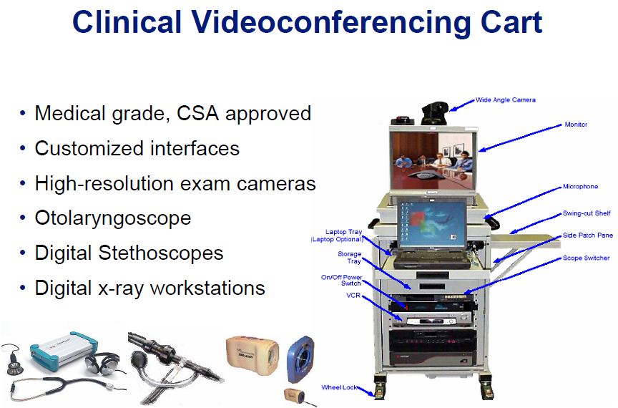
Case 4: Ontario Telemedicine Network
Government-funded Healthcare Delivery
110 employees, 1500 Participating Health Care Professionals
BUSINESS CHALLENGE
Support delivery of complex medical care that is exacerbated by sparsely populated large area lacking access to modern facilities/specialists
Facilitate cost-effective, time-sensitive delivery of expert healthcare to citizens in remote locations
SOLUTION
Employ Cisco’s MPLS Network, Unified Communications, Collaborative Care, and Unified Contact Center Express to bring remote specialist care without travel
Reliable high-bandwidth videoconferencing stations transfer audio, video, and data to allow for remote evaluations and diagnoses
Backbone is Cisco Medical-Grade Network
BUSINESS RESULTS
Provincial medical-related travel costs reduced Canadian $8 million annually
Network hosts more than 32,000 clinical consultations each year safety and patient flow
Notes:
The province of Ontario in Canada has a population of approximately 12 million, most of it concentrated in the large cities of Toronto, Ottawa, and London near the U.S. border. Ontario's northern sector, on the other hand, is often referred to as a province within a province. The area is roughly the size of Texas and California combined, yet it is home to fewer than 1.5 million residents. In such a sparsely populated land, healthcare providers constantly battle shortages of health professionals, distance barriers, isolation, escalating health care costs, and the demands of serving the diverse needs of distinct populations.
Of course, serving an isolated population is a challenge for medical professionals. It is impractical for every specialty to represent itself in such a ryet medical challenges in which time is a critical factor arise regularly.
“Thousands of people every year, spread out over a great distance, need access to medical care,” says Dr. Ed Brown, President and Chief Executive Officer of the Ontario Telemedicine Network (OTN). Brown noted that oncology, neurology, internal medicine and mental health care are among the specialties most often requested for patient referral.
Three telemedicine networks had existed in Ontario since 1998, providing remote patient consultations with a specialist via video teleconferencing. While each successful in their own right, the three networks were not a complete solution due to compatibility problems between them that sometimes delayed care or required users to switch locations. The province needed a stable, secure, compatible solution that would serve both the isolated residents and the medical community. OTN, the result of a merger of the three Networks in 2006, filled that void. It uses videoconferencing and advanced information communication technologies to deliver clinical, educational and administrative services to more than 395 health care sites province-wide. It engages providers and institutions to provide the service, manages the technologies, fosters innovation through collaboration with its members and delivers telemedicine training.
Medical telemedicine networks require the utmost performance since the information carried on them can literally mean life or death. Quality is equally important, since medical images or sounds require the highest resolution possible so doctors can quickly discern ailments and make accurate diagnosis. What is needed is a high-quality; reliable, compatible, far-reaching network able to serve a remote section of the country 24-hours a day.

Slide 24
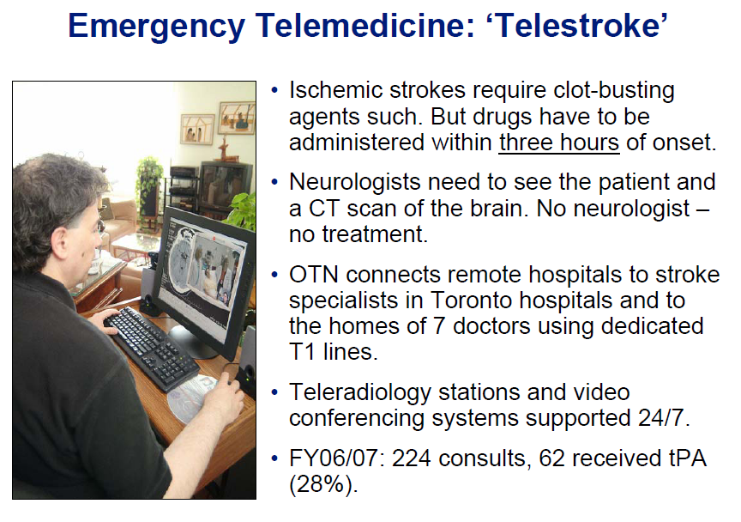
Ontario THE Network
.
Notes:
Tissue plasminogen activator (abbreviated tPA or PLAT) is a protein involved in the breakdown of blood clots. Specifically, it is a serine protease (EC 3.4.21.68) found on endothelial cells, the cells that line the blood vessels. As an enzyme, it catalyzes the conversion of plasminogen to plasmin, the major enzyme responsible for clot breakdown. Because it works on the clotting system, tPA is used in clinical medicine to treat stroke.

Slide 25

Questions?

