Slide 1
ECG Signal processing (2)
ECE, UA

Slide 2
Content
Introduction
Support Vector Machines
Active Learning Methods
Experiments & Results
Conclusion

Slide 3
Introduction
ECG signals represent a useful information source about the rhythm and functioning of the heart.
To obtain an efﬁcient and robust ECG classiﬁcation system
SVM classiﬁer has a good generalization capability and is less sensitive to the curse of dimensionality.
Automatic construction of the set of training samples – active learning

Slide 4
Support Vector Machines
the classifier is said to assign a feature vector x to class w_{I} if
For two-category case,
An example
Minimum-Error-Rate Classifier

Slide 5
Discriminant Function
It can be arbitrary functions of x, such as:
Nearest
Neighbor
Decision
Tree
Linear
Functions
Nonlinear
Functions

Slide 6
Linear Discriminant Function
g(x) is a linear function:
x₂
w^{T} x + b > 0
A hyper-plane in the feature space
w^{T} x + b = 0
n
(Unit-length) normal vector of the hyper-plane:
w^{T} x + b < 0
x₁

Slide 7
Linear Discriminant Function
denotes +1
denotes -1
How would you classify these points using a linear discriminant function in order to minimize the error rate?
x₂
Infinite number of answers!
x₁

Slide 8
Linear Discriminant Function
denotes +1
denotes -1
How would you classify these points using a linear discriminant function in order to minimize the error rate?
x₂
Infinite number of answers!
x₁

Slide 9
Linear Discriminant Function
denotes +1
denotes -1
How would you classify these points using a linear discriminant function in order to minimize the error rate?
x₂
Infinite number of answers!
x₁

Slide 10
Linear Discriminant Function
denotes +1
denotes -1
How would you classify these points using a linear discriminant function in order to minimize the error rate?
x₂
Infinite number of answers!
Which one is the best?
x₁

Slide 11
Large Margin Linear Classifier
denotes +1
denotes -1
The linear discriminant function (classifier) with the maximum margin is the best
x₂
Margin
“safe zone”
Margin is defined as the width that the boundary could be increased by before hitting a data point
Why it is the best?
Robust to outliners and thus strong generalization ability
x₁

Slide 12
Large Margin Linear Classifier
denotes +1
denotes -1
Given a set of data points:
x₂
, where
With a scale transformation on both w and b, the above is equivalent to
x₁

Slide 13
Large Margin Linear Classifier
denotes +1
denotes -1
We know that
x₂
Margin
x⁺
w^{T} x + b = 1
x⁺
w^{T} x + b = 0
w^{T} x + b = -1
The margin width is:
n
x⁻
Support Vectors
x₁

Slide 14
Large Margin Linear Classifier
denotes +1
denotes -1
Formulation:
x₂
Margin
x⁺
w^{T} x + b = 1
such that
x⁺
w^{T} x + b = 0
w^{T} x + b = -1
n
x⁻
x₁

Slide 15
Large Margin Linear Classifier
denotes +1
denotes -1
Formulation:
x₂
Margin
x⁺
w^{T} x + b = 1
such that
x⁺
w^{T} x + b = 0
w^{T} x + b = -1
n
x⁻
x₁

Slide 16
Large Margin Linear Classifier
denotes +1
denotes -1
Formulation:
x₂
Margin
x⁺
w^{T} x + b = 1
such that
x⁺
w^{T} x + b = 0
w^{T} x + b = -1
n
x⁻
x₁

Slide 17
Solving the Optimization Problem
Quadratic programming
with linear constraints
s.t.
Lagrangian
Function
s.t.

Slide 18
Solving the Optimization Problem
s.t.

Slide 19
Solving the Optimization Problem
s.t.
Lagrangian Dual
Problem
s.t.
, and

Slide 20
Solving the Optimization Problem
From KKT condition, we know:
x₂
x⁺
w^{T} x + b = 1
w^{T} x + b = 0
Thus, only support vectors have
x⁺
w^{T} x + b = -1
x⁻
The solution has the form:
Support Vectors
x₁

Slide 21
Solving the Optimization Problem
The linear discriminant function is:
Notice it relies on a dot product between the test point x and the support vectors x_{i}
Also keep in mind that solving the optimization problem involved computing the dot products x_{i}^{T}x_{j} between all pairs of training points

Slide 22
Large Margin Linear Classifier
denotes +1
denotes -1
What if data is not linear separable? (noisy data, outliers, etc.)
x₂
Slack variables ξ_{i} can be added to allow mis-classification of difficult or noisy data points
w^{T} x + b = 1
w^{T} x + b = 0
w^{T} x + b = -1
x₁

Slide 23
Large Margin Linear Classifier
Formulation:
such that
Parameter C can be viewed as a way to control over-fitting.

Slide 24
Large Margin Linear Classifier
Formulation: (Lagrangian Dual Problem)
such that

Slide 25
Non-linear SVMs
Datasets that are linearly separable with noise work out great:
0
x
But what are we going to do if the dataset is just too hard?
0
x
How about… mapping data to a higher-dimensional space:
x²
0
x
This slide is courtesy of www.iro.umontreal.ca/~pift6080/documents/papers/svm_tutorial.ppt

Slide 26
Non-linear SVMs: Feature Space
General idea: the original input space can be mapped to some higher-dimensional feature space where the training set is separable:
Φ: x → φ(x)
This slide is courtesy of www.iro.umontreal.ca/~pift6080/documents/papers/svm_tutorial.ppt

Slide 27
Nonlinear SVMs: The Kernel Trick
With this mapping, our discriminant function is now:
No need to know this mapping explicitly, because we only use the dot product of feature vectors in both the training and test.
A kernel function is defined as a function that corresponds to a dot product of two feature vectors in some expanded feature space:

Slide 28
Nonlinear SVMs: The Kernel Trick
An example:
2-dimensional vectors x=[x₁ x₂];
let K(x_{i},x_{j})=(1 + x_{i}^{T}x_{j})²,
Need to show that K(x_{i},x_{j}) = φ(x_{i}) ^{T}φ(x_{j}):
K(x_{i},x_{j})=(1 + x_{i}^{T}x_{j})²,
= 1+ x_{i1}²x_{j1}² + 2 x_{i1}x_{j1} x_{i2}x_{j2}+ x_{i2}²x_{j2}² + 2x_{i1}x_{j1} + 2x_{i2}x_{j2}
= [1 x_{i1}² √2 x_{i1}x_{i2} x_{i2}² √2x_{i1} √2x_{i2}]^{T} [1 x_{j1}² √2 x_{j1}x_{j2} x_{j2}² √2x_{j1} √2x_{j2}]
= φ(x_{i}) ^{T}φ(x_{j}), where φ(x) = [1 x₁² √2 x₁x₂ x₂² √2x₁ √2x₂]
This slide is courtesy of www.iro.umontreal.ca/~pift6080/documents/papers/svm_tutorial.ppt

Slide 29
Nonlinear SVMs: The Kernel Trick
Examples of commonly-used kernel functions:
Linear kernel:
Polynomial kernel:
Gaussian (Radial-Basis Function (RBF) ) kernel:
Sigmoid:
In general, functions that satisfy Mercer’s condition can be kernel functions.

Slide 30
Nonlinear SVM: Optimization
Formulation: (Lagrangian Dual Problem)
such that
The solution of the discriminant function is
The optimization technique is the same.

Slide 31
Support Vector Machine: Algorithm
1. Choose a kernel function
2. Choose a value for C
3. Solve the quadratic programming problem (many software packages available)
4. Construct the discriminant function from the support vectors

Slide 32
Some Issues
Choice of kernel
- Gaussian or polynomial kernel is default
- if ineffective, more elaborate kernels are needed
- domain experts can give assistance in formulating appropriate similarity measures
Choice of kernel parameters
- e.g. σ in Gaussian kernel
- σ is the distance between closest points with different classifications
- In the absence of reliable criteria, applications rely on the use of a validation set or cross-validation to set such parameters.
Optimization criterion – Hard margin v.s. Soft margin
- a lengthy series of experiments in which various parameters are tested
This slide is courtesy of www.iro.umontreal.ca/~pift6080/documents/papers/svm_tutorial.ppt

Slide 33
Summary: Support Vector Machine
1. Large Margin Classifier
Better generalization ability & less over-fitting
2. The Kernel Trick
Map data points to higher dimensional space in order to make them linearly separable.
Since only dot product is used, we do not need to represent the mapping explicitly.

Slide 34
Active Learning Methods
Choosing samples properly so that to maximize the accuracy of the classiﬁcation process
Margin Sampling
Posterior Probability Sampling
Query by Committee

Slide 35
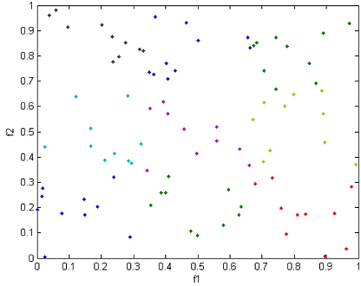
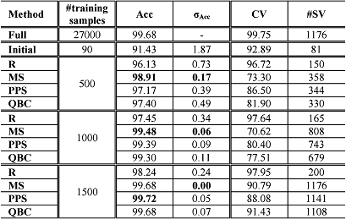
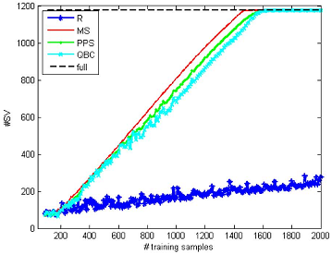
Experiments & Results
Simulated Data
chessboard problem
linear and radial basis
function (RBF) kernels

Slide 36
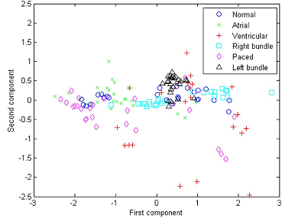
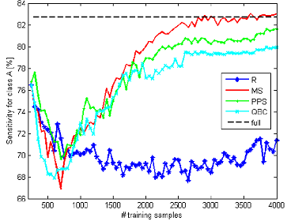
Experiments & Results
B. Real Data
MIT-BIH, morphology three ECG temporal features

Slide 37
Conclusion
Three active learning strategies for the SVM classiﬁcation of electrocardiogram (ECG) signals have been presented.
Strategy based on the MS principle seems the best as it quickly selects the most informative samples.
A further increase of the accuracies could be achieved by feeding the classiﬁer with other kinds of features

