Slide 1
ECG SIGNAL RECOGNIZATION AND APPLICAITIONS
ECE, UA

Slide 2
12 Lead ECG Interpretation

Slide 3
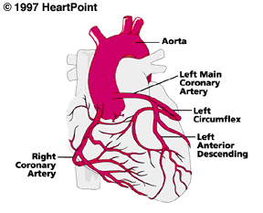
Anatomy Revisited
RCA
  right ventricle
  inferior wall of LV
  posterior wall of LV (75%)
  SA Node (60%)
  AV Node (>80%)
LCA
  septal wall of LV
  anterior wall of LV
  lateral wall of LV
  posterior wall of LV (10%)

Slide 4
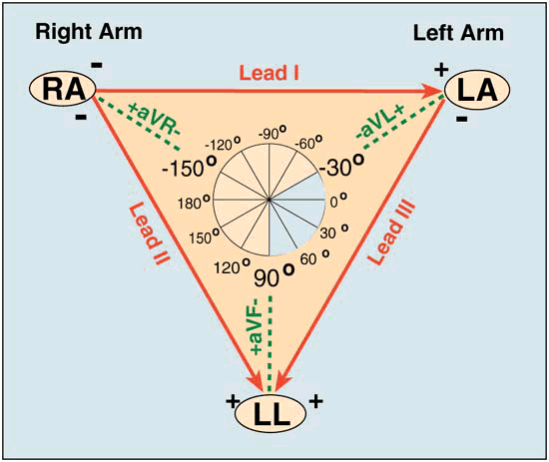
Unipolar Leads
1 positive electrode & 1 negative “reference point”
  calculated by using summation of 2 negative leads
Augmented Limb Leads
  aVR, aVF, aVL
  view from a vertical plane
Precordial or Chest Leads
  V1-V6
  view from a horizontal plane

Slide 5
Waveform Components:
R Wave
First positive deflection; R wave includes the downstroke returning to the baseline

Slide 6
Waveform Components:
Q Wave
First negative deflection before R wave; Q wave includes the negative downstroke & return to baseline

Slide 7
Waveform Components:
S Wave
Negative deflection following the R wave; S wave includes departure from & return to baseline

Slide 8
Waveform Components:
QRS
Q waves
  Can occur normally in several leads
    Normal Q waves called physiologic
  Physiologic Q waves
    < .04 sec (40ms)
  Pathologic Q
    >.04 sec (40 ms)

Slide 9
Waveform Components:
QRS
Q wave
  Measure width
  Pathologic if greater than or equal to 0.04 seconds (1 small box)

Slide 10
Waveform Components:
QS Complex
Entire complex is negatively deflected; No R wave present

Slide 11
Waveform Components:
J-Point
Junction between end of QRS and beginning of ST segment; Where QRS stops & makes a sudden sharp change of direction

Slide 12
Waveform Components:
ST Segment
Segment between J-point and beginning of T wave

Slide 13
Lead Groups
I aVR V1 V4
II aVL V2 V5
III aVF V3 V6
Limb Leads
Chest Leads

Slide 14
Review of Leads
EKG Leads
  EKG machines record the electrical activity.
    Precordial leads or chest leads [ V1, V2, V3, V4, V5, V6 ] view the hearts horizontal plane
    The heart acts as a central point of the cross section and the electrical current flows from the central point out to each of the V leads

Slide 15
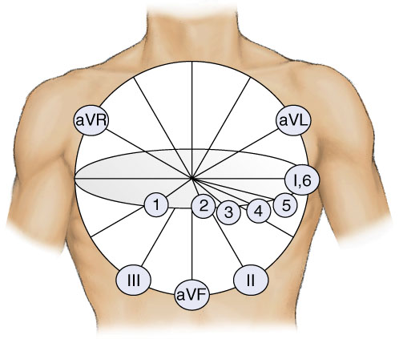
12-Lead View in perspectives
Axis Deviation
Bundle Branch Blocks

Slide 16
Arrhythmias
Sinus Rhythms
Premature Beats
Supraventricular Arrhythmias
Ventricular Arrhythmias
AV Junctional Blocks

Slide 17
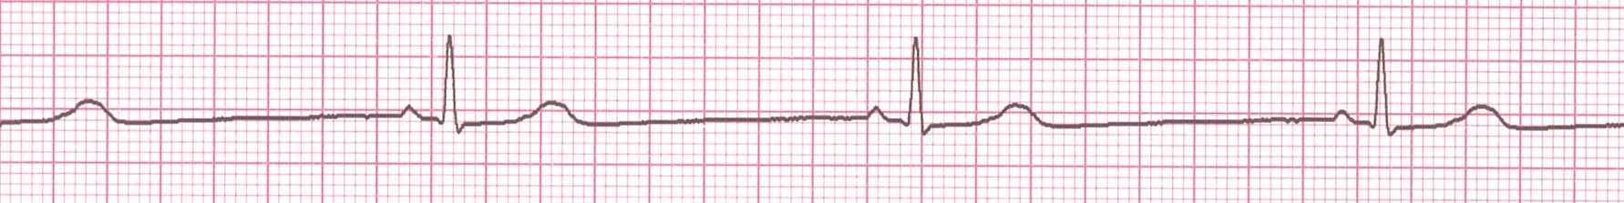
Rhythm #1
Rate?
30 bpm
Regularity?
regular
P waves?
normal
PR interval?
0.12 s
QRS duration?
0.10 s
Interpretation?
Sinus Bradycardia

Slide 18
Sinus Bradycardia
Deviation from NSR
- Rate < 60 bpm

Slide 19

Rhythm #2
Rate?
130 bpm
Regularity?
regular
P waves?
normal
PR interval?
0.16 s
QRS duration?
0.08 s
Interpretation?
Sinus Tachycardia

Slide 20
Sinus Tachycardia
Deviation from NSR
- Rate > 100 bpm

Slide 21
Premature Beats
Premature Atrial Contractions (PACs)
Premature Ventricular Contractions (PVCs)

Slide 22
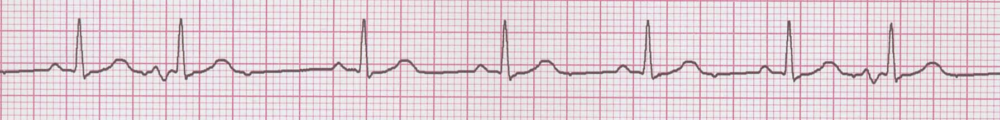
Rhythm #3
Rate?
70 bpm
Regularity?
occasionally irreg.
P waves?
2/7 different contour
PR interval?
0.14 s (except 2/7)
QRS duration?
0.08 s
Interpretation?
NSR with Premature Atrial Contractions

Slide 23
Premature Atrial Contractions
Deviation from NSR
  These ectopic beats originate in the atria (but not in the SA node), therefore the contour of the P wave, the PR interval, and the timing are different than a normally generated pulse from the SA node.

Slide 24
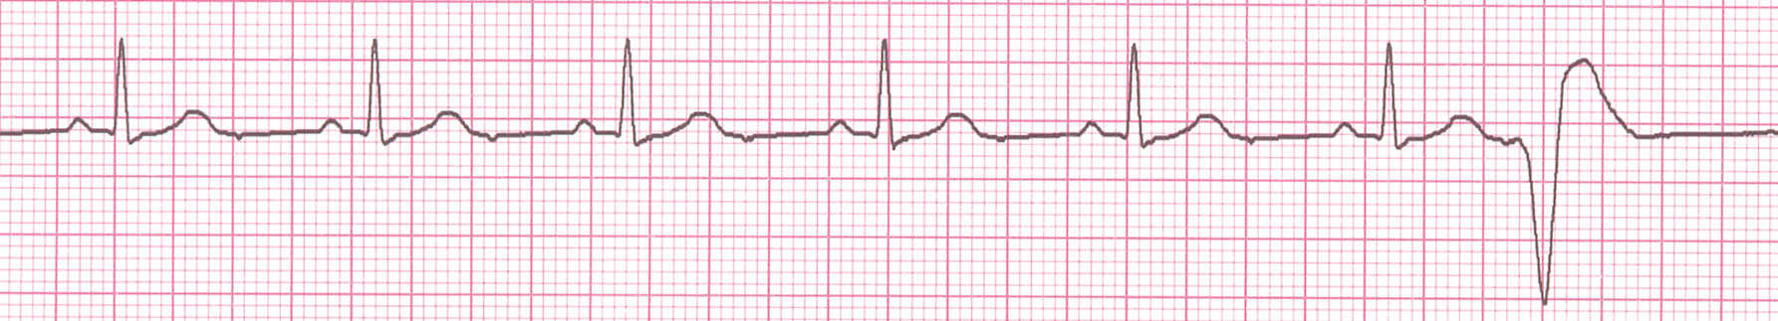
Rhythm #4
Rate?
60 bpm
Regularity?
occasionally irreg.
P waves?
none for 7th QRS
PR interval?
0.14 s
QRS duration?
0.08 s (7th wide)
Interpretation?
Sinus Rhythm with 1 PVC

Slide 25
PVCs
Deviation from NSR
  Ectopic beats originate in the ventricles resulting in wide and bizarre QRS complexes.
  When there are more than 1 premature beats and look alike, they are called “uniform”. When they look different, they are called “multiform”.

Slide 26
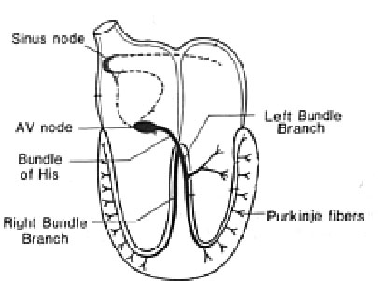
Ventricular Conduction
Normal
Signal moves rapidly through the ventricles
Abnormal
Signal moves slowly through the ventricles

Slide 27
Data Mining and Medical Informatics

Slide 28
The Data Pyramid
Value
Wisdom
(Knowledge + experience)
How can we improve it ?
Knowledge
(Information + rules)
What made it that unsuccessful ?
Volume
Information
(Data + context)
What was the lowest selling
product ?
Data
How many units were sold
of each product line ?

Slide 29
Data Mining Functions
Clustering into ‘natural’ groups (unsupervised)
Classification into known classes; e.g. diagnosis (supervised)
Detection of associations; e.g. in basket analysis:
”70% of customers buying bread also buy milk”
Detection of sequential temporal patterns; e.g. disease development
Prediction or estimation of an outcome
Time series forecasting

Slide 30
Data Mining Techniques
(box of tricks)
Statistics
Linear Regression
Visualization
Cluster analysis
Older,
Data preparation,
Exploratory
Decision trees
Rule induction
Neural networks
Abductive networks
Newer, Modeling,
Knowledge Representation

Slide 31
Data-based Predictive Modeling
1
Develop Model
With Known Cases
2
Use Model
For New Cases
IN
OUT
IN
OUT
Attributes, X
F(X)
Diagnosis, Y
Attributes
(X)
Rock
Properties
Diagnosis
(Y)
Determine F(X)
Y = F(X)

Slide 32
Data-based Predictive Modeling by supervised Machine learning
Database of solved examples (input-output)
Preparation: cleanup, transform, add new attributes...
Split data into a training and a test set
Training:
Develop model on the training set
Evaluation:
See how the model fares on the test set
Actual use:
Use successful model on new input data to estimate unknown output

Slide 33
The Neural Network (NN) Approach
Input Layer
HiddenLayer
Output Layer
Age
34
.6
.4
Neurons
Actual: 0.65
.2
Σ
.5
0.60
.1
Gender
2
Σ
.3
.2
.7
Σ
.8
Stage
4
.2
Error: 0.05
Transfer Function
Weights
Weights
Dependent Output Variable
Independent Input Variables (Attributes)
Error back-propagation

Slide 34
Medicine revolves on
Pattern Recognition, Classification, and Prediction
Diagnosis:
Recognize and classify patterns in multivariate
patient attributes
Therapy:
Select from available treatment methods; based on
effectiveness, suitability to patient, etc.
Prognosis:
Predict future outcomes based on previous
experience and present conditions

Slide 35
Need for Data Mining in Medicine
Nature of medical data: noisy, incomplete, uncertain, nonlinearities, fuzziness ⇒ Soft computing
Too much data now collected due to computerization (text, graphs, images,…)
Too many disease markers (attributes) now available for decision making
Increased demand for health services: (Greater awareness, increased life expectancy, …)
- Overworked physicians and facilities
Stressful work conditions in ICUs, etc.

Slide 36
Medical Applications
Screening
Diagnosis
Therapy
Prognosis
Monitoring
Biomedical/Biological Analysis
Epidemiological Studies
Hospital Management
Medical Instruction and Training

Slide 37
Diagnosis and Classification
Assist in decision making with a large number of inputs and in stressful situations
Can perform automated analysis of:
- Pathological signals (ECG, EEG, EMG)
- Medical images (mammograms, ultrasound, X-ray, CT, and MRI)
Examples:
- Heart attacks, Chest pains, Rheumatic disorders
- Myocardial ischemia using the ST-T ECG complex
- Coronary artery disease using SPECT images

Slide 38
Diagnosis and Classification ECG Interpretation
R-R interval
QRS amplitude
SV tachycardia
QRS duration
V
entricular tachycardia
AVF lead
L
V hypertrophy
S-T elevation
R
V hypertrophy
P-R interval
Myocardial infarction

Slide 39
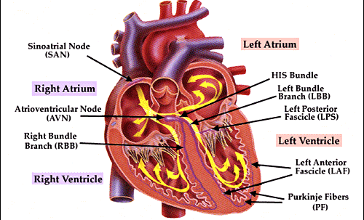
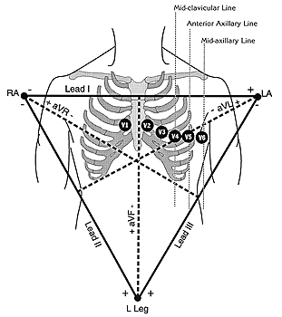
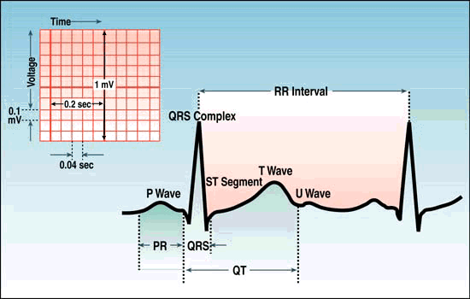
Biological Problem
Heart Physiology
ventricular repolarization
ECG
Simultaneously ventricular activation (depolarization)
Sequential atrial activation
(depolarization)
After depolarizations
in the ventricles
Outline

Slide 40
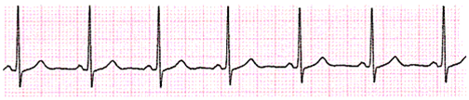
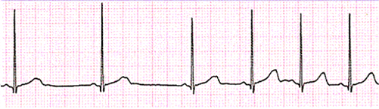
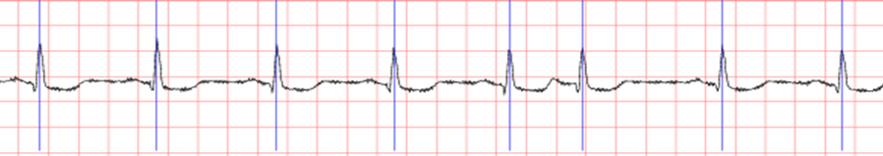

Biological Problem
ECG wave shape characterization
Difference In Wave Shape And Frequency :
REGULAR RHYTHM
Normal
IRREGULAR RHYTHM
Arrhythmia
P ,T AND U WAVE
INDISTINCT.
IRREGULAR RHYTHM
Ventricular
Arrhythmia
REGULAR RHYTHM
Bradycardia
Outline

Slide 41


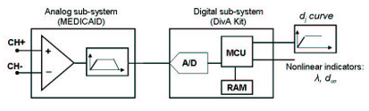
The Algorithm: time domain statistics
Outline

Slide 42
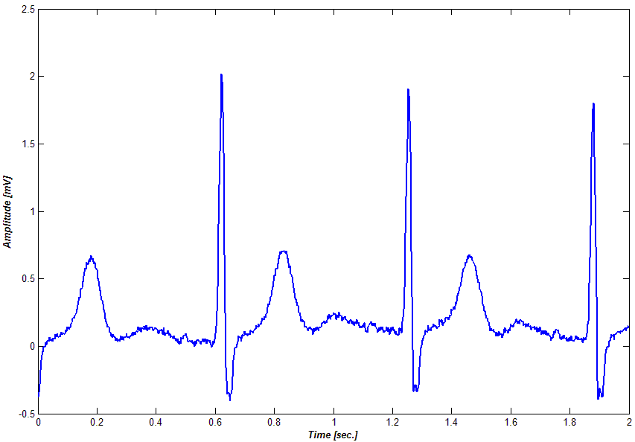
The Algorithm
Input Parameters
Three Initial
Conditions
d₀ range
Signal derivative
at the starting point
Number of Samples
for
Trajectors
Minimum Distance
between
Trajectories
Number of couples
of trajectories
Signal derivative
in initial condition
point
d range
0
Minimum Distance between trajectories
Outline

Slide 43

The Algorithm
From Discrete Map to d_{j}
Discrete
Map #1
Matrix of
Difference #1
d 1
j
Discrete
Map #2
Matrix of
Difference #2
d 2
j
Discrete
Map #3
Matrix of
Difference #3
d 3
j
Total Matrix
of Difference
d Totale
j
Outline

Slide 44
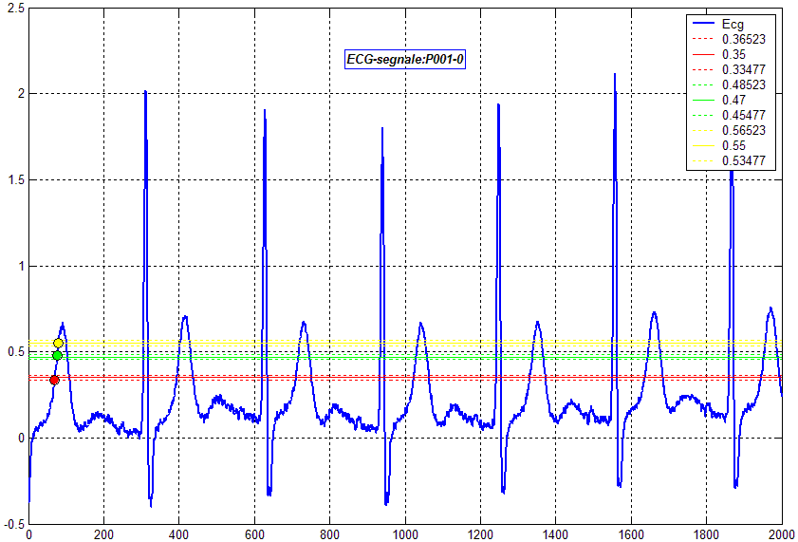
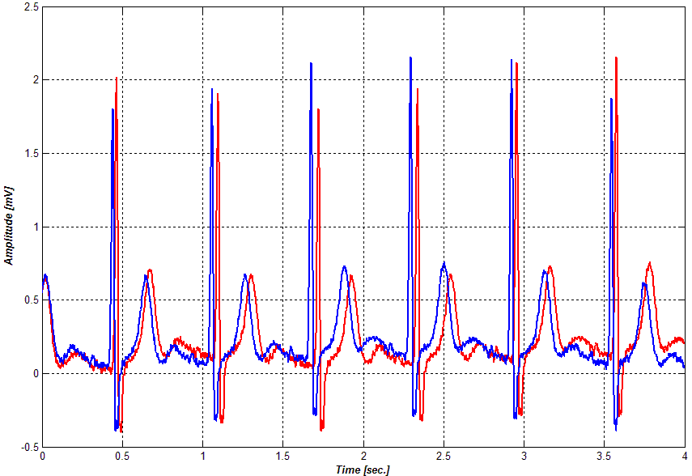
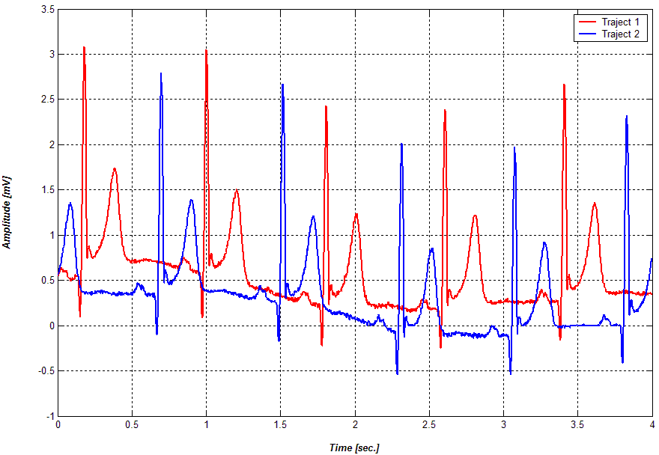
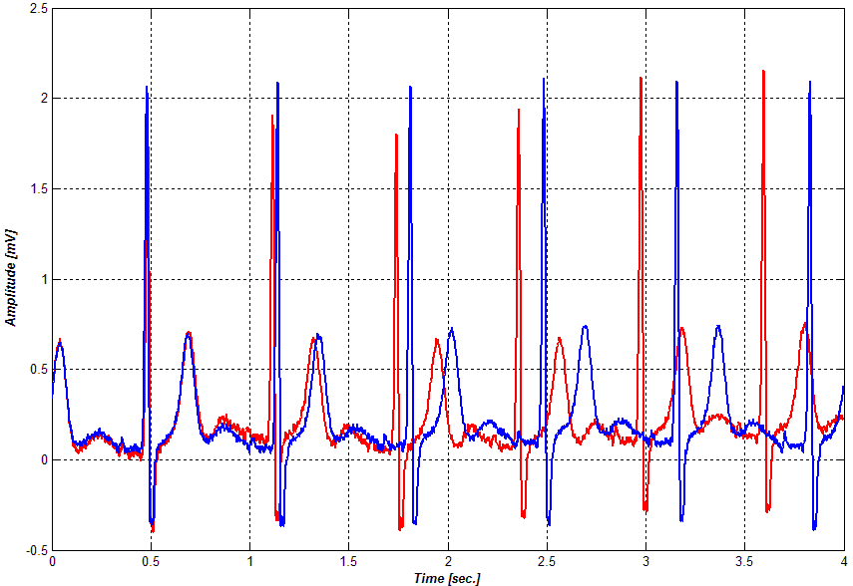
Parametric Study
Initial Condition
In P-wave choose the points in order to extract coherent trajectories
Outline

Slide 45
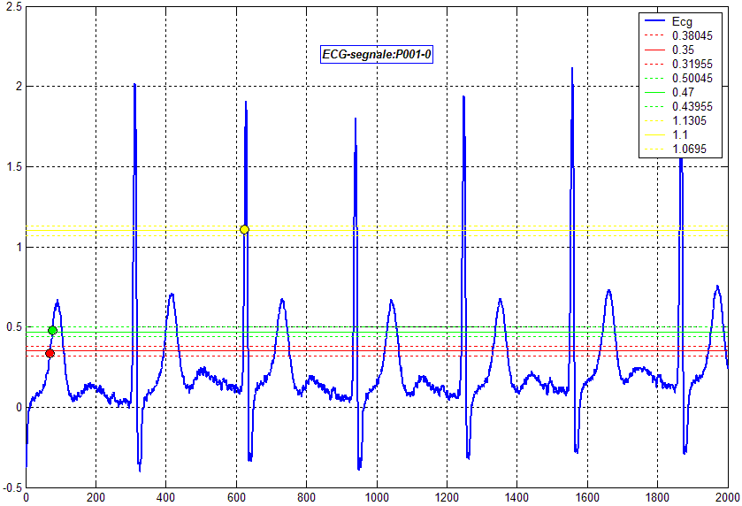
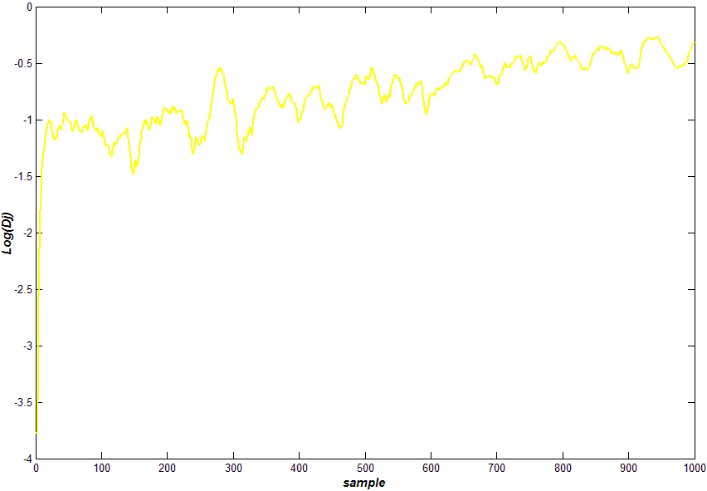
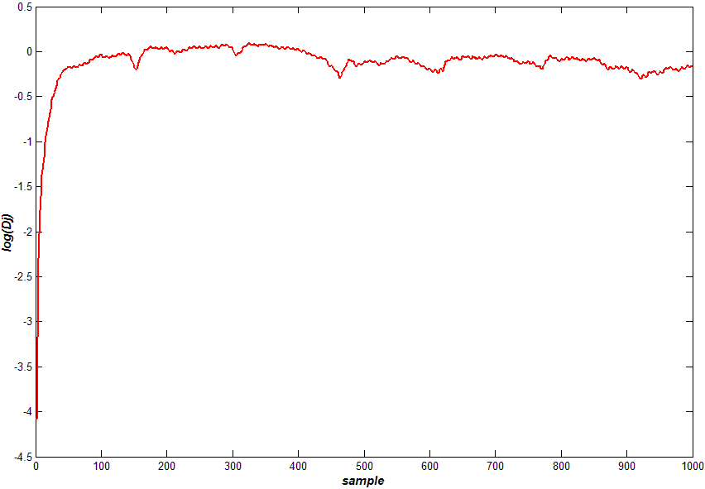
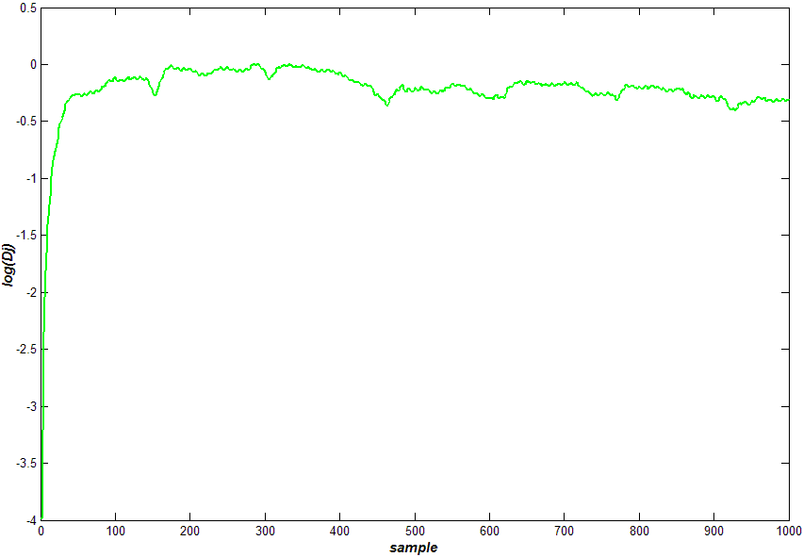
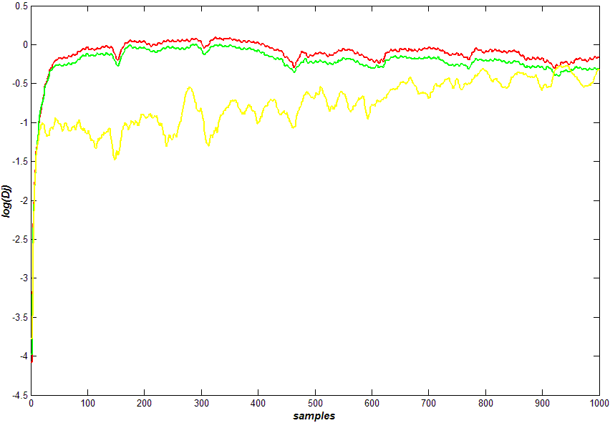
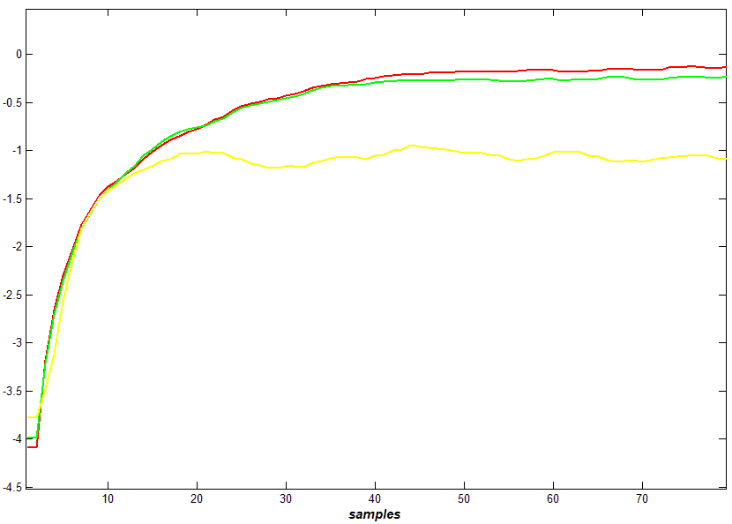
Parametric Study
Extraction of dj parameters
From points in P-wave extract dj that have asymptotic behaviour and present limited oscillation
Outline

Slide 46
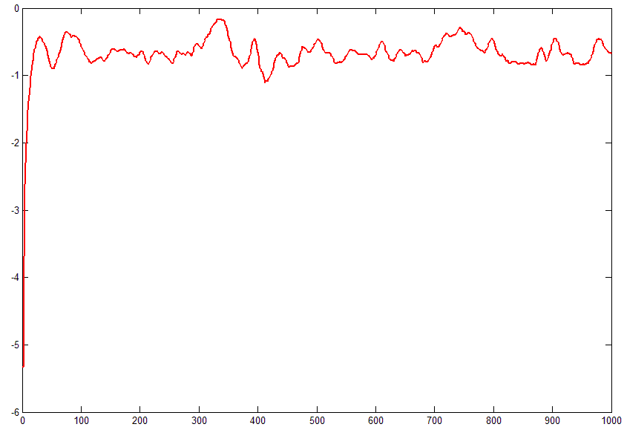
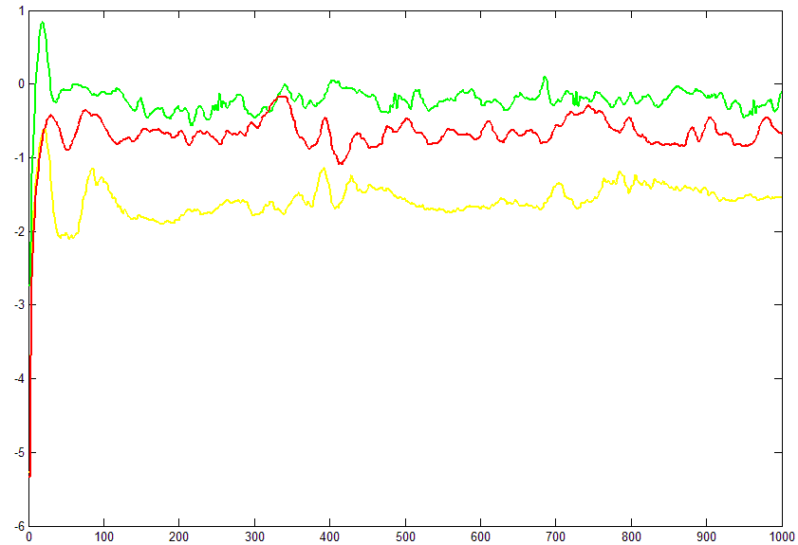
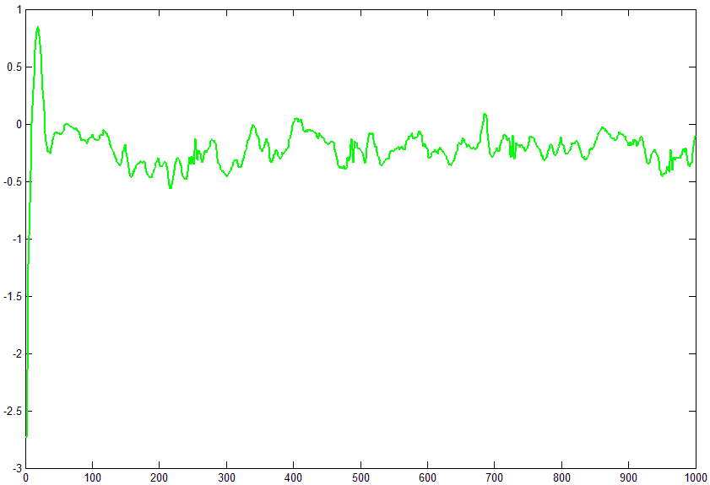
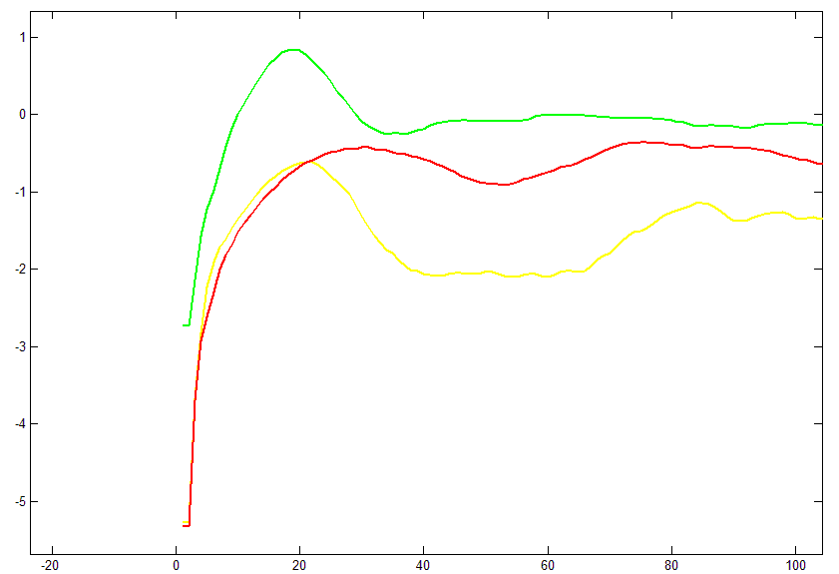
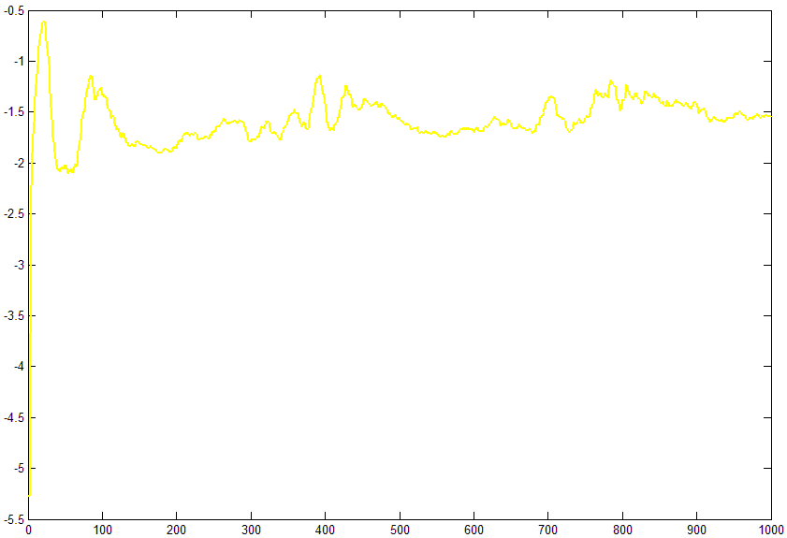
Results
Trend of d_{j}
d
d_{j} have a similar trend for the three cases but with different value.
j
Normal
Arrhythmia
Ventricular
Arrhythmia
Initial
Slope
Results

Slide 47
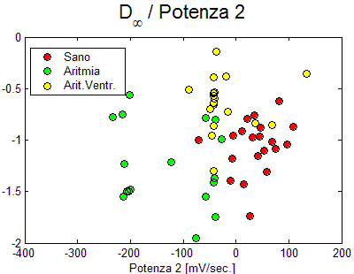
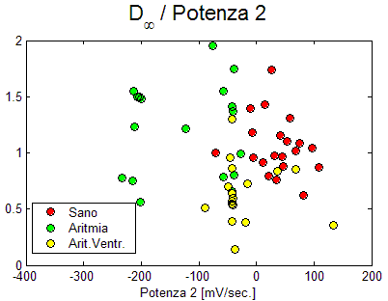
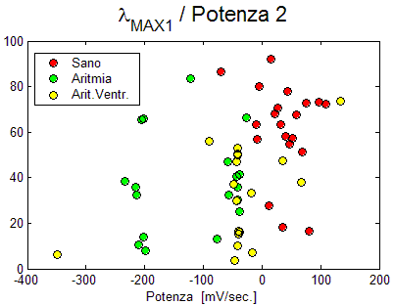
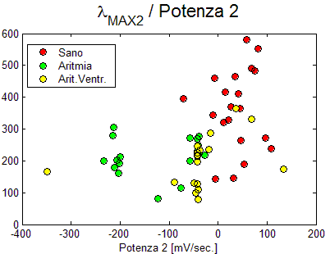
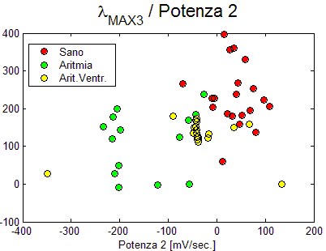
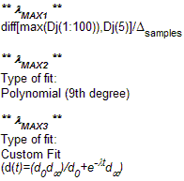

Results
(d∞ - λ_{MAX}) vs Power₂
| |
Normal
Arrhythmia
Ventricular
Arrhythmia
Best proportionality
between |d∞ | and λ
Results

Slide 48
Future Development
2
1
Algoritm of Automatic clustering
for 3D graphics
Initial conditions obtained by
visual inspection on the P-wave
Possible
Solution
Operator Dependent
Neural Network for P-wave
recognition
Automatic search of initial conditions
Outline

Slide 49
Conclusions
The asymptotic distance between trajectories, d∞, has been obtained from computation of d_{j}
dj trend is similar to one reported in literature on Chaotic System
The study of the d∞ and the Lyapunov Exponent are performed
simultaneously
Theoretical study
Need more medical statistics and inputs!
Application
healthy
Biomedical Application:
Automatic Diagnostic
unhealthy
Outline

Slide 50
Attribute Selection: Information Gain
Select the attribute with the highest information gain
Let p_{i} be the probability that an arbitrary tuple in D belongs to class C_{i}, estimated by |C_{i, D}|/|D
Expected information (entropy) needed to classify a tuple in D:
Information needed (after using A to split D into v partitions) to classify D:
Information gained by branching on attribute A

Slide 51
Classification Function of Ensemble Classifier
…
f₂(x)
f₃(x)
f₁(x)
f_{n}(x)
∑
Weighted
Sum
a_{i} : weight for Tree i
f_{i}(x) : classification of Tree i
f(x) =
∑_{i}
a_{i}
f_{i}(x)

Slide 52
Factor and Component Analysis
Principal Component Analysis (PCA)

Slide 53
Why Factor or Component Analysis?
We have too many observations and dimensions
  To reason about or obtain insights from
  To visualize
  Too much noise in the data
  Need to “reduce” them to a smaller set of factors
  Better representation of data without losing much information
  Can build more effective data analyses on the reduced-dimensional space: classification, clustering, pattern recognition
Combinations of observed variables may be more effective bases for insights, even if physical meaning is obscure

Slide 54
Basic Concept
What if the dependences and correlations are not so strong or direct?
And suppose you have 3 variables, or 4, or 5, or 10000?
Look for the phenomena underlying the observed covariance/co-dependence in a set of variables
  Once again, phenomena that are uncorrelated or independent, and especially those along which the data show high variance
These phenomena are called “factors” or “principal components” or “independent components,” depending on the methods used
  Factor analysis: based on variance/covariance/correlation
  Independent Component Analysis: based on independence

Slide 55
Principal Component Analysis
Most common form of factor analysis
The new variables/dimensions
  Are linear combinations of the original ones
  Are uncorrelated with one another
    Orthogonal in original dimension space
  Capture as much of the original variance in the data as possible
  Are called Principal Components

Slide 56
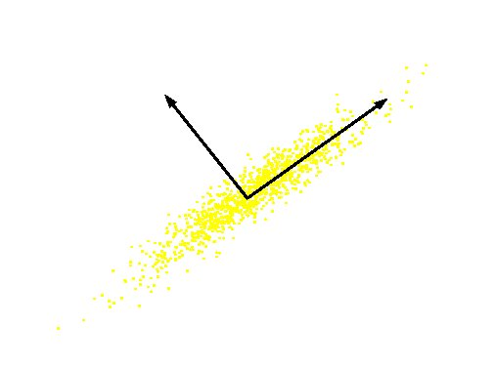
What are the new axes?
Original Variable B
PC 2
PC 1
Original Variable A
Orthogonal directions of greatest variance in data
Projections along PC1 discriminate the data most along any one axis

Slide 57
Principal Components
First principal component is the direction of greatest variability (covariance) in the data
Second is the next orthogonal (uncorrelated) direction of greatest variability
  So first remove all the variability along the first component, and then find the next direction of greatest variability
And so on …

Slide 58
Computing the Components
Data points are vectors in a multidimensional space
Projection of vector x onto an axis (dimension) u is u.x
Direction of greatest variability is that in which the average square of the projection is greatest
  I.e. u such that E((u.x)²) over all x is maximized
  (we subtract the mean along each dimension, and center the original axis system at the centroid of all data points, for simplicity)
  This direction of u is the direction of the first Principal Component

Slide 59
Computing the Components
E((u.x)²) = E ((u.x) (u.x)^{T}) = E (u.x.x ^{T}.u^{T})
The matrix C = x.x^{T} contains the correlations (similarities) of the original axes based on how the data values project onto them
So we are looking for w that maximizes uCu^{T}, subject to u being unit-length
It is maximized when w is the principal eigenvector of the matrix C, in which case
  uCu^{T} = uλu^{T} = λ if u is unit-length, where λ is the principal eigenvalue of the correlation matrix C
  The eigenvalue denotes the amount of variability captured along that dimension

Slide 60
Why the Eigenvectors?
Maximise u^{T}xx^{T}u s.t u^{T}u = 1
Construct Langrangian u^{T}xx^{T}u – λu^{T}u
Vector of partial derivatives set to zero
xx^{T}u – λu = (xx^{T} – λI) u = 0
As u ≠ 0 then u must be an eigenvector of xx^{T} with eigenvalue λ

Slide 61
Singular Value Decomposition
The first root is called the prinicipal eigenvalue which has an associated orthonormal (u^{T}u = 1) eigenvector u
Subsequent roots are ordered such that λ₁> λ₂ >… > λ_{M} with rank(D) non-zero values.
Eigenvectors form an orthonormal basis i.e. u_{i}^{T}u_{j} = δ_{ij}
The eigenvalue decomposition of xx^{T} = UΣU^{T}
where U = [u₁, u₂, …, u_{M}] and Σ = diag[λ ₁, λ ₂, …, λ _{M}]
Similarly the eigenvalue decomposition of x^{T}x = VΣV^{T}
The SVD is closely related to the above x=U Σ^{1/2} V^{T}
The left eigenvectors U, right eigenvectors V,
singular values = square root of eigenvalues.

Slide 62
Computing the Components
Similarly for the next axis, etc.
So, the new axes are the eigenvectors of the matrix of correlations of the original variables, which captures the similarities of the original variables based on how data samples project to them
Geometrically: centering followed by rotation
  Linear transformation

Slide 63
Using LSI (Latent Semantic Indexing)
M
U
S
V^{t}
U_{k}
V_{k}^{t}
⇒
S_{k}
Recreate Matrix:
Multiply to produce
approximate term-
document matrix.
Use new matrix to
process queries
OR, better, map query to
reduced space
Singular Value
Decomposition
(SVD):
Convert term-document
matrix into 3matrices
U, S and V
Reduce Dimensionality:
Throw out low-order
rows and columns

Slide 64
What LSI can do
LSI analysis effectively does
  Dimensionality reduction
  Noise reduction
  Exploitation of redundant data
  Correlation analysis and Query expansion (with related words)
Some of the individual effects can be achieved with simpler techniques (e.g. thesaurus construction). LSI does them together.
LSI handles synonymy well, not so much polysemy
Challenge: SVD is complex to compute (O(n³))
  Needs to be updated as new documents are found/updated

Slide 65
Limitations of PCA
Should the goal be finding independent rather than pair-wise uncorrelated dimensions
Independent Component Analysis (ICA)
ICA
PCA

Slide 66
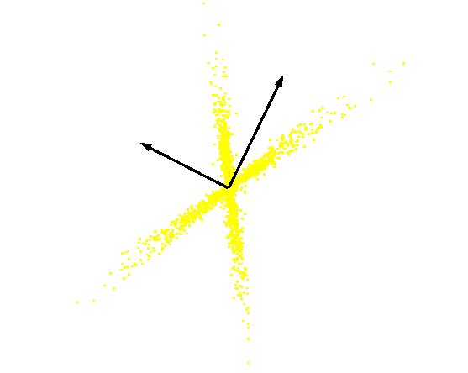
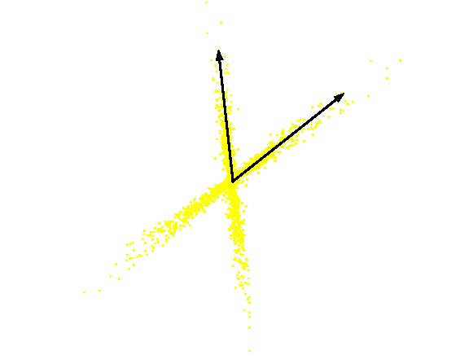
PCA vs ICA
PCA
(orthogonal coordinate)
ICA
(non-orthogonal coordinate)

Slide 67
PCA applications -Eigenfaces
To generate a set of eigenfaces:
Large set of digitized images of human faces is taken under the same lighting conditions.
The images are normalized to line up the eyes and mouths.
The eigenvectors of the covariance matrix of the statistical distribution of face image vectors are then extracted.
These eigenvectors are called eigenfaces.

Slide 68
Source Separation Using ICA
Microphone 1
Separation 1
W11
+
W21
W12
Microphone 2
Separation 2
W22
+

Slide 69


The ICA model
s₁
s₃
s₄
s₂
x_{i}(t) = a_{i1}*s₁(t) +
a_{i2}*s₂(t) +
a_{i3}*s₃(t) +
a_{i4}*s₄(t)
Here, i=1:4.
In vector-matrix notation, and dropping index t, this is
x = A * s
a₁₂
a₁₃
a₁₁
a₁₄
x₁
x₂
x₃
x₄

Slide 70
Application domains of ICA
Blind source separation
Image denoising
Medical signal processing – fMRI, ECG, EEG
Modelling of the hippocampus and visual cortex
Feature extraction, face recognition
Compression, redundancy reduction
Watermarking
Clustering
Time series analysis (stock market, microarray data)
Topic extraction
Econometrics: Finding hidden factors in financial data

Slide 71
Feature Extraction in ECG data
(Raw Data)

Slide 72
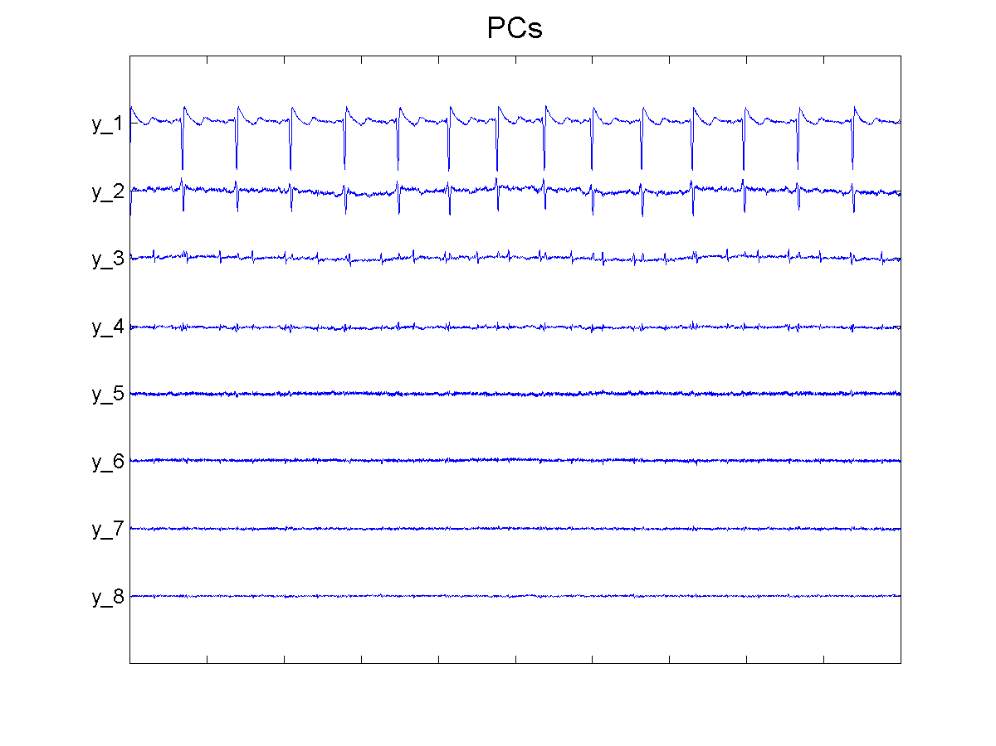
Feature Extraction in ECG data
(PCA)

Slide 73
Feature Extraction in ECG data (Extended ICA)

Slide 74
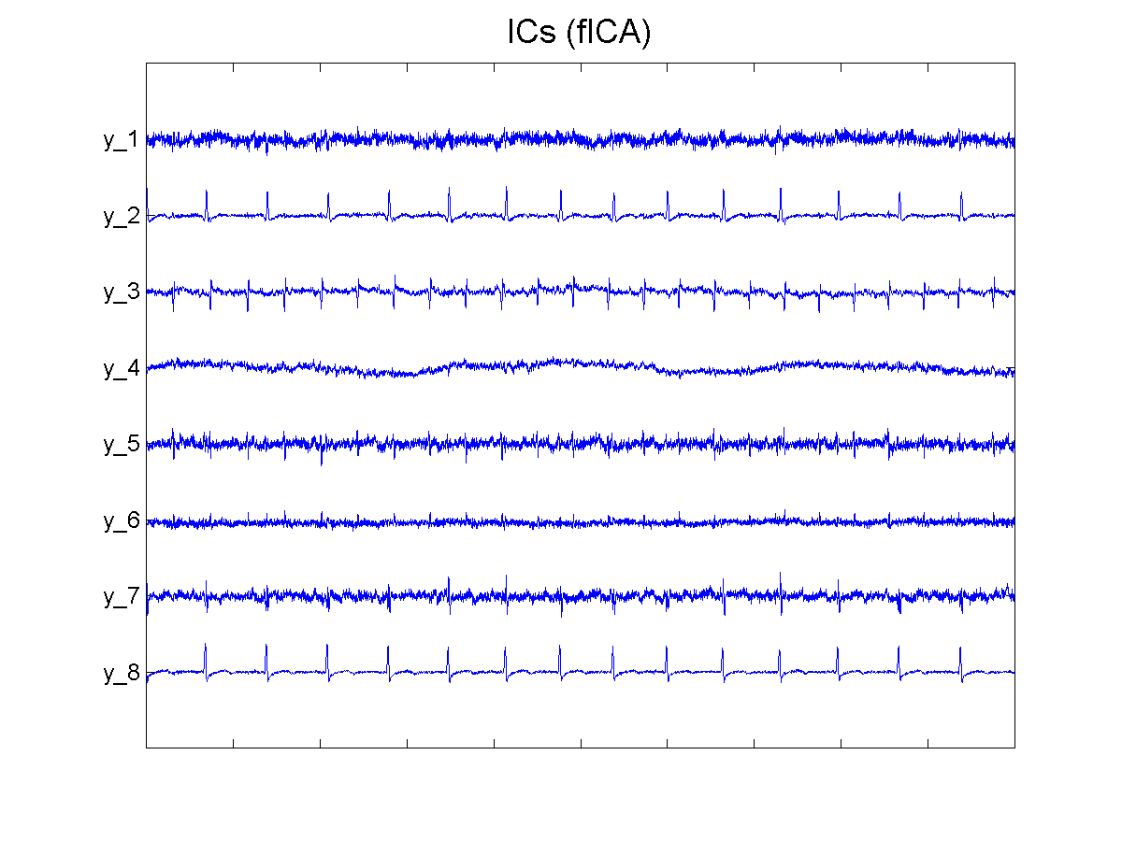
Feature Extraction in ECG data
(flexible ICA)

Slide 75
PCA vs ICA
Linear Transform
  Compression
  Classification
PCA
  Focus on uncorrelated and Gaussian components
  Second-order statistics
  Orthogonal transformation
ICA
  Focus on independent and non-Gaussian components
  Higher-order statistics
  Non-orthogonal transformation

Slide 76
Gaussians and ICA
If some components are gaussian and some are non-gaussian.
  Can estimate all non-gaussian components
  Linear combination of gaussian components can be estimated.
  If only one gaussian component, model can be estimated
ICA sometimes viewed as non-Gaussian factor analysis

Slide 77
Detection of Ischemic ST segment Deviation Episode in the ECG
Reflection of Ischemia in ECG:
ST segment deviation
Elevation
Depression
T wave Inversion

Slide 78
System Architecture

Slide 79
Detection of Ischemic ST segment Deviation Episode in the ECG
EDC Database Subject #e1301 Isoelectric level

Slide 80
Detection of Ischemic ST segment Deviation Episode in the ECG
PCA( Principal component analysis):
Procedure:
Project the data as 1-dimensional Data sets
Subtract mean of the data from each data set
Combine the mean centered data sets (mean centered matrix)
Multiply the mean centered matrix by it’s transpose (Covariance matrix)

Slide 81
Detection of Ischemic ST segment Deviation Episode in the ECG
PCA( Principal component analysis):
Procedure:
5. This covariance matrix has up to P eigenvectors associated with non-zero eigenvalues.
6. Assuming P<N. The eigenvectors are sorted high to low.
7. The eigenvector associated with the largest eigenvalue is the eigenvector that finds the greatest variance in the data.

Slide 82
Detection of Ischemic ST segment Deviation Episode in the ECG
PCA( Principal component analysis):
Procedure:
Smallest eigenvalue is associated with the eigenvector that finds the least variance in the data.
According to a threshold Variance, reduce the dimensions by discarding the eigenvectors with variance less than that threshold.

Slide 83
Detection of Ischemic ST segment Deviation Episode in the ECG
Training Results
Lead | Total Beats | Training Beats | Cross-Validation Beats | Cross-Validation Error
MLIII | 73651 | 52493 | 20123 | 0.068%

Slide 84
Detection of Ischemic ST segment Deviation Episode in the ECG
Accuracy Parameters
TP (True Positives)
Target and predicted value both are positives.
FN (False Negative)
Target value is +ive and predicted one –ive.
FP (False Positive)
Target value is –ive and predicted one +ive.
TN (True Negative)
Target and predicted both are –ive.

Slide 85
Detection of Ischemic ST segment Deviation Episode in the ECG
Accuracy Parameters
Sensitivity
TP/(TP+FN)*100
Specificity
TN/(TN+FP)*100

Slide 86
Detection of Ischemic ST segment Deviation Episode in the ECG
MLIII Data
Lead | Total beats | Normal | Ischemic
MLIII | 184246 | 174830 | 9416
Training | 73651 | 68939 | 4712
Testing | 110595 | 105891 | 4704

Slide 87
Detection of Ischemic ST segment Deviation Episode in the ECG
MLIII Testing Results
Lead | No.0f Beats | Sensitivity | Specificity | Threshold
MLIII | 110595 | 21% | 99% | 0
MLIII | 110595 | 4% | 99% | 0.7
MLIII | 110595 | 76% | 72% | -0.7

Slide 88
Application of the Discrete Wavelet transform in Beat Rate Detection

Slide 89
Outline
Introduction to Wavelet Transform
Applications of the Discrete Wavelet Transform in Beat Rate Detection
  DWT Based Beat Rate Detection in ECG Analysis.
  Improved ECG Signal Analysis Using Wavelet and Feature.
Conclusion
Reference

Slide 90
Introduction to wavelet transform
Fourier transform is the well-known tool for signal processing.
    One limitation is that a Fourier transform can’t deal effectively with non-stationary signal.
Short time Fourier transform

Slide 91
Introduction to wavelet transform
The principle of wavelet transform is based on the concept of STFT and Uncertainly principle.
  A mother wavelet .
  Scaling and translating .
    Sub-wavelets
    Fourier transform

Slide 92
Introduction to wavelet transform
Continuous wavelet transform(CWT)
ICWT

Slide 93
Introduction to wavelet transform
Discrete wavelet transform(DWT)
  Sub-wavelets
IDWT

Slide 94
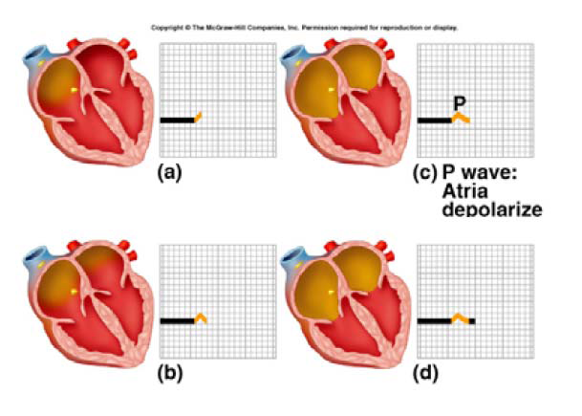
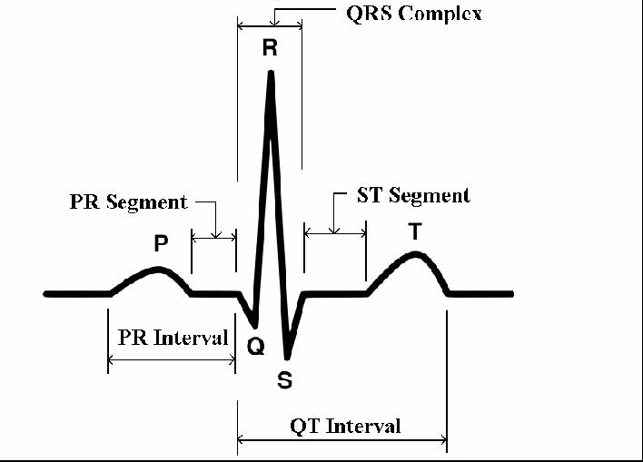
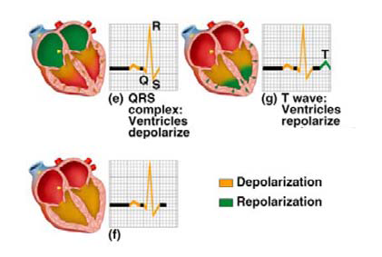
DWT Based Beat Rate
Detection in ECG Analysis
ECG(Electrocardiogram) signal

Slide 95
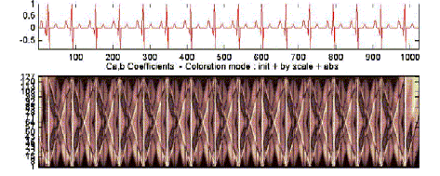
ECG signal [ bottom] and the Wavelet transform [top]

Slide 96
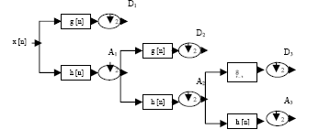
DWT Based Beat Rate
Detection in ECG Analysis
Preprocessing
  Denoising : The wavelet transform is used pre-filtering step for subsequent R spike detection by thresholding of the coefficients.
    Decomposition.
    Thresholding detail coefficients.
    Reconstruction.

Slide 97
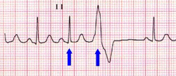
Improved ECG Signal Analysis Using Wavelet and Feature.
Some kinds of ECG signal:
Atrial premature beat
Normal beat
Premature ventricular contractions

Slide 98
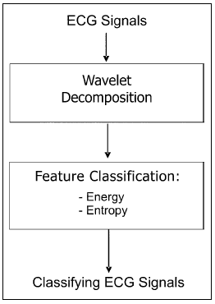
Improved ECG Signal Analysis Using Wavelet and Feature.
ECG signal analysis flow

Slide 99
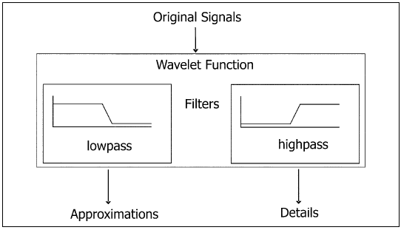
Improved ECG Signal Analysis Using Wavelet and Feature.
Feature Extraction
  Matlab : wpdec function, the wavelet ‘bior5.5’.

Slide 100
Improved ECG Signal Analysis Using Wavelet and Feature.
Feature Extraction
  Energy
  Normal Energy
  Entorpy

Slide 101
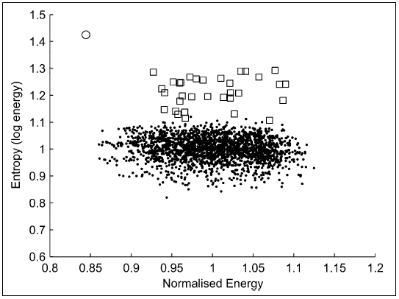
Improved ECG Signal Analysis Using Wavelet and Feature.
Feature Extraction
  Clustering

Slide 102


Improved ECG Signal Analysis Using Wavelet and Feature.
Method 1
wavelet: bior5.5, decomposition level: 1 and 3 with Method 1(●: normal beats, □: atrial premature beats, ○ : premature ventricular contractions)

Slide 103
Conclusion
Wavelet analysis is widely used in many application. Because it provides both time and frequency information, can overcome the limitation of Fourier transform.
We can learn about the wavelet transform which is able to detect beat rate of signals and to classify the difference of signals.
We also use the wavelet transform on the other beat rate detection.

Slide 104
References
[1] Understanding 12 Lead EKGs ,A Practical Approach, BRADY: Understanding 12 Lead EKGS Ch. 14
[2] Data Mining and Medical Informatics , R. E. Abdel-Aal,November 2005
[3] Factor and Component Analysis, esp. Principal Component Analysis (PCA)
[4] Algorithms for Distributed Supervised and Unsupervised Learning, Haimonti Dutta
The Center for Computational Learning Systems (CCLS),Columbia University, New York.
[5]Applications of the DWT in beat rate detection,
Ding jian,Jun, DISP lab, NTU

Slide 105
References
[6] Kyriacou, E.; Pattichis, C.; Pattichis, M.; Jossif, A.; Paraskevas, L.; Konstantinides, A.; Vogiatzis, D.; An m-Health Monitoring System for Children with Suspected Arrhythmias, 29th Annual International Conference of the IEEE Engineering in Medicine and Biology Society, 2007 Page(s): 1794 – 1797
[7] Wang Zhiyu; Based on physiology parameters to design lie detector, International Conference on Computer Application and System Modeling (ICCASM), 2010 Page(s): V8-634 - V8-637
[8] Cutcutache, I.; Dang, T.T.N.; Leong, W.K.; Shanshan Liu; Nguyen, K.D.; Phan, L.T.X.; Sim, E.; Zhenxin Sun; Tok, T.B.; Lin Xu; Tay, F.E.H.; Weng-Fai Wong; BSN Simulator: Optimizing Application Using System Level Simulation, Sixth International Workshop on Wearable and Implantable Body Sensor Networks, 2009 Page(s): 9 – 14
[9] Chareonsak, C.; Farook Sana; Yu Wei; Xiong Bing; Design of FPGA hardware for a real-time blind source separation of fetal ECG signals, IEEE International Workshop on Biomedical Circuits and Systems, 2004 Page(s): S2/4 - 13-16

Slide 106
References
[10] Galeottei, L.; Paoletti, M.; Marchesi, C.; Development of a low cost wearable prototype for long-term vital signs monitoring based on embedded integrated wireless module, Computers in Cardiology, 2008 Page(s): 905 – 908
[11] Low, Y.F.; Mustaffa, I.B.; Saad, N.B.M.; Bin Hamidon, A.H.; Development of PC-Based ECG Monitoring System, 4th Student Conference on Research and Development, 2006 Page(s): 66 – 69
[12] Kyriacou, E.; Pattichis, C.; Hoplaros, D.; Jossif, A.; Kounoudes, A.; Milis, M.; Vogiatzis, D.; Integrated platform for continuous monitoring of children with suspected cardiac arrhythmias, 9th International Conference on Information Technology and Applications in Biomedicine, 2009 Page(s): 1 – 4
[13] Romero, I.; Grundlehner, B.; Penders, J.; Huisken, J.; Yassin, Y.H.; Low-power robust beat detection in ambulatory cardiac monitoring, IEEE Biomedical Circuits and Systems Conference, 2009 Page(s): 249 – 252
[14] Saeed, A.; Faezipour, M.; Nourani, M.; Tamil, L.; Plug-and-play sensor node for body area networks, IEEE/NIH Life Science Systems and Applications Workshop, 2009 Page(s): 104 – 107

