Slide 1
Final Electrocardiography Review
Notes:
From a previous student group
11

Slide 2
Outline place
Problem Statement
Objectives & Goals
Deliverables
System Overview
Personnel Allocation
Design Metrics
Theory of Operation & Validation of Analog Sensor
Theory of Operation & Validation of Wireless Network
System Integration
Societal &Environmental Impacts
Safety, Health, and Ethical Concerns
Budget
Schedule
Conclusion

Slide 3
Problem Statement place
Numerous patients have multiple heart conditions which require close and frequent monitoring
Standard EKG traces only represent a short sampling of patient data; therefore, cardiac conditions, which are sporadic and irregular, are not identifiable
These conditions require continuous monitoring to be detected

Slide 4
Objectives & Goals place
Design and fabricate a portable, low-cost, and low-power wireless EKG sensor capable of monitoring heart signals
Small, analog sensor board attached to RF transmitter board
RF receiver board attached to computer
EKG Signal
Sensing Chip
Microcontroller
RF Board
Memory
Power Source (2 AA Batteries)

Slide 5
Deliverables place
Sensor Network and System
Consumes a low amount of power
Compact and portable
Wireless communication capabilities
Processes signals similar in frequency and magnitude to cardiac signals

Slide 6
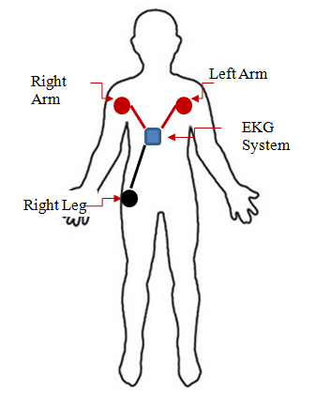
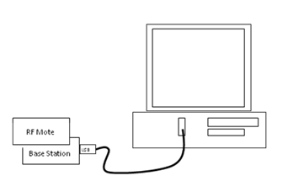
System Overview place
Two Separate Components
Wearable Sensor System with Electrodes
Base Station (i.e. Nurses’ Station)
Two Subsystems
Analog Sensor Board
Wireless Network
Wireless
Transmissions
Wireless Transmissions

Slide 7
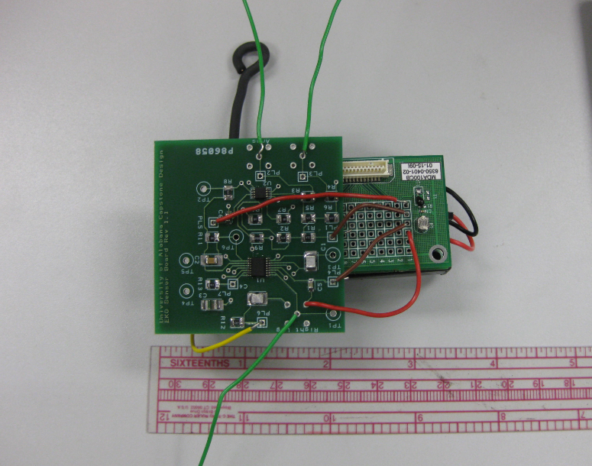
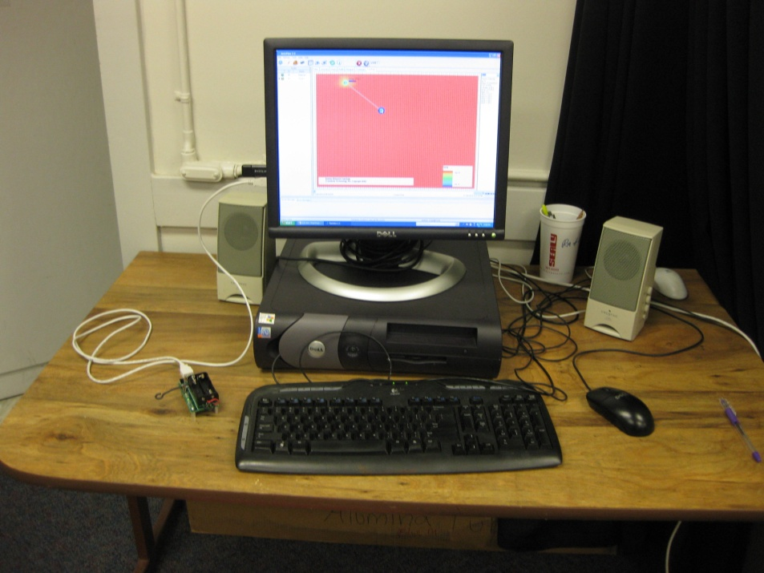
System Overview place
Left Arm Signal
Right Arm Signal
Power & Ground from Mica2
Graphical Data Display
Wearable Components
Base Station
Output to A/D Channel on Mica2
Right Leg Signal
RF Mote & Base Station

Slide 8
Design Metrics place
Analog Sensor Board
Circuit operates with a 3V power supply
Power supplied from Mica2
Amplification of signals in the -5mV to 5mV range
Common Mode Rejection Ratio of at least 60dB
Final output signal should be between 0V to 3V for A/D Conversion
Size should be similar to the Mica2 in order to maintain desired portability
Sensor will integrate onto Data Acquisition Board of Mica2
Wireless Network
20Hz sampling rate
916MHz frequency band communication
20-30m indoor range and 50-100 outdoor range
Multi-hop wireless network
Display graphical representation of sensor data

Slide 9
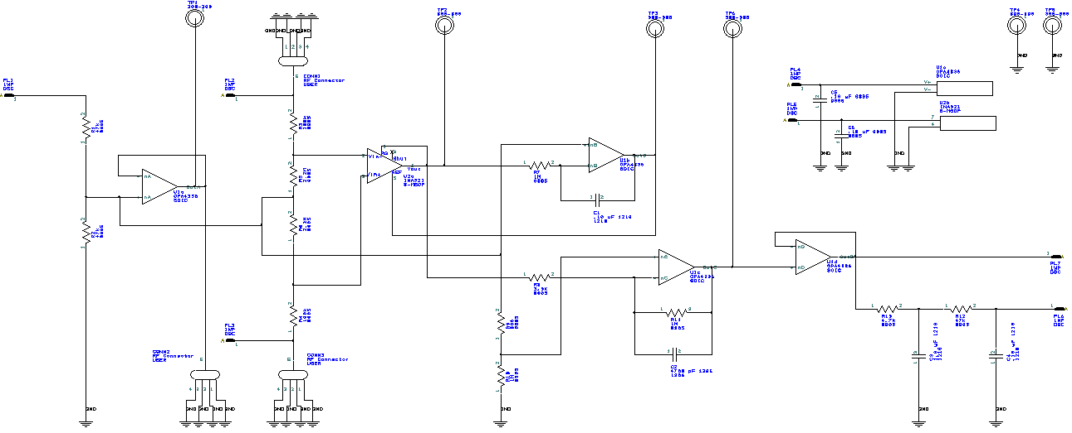
Theory of Operation: Analog Sensor
Right Leg Driver
Amplification
INA321 Support
Power Supply
Filtering

Slide 10
Validation: Analog Sensor Validation Overview
Schematic Design Validation
TINA Simulations
PCB Design Validation
PCB Artist
External Professional
Simulation and Hardware Comparison
TINA Simulations
High Frequency Inputs
Additional Hardware Validation
Low Frequency Inputs
Preparation for Integration Testing and Validation

Slide 11
Validation: Analog Sensor Validation Overview
White Box Testing
Right Leg Drive Circuit
INA321 Amplification
Low Pass Filter
Final Output
Black Box Testing
Final Output

Slide 12
Validation: Analog Sensor Schematic Testing
White Box Testing: INA321 Amplification
Purpose: Verify the circuit will operate as expected given input signals and an input voltage in its operating range.
Input Signals:
Right Arm: 5mV with a frequency of 2kHz
Left Arm: 1mV with a frequency of 2kHz
Power Supply: 3V DC
Conclusion: Output voltage reflects an amplification of the two input signals by a factor of approximately 5. The test was successful.

Slide 13
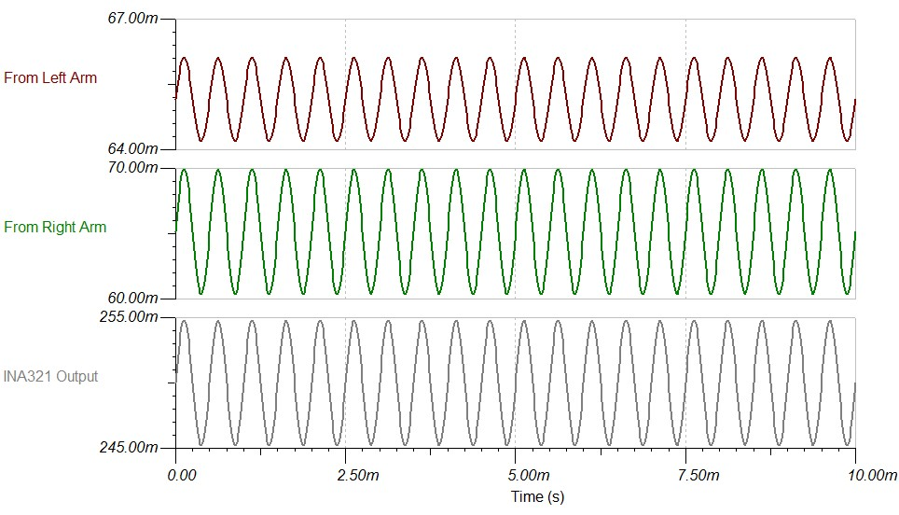
Validation: Analog Sensor Schematic Testing
White Box Testing Results: INA321 Amplification

Slide 14
Validation: Analog Sensor Schematic Testing
Black Box Testing: Complete Circuit
Purpose: Verify amplification, integrity, and filtering of signals in preparation for A/D Conversion and transmission
Input Signals:
Right Arm: 5mV with a frequency of 2kHz
Left Arm: 1mV with a frequency of 2kHz
Power Supply: 3V DC
Conclusion: Voltage obtained from the low pass filter remains as expected. The final output voltage through the final buffer amplifier is not as expected; the expected voltage should be similar to the voltage coming from the low pass filter. This test needs to be tested in the laboratory to observe if results are similar or different. Depending on the outcome, the buffer amplifier may need to be omitted in the final design when high frequency inputs are necessary.

Slide 15
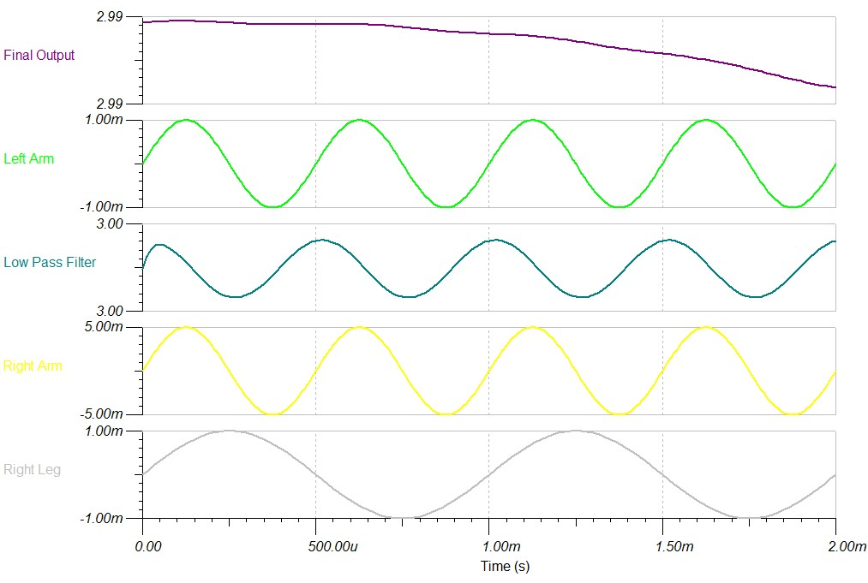
Validation: Analog Sensor Schematic Testing
Black Box Testing: Complete Circuit

Slide 16
Validation: Analog Sensor Schematic Validation
Design Metrics Validated:
Circuit operates with a 3V power supply
Amplification of signals in the -5mV to 5mV range
Common Mode Rejection Ratio of at least 60dB
Components chosen are surface mounts to aid in size requests
Design Errors and Changes
Design provided by Harvard’s CodeBlue project
Issue with final output from buffer amplifier
Other Issues Encountered
Demo version of OrCad Pspice not able to simulate complete circuit
MultiSim unable to model OPA336
Substituted OPA335 for simulation in TINA

Slide 17
Validation: Analog Sensor PCB Design Validation
Design constructed with PCBArtist
Schematic was converted to PCB
Error checking in PCBArtist verified correct spacing, trace widths, and connected nets
External professional evaluated our design
First Review
Pad lengths did not extend 20 mils beyond edge of component
Extend ground plane to cover bottom layer
Pin-to-Pin spacing issues on the INA321 footprint
Second Review
Given “okay” to order
Minor issues found afterwards that should not affect the integrity of the circuit

Slide 18
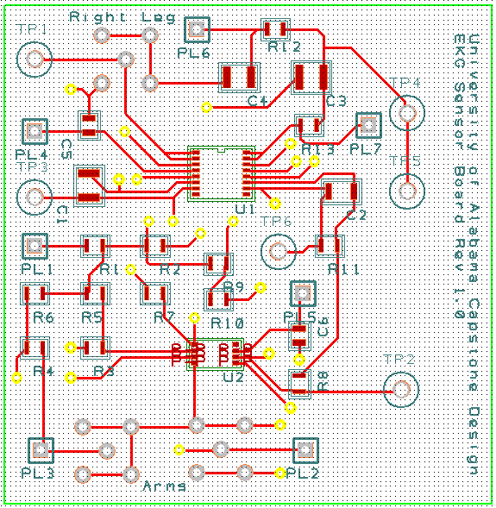
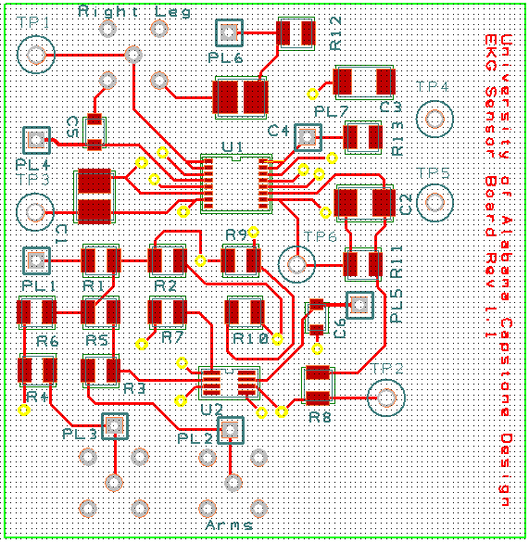
Validation: Analog Sensor PCB Design Validation
Rev 1 Top Layer
Rev 2 Top Layer

Slide 19
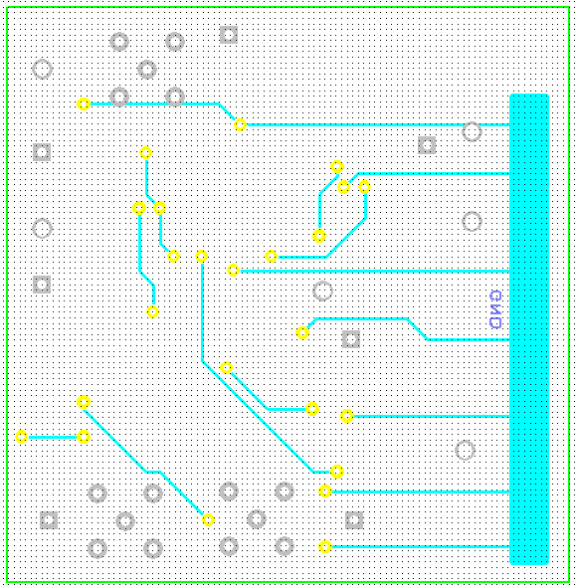
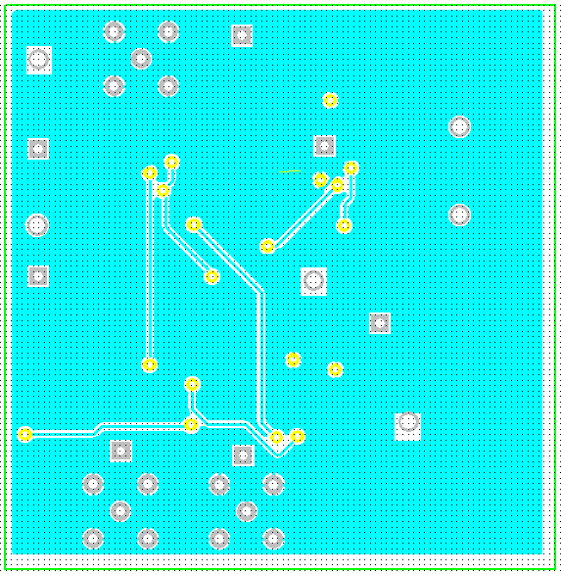
Validation: Analog Sensor PCB Design Validation
Rev 1 Bottom Layer
Rev 2 Bottom Layer

Slide 20
Validation: Analog Sensor PCB Design Validation
Verification of footprint sizes
Before ordering: Placement on paper
After ordering: Placement on board
Design Metrics Validated
Size should be similar to the Mica2 in order to maintain desired portability
Board measures 2” x 2”
All components surface mount for small size

Slide 21
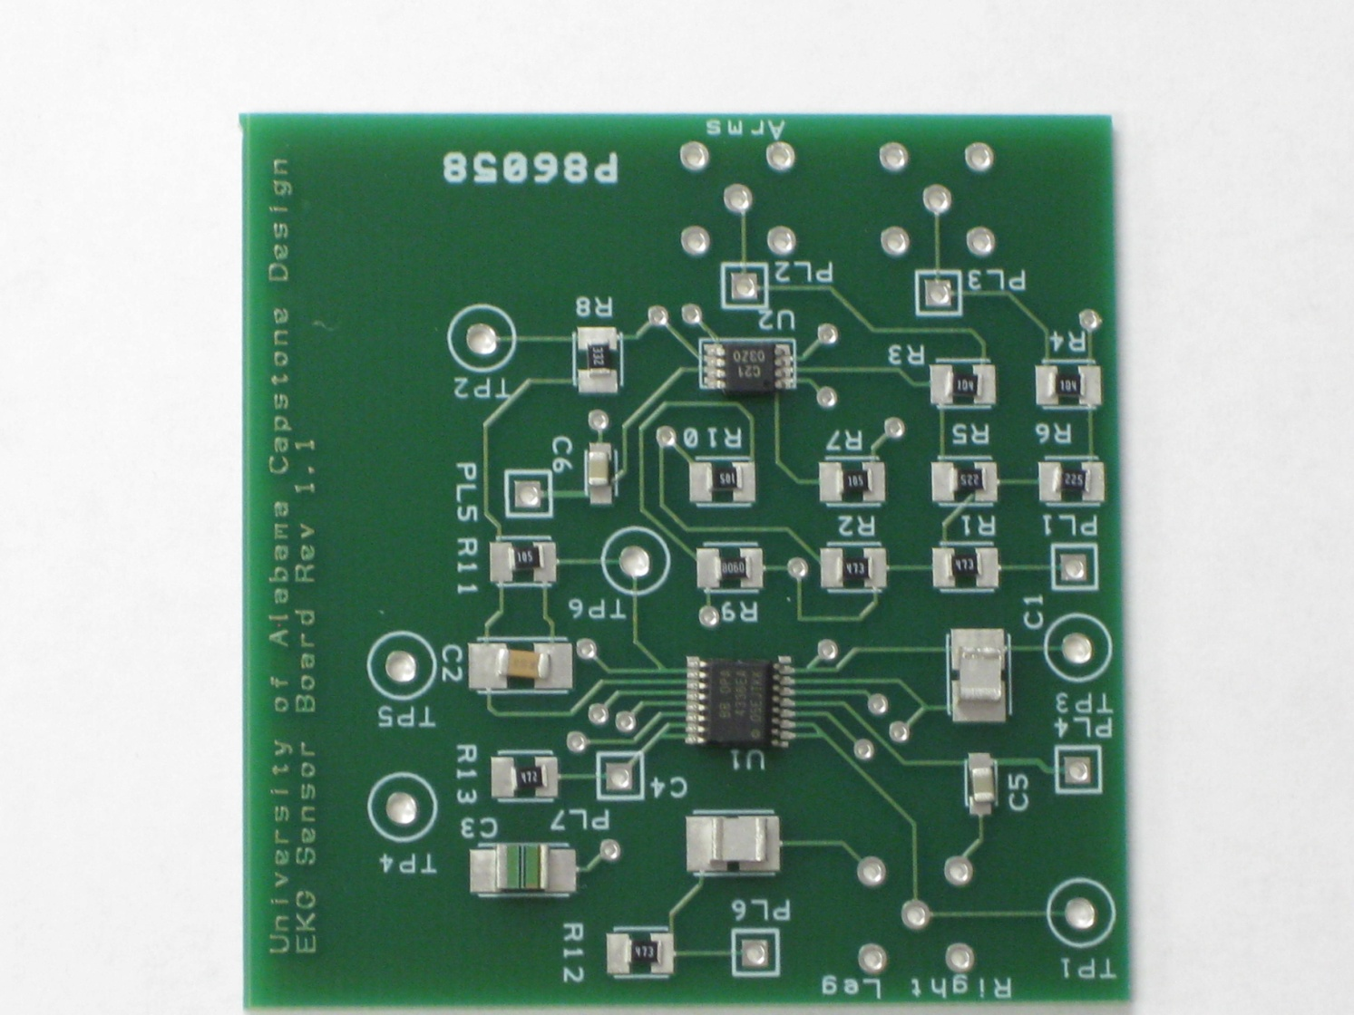
Validation: Analog Sensor PCB Design Validation
Paper Layout
Board Layout

Slide 22
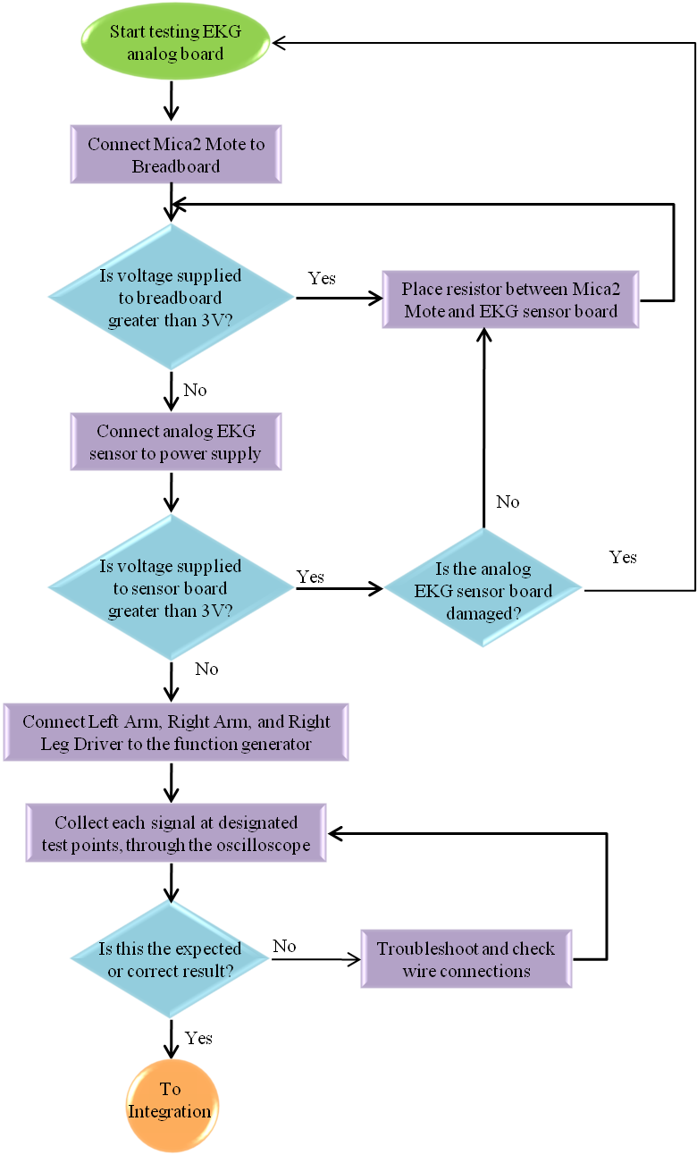
Validation: Analog Sensor Simulation & Hardware Comparison

Slide 23
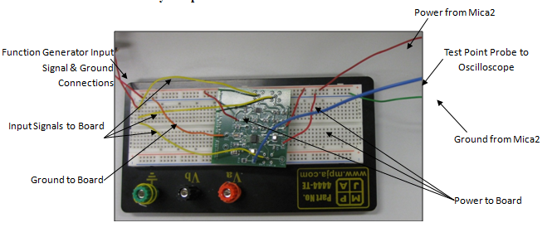
Validation: Analog Sensor Simulation & Hardware Comparison
Hardware Testing Setup

Slide 24
Validation: Analog Sensor Simulation & Hardware Comparison
Purpose:
Verify expected operation at specific points and the final output
High frequency inputs, same for all inputs
Equipment:
Two agilent function generators with one probe per generator
One tektronix oscilloscope with three channels and one probe per channel
One Analog Sensor PCB
One Mica2 mote with attached DAQ
Breadboard and assorted wires
Safety Precautions:
Inputs signals
Board power
Electrostatic resistance

Slide 25
Validation: Analog Sensor Simulation & Hardware Comparison
White Box Testing: INA321 Amplification
Purpose: Verify the circuit will operate as expected given input signals and an input voltage in its operating range.
Input Signals:
Left Arm: 1kHz square wave with 100mV amplitude
Right Arm: 1kHz square wave with 500mV amplitude
Right Leg: 1kHz square wave with 500mV amplitude
Power Supply: 3V DC (supplied by MICA2)
Conclusion: Both the simulation and laboratory results depict an amplified version of the differential between the input signals. Overall the results obtained in the laboratory provide a better and more expected output than the simulation results.

Slide 26
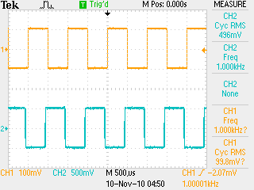
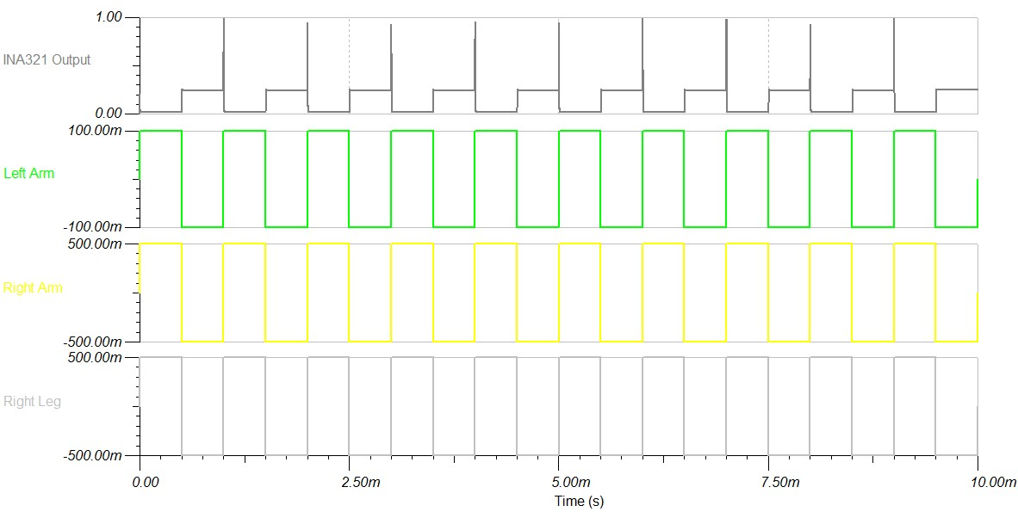
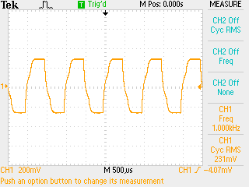
Validation: Analog Sensor Simulation & Hardware Comparison
White Box Testing Results: INA321 Amplification

Slide 27
Validation: Analog Sensor Simulation & Hardware Comparison
Black Box Testing: Complete Circuit
Purpose: Verify amplification, integrity, and filtering of signals in preparation for A/D Conversion and transmission
Input Signals:
Left Arm: 1kHz square wave with 100mV amplitude
Right Arm: 1kHz square wave with 500mV amplitude
Right Leg: 1kHz square wave with 500mV amplitude
Power Supply: 3V DC (supplied by MICA2)
Conclusion: Here the results obtained reflect undesirable values both in the simulation and laboratory data. These results are consistent with the ones obtained from the schematic design validation, and prove that the final output must come from the previous test point if high frequency inputs are necessary.

Slide 28
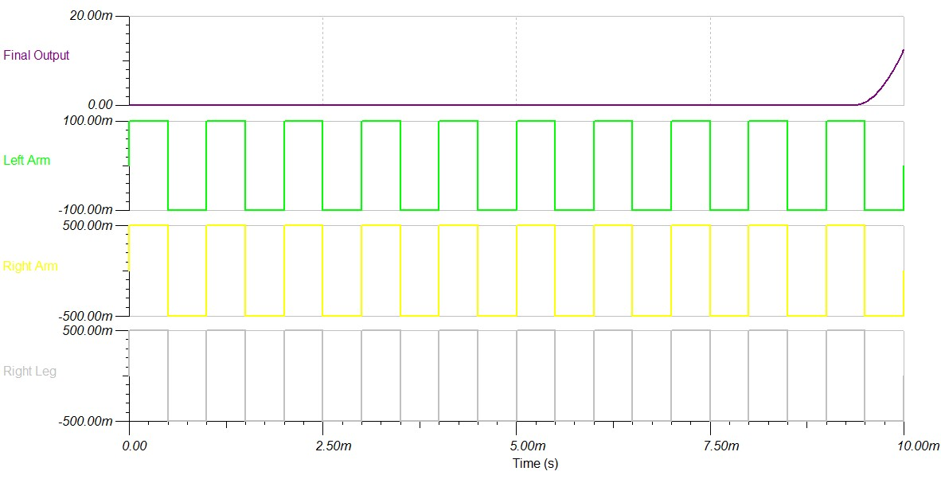
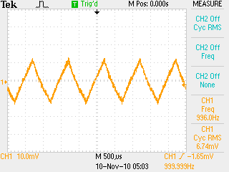
Validation: Analog Sensor Simulation & Hardware Comparison
Black Box Testing Results: Complete Circuit

Slide 29
Validation: Analog Sensor Simulation & Hardware Comparison
Design Metrics Validated:
Power Supplied from Mica2
Final output signal should be between 0V to 3V for A/D Conversion
Design Errors and Changes
Pins 7 and 8 of the INA321 had to be soldered together
Shutdown pin (8) on INA321 had to be tied to a voltage source (7)

Slide 30
Validation: Analog Sensor Additional Hardware Validation
Purpose:
Verify expected operation at specific points and the final output
Low frequency inputs; same for all inputs
Same laboratory setup and equipment
Safety Precautions
Analog Sensor Validated

Slide 31
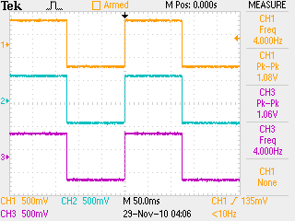
Validation: Analog Sensor Additional Hardware Validation
White Box Testing: Right Leg Drive Circuit
Input Signal: Square Wave with 500mV amplitude at 4Hz
Power Supply: 3V DC (supplied by Mica2)
Conclusion: As expected, the output from the right leg drive circuit mirrors the input into the right leg resulting in a successful test.

Slide 32
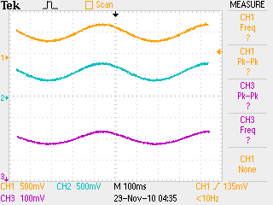
Validation: Analog Sensor Additional Hardware Validation
White Box Testing: Low Pass Filtering
Input Signal: Sine Wave with 500mV amplitude at 2Hz
Power Supply: 3V DC (supplied by Mica2)
Conclusion: Here the output signal is reduced slightly after moving through the filter as expected.

Slide 33
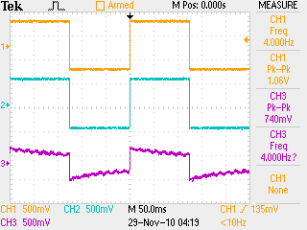
Validation: Analog Sensor Additional Hardware Validation
Black Box Testing: Complete Circuit
Input Signal: Square wave with 500mV amplitude at 4Hz
Power Supply: 3V DC (supplied by Mica2)
Conclusion: The final output obtained is a reflection of the input signals as opposed to the tests using high frequency inputs. The output signal is amplified and filtered.

Slide 34
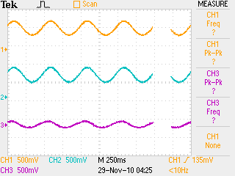
Validation: Analog Sensor Additional Hardware Validation
Black Box Testing: Complete Circuit
Input Signal: Sine wave with 500mV amplitude at 2Hz
Power Supply: 3V DC (supplied by Mica2)
Conclusion: The final output obtained is a reflection of the input signals as opposed to the tests using high frequency inputs. The output signal is amplified and filtered.

Slide 35
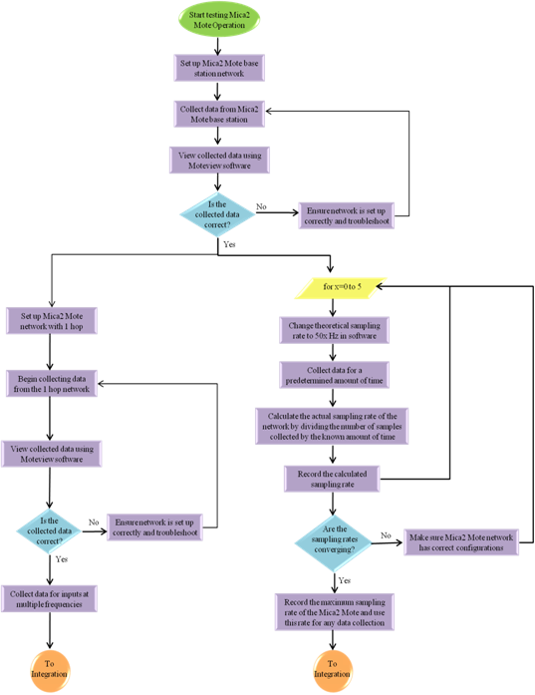
Validation: Wireless Network Validation & Testing of Wireless Sensor Network

Slide 36
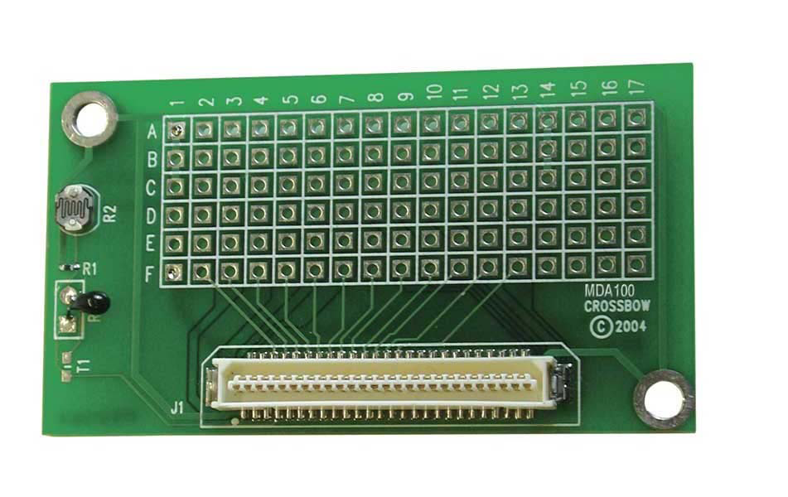
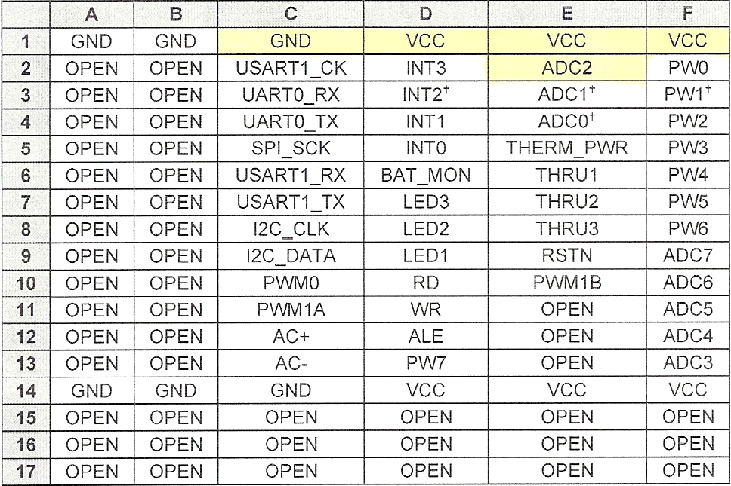
Validation: Wireless Network Validation & Testing of Wireless Sensor Network
MDA100 Data Acquisition Unit

Slide 37
Validation: Wireless Network Sensor Network Testing
Data Collection Testing
Purpose: Verify Mica2 receives the correct data from the temperature sensor
Equipment
Mica2
MDA100CB sensor board
Software to view data from Mica2
Success Criteria
Data displayed from Mica2 mirrors the actual temperature
Design Metrics Tested
Graphical representation of sensor data

Slide 38
Validation: Wireless Network Sensor Network Testing
Data Collection Testing
Test ability of integrated Mica2 and MDA100CB to collect accurate data
Sensor placed in freezer until stabilized
Sensor placed back in room temperature

Slide 39
Validation: Wireless Network Single & Multi-Hop Wireless Sensor Testing
Network Topology Testing
Purpose: Verify wireless sensor network’s ability to handle multiple nodes in many different configurations
Equipment
Software to view data from Mica2
MIB520 Base Station
5 Mica2 Motes
Success Criteria
Moteview topology matches desired configuration
Design Metrics Tested
Wireless network multi-hop capabilities

Slide 40
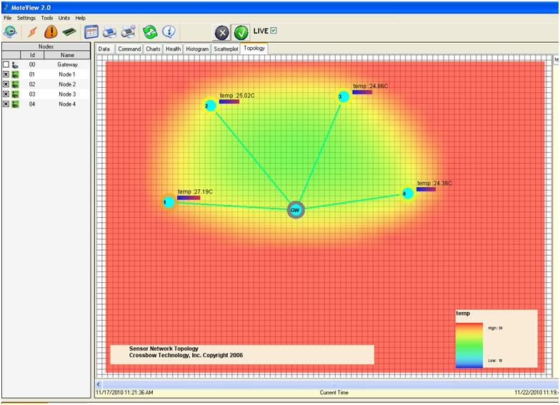
Validation: Wireless Network Single & Multi-Hop Wireless Sensor Testing
Network Topology Testing
Initial topology of the wireless sensor network
Cases required to show full functionality and diversity of the network
Case 1
Case 2
Case 3
Case 4
GW
GW
GW
GW
1
4
1
1
2
1
3
2
2
3
2
3
4
3
4
4

Slide 41
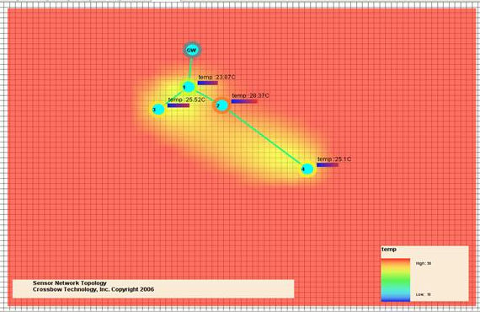
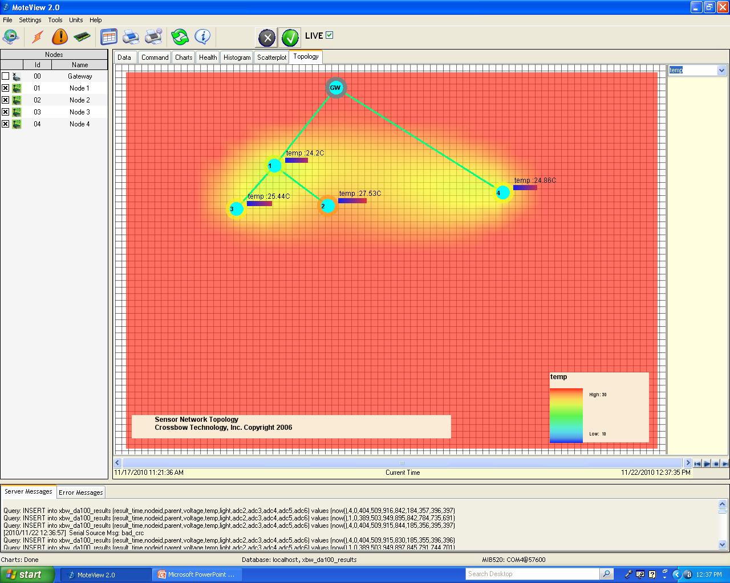
Validation: Wireless Network Single & Multi-Hop Wireless Sensor Testing
Network Topology Testing
Case 1
GW
1
3
2
4
Case 2
GW
1
4
3
2

Slide 42
Validation: Wireless Network Single & Multi-Hop Wireless Sensor Testing
Sampling Rate Testing
Purpose: Determine the maximum sampling rate of the Mica2
Equipment
Software to view data from Mica2
MIB520 Base Station
Test | Time (s) | Samples | Frequency (Hz)
1 | 30 | 621 | 20.700
2 | 30 | 611 | 20.366
3 | 30 | 520 | 17.333
4 | 30 | 597 | 19.900

Slide 43
Validation: Wireless Network Sensor Network Testing
Battery Testing
Purpose: Verify the Mica2 capability to collect continuous data
Equipment
Software to view data from Mica2
MIB520 Base Station
Mica2
RF Mote
RF Mote
Base Station
USB

Slide 44
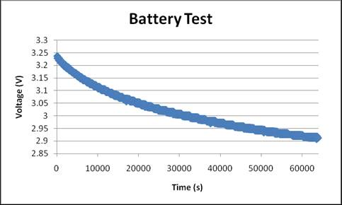
Validation: Wireless Network Sensor Network Testing
Battery Testing
Success Criteria
Mica2 collects continuous data for more than 12 hours
Design Metric Tested
Sensor network operates for an extended period of time while consuming a low amount of power

Slide 45
Validation: Wireless Network Sensor Network Testing
Reconstructed Signal Testing
Purpose: Determine the frequencies for which the software and Mica2 can accurately reconstruct a signal
Equipment
Software to view data from Mica2
MIB520 Base Station
Mica2
Function generator for inputs
Success Criteria
Data displayed from Moteview mirrors input signals
Design Metrics Tested
Preparation for testing collection of graphical representation of sensor data

Slide 46
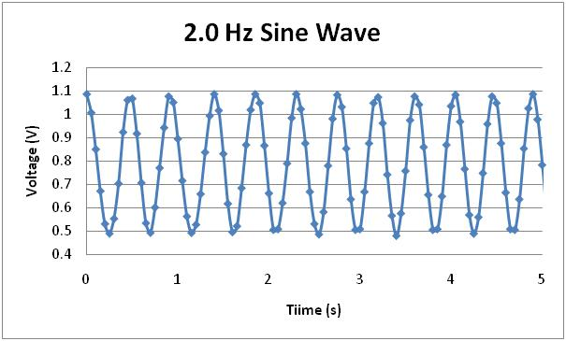
Validation: Wireless Network Sensor Network Testing
Reconstructed Signal Testing
Sine Wave Input
Frequency: 2.0 Hz
V_{pp}: 300mV
DC offset: 400mV

Slide 47
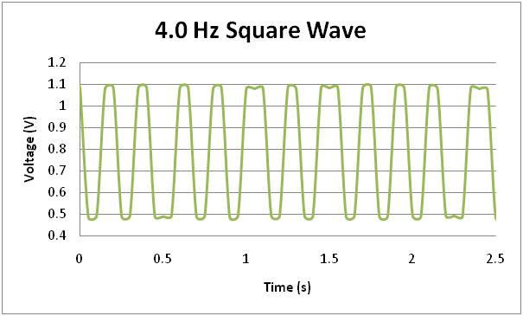
Validation: Wireless Network Sensor Network Testing
Reconstructed Signal Testing
Square Wave Input
Frequency: 4.0 Hz
V_{pp}: 300mV
DC offset: 400mV

Slide 48
Validation: Wireless Network
Design Metrics Validated:
20Hz sampling rate
916MHz frequency band used for mote to mote communication
20-30m indoor and 50-100m outdoor range between hops
Graphical representation of topology and data
Other Issues Encountered
Unable to increase one-hop sampling rate

Slide 49
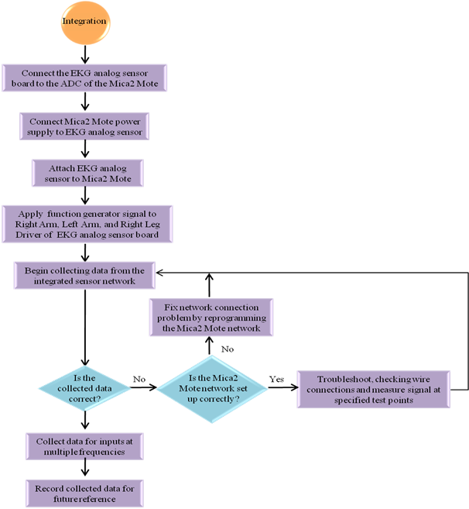
Validation: System Integration Validation & Testing of Complete System

Slide 50
Validation: System Integration Validation & Testing of Complete System
Full System Signal Testing
Purpose: Determine the frequencies for which the integrated sensor network can accurately reconstruct a signal
Equipment
Software to view data from Mica2
MIB520 Base Station
Mica2
EKG analog sensor board
Function generator for inputs
Oscilloscope for outputs
Success Criteria
Data displayed from Moteview mirrors input signals
Design Metrics Tested
Display graphical representation of sensor data
Sensor will integrate onto Data Acquisition Board of Mica2

Slide 51
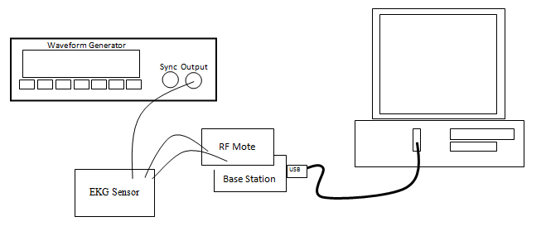
Validation: System Integration Validation & Testing of Complete System
Full System Signal Testing
Connection Diagram

Slide 52
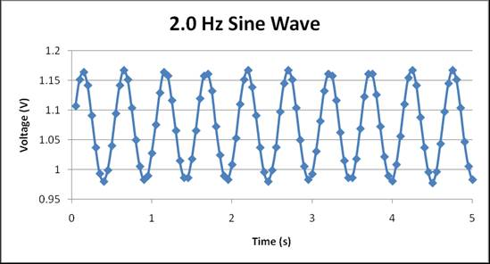
Validation: System Integration Validation & Testing of Complete System
Full System Signal Testing
Sine Wave Input
Frequency: 2.0 Hz
V_{pp}: 500mV
DC offset: 0mV

Slide 53
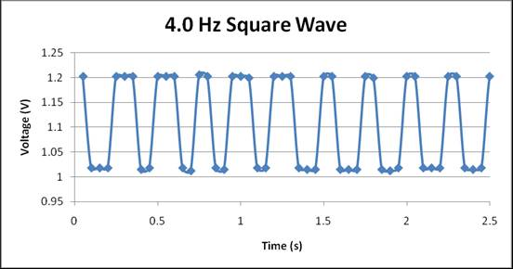
Validation: System Integration Validation & Testing of Complete System
Full System Signal Testing
Square Wave Input
Frequency: 4.0 Hz
V_{pp}: 500mV
DC offset: 0mV

Slide 54
Validation: System Integration Validation & Testing of Complete System
One-Hop Full System Signal Testing
Purpose: Determine the frequencies for which the integrated sensor network can accurately reconstruct a signal for a one-hop configuration
Equipment
Software to view data from Mica2
MIB520 Base Station
Mica2
EKG analog sensor board
Function generator for inputs
Oscilloscope for outputs
Success Criteria
Data displayed from Moteview mirrors input signals
Design Metrics Tested
Display graphical representation of sensor data
Sensor will integrate onto Data Acquisition Board of Mica2

Slide 55
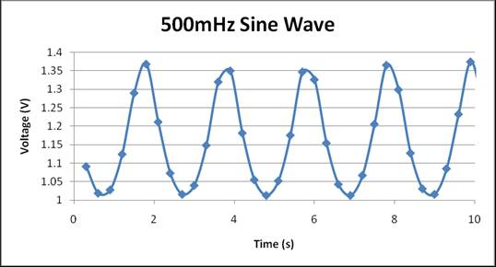
Validation: System Integration Validation & Testing of Complete System
One-Hop Full System Signal Testing
Sine Wave Input
Frequency: 500 mHz
V_{pp}: 400mV
DC offset: 400mV

Slide 56
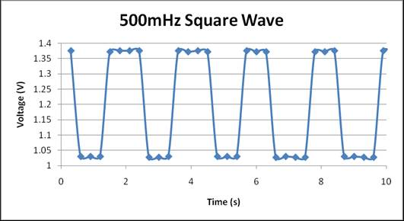
Validation: System Integration Validation & Testing of Complete System
One-Hop Full System Signal Testing
Square Wave Input
Frequency: 500 mHz
V_{pp}: 400mV
DC offset: 400mV

Slide 57
Validation: System Integration Validation & Testing of Complete System
Full System Heartbeat Testing
Purpose: Determine the frequencies for which the integrated sensor network can accurately reconstruct a signal
Equipment
Software to view data from Mica2
MIB520 Base Station
Mica2
EKG analog sensor board
Function generator for inputs
Oscilloscope for outputs
Success Criteria
Data displayed from Moteview mirrors input signals
Design Metrics Tested
Display graphical representation of sensor data
Sensor will integrate onto Data Acquisition Board of Mica2

Slide 58
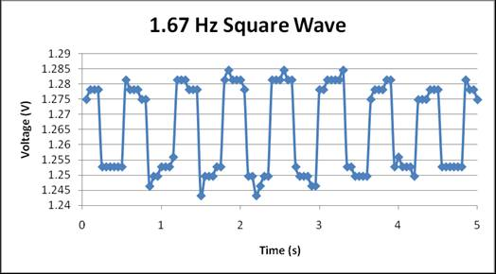
Validation: System Integration Validation & Testing of Complete System
Full System Heartbeat Testing
Square Wave Input
Frequency: 1.67 Hz
V_{pp}: 50mV
DC offset: 400mV

Slide 59
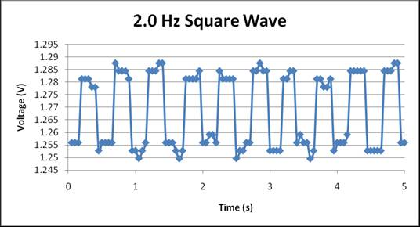
Validation: System Integration Validation & Testing of Complete System
Full System Heartbeat Testing
Square Wave Input
Frequency: 2.0 Hz
V_{pp}: 50mV
DC offset: 400mV

Slide 60
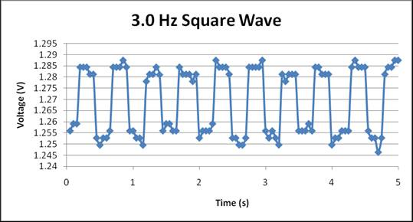
Validation: System Integration Validation & Testing of Complete System
Full System Heartbeat Testing
Square Wave Input
Frequency: 3.0 Hz
V_{pp}: 50mV
DC offset: 400mV

Slide 61
Societal & Environmental Impacts place
Make possible the capturing of rare medical emergency events that cannot be captured by standard ECG tests
The wireless sensor expands the time frame of data collection, therefore capturing rare but serious heart problems
Improve the quality of healthcare delivery by eliminating frequent doctor visits
Wireless transmission capability will allow remote patient monitoring
Currently 15.1% of the U.S. Gross Domestic Product (GDP) is spent on healthcare expenses, which is just over $2 Trillion dollars
Constant use of the device may lead to more electronic devices in landfills

Slide 62
Health, Safety, & Ethical Issues place
While wearing the device, possible contact with a relatively large voltage source can cause a minor electrical shock
Isolate patient connections to limit leakage current levels from the patient contact points; also, reduce the amount of current that can flow into the patient connections from another device
A waveform generator will be required to perform testing on our system
Electrode material can cause irritation of skin

Slide 63
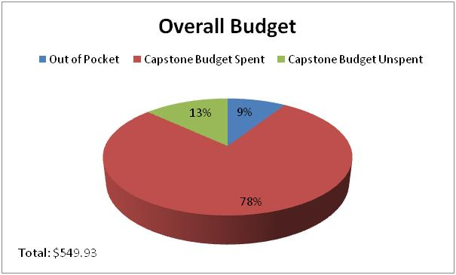
Budget place
Category | Amount ($)
Out of Pocket Expenditures | $49.93
Capstone Budget Spent | $427.82
Capstone Budget Unspent | $72.18
Total | $549.93

Slide 64
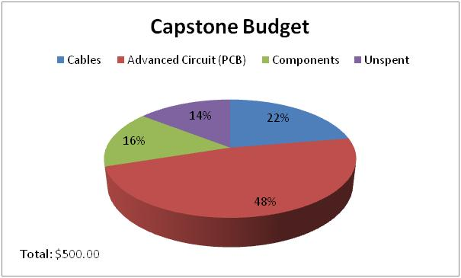
Budget place
Category | Amount ($)
Cables & Connectors | $111.75
Advanced Circuit (PCB) | $237.99
Components | $78.08
Unspent | $72.18
Total | $500.00

Slide 65
Budget place
Category | Amount ($)
Shipping | $40.53
Electrodes | $9.40
Total | $49.93

Slide 66
Conclusion
The main goal was to design a portable, low-power EKG sensor capable of wireless transmission
The analog sensor
Operates using a 3V power supply
Provides adequate amplification of a cardiac signal
Provides a final output signal between 0V to 3V
The wireless sensor
Operates within the 916 MHz frequency band
Has an indoor range of 20-30m

