Slide 1
ECG signal acquisition hardware design
University of Alabama
ECE Department
Notes:
Thank to Mengcheng Guo

Slide 2
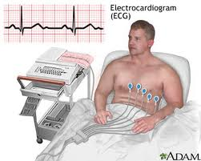
Background
ECG/EKG (electrocardiogram)
Records the heart's electrical activity:
Heart beat rate
Heart beat rhythm
Heart strength and timing

Slide 3
Note: The last slide has all references that these slides have referred to. All these slides cover the major ideas of ECG sensor design from 9 journal papers (References [1] – [9])

Slide 4
Background
ECG works mostly by detecting and amplifying the tiny potential changes on the skin that are caused when the electrical signal in the heart muscle is charged and spread during each heart beat.
This is detected as tiny rises and falls in the voltage between two electrodes placed either side of the heart.

Slide 5
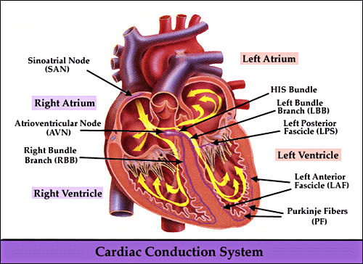
Background
The heart's electrical system:
Sinoatrial(SA) node
Atrioventricular(AV)
node
His-Purkinje system

Slide 6
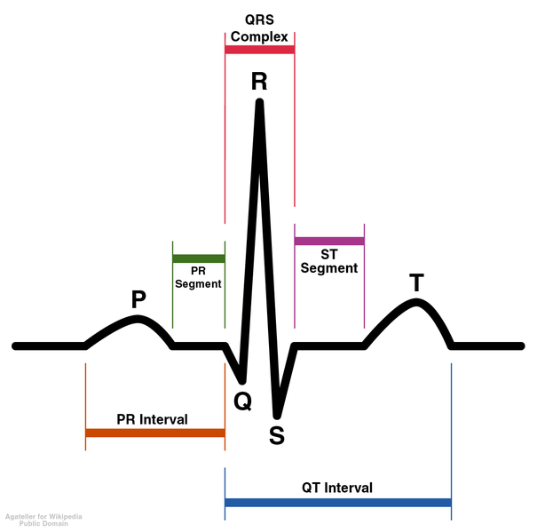
Background
P wave: signal spread from SA node to make the atria contract.
P-Q Segment: signal arrives AV node stay for a instant to allow the ventricle to be filled with blood.
Q wave :After the Buddle of His, the signal is divided into two branches and run through the septum.
R,S wave: Left and right ventricle contraction are marked by the R,S wave.
T wave: ventricle relaxing
Schematic representation of normal ECG

Slide 7
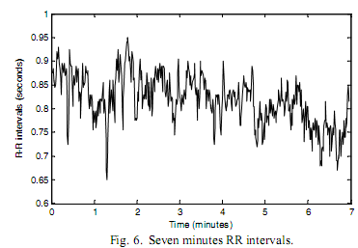
ECG SIGNAL
ECG bio-signal typical specifications:
low differential voltage from 0.4 to 3 mV
high common-mode rejection ratio level
low frequency range
high noise

Slide 8
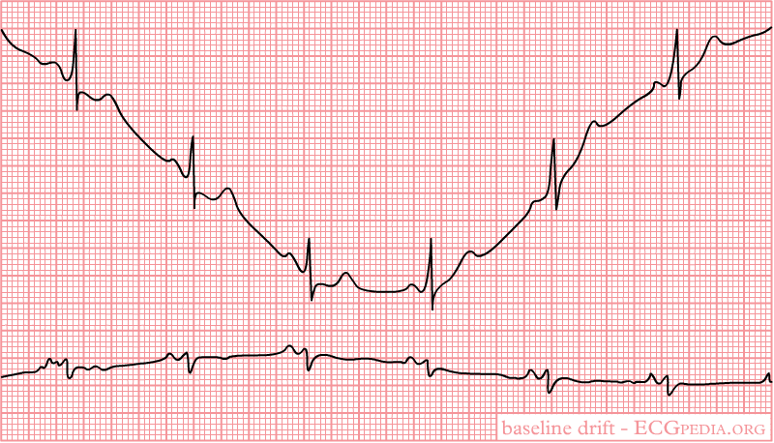
ECG SIGNAL
Artifacts (disturbances) can have many causes. Common causes are:
Movement
Sudden movement
Baseline drift

Slide 9
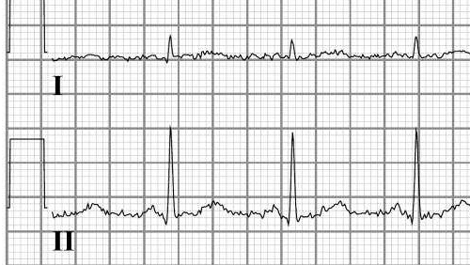
Ecg signal
Electrical interference
→From a nearby electrical appliance. A typical example is a 100 Hz background distortion from fluorescent lights. To be confused with atrial fibrillation.

Slide 10
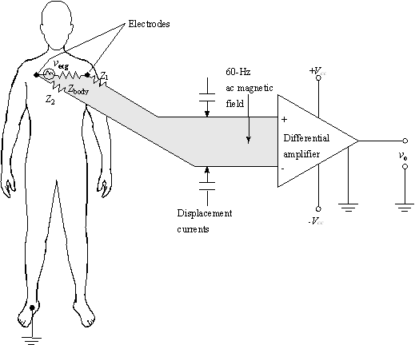
ECG electrode
Lead
The signal recorded as the difference between two potentials on the body surface is called an "ECG lead". Each lead is said to look at the heart from a different angle.

Slide 11
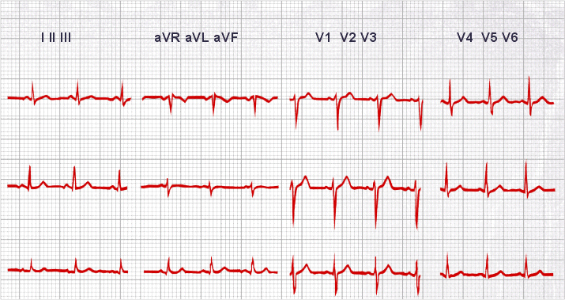
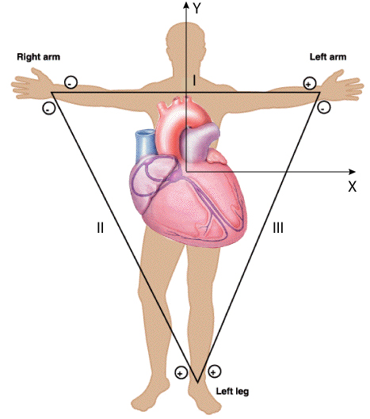
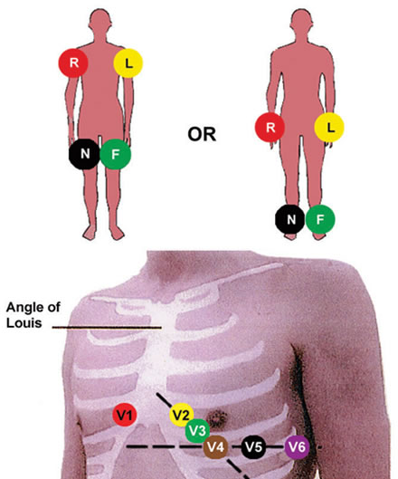
Electrode
Lead position
Lead III
Lead 12

Slide 12
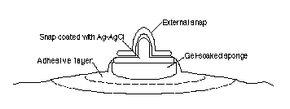
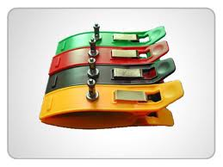
ECG electrode
A typical surface electrode used for ECG recording is made of Ag/AgCl, as shown on right Figure . The disposable electrodes are attached to the patients’ skin and can be easily removed.
Limb Leads (Bipolar)
Chest Leads (Unipolar)
Augmented Limb Leads (Unipolar)
Wet, dry and insulating…

Slide 13
Design(1)
A 0.5-uVrms 12-uW Wirelessly Powered Patch-Type Healthcare Sensor [1]
Thick-ﬁlm electrodes
Fabric inductor
W-BSN controller
Desired Circuit Design (LDO , NCA, PGA, ADC)

Slide 14
Design(1)
Advantages:
Long-term continuous monitoring, comfortable without skin irritation
Wireless powered without battery through fabric inductor coupling is realized.
Low electrode referred noise by NCA
Small IC size (2.6 mm² )
Convenience and Safety

Slide 15
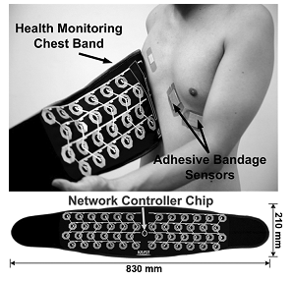
Design(1)
System Architecture:
Controller on chest band:
12 x 4 inductor array and W-BSN controller.
sensors are attached at arbitrary locations.
automatically ﬁnds the locations and activates each sensor by self-conﬁguration

Slide 16
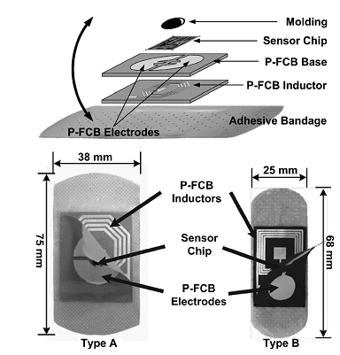
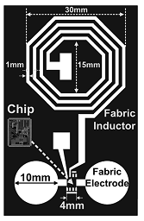
Design(1)
System Architecture:
B. Wireless powered Sensor:
Two dry electrodes
Sensor chip
P-FCB inductors
Adhesive bandage
Take the power overhead from the sensors, moving it to the relatively power-sufﬁcient health monitoring chest band.

Slide 17
Design(1)
Requirements:
Sensor IC must consume power in total of less than 20 uW.
The noise contribution of the sensor readout front-end must be less than 1 uVrms.
The contact impedance and the motion artifacts of the dry fabric electrode must be minimized

Slide 18
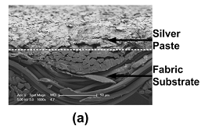
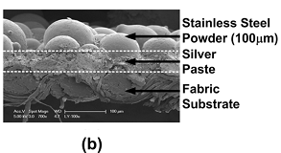
Design(1)
Electrode Design:
Wet electrode: uncomfortable, good conduction, short time
Plaster electrode:
Stiff, uncomfortable, motion artifacts
Fabric electrode:
Soft, comfortable, long term
A silver paste is screen printed directly on a fabric, a stainless steel powder with grain size of 100 um is added on top of the silver paste.

Slide 19
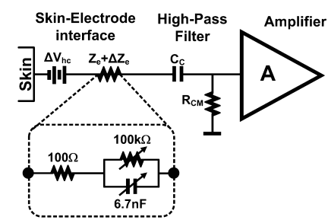
Design(1)
Noise and Artifacts
A. Electrode Noise:
B. Motion Artifacts:

Slide 20
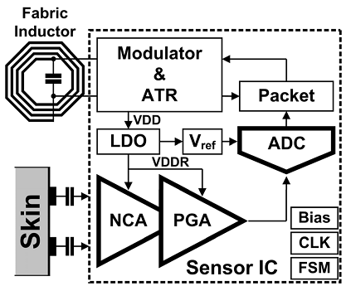
Design(1)
System Architecture:

Slide 21
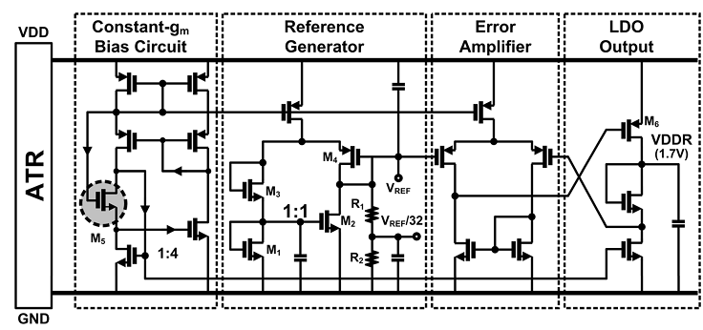
Design(1)
LDO Regulator
Generated voltage(VDD) is regulated by an LDO regulator to create an internal silent supply voltage (VDDR) of 1.7 V, and it is dispatched to the NCA, PGA and ADC.

Slide 22
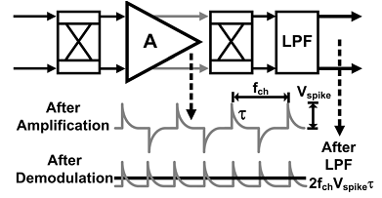
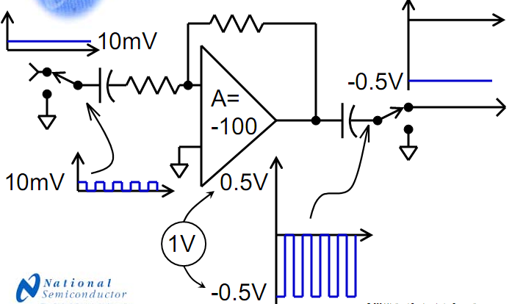
Design(1)
B. NCA (nested chopping amplifier)
Chopper amplifier
A chopper amplifier is a type of amplifier that exhibits precise outputs and low noise.
Reduces the offset from part to part.
Reduces the offset over time
Reduces the offset over
temperature.
Reduces offset over common mode voltage.

Slide 23
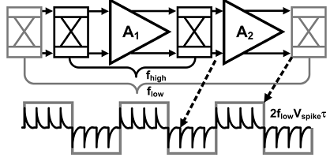
Design(1)
B. NCA (nested chopping amplifier)
Nested Chopping amplifier
A LPF generates a residual offset proportional to its chopping frequency, and it may raise the in-band noise power.
Another low-frequency chopper switch is introduced, enclosing the high-frequency chopped ampliﬁer.
The inner HF (10 kHz) chopped ampliﬁer mitigates the 1/f and dc offset drift while the outer low-frequency (625 Hz) chopper suppresses the residual offset down to 24 dB.

Slide 24
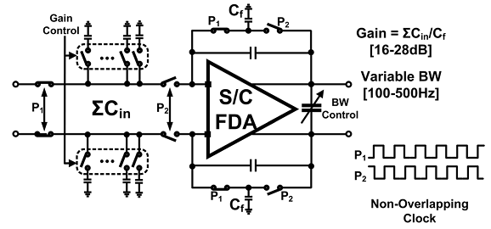
Design(1)
C. PGA
Different magnitudes of the vital signals with different bandwidth are matched by adjusting Cin and Cf.

Slide 25
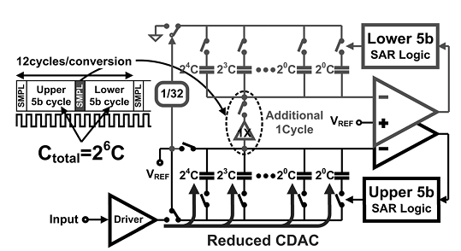
Design(1)
D. Folded 10-b SAR ADC
Utilized with capacitive DAC.
Two internally folded 5-b CDAC for power efficiency.
Upper& Lower
94% of the CDAC size reduction
It relaxes the power budget of the ADC driver by
36%

Slide 26
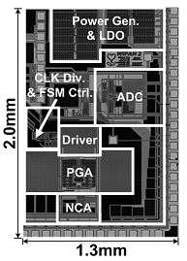
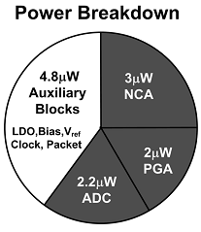
Design(1)
Implementation & Results[1]
Chip micrograph and its power breakdown

Slide 27
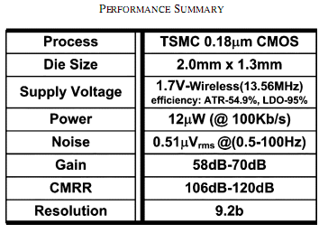
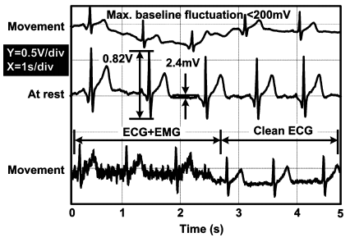
Design(1)
Implementation & Results[1]
Measured ECG waveforms by the proposed wirelessly powered patch-type healthcare sensor.

Slide 28
Design(1)
Conclusion:
A wirelessly powered wearable healthcare sensor is presented.
A pair of dry fabric electrodes with stainless steel powder on to ensure stable contact.
The NCA reduces electrode referred noise down to 0.5 uVrms while boosting its CMRR to greater than 100 dB.
A 9-b ECG recording while consuming only 12-uW power supplied through fabric inductor coupling.

Slide 29
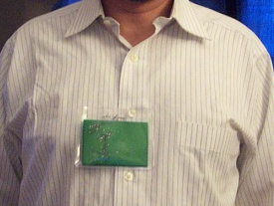
Design(2)
Uncontacted Doppler Radar System for Heart and Respiratory Rate Measurements [2][9]
Introduction
Principle
Implementation
System Architecture
Results
Conclusion

Slide 30
Design(2)
Clip-on wireless ECG for ambulatory cardiac monitoring design[34]
Measure heart movement rather than electrical activity is a complementary to ECG
Microwave doppler radar detection
outgoing beam + Doppler-shifted reflected beam = low frequency signal
(physical motion of the heart)

Slide 31
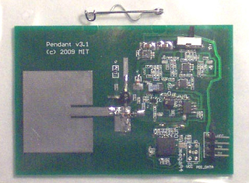
Design(2)
Microwave oscillator(2.45G)
Microstrip Transformer
(electrically isolate the
oscillator circuit and also
impedance match to the antenna. )
Microstrip Patch edge-fed Antenna
Diode Mixer

Slide 32
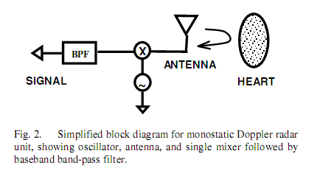
Design(2)
Low-pass filter
Microcontroller(8 bit)
Wireless Link
2.48G IEEE802.15.4
Battery and Power(30mw)

Slide 33
Design(2)
System Architecture:
Block diagram of radar system

Slide 34
Design(2)
The radio transceiver is on the custom radar chip, and a circulator isolates the RF output from the RF input.
A single patch antenna is used for both transmitting and receiving.
Each baseband channel uses an instrumentation ampliﬁer for single-to-differential conversion, has a dc block and gain stage followed by an anti- aliasing low-pass ﬁlter.
The signals are the then digitized and processed with a PC with custom MATLAB signal processing software.

Slide 35
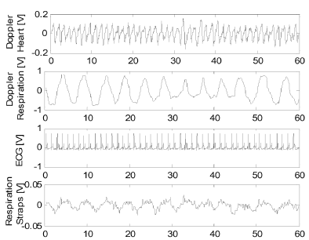
Design(2)
Results:
a. the heart motion signature obtained with the Doppler radar system
b. respiration motion signature obtained with the Doppler radar, c.ECG
d. heart motion trace obtained with the respiratory effort
belts
Heart and respiration signatures

Slide 36
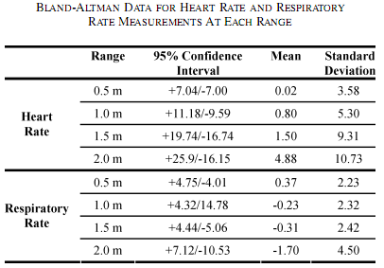
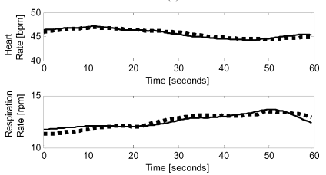
Design(2)
Results:
The dotted line is the rate obtained with the control (ECG
or respiratory effort belts) and the solid line is that obtained with the Doppler
radar system.

Slide 37
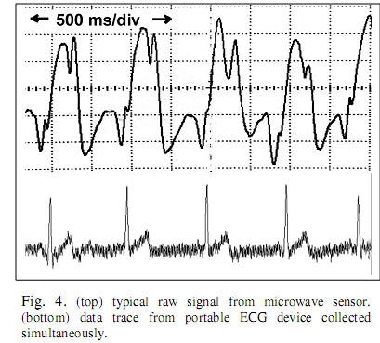
Design(2)
Conclusion:
Comparison with ECG
Similar to ECG but not
a substitute result
Different for different
persons
However, it may be an interesting portable and lower cost alternative to M-mode echocardiography for monitoring of certain types of heart failure associated with heart mechanics, such as depressed systolic function, akinesia and fibrillation.

Slide 38
DESIGN (3)
A 60 uW60 nV/ Hz Readout Front-End for Portable Biopotential Acquisition Systems [3]
Introduction
Readout Front-end Architecture
AC Coupled Chopped Instrumentation Amplifier
Chopping Spike Filter (CSF)
Programmable Gain Stage
Results
Conclusion

Slide 39
DESIGN (3)
Introduction
Common biopotential signals: EEG, ECG,EMG
Demand for low-power, small-size, and ambulatory biopotential acquisition systems.
Comfortable and invisible to eye with long-term power autonomy, high signal quality, and conﬁgurability for different biopotential signals.

Slide 40
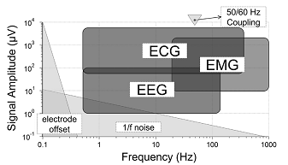
DESIGN (3)
Introduction
A.
1/f noise
common-mode interference
electrode offset
B.
high CMRR
low-noise
HPF
conﬁgurable
gain and ﬁlter
Frequency and amplitude characteristics of biopotential signals

Slide 41
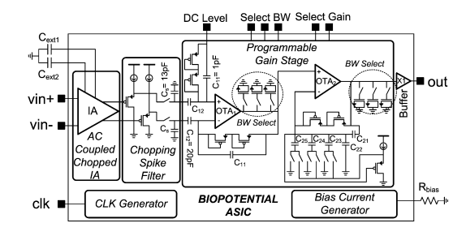
DESIGN (3)
Readout Front-end Architecture
front-end for the acquisition of EEG, ECG, and EMG signals

Slide 42
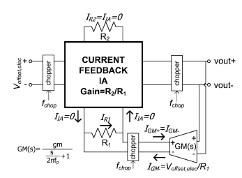
DESIGN (3)
AC Coupled Chopped Instrumentation Amplifier
Neither three-opamp IA nor SC IA is convenient for low-power and low-noise front-ends.

Slide 43
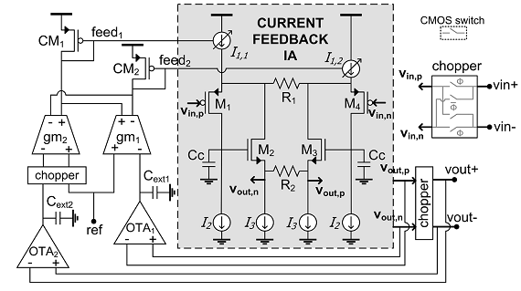
DESIGN (3)
AC Coupled Chopped Instrumentation Amplifier
ACCIA implementation that can eliminate the 1/f noise, while ﬁltering the DEO and the IA offset.

Slide 44
DESIGN (3)
AC Coupled Chopped Instrumentation Amplifier
Current Feedback Instrumentation Ampliﬁer
AC coupling ﬁlters the DEO, chopping
improves the CMRR and ﬁlters the 1/f noise of the current feed-back IA.
chopping spikes generated at the output

Slide 45
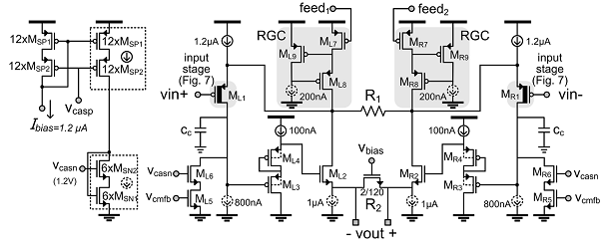
DESIGN (3)
AC Coupled Chopped Instrumentation Amplifier
Complete schematic of the current feedback IA

Slide 46
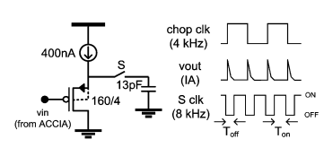
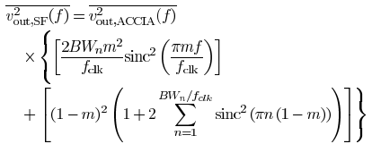
DESIGN (3)
Chopping Spike Filter (CSF)
To ﬁlter chopping spikes
Effect of T&H operation on
the output noise of the IA

Slide 47
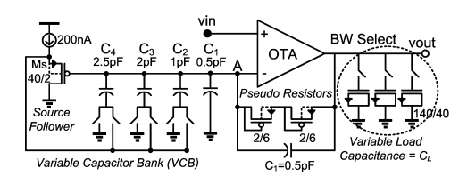
DESIGN (3)
Programmable Gain Stage
For different signals
Schematic of the VGA. Gain is set by the variable capacitor bank switches and low-pass cut-off frequency is set by the BW select switches.

Slide 48
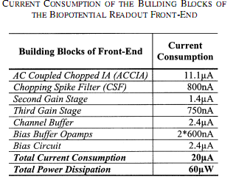
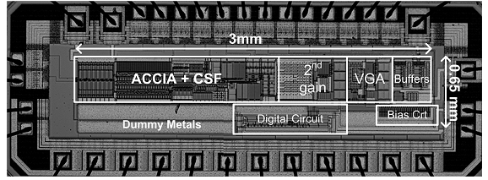
DESIGN (3)
Results
Die micrograph

Slide 49
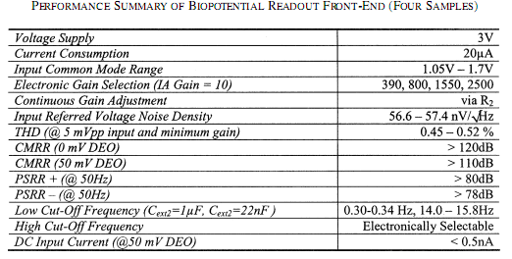
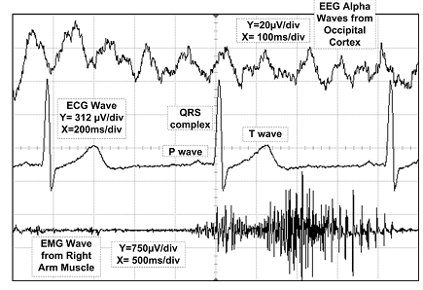
DESIGN (3)
Results
Extracted biopotential signals

Slide 50
DESIGN (3)
Conclusion
A readout front-end with conﬁgurable characteristics for EEG, ECG and EMG signals is presented.
Combination of the AC-coupled chopping technique with the low-power current feedback IA achieves more than 120 dB CMRR and 57 nV/ Hz input-referred noise density, while consuming only 11.1 uA from 3 V.
Chopping spike ﬁlter stage completely ﬁlters the chopping spike components.
Portable/wearable

Slide 51
Design(4)
Novel dry electrodes for ECG monitoring[4]
Journal of Physiological Measurement
Abstract
Outline
Introduction
Biomedical Basics
Novel dry and capacitive electrodes
Materials and methods
Results
Summary

Slide 52
Abstract
Two novel dry bioelectrodes (conductive & capacitive) for biopotential monitoring: development, fabrication and characterization;
Improve the applicability of dry electrodes in ambulant recording of ECG by reducing motion artifacts and the contact impedance to the skin;
Exhibit equivalent and superior contact impedances and biosignals;
Integrate a passive filter network into the new electrodes to suppress slow offset fluctuation of the ECG signal;

Slide 53
Outline
Introduction
Biomedical basics
Novel dry and capacitive electrodes
Reduction of contact impedance
Reduction of motion artifacts
Dry electrodes as a passive filter network
Materials and methods
Electrode types
Characterization methods
Results and discussion
Summary and outlook

Slide 54
Introduction
Increased costs for health care.
A challenge: to develop new OR to improve by decreasing the costs?
Microsystem technologies => miniaturized and innovative medical systems => increase the patient comfort considerably
Cardiovascular diseases! Main cause of death!!!
An early recognition of symptoms help.
Long-term recording of ECG is desirable, but limited by electrode performance (only a few days).

Slide 55
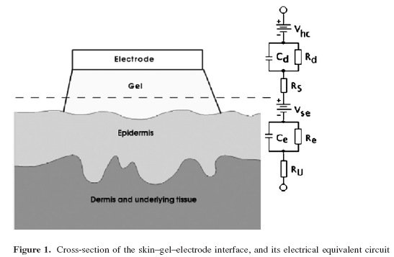
Biomedical basics - skin–gel–electrode interface
Ion currents have to be converted to electron currents with the electrode as the transducer.
The skin impairs the transfer from ions in the tissue to electrons in the electrode.
The capacitance of this layer is poorly defined and unstable.
The electrical transducer comprises the resistance of the electrolytic gel and the double layer at the electrode–electrolyte interface, as well as the half-cell potentials at both electrolyte interfaces.

Slide 56
Biomedical basics - Ag/AgCl gel, dry and capacitive electrodes
Ag/AgCl gel electrode
weakly polarized;
introduce very low ohmic impedances;
limited shelf life and are not reusable;
Dry electrode
partly polarized;
introduce a parallel circuit of an ohmic and a capacitive impedance;
Capacitive electrode
perfectly polarized;
introduce a capacitor;
Limited long-term performance improvement by dry and capacitive electrode.

Slide 57
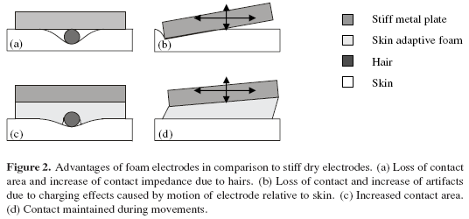
Novel dry and capacitive electrodes (1)
Adapt to the skin topography;
Guarantee small relative motion of the skin to the electrode;

Slide 58
Novel dry and capacitive electrodes (2)
Reduction of contact impedance
Enlarge the contact area by skin adaptive electrode, which is soft enough to adapt the geometry of the hair;
Reduction of motion artifacts
Maintain the contact even under motion by a soft electrode;
Dry electrodes as a passive filter network
Suppress fluctuations by a high-pass filter;

Slide 59
Materials and methods - Electrode types
Ag/AgCl gel electrode of type ARBO H92SG;
Dry silver electrodes (dry Ag) with a diameter of 2 cm were cut from a 0.3 mm thin silver foil;
Electrodes 2 cm in diameter were punched out of an electrically conductive foam. They were coated with a silver layer 400 nm thick on all surfaces. A 100 nm layer of titanium was used as an adhesion layer;
Capacitive electrodes (SiO2) were fabricated on silicon with a thermally grown silicon dioxide as the dielectric layer;

Slide 60
Materials and methods - Characterization methods (1)
Impedance spectroscopy.
The electrode–skin contact impedance was analyzed by a computer-controlled HP4192A impedance analyzer.
Motion artifacts.
The motion artifacts were evaluated from ECGs taken with a longterm ECG recorder, the CardioLight Smart Reader.
Minimum distance for electrodes.
Two electrodes were placed next to each other as close as 1 cm right under the left nipple.

Slide 61
Materials and methods - Characterization methods (2)
Passive filtering.
The transfer function was measured in a two-port measurement setup.
To eliminate the 50 Hz noise, a shielded measurement setup and symmetric input impedance at an amplifier with high common mode rejection is necessary.

Slide 62
Results and discussion (1)

Slide 63
Results and discussion (2)

Slide 64
Results and discussion (3)

Slide 65
Results and discussion (4)

Slide 66
Summary and outlook
The new dry and capacitive electrodes avoid the shortcomings of standard Ag/AgCl gel electrodes.
Rigid silver plates, silver plates coated with silver chloride, Ag-coated conductive polymer foam soft electrodes, and capacitive SiO2–Si electrodes were designed, fabricated and characterized with the objective of improving the contact on hairy skin to reduce the electrode impedance, to diminish motion artifacts and to passively filter zero-line fluctuations.
Future work will concentrate on the development of a soft capacitive electrode to combine the advantages of both new types of electrodes for a long-term ECG system, which is convenient with respect to all relevant electrode properties.

Slide 67
DESIGN(5)
3.9 mW 25-Electrode Reconﬁgured Sensor[5]
Introduction
Electrode design
System Architecture
REIA
Band switched ﬁlter
Remote controller
Low duty cycle transmitter
Implementation and results
Conclusion

Slide 68
DESIGN(5)
Introduction
A low power highly sensitive Thoracic Impedance Variance (TIV) and Electrocardiogram (ECG) monitoring SoC.
Multi-application integrated together
TIV requires high impedance detection sensitivity
The low noise requirements
Low power consumption for wearable

Slide 69
DESIGN(5)
Electrode Design:
Tightly attached to the chest to cover
the area of the heart
Compact poultice-like plaster sensor (15
cm* 15 cm 4-layer patch)
Wearable low cost cardiac healthcare
16 different sites across the heart to
enable the optimal sensing point

Slide 70
DESIGN(5)
Electrode Design
25 electrodes array d(reconﬁgurable)
Cm-range inductively
coupled power switch
A thin ﬂexible battery of 1.5
V with 30 mAh capacity
Fabric broad
thickness<<2mm

Slide 71
DESIGN(5)
ECG the electrode-skin contact impedance is less than 120 k at frequencies below1 kHz
sub-period 1:
ECG (Mode 0) is measured using 8 electrodes in direction 1

Slide 72
DESIGN(5)
sub-periods 2:
ECG (Mode 0) is measured using 8 electrodes in direction 0
The optimal sensing point to be selected

Slide 73
DESIGN(5)
System Architecture SoC(5mm*5mm)
a System Start-up Module (SSM)
four Reconﬁgurable Electrode sensor Front Ends (RE-FE)
DSCG(Differential Sinusoidal Current Generator
a digital module
a duty-cycled Body-Channel Transceiver(5%)

Slide 74
DESIGN(5)
Reconfigurable electrode instrumentation amplifier (REIA)
Enables reconﬁgurable electrode operation
Four switches (SE0–SE3) to time-multiplexed operation in ECG
detection mode
noise advantages
current efﬁciency
Gain=R2/R1

Slide 75
DESIGN(5)
Band switched ﬁlter
dual-mode operation to selectively amplify ECG signal
CH +pseudo-resistor→high pass (0.4Hz)
AC coupling→reject
DC offset
C2,R2 LPF (1.1kHz)
PGA→ minimize the
degradation of SNR

Slide 76
DESIGN(5)
Post processing analog readout signal path

Slide 77
DESIGN(5)
Remote controller
remote 8 b ID check
Step 1: remote controller in the base station provides a continuous wave at 13.56 MHz
Step 2: CMOS rectiﬁer in the SSM generates
Power-on-Reset (PoR) trigger signa
Step 3: transmits an
encoded ID packet
Step 4: decodes
the data packet and
veriﬁers its ID

Slide 78
DESIGN(5)
PI Decoder
Each symbol of the PIE envelope starts with
’0’ and ﬁnishes with ’1’ to separate each symbol
REF as a threshold signal is created by
charging a 4 pF MIM capacitor (2C)

Slide 79
DESIGN(5)
Low duty transceiver
FSK BCT
5 MHz gives a
data rate of 1 Mbps
Buffered
2.3 mW
%5 duty cycle

Slide 80
Design (5)
Implementation & results
Measured gain curve for dual-band operation of REIA
Measured TIV and ECG waveforms

Slide 81
Design (5)
Conclusion:
A low power, high resolution TIV and ECG monitoring SoC is designed for wearable.
TIV detection is possible with a high detection sensitivity.
high quality balanced sinusoidal current source and reconﬁgurable high CMRR readout electronics are utilized.
Low duty BCT to achieve low power consumption and low cost

Slide 82
Design(6)
Power-Efﬁcient Cross-Correlation Beat Detection in Electrocardiogram Analysis Using Bitstreams [6]
Introduction
Heartbeat Detection
Single-Chip Cross-Correlator
Implementation
Measurement Results
Conclusion

Slide 83
Design(6)
Introduction
The beneﬁt of adopting specialized silicon systems forminimal size and power consumption in BSN applications is evident.
Long-term ECG observation sensor worn during normal activity and should not interfere with normal lifestyle to catch some typical diseases.
A novel single-chip cross-correlator is proposed for ECG analyses.
“Smart” ECG electrode with embedded heart-beat detection

Slide 84
Design(6)
Heartbeat Detection
P, QRS, T, Timing…
Trade-off between the computational efﬁciency and detection quality.
Beat detection involves identifying all cardiac cycles in ECG recordings and locating each identiﬁable waveform component within a cycle.

Slide 85
Design(6)
Heartbeat Detection
Multicomponent-Based Heartbeat Detection
Three templates were used to search the wave isolation.
Locate the QRS complex by cross-correlating the QRS template with the ECG signal
Repeat with the P, T wave templates.
The threshold value is established during a pre-learning phase and can be adjusted.
Computational complexity requires power-efﬁcient implementations.

Slide 86
Design(6)
Single-Chip Cross-Correlator
Multiply elements from template and input over a window of lengh n.
The computation methods should be considered for the power saving.

Slide 87
Design(6)
Single-Chip Cross-Correlator
Bitstream Representation Perform cross-correlation by processing bitstream.
Bitstream Conversion binary-to-bitstream by interpolation filter and sigma-delta modulator, CIS filter, low OSR
Bitstream Operations Use simple XNOR , asynchronous counter design, bubble register, thermometer coded

Slide 88
Design(6)
Single-Chip Cross-Correlator
D. Bitstream Cross-Correlation
Computed directly on bitstream coded signals.
The template is shifted in directly as a bitstream coded sequence of up to 1024 bits in a template register.
Incoming bitstream signal is shifted through the correlation register.
Multiplied by XNOR gates at the start of every clock cycle.
Bubble register is loaded with the results for asynchronous sorting.

Slide 89
Design(6)
Implementation
1x1 mm
Delta-sigma converter
1024-bits cross-corelator
STMicro 90-nm Tech
Chip layout

Slide 90
Design(6)
Implementation
Asynchronous bubble register
diagram of the implemented chip

Slide 91
Design(6)
Measurement Results
(a) QRS template. (b) T template
Cross-correlation results for the QRS

Slide 92
Design(6)
Conclusion
Presented a novel bitstream
-based single-chip running
cross-correlator.
Compact and power-efﬁcient
Reduce communication demands and power consumption.

Slide 93
Design(7)
A Wearable Health Care System Based on Knitted Integrated Sensors[7]
Introduction
Wealthy system
Wealthy functions
Materials and Methods
Results
Conclusion

Slide 94
Design(7)
Introduction
Need for renovation in our health managing system.
Comfortable sensing interface, easy to use and easy to
Textile customize embedded in clothing items
WEALTHY system, conductive and piezoresistive yarns.

Slide 95
Design(7)
Wealthy system
Strain fabric sensors based on piezoresistive yarns, fabric electrodes realized with metal-based yarns.
In the sensitive garment
Continuous monitoring

Slide 96
Design(7)
Wealthy functions
Signal sensing
Signal conditioning
Signal processing
Data transmission

Slide 97
Design(7)
Materials and Methods
Fabric Electrodes
Fabric Piezoresistive Sensor
Impedance Pneumography
Connections
Garment Model and Realization
Washability and Reusability

Slide 98
Design(7)
Results
Signals in basal condition, D1, D2, D3 Einthoven leads I, II, III. V2,V5: standard precordial leads V2 and V5. Th-R, Ab-R: respiration sensors in thoracic and abdominal positions, respectively. Sh-M, Eb-M:movement sensors on the left shoulder and elbow, respectively.
Detail of ECG signals during abduction–adduction of the left shoulder.

Slide 99
Design(7)
Results
Comparison of V2 and V5 precordial leads acquired with fabric and standard electrodes
Comparison of precordial V2 and V5 ECG signals obtained with subject walking on the spot with standard and fabric electrodes.

Slide 100
Design(7)
Conclusion
The most innovative characteristic of the WEALTHY system consists of the use of conductive and piezoresistive materials in the form of ﬁbers and yarns.
These new integrated knitted systems enable applications
The possibility of simultaneously recording different signals
Use of standard textile to realize the sensing elements
possible to perform normal daily activities while the clinical status is monitored

Slide 101
Design(8)
ECG Recording on a Bed During Sleep Without Direct Skin-Contact[8]
Introduction
Methodology
Experiment Setup
Results
Discussion
Conclusion

Slide 102
Design(8)
Introduction
An electrocardiogram (ECG) measurement
during sleep
long-term
easy home usage
nonintrusive daily ECG monitoring
Indirect contact (IDC) electrocardiogram(ECG) measurement method (IDC-ECG).
Maintaining contact
Reduce skin irritation

Slide 103
Design(8)
Methodology
Insulated electrodes
An array of active
electrodes
Ground conductive textile
Mattress cover and
pajamas clothes

Slide 104
Design(8)
Methodology
A. Active Electrodes
electrode face,
preamp, and shield.
high-input
impedance ampliﬁer
shield to prevent noise

Slide 105
Design(8)
Methodology
B. Frequency Response of the Active Electrode
OPA124

Slide 106
Design(8)
Methodology
C. ECG Measurement by Electrode Array
D. Indirect-Contact Ground
Requires a reference
Large conductive textile laid on
the lower area of the bed
compensated for the high impedance
per unit area

Slide 107
Design(8)
Experiment Setup
A. Active Electrode
B. Mattress Assembly
C. Electronics and Data Acquisition
D. ECG With Ag-AgCl Electrodes for Comparison

Slide 108
Design(8)
Results
(a) supine position; (b) on right side; (c) on left side; (d) supine position movement.

Slide 109
Design(8)
Results
Outputs obtained from two of the eight electrodes over a 6-h sleep period

Slide 110
Design(8)
Discussion
Variation in
impedance between
the electrodes and the body and the variation in the whole body potential due to triboelectricity.
------- cotton produces the least motion artifacts.
Hard to discriminate ECG from most of the large artifacts.
Used for diagnosis in a restricted area or as an auxiliary method.

Slide 111
Design(8)
Conclusion
An ECG was recorded with distinct R-peaks during sleep, regardless of body position and location on the bed.
The waveforms varied according to the contact condition and position.
Further study on analyzing the waveform is needed for the motion artifacts.
Shows the feasibility of using IDC-ECG for long-term
daily ECG monitoring during sleep with minimal intrusion.

Slide 112
REFERENCES
[1] Long Yan, Jerald Yoo, Hoi-Jun Yoo.; A 0.5-uVrms 12-uW Wirelessly Powered Patch-Type Healthcare Sensor for Wearable Body Sensor Network, IEEE journal of solid-state circuits, vol. 45, no. 11, Nov 2010
[2] Amy D. Droitcour, Olga Boric-Lubecke Gregory; Signal-to-Noise Ratio in Doppler Radar System for Heart and Respiratory Rate Measurements, IEEE transactions on Microwave theory and techniques, vol 57,no.10, OCT 2009.
[3] Refet Firat Yazicioglu; Patrick Merken; Robert Puers; A60 uW60 nV/ Hz Readout Front-End for Portable Biopotential Acquisition Systems, IEEE journal of solid-stae circuits, Vol,42, No.5, May 2007
[4] Anna Gruetzmann, Stefan Hansen and J¨ org M¨ uller; Novel dry electrodes for ECG monitoring, Journal of Physiological Measurement, 2007 Page(s): 1375–1390
[5] Long Yan; Joonsung Bae; Hoi-Jun Yoo; A 3.9 mW 25-Electrode Reconﬁgured Sensor for Wearable Cardiac Monitoring System, IEEE Journal of solid –state circuits, Jan 2010

Slide 113
REFERENCES
[6] Olav E. Liseth, Daniel Mo, Håkon A. Hjortland; ower-Efﬁcient Cross-Correlation Beat Detection in Electrocardiogram Analysis Using Bitstreams, IEEE Transactions on Biomedical Circuits and Systems, Vol 4, No.6, Dec. 2010.
[7] Rita Paradiso, Giannicola Loriga, and Nicola Taccini; A Wearable Health Care System Based on Knitted Integrated Sensors, IEEE Transactions on Information Technology in Biomedicine, vol. 9, No. 3, Sep. 2005.
[8] Yong Gyu Lim, Ko Keun Kim, and Kwang Suk Park; ECG Recording on a Bed During Sleep Without Direct Skin-Contact, IEEE Transactions on Biomedical Engineering, Vol. 54,No. 4, April 2007.
[9] Richard R. Fletcher; Sarang Kulkarni ; Clip-on Wireless Wearable Microwave Sensor for Ambulatory Cardiac Monitoring , 32nd Annual International Conference of the IEEE EMBS Buenos Aires, Argentina, August 31 - September 4, 2010

Slide 114
REFERENCES
[10] Galeottei, L.; Paoletti, M.; Marchesi, C.; Development of a low cost wearable prototype for long-term vital signs monitoring based on embedded integrated wireless module, Computers in Cardiology, 2008 Page(s): 905 – 908
[11] Low, Y.F.; Mustaffa, I.B.; Saad, N.B.M.; Bin Hamidon, A.H.; Development of PC-Based ECG Monitoring System, 4th Student Conference on Research and Development, 2006 Page(s): 66 – 69
[12] Kyriacou, E.; Pattichis, C.; Hoplaros, D.; Jossif, A.; Kounoudes, A.; Milis, M.; Vogiatzis, D.; Integrated platform for continuous monitoring of children with suspected cardiac arrhythmias, 9th International Conference on Information Technology and Applications in Biomedicine, 2009 Page(s): 1 – 4
[13] Romero, I.; Grundlehner, B.; Penders, J.; Huisken, J.; Yassin, Y.H.; Low-power robust beat detection in ambulatory cardiac monitoring, IEEE Biomedical Circuits and Systems Conference, 2009 Page(s): 249 – 252
[14] Saeed, A.; Faezipour, M.; Nourani, M.; Tamil, L.; Plug-and-play sensor node for body area networks, IEEE/NIH Life Science Systems and Applications Workshop, 2009 Page(s): 104 – 107

Slide 115
REFERENCES
[15] Whitchurch, A.K.; Abraham, J.K.; Varadan, V.K.; Remote system for patient monitoring using Bluetooth, IEEE Region 5 Technical Conference, 2007 Page(s): 163 – 166
[16] Amien, M.B.M.; Bo Cheng; Jiarui Lin; Robust techniques for designing remote real-time arrhythmias classification system, IEEE/NIH Life Science Systems and Applications Workshop, 2007 Page(s): 200 – 204
[17] Wong, A.C.W.; McDonagh, D.; Omeni, O.; Nunn, C.; Hernandez-Silveira, M.; Burdett, A.J.; Sensium: an ultra-low-power wireless body sensor network platform_ Design & application challenges, Page(s): 6576 – 6579
[18] Ang, K.H.; Yuanda Xu; Khandoker, A.H.; Simulink-based sleep apnea screening model for portable diagnosis, 5th International Conference on Intelligent Sensors, Sensor Networks and Information Processing (ISSNIP), 2009 Page(s): 201 – 206
[19] Williams, G.; King, P.J.; Capper, A.M.; Doughty, K.; The Electronic Doctor (TED)-a home telecare system, Proceedings of the 18th Annual International Conference of the IEEE Engineering in Medicine and Biology Society, 1996 Page(s): 53 - 54 vol.1
[20] Qiaoling Tu; Jing Zhang; Zhexia Deng; The Research for Wireless electrocardiogram Biosensor System, IEEE International Conference on Information Acquisition, 2006 Page(s): 6 – 10

Slide 116
REFERENCES
[21] Frehill, P.; Chambers, D.; Rotariu, C.; Using Zigbee to Integrate Medical Devices, 29th Annual International Conference of the IEEE Engineering in Medicine and Biology Society, 2007 Page(s): 6717 – 6720
[22] Justesen, J.; Madsen, S.C.; Wearable wireless ECG monitoring hardware prototype for use in patients own home, 3rd International Conference on Pervasive Computing Technologies for Healthcare, 2009 Page(s): 1 – 3
[23] Fei Hu; Yang Xiao; Qi Hao; Congestion-aware, loss-resilient bio-monitoring sensor networking for mobile health applications, IEEE Journal on Selected Areas in Communications, Volume: 27 , Issue: 4 2009 , Page(s): 450 – 465
[24] Chuo, Y.; Marzencki, M.; Hung, B.; Jaggernauth, C.; Tavakolian, K.; Lin, P.; Kaminska, B.; Mechanically Flexible Wireless Multisensor Platform for Human Physical Activity and Vitals Monitoring, IEEE Transactions on Biomedical Circuits and Systems, Volume: 4 , Issue: 5 2010 , Page(s): 281 – 294

Slide 117
REFERENCES
[25] Fei Hu; Meng Jiang; Wagner, M.; De-Cun Dong; Privacy-Preserving Telecardiology Sensor Networks:Toward a Low-Cost Portable Wireless Hardware/Software Codesign, IEEE Transactions on Information Technology in Biomedicine, Volume: 11 , Issue: 6 2007 , Page(s): 619 - 627
[26] B. Lo, G.Y. Yang, “Architecture for body sensor networks,” IEEE Proceeding of Perspective in Pervasive Computing. 2005, pp 23-28.
[27] http://en.wikipedia.org/wiki/Ecg
[28]http://focus.ti.com/lit/ds/symlink/ina114.pdf
[29]http://www.bluegiga.com/
[30] Shih-Lun Chen, Ho-Yin Lee, Chiung-An Chen, Hong-Yi Huang, Ching-Hsing Luo, Wireless Body Sensor Network With Adaptive Low-Power Design for Biometrics and Healthcare Applications. IEEE SYSTEMS JOURNAL, VOL. 3, NO. 4, DECEMBER 2009
[31] Kiing-Ing Wong , Miri, Malaysia , Real-time Heart Rate Variability Detection on Sensor
Node . SAS 2009-IEEE Sensors Applications Symposium, New Orleans, LA, USA- February 17-19, 2009

Slide 118
REFERENCES
[32] Tee Hui Teo. Xinbo Qian, “A 700-uW Wireless Sensor Node SoC for Continuous Real-Time Health Monitoring”, IEEE JOURNAL OF SOLID-STATE CIRCUITS, VOL. 45, NO. 11, NOVEMBER 2010
[33] Cosmin Rotariu, Petronel Bigioi, Des Chambers, “Lightweight PnP ECG sensor for Monitoring of Biomedical Signals”
[34] Richard R. Fletcher, Sarang Kulkarni, “Clip-on Wireless Wearable Microwave Sensor for Ambulatory Cardiac Monitoring”, 32nd Annual International Conference of the IEEE EMBS Buenos Aires, Argentina, August 31 - September 4, 2010
[35] Long Yan, Joonsung Bae, Seulki Lee, “A 3.9 mW 25-Electrode Reconﬁgured Sensor for Wearable Cardiac Monitoring System”, IEEE JOURNAL OF SOLID-STATE CIRCUITS, VOL. 46, NO. 1, JANUARY 2011

Slide 119
REFERENCES
[36] Braga, F.; Forlani, C.; Signorini, M.G.; A knowledge based home monitoring system for management and rehabilitation of cardiovascular patients, Computers in Cardiology, 2005 Page(s): 41 – 44
[37] Kim, Hyejung; Yongsang Kim,; Hoi-Jun Yoo,; A low cost quadratic level ECG compression algorithm and its hardware optimization for body sensor network system, 30th Annual International Conference of the IEEE Engineering in Medicine and Biology Society, 2008 Page(s): 5490 – 5493
[38] Jae Hyuk Shin; Youngjoon Chee; Myungsoo Lee; Kwang Suk Park; A Multiparameter Wearable Workload Analysis System for Power Plant Operators, 3rd IEEE/EMBS International Summer School on Medical Devices and Biosensors, 2006 Page(s): 112 – 114
[39] Borromeo, S.; Rodriguez-Sanchez, C.; Machado, F.; Hernandez-Tamames, J.A.; de la Prieta, R.; A Reconfigurable, Wearable, Wireless ECG System, 29th Annual International Conference of the IEEE Engineering in Medicine and Biology Society, 2007 Page(s): 1659 – 1662
[40] Cai Ken; Liang Xiaoying; A Zigbee Based Mesh Network for ECG Monitoring System, 4th International Conference on Bioinformatics and Biomedical Engineering (iCBBE), 2010 Page(s): 1 – 4

