Slide 1
They Can Hear Your Heartbeats: Non-Invasive Security for Implantable Medical Devices
Shyamnath Gollakota, Haitham Hassanieh, Benjamin Ransford, Dina Katabi, and Kevin Fu ACM SIGCOMM 2011

Slide 2
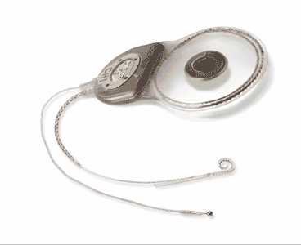
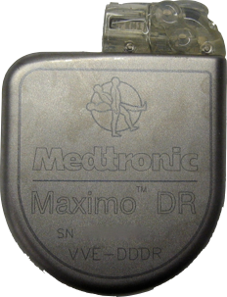
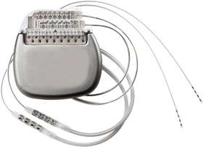
Implantable Medical Devices (IMD)
Neurostimulators
Cardiac
Defibrillators
Cochlear Implants

Slide 3
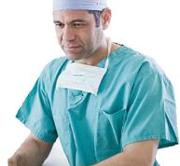
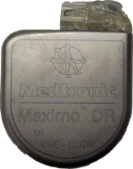
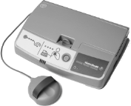
Wireless Interaction in IMD
Notes:
Having wireless in these devices has multiple benefits.
First, it makes it easier to communicate with the implant itself.
More importantly, it enables remote monitoring of the patient’s status.
The patient can be in her home; she would have an implant reader that periodically queries the implant for patient’s vital signals. The reader then forwards this information to the medical professionals over the internet.

Slide 4
Wireless Interaction in IMD
Pro: Safety and Cost
Con: Security and Privacy
Easier communication with implant
Remote monitoring
Reduces hospital visits by 40% and cost per visit by $1800 [Journal of the American College of Cardiology, 2011]
Passive attack: Eavesdrop on private data
Active attack: Send unauthorized commands

Slide 5
Possible Security Measurements
Cryptography?
Problems 1) In emergencies, patient may be taken to a foreign hospital where doctors do not have the secret key 2) Millions of patients already have implants with no crypto; would require surgery to replace

Slide 6
Ideal Solution
Cryptography? => The “Shield”
Problems 1) In emergencies, patient may be taken to a foreign hospital where doctors do not have the secret key => can be non-intrusively disable 2) Millions of patients already have implants with no crypto; would require surgery to replace => external security module

Slide 7
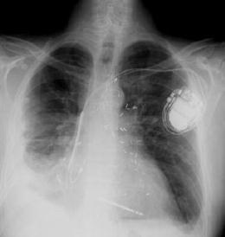
Traditional System

Slide 8
Shield: Secure Legal Communication
Use encryption
Doctor configures the shield with a secret key
Shield encrypts the implant data and forwards it to doctor
→ Shield acts as proxy

Slide 9
Shield: Jam Illegal Communication
Turn off therapy
Implant ID
Shield listens on medium
Shield jams unauthorized commands
➔ Implants can’t decode or react to illegal commands

Slide 10
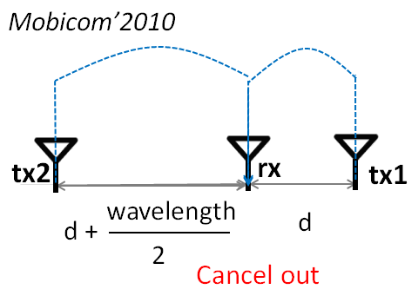
Technical Issue
Needs to be able to Tx (jam) and Rx at the same time.
Needs to be small enough to be portable.
wavelength
≈ 40 cm
2

Slide 11
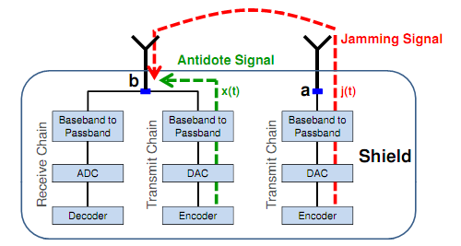
Solution
The “Antidote”
w/o antidote: 50% BER
w/ antidote: 0.2% packet loss

Slide 12
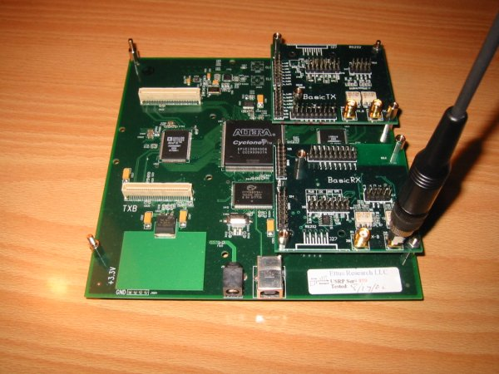
Implementation
USRP2 (Universal Software Radio Peripheral)
Antenna *2
FPGA
Ethernet interface
SD card reader

Slide 13
Evaluation
IMD: MedtronicTM cardiac implants
Legal user: MedtronicTM IMD programmer
Attacker: USRP2
Shield: USRP2
Human body: bacon & beef

Slide 14
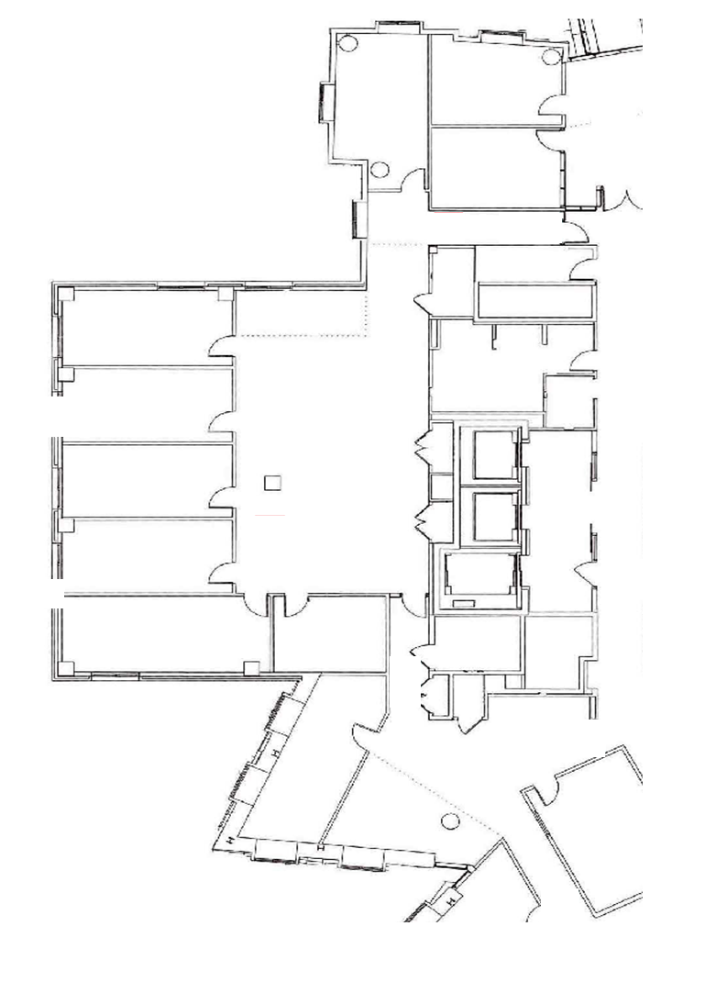
Test Bed
IMD & Shield fixed in one place
20 locations for attacker to test
20cm
30 m

Slide 15
Phase1: Passive Eavesdrop
Worst case scenario
Attacker is only 20cm away from IMD
Average loss rate
0.2%

Slide 16
Phase2: Active Attack
Simulating two kinds of attackers 1) Off-the-shelf IMD programmer 2) Self-modified programmer with x100 transmission power

Slide 17
Phase2-1: Off-the-shelf Attacker
w/o Shield
w/ Shield
Less than 14 meters

Slide 18
Any attack successful
Without the Shield
No attack successful
14 m
Notes:
Here are the results without the shield. As we can the attacker is successful as far 14 meters away and in non-line-of-sight configuration. Thus, an attacker can be in a different room and still mount this attack on an unsuspecting target.

Slide 19
Any attack successful
With the Shield
No attack successful
20 cm
Notes:
Next, here are the results in the presence of a shield.
As we can see, even at the closest attacker location which is about 20 cm away from the implant, the adversary is unsuccessfully in mount the attack.
Thus, we conclude that independent of the location, the shield protects from an adversary mounting active attacks using off-the-shield programmers.

Slide 20
Phase2-2: x100 Power Attacker
Too powerful, cannot jam it due to limited battery power of Shield
However, can warn the wearer by beeping and/or vibration to leave the location

Slide 21
Phase2-2: x100 Power Attacker

Slide 22
Any attack successful
Without the Shield
No attack successful
27 m
Notes:
First lets look at the result when there is no shield. Now the attack can be mount from farther locations which are as far as 27 meters away. This is expected because the adversary uses much higher power and hence can reach longer distances.
Now lets look at the results in the presence of the shield.

Slide 23
Any attack successful
With the Shield
No attack successful
Notes:
Here are the result.
We can see that the attacker is successful only from nearby locations.
Thus, although the shield cannot protect from all high power attacks, now the attacker has to get much closer to the patient to successfully mount its attack.
thus, It has significantly raised the bar on the attacker.
But, once the attacker gets close enough, it can overwhelm the jamming power and reach the implant.
This is a intrinsic limitation of jamming where the shield is constrained by the FCC limitations, while the attacker is not.

Slide 24
Phase2-2: x100 Power Attacker
Cannot totally eliminate the hazard
But,
Raise the bar of active attack
Provide detection of hazard

Slide 25
Conclusion
First to secure medical implants without modifying them
Other applications in RFIDs, small low-power sensors, legacy devices
Convergence of wireless and medical devices open up new research problems

Slide 26
Few Comments (kcir)
Meticulous foot notes
Kind of verbose/repetitive
DoS -> wears out the battery
Technical invention in disguise of an application work, incurs more attention

