Slide 1
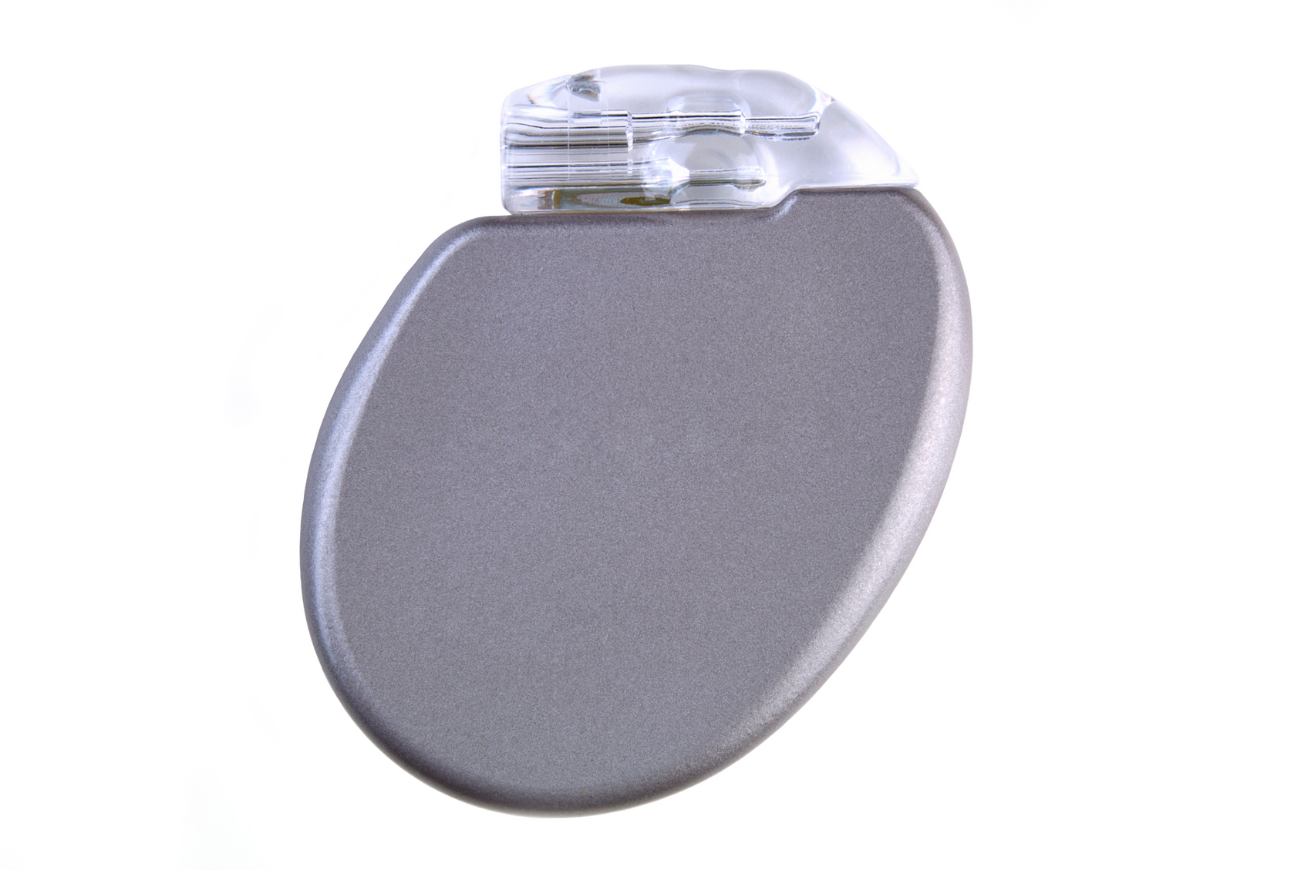
SoK: Security and Privacy in Implantable Medical Devices and Body Area Networks
Michael Rushanan*, Denis Foo Kune, Colleen M. Swanson, Aviel D. Rubin, s&p14
Fall 2014
Presenter: Kun Sun, Ph.D.
Thank Michael for sharing the slides.

Slide 2
What is an Implantable Medical Device?
The FDA strictly defines a medical device
Device
  Embedded system that can sense and actuate
Implantable
  Surgically placed inside of a patient’s body
Medical
  Provides diagnosis and therapy for numerous health conditions

Slide 3
IMD are not your typical PCs

Slide 4

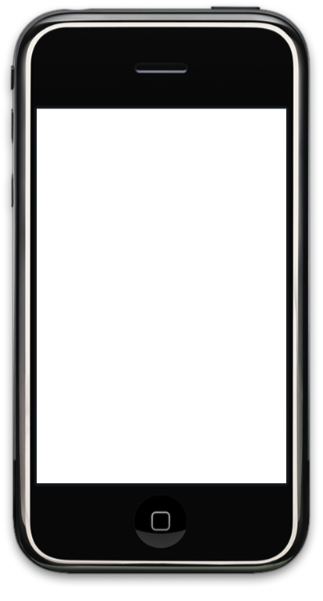

IMD are not your typical PCs

Slide 5
IMD are not your typical PCs
There exists resource limitations
  The battery limits computation and is not rechargeable
There are safety and utility concerns
  The IMD must be beneficial to the patient and elevate patient safety above all else
  Security and privacy mechanisms must not adversely affect the patient or therapy
Lack of security mechanisms may have severe consequences
IMD’s provide safety-critical operation
  Must fail-open in the context of an emergency

Slide 6
Research Questions
How do we provide security and privacy mechanisms that adequately consider safety and utility?
When do we use traditional security and privacy mechanisms or invent new protocols?
How do we formally evaluate security and privacy mechanisms?
Novel attack surfaces

Slide 7


A Healthcare Story
Alice
Cardiac Carl
Nurse
Patient

Slide 8
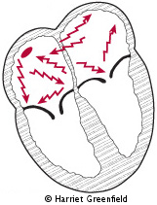
Cardiac Carl’s Condition
Atrial Fibrillation
Implantable Cardioverter Defibrillator
His ICD is safety-critical
Cardiac Carl
Atrial Fib.

Slide 9

Alice and Carl’s Relationship
Where are the security and privacy mechanisms?
visits
Cardiac
Carl
Nurse
Alice
accesses ICD w/ programmer
receives private data
adjusts therapy

Slide 10
Alice and Carl’s Relationship
Mallory
Hacker Elite

Slide 11
Alice Mallory and Carl’s Relationship
Mallory
Cardiac
Carl
Nurse
Alice
eavesdrop
forge
modify
jam
wireless communication
  [Halperin, S&P, 08], [Li, HealthCom, 11]

Slide 12
Attack Surfaces
Cardiac
Carl

Slide 13
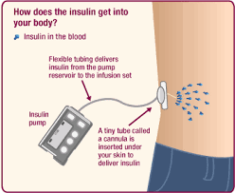
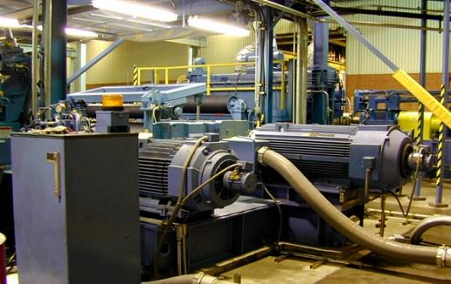
Red Herring?
Insulin pump: a self-contained controller
Most wireless communication is one direction
  Read data from IMD
  No write to IMD (like Dick Cheney’s)
  malware
Similar to Industrial Control System
  Can read data from sensors
  No write to control the actuators
  Stuxnet on Iran’s nuclear plant

Slide 14
Security and Privacy Mechanisms
Security and Privacy mechanisms exist in standards
  Medical Implant Communication Services
  Wireless Medical Telemetry Service
These mechanisms are optional
Interoperability might take priority of security
  [Foo Kune, MedCOMM, 12]

Slide 15
Biometrics and Physiological Values
Out-of-Band
Distance Bounding
Software/Malware
External Devices
Anomaly Detection
Future Work
Telemetry Interface

Slide 16
Research Challenges
Access to Implantable Medical Devices
  Is much harder then getting other components
Reproducibility
  Limited analysis of attacks and defenses
  Do not use meat-based human tissue simulators
  Do use a calibrated saline solution at 1.8 g/L at 21 ◦C
    The complete design is described in the ANSI/AAMI PC69:2007 standard [92, Annex G]

Slide 17
Security and Privacy Mechanisms
Biometric and Physiological Values
  Key generation and agreement
Electrocardiogram (ECG)
  Heart activity signal
Interpulse interval
  Time between heartbeats

Slide 18
H2H Authentication Protocol
TLS without certs
Cardiac
Carl
measure ECG α
Nurse
Alice
measure ECG β
send ECG measurement β
send ECG measurement α
  [Rostami, CCS, 13]
Notes:
Intended for emergency authentication with no pre-established relationship
IPI measurements are one time values and may be used to authenticate every session
When Carl decommits to Alice she checks if the measurements are approximately the same.
If it is she decommits for Carl

Slide 19
H2H Authentication Protocol
Adversarial Assumptions
  Active attacker with full network control
  The attacker cannot:
    Compromise the programmer
    Engage in a denial-of-service
    Remotely measure ECG to weaken authentication
  [Rostami, CCS, 13]
Notes:
Strong adversary

Slide 20
Physiological Values as an Entropy Source
How do ECG-based protocols work in practice?
  Age, Exertion, Noise
ECG-based protocols rely on an analysis of ideal data in an unrealistic setting
  Data sample is close to their ideal distribution
  Very accurate estimate of distribution characteristics
  Extract randomness using the estimate on the same data sample
Observability
  Using video processing techniques to extract ECG-signals
  [Rostami, S&P, 2013] [Chang, HealthTech, 2012]
  [Poh, Biomedical Engineering, 11]

Slide 21
Future Work

Slide 22
Trusted Sensor Interface
Current systems trust their analog sensor inputs
This assumption may not always hold
Forging signals using electromagnetic interference
  Inject cardiac waveform
[Foo Kune, S&P, 2013]

Slide 23
Neurosecurity
Neurostimulators
  What are the new attack surfaces
  What are the implications of recording and transmitting brainwaves
Brain computer interfaces
Cognitive recognition could leak:
  Passwords, personal information
[Martinovic, USENIX, 2012], [Denning, Neurosurg Focus, 09]

Slide 24
Questions?
IMDs are becoming more common
  Improving patient outcome
Research gaps exists
  Software
  Sensor Interface
Areas for future work include
  Physiological values as an Entropy Source
  Trusted Sensor Interface
  Neurosecurity

