Slide 1
Neighborhood Watch: Security and Privacy Analysis of Automatic Meter Reading Systems
Ishtiaq Rouf, Hossen Mustafa
Rob Miller
Marco Grutese
Presented By Krishna Rawali Puppala

Slide 2
What is a Smart Meter??

Slide 3
Benefits of having a Smart Meter
No more manual readings.
More accurate bills.
Improves efficiency and reliability.
Real time reports.
And many more.....
But is it SECURE ????

Slide 4
Beware!! Smart Meters are tracking us

Slide 5
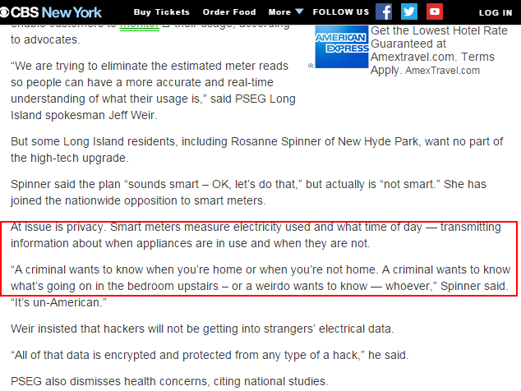
Recent Articles

Slide 6
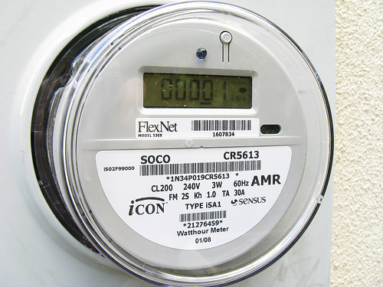
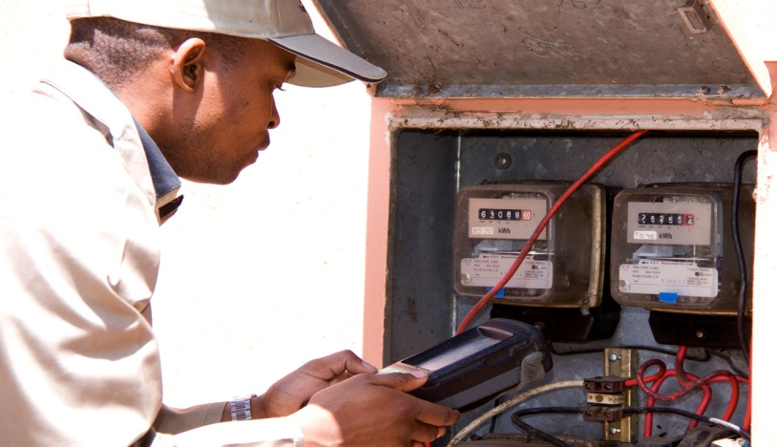
Architecture
AMR Meters
Has metering engine &
ERT(Encoder-Re
-ceiver-Transmitter)
AMR Readers
Handheld devices
Mobile collectors
Fixed Network AMR
- No manual walk.

Slide 7
Communication Protocol
Meters use simple modulation schemes-
OOK ( on-off Keying) or FSK ( Frequency Shift Keying) included with the Manchestor Encoding Scheme.
Two types of Communication models-
Wake-up Model
Two-way communication
Reader sends an Activation signal to wake-up the meter.
Bubble-up Model
One-way communication
There is a meter reading broadcast for every 30s.

Slide 8
Reverse Engineering to discover meter protocol
First step is to capture few transmissions from each meter.
Built a detection software to capture, replay and verify signals.

Slide 9
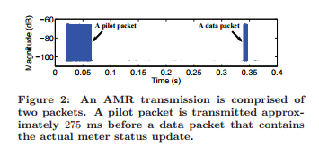
AMR Transmission Packets
Pilot Packet-
A high priority control packet associated with the data packet.

Slide 10
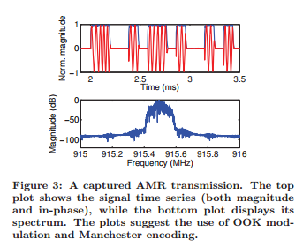
Reverse Engineering to discover meter protocol (cont)
Decoding Packets

Slide 12
Lessons Learned
Reverse Engineering requires modest effort.
- Anyone can reverse engineer with low cost and effort.
No Encryption.
- Anyone can eavesdrop on real time consumption packets.
Battery drain attacks.
- Wake-up meters transmit a packet as soon as they receive an activation signal.

Slide 13
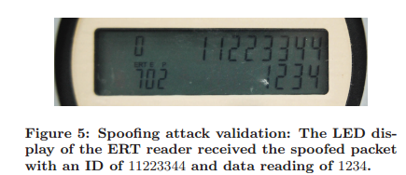
Packet Spoofing
Spoofing a packet has become easier.
Packet is spoofed with an arbitrary meter ID and reading.
Observations-
No Authentication.
No Input Validation.

Slide 14
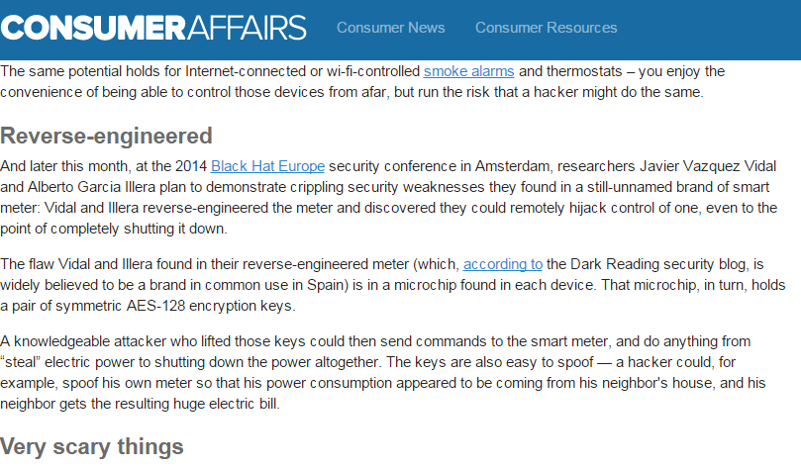
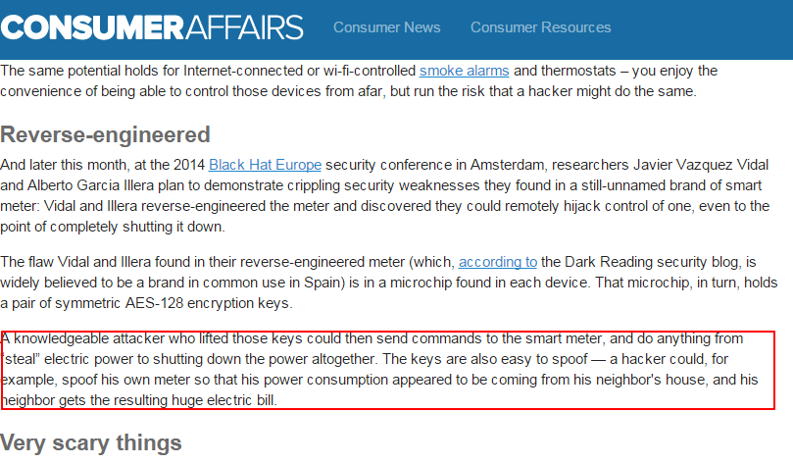

Slide 15
Neighborhood Monitoring
Eavesdropping Range-
Tested two locations in a state: Rural and Urban
Location Range
Rural 150m
Urban 70m
Results- Attacker can able to sniff packets in any area without entering private property.

Slide 16
Neighborhood Monitoring(cont)
Boosted Eavesdropping Range
How to boost the range at low cost?
- Adding LNA ( Low Noise Amplifier).
- LNA amplifies received signal strength.
Increases eavesdropping range in the urban area from 70m to 300m

Slide 18
Neighborhood Monitoring
Number of Observed Meters
Used two RF Sniffers –
- Narrowband Sniffer 4 MHz
- Wideband Sniffer 12.5MHz
Meter w/o LNA w LNA
Narrowband 72 161
Wideband 106 485

Slide 19
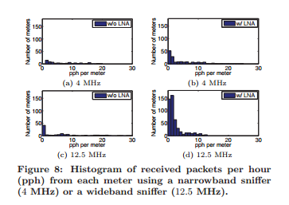
Neigborhood Monitoring
Packet Reception Rate
Received packets per hour (pph)
Larger pph maps to more frequent energy consumption and high level of information leakage.

Slide 20
Even at a low packet reception rate, it is very easy to infer data of the residents.

Slide 21
Inferring Household Events
Visual Observation Mechanisms
- on-board LCD display
- infrared (IR) LED using cameras or IR photodiodes.

Slide 22
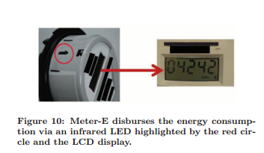
Inferring Household Events
Automated LCD Screen Monitoring
For every consumption of Wh( Watt-hour), one of the dot toggles
Tracks the toggles on a laptop and generates electricity trace.

Slide 23
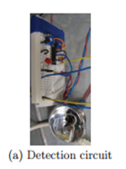
Inferring Household Evemts
Infrared LED Monitoring
For every consumption of 1Wh, IR LED flashes.
Designed IR circuit to capture the IR flashes.
Once the diode detects the flash, the voltage becomes high.

Slide 24
Experiments & Results
Examined whether RF Sniffing can reveal sensitive information.
Found that RF sniffing suffered from low granularity of data.
Question: RF eavesdropping information sufficient to infer sensitive data?
Ans: Conducted two experiments and found that both camera and IR based methods captured data with high granularity than RF Eavesdropping.

Slide 25
Results

Slide 26
Defense Strategies
Spoofing Defenses for Legacy Meters
Radio fingerprinting techniques.
Anomaly Detection.
Cryptographic Mechanisms
Encrypting data packets using standard block encryption algorithms.
Requires upgrading of the meters.
Jammer add-on
add-on device PPJ (Privacy Preserving Jammer). No upgradation.

Slide 27
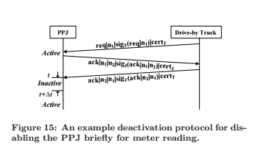
Privacy Preserving Jammer
Deactivation Protocol

Slide 28
Conclusion
AMR systems are vulnerable to spoofing attacks.
Continuous broadcast of readings for every 30s risking millions of meters.
Offered a security solution that the authors call PPJ.
No modification of current meters.
Prevents information leakage.

