Slide 1
Lab Materials
Wireless Power Charge Security Via Chaos-Based Frequency Adjustment
Austin Burnett Nathan Howdon D’Arrys Smith Allison O’Shea Philip Zicarelli
Faculty Advisor: Dr. Fei Hu

Slide 2
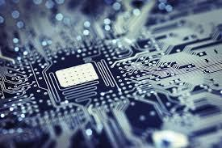
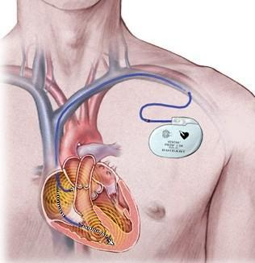
What is a Cyber-Physical System(CPS)?
A cyber-physical system is a system of computational elements interacting physical entities.
Example: Implanted Medical Devices
Cyber Physical
Notes:
"Cyber-Physical Systems (CPS) is a critical part of the national cyber infrastructure. Security threats to CPS pose significant risk to the health and safety of human lives, threaten severe damage to the environment, and could impose an adverse impact on the U.S. economy." - Homeland Security, Dr. Nabil Adam, 2010.

Slide 3
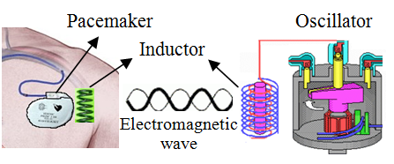
Motivation (Why?)
•Homeland Security
•Health and Safety
•General security measures cannot be used to protect all cyber-physical systems
–Securing IMD Wireless Charging
Notes:
More energy transferred to the IMD than the required amount results in the energy releasing through heat causing organs to be damaged. If not enough energy is transferred then the IMD can not work properly. A vulnerable, unsecured system could be susceptible to a cyber attack Attack on Smart Grid → Loss of Power Attack on Implanted Medical Device → Health and Safety Risks

Slide 4
Project Goal
Build integrated analog and digital circuit to achieve wireless power charge security of a cyber-physical system based on randomness as well as controllable capacitor array
n
Objectives Met
Static Wireless Power Transfer Achieved
Switching Capacitance Implemented
Microcontroller Code Complete
Additional Objectives
Full Integration of Microcontroller and Breadboard Circuit

Slide 5
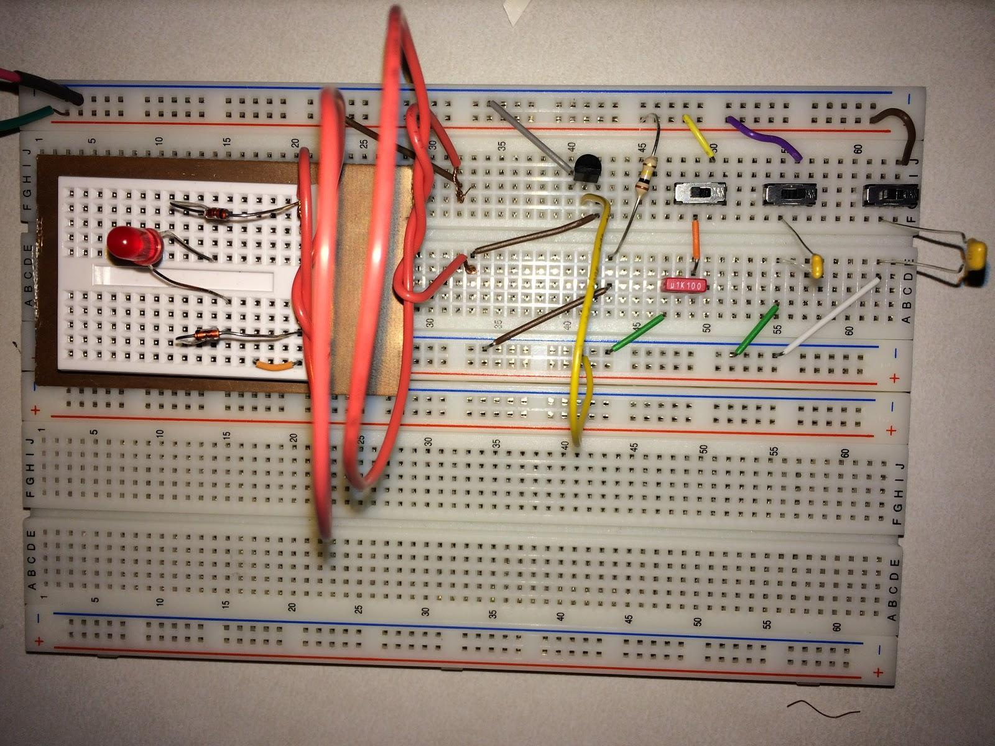
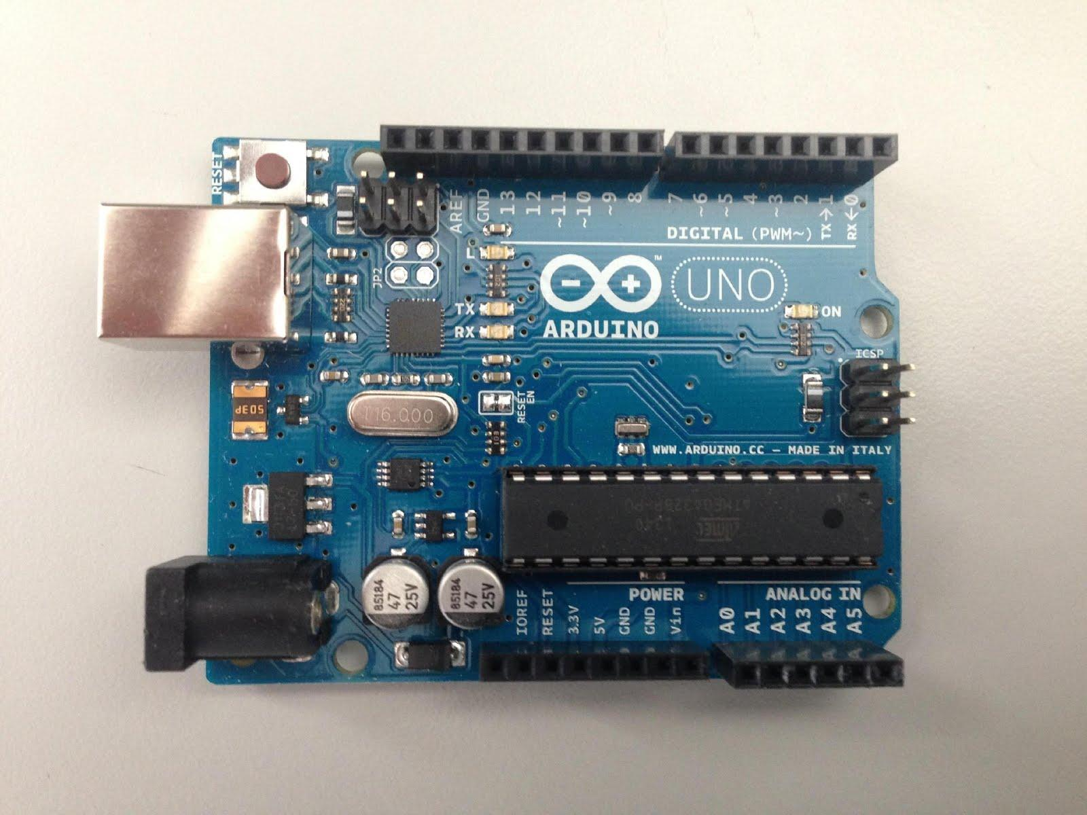
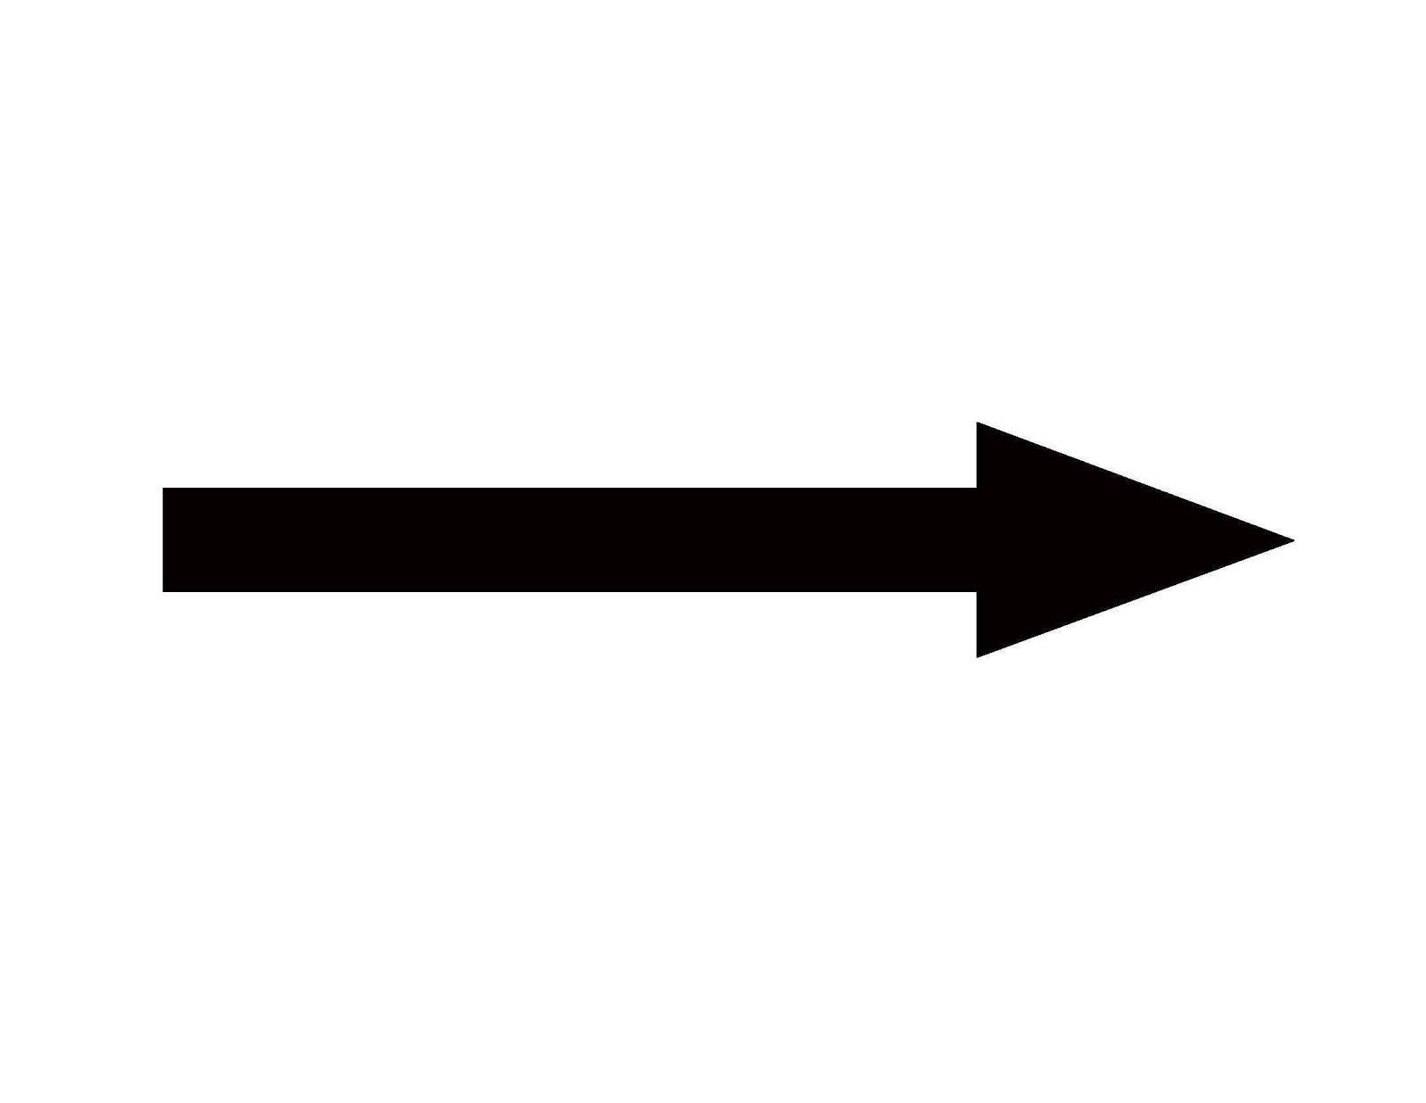
Strategy
Computer to view Chaotic Map
USB Link
Notes:
talk about the differences in our project vs the paper. desired frequency range needs to be in the 100kHz . If the frequency is <10kHz then it could harm the surrounding the organs. The L is supposed to come from the coil.

Slide 6
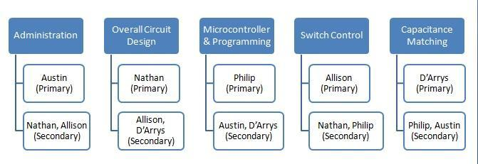
Distribution of Responsibilities

Slide 7
Distribution of Responsibilities
Austin
Microcontroller/Code
Nathan
Wireless Power Transfer Circuit (Sender)
D’Arrys
Test Lead and Validation Planner
Allison
Wireless Power Transfer Circuit (Receiver)
Philip
Integration Lead

Slide 8
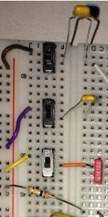
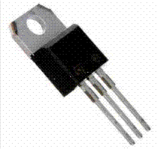
Switches
Slide Switch
MOSFET
Instantaneous Switching
Absolute ON/OFF
Simple for testing
Does not require manual switching
Allows microcontroller code to be used

Slide 9
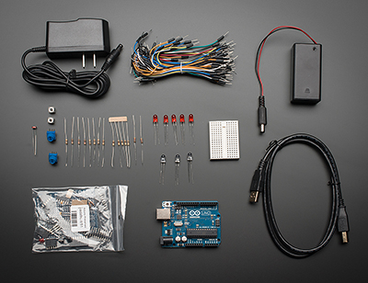
Microcontroller
Arduino Microcontroller Starter Kit
Adequate speed (Clock speed 16 MHz)
Cost efficiency
Comes with additional parts
Will be used to implement our random code
Will be used as our USB interface
Has 14 digital I/O pins

Slide 10
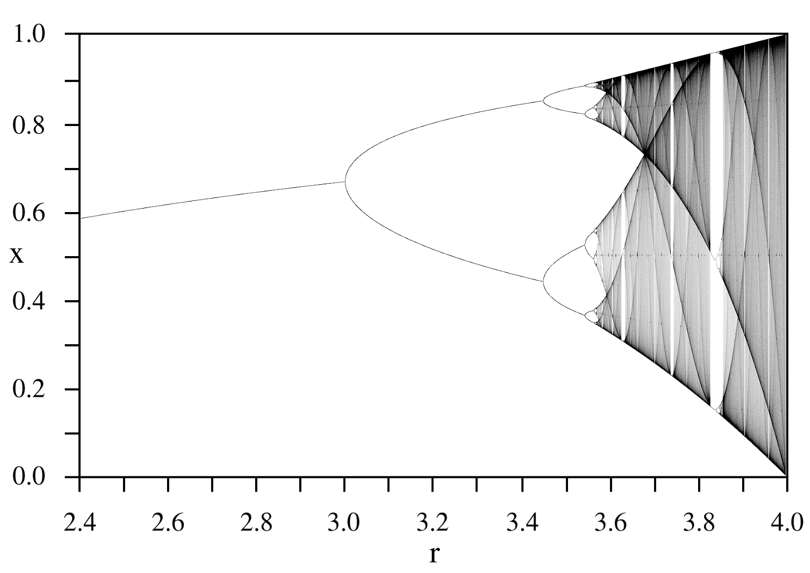
Randomness
To make the frequency switch sequence confidential to attackers, we propose a Logistic Maps based capacity control.
Chaos comes from microcontroller
Chaos → randomness
Frequency range can be divided into 2¹⁰ = 1024 different subranges
X_{n+1} = rX_{n}(1-X_{n}), 0<X_{n}<1, r>0

Slide 11
Final Microcontroller Code
//Initialization of Parameters
const double A = 4.0; // Logistic map constant
double X0 = 0.1; // Initial position (0 < X0 < 0.8)
double X = X0; // Use X0 as your first calculated point
//Loop to Select LEDs
void loop(){
if (X < 0.1) //Truth Table Case 0
{ digitalWrite(LEDpin[0],LOW);
digitalWrite(LEDpin[1],LOW);
digitalWrite(LEDpin[2],LOW);
delay(wait);}
else if ((X >= 0.1) && (X < 0.2)) //Truth Table Case 1
blinkLED (LEDpin[2]);
.
.
.
else //Truth Table Case 7
{digitalWrite(LEDpin[0],HIGH);
digitalWrite(LEDpin[1],HIGH);
digitalWrite(LEDpin[2],HIGH);
delay(wait);
digitalWrite(LEDpin[0],LOW);
digitalWrite(LEDpin[1],LOW);
digitalWrite(LEDpin[2],LOW);}
//Logistic Map Equation
X0 = X;
X = A * X0 * (1.0 - X0);

Slide 12
Final Microcontroller LED Test

Slide 13
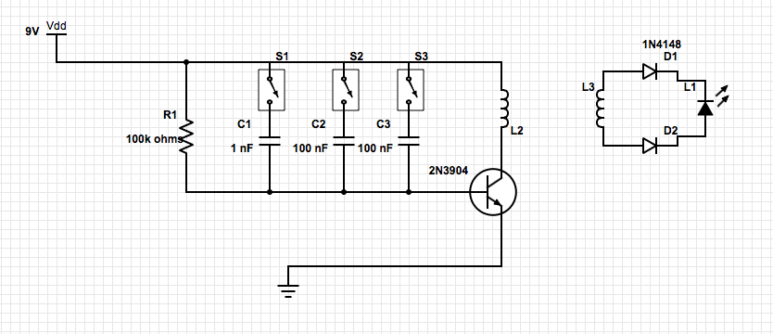
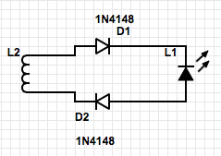
Wireless Power Transfer Circuit
4.7 nF

Slide 14
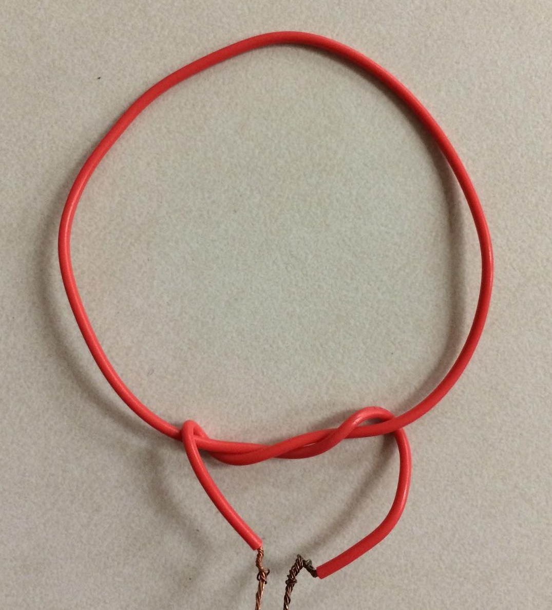
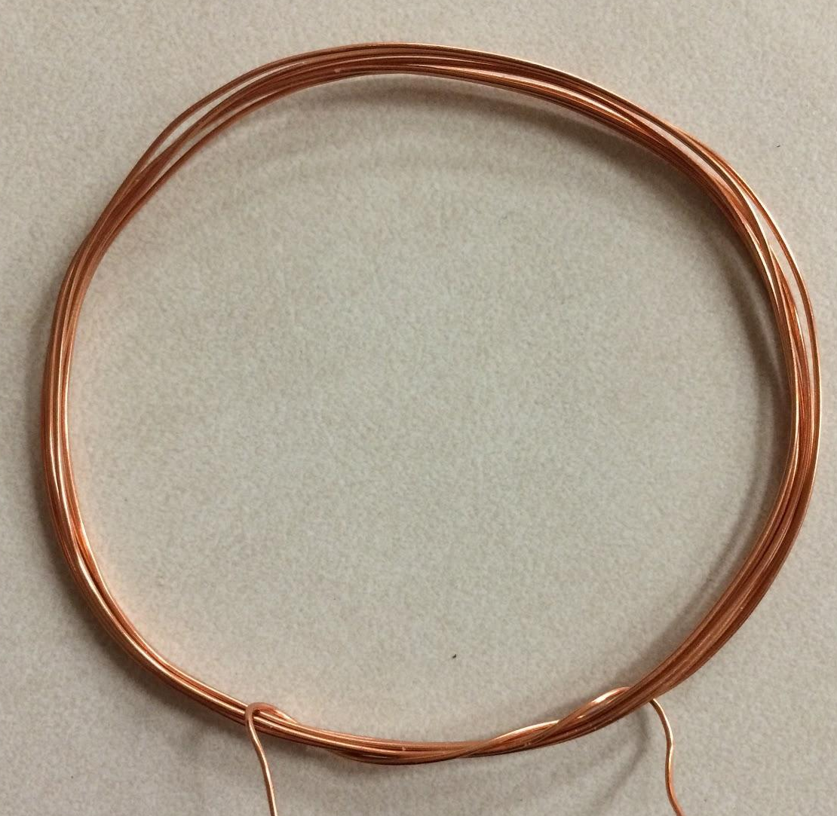
Inductors
Copper Wire
-less secure
-would not transmit current to the receiver circuit.
-easier to create
Insulated Wire
- provides protection from power frequency in security systems
-strengthen power transfer

Slide 15
Wireless Power Transfer Circuit
Components:
Switches
100k resistor
100 nF capacitor
1nF capacitor
4.7 nF
Insulated wire
LED
2N3904 Transistor
1N4148 diodes

Slide 16
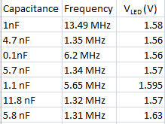
Frequency Values
1 Turn

Slide 17
Demonstration Varying Distance

Slide 18
Demonstration Capacitance Variation

Slide 19
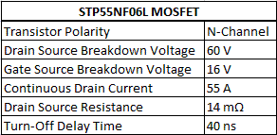
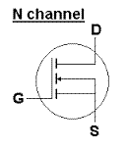
Overall Integration
Notes:
I have 2 minutes on this slide, but need to add some color to the slide. - NH

Slide 20
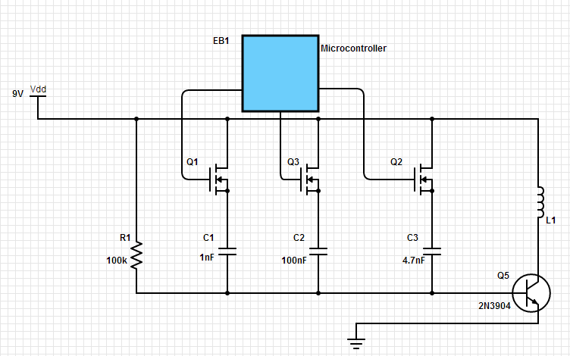
Primary Circuit after Integration
Notes:
I have about 1.5 minutes on this slide - NH

Slide 21
Societal Impacts
●More Security → More Intense Threats
●Difficulty Sustaining Charge
○Time
○Energy
●Benefits
○Decrease the need for surgery →Less complications
○Safety of patient from cyber attacks

Slide 22
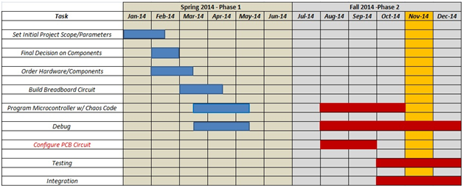
Project Schedule
Notes:
Spring 2014 - Breadboard, Proof of Concept… Fall 2014 - PCB, More Realistic Implementation

Slide 23
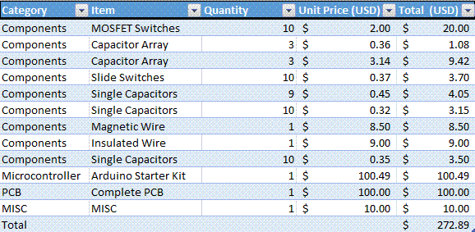
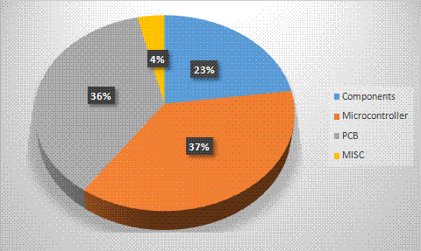
Budget
Notes:
Updated budget. I can make this slide 1- 2 minutes as needed - NH

Slide 24
Thank you for your time.
Does anyone have questions?

