Slide 1
Comprehensive Experimental Analyses of Automotive Attack Surfaces
Stephen Checkoway, Damon McCoy, Brian Kantor, Danny Anderson, Hovav Shacham, and Stefan Savage
University of California, San Diego
Karl Koscher, Alexei Czeskis, Franziska Roesner, and Tadayoshi Kohno
University of Washington
Presented by
Tejaswee Bhargava Pasumarti

Slide 2
Authors
Stephen Checkoway
Research interests are in (embedded) systems security, health IT security, and voting particularly in voting security and post-election auditing.
Damon McCoy
Research includes work on wireless privacy, anonymous communication systems, cyber-physical security, and economics of e-crime.
Brian Kantor
Research interests include: Wireless and satellite communications, digital signal processing
Alexei Czeskis
Authentication in a variety of contexts: from resource constrained embedded devices (for example in RFIDs or automotive systems) to online transactions involving powerful desktop computers, and, of course, mobile devices.
Franziska Roesner
Research interests: security, privacy and systems.
Karl Koscher
Analyzing how information can leak from deniable file systems, developing embedded systems.
Hovav Shacham
Cybersecurity Policy, cryptography

Slide 3
Abstract
Modern automobiles are pervasively computerized.
Vulnerable to attacks.
Internal networks within modern cars are insecure.
Whether automobiles are susceptible to remote compromise.
Broad range of attack vectors.
Wireless communications channels usage.
Structural characteristics of automotive system and practical challenges.

Slide 4
Outline
Introduction
Threat Model
Vehicle Attack Service
Vulnerability Analysis
Indirect Physical Exploits
Short-range Wireless Exploits
Long-range Wireless Exploits
Threat Motivation
Fixes & Conclusion

Slide 5
Introduction
Modern cars controlled by complex distributed computing systems.
Systems are controlled by tens of heterogeneous processors (ECUs)
ECUs : is a controller with responsibilities including braking, lighting, gps etc
Each ECU has multiple interfaces fro different buses
Millions of lines of code
Multiple separate communication buses
Benefits like efficiency, safety, cost
New attacks are possible
Analysis of external attack vectors

Slide 6
Threat Model
Technical Capabilities
Capabilities in analyzing the system and developing exploits
Focuses on making technical capabilities realistic
Operational capabilities
Analysis of attack surface of vehicles
How malicious payload is delivered
Indirect physical access, short-range wireless, long-range wireless accesses

Slide 7
Vehicle attack surface
Indirect physical access
OBD-II
On board diagnostics II
Connects to all key CAN buses of vehicle
Used during vehicle maintenance
Entertainment : Disc, USB, iPod

Slide 8
Vehicle attack surface
Short-range wireless access
Bluetooth
Remote Keyless Entry
Tire Pressure (TPMS)
Wifi

Slide 9
Vehicle attack surface
Long-range wireless access
GPS
Satellite radio
Digital radio
Remote Telematics Systems

Slide 10
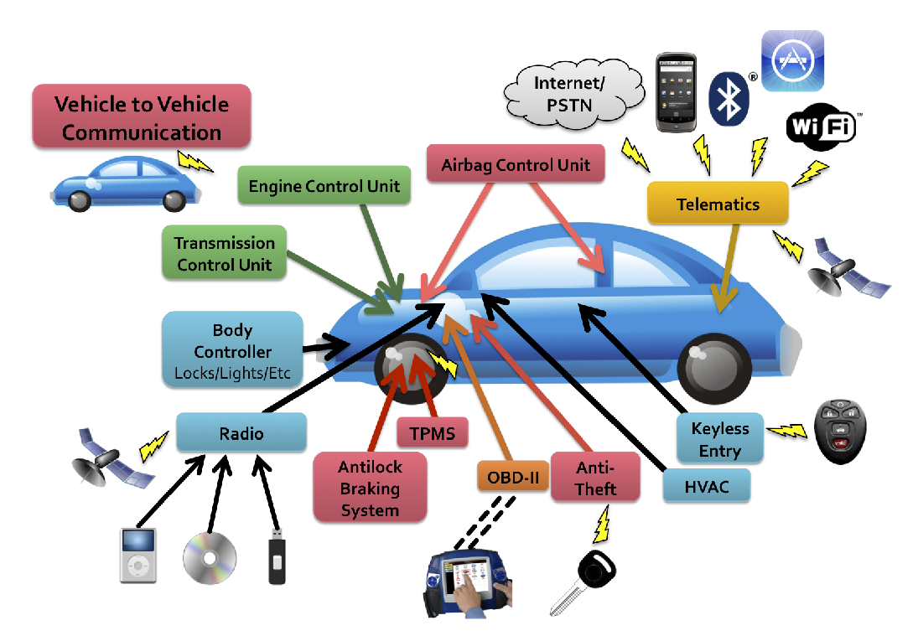
Vehicle attack surface

Slide 11
Vulnerability Analysis
Focused on moderately priced sedan with standard options and components
Cars < 30 ECUS comprising both critical drivetrain components & less critical components
PassThru for ECU diagnosis and reprogramming
Every vulnerability demonstrated allowed complete control of vehicle’s system
General Procedure:
Identify microprocessor (PowerPC, ARM, Super-H, etc)
Extract firmware and reverse engineer using debugging devices/software where possible
Exploit vulnerability or simply reprogram ECU

Slide 12
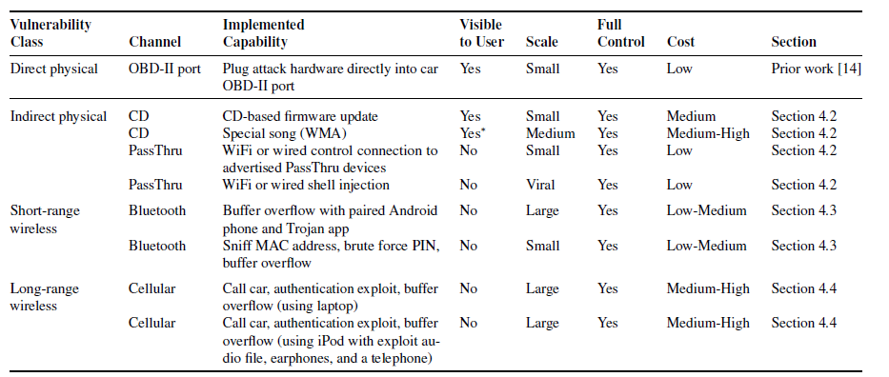
Exploitation Summary

Slide 13
Indirect physical exploits
Media Player
Accepts compact discs
Software running on CPU handles audio parsing, UI functions, handles connections
Two exploits
Latent update capability of player manufacturer
Updates when user does nothing
WMA parser vulnerability
Audio file parse correctly on a PC - In vehicle send arbitrary CAN packets

Slide 14
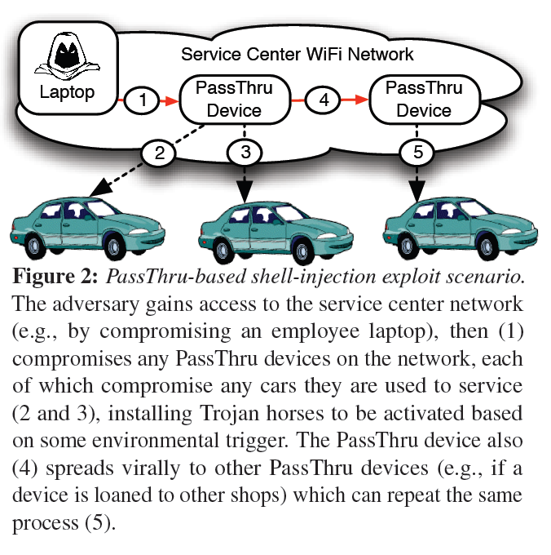
Indirect physical exploits
OBD-II
Looked at PassThru device from manufacturere
Found no authentication for PC’s on same WiFi network
Found exploit allowing reprogramming of PassThru
Allows for PassThru worm
Allows for control of vehicle reprogramming
Includes unsecured and unused Linux programs

Slide 15
Short-range wireless exploitation
Bluetooth:
Found popular Bluetooth protocol stack with custom manufacture code on top
Custom code contained 20 unsafe calls to strcpy()
Indirect attack → assumes attacker has paired device
Implemented Trojan on Android device to compromise machine
Direct attack → exploits with a paired device
Requires brute force of PIN to pair device (10 hours) → Limited by response of vehicle’s Bluetooth

Slide 16
Long-range wireless exploitation
Cellular attack
Telematics
SSL
PPP
3G
Telematics
Software modem
Voice channel
Cell phone

Slide 17
Long-range wireless exploitation
Telematics Connectivity:
Similar to Bluetooth → 3rd party device with manufacturer code on top
Again found exploit in transition from 3rd party to manufacturer “Command” program for data transfer
Lucky for manufacturer → bandwidth did not allow exploit transfer within timeout
Exploit required of authentication code
Random nonce not so random
Bug that allows authentication without correct response

Slide 18
Threat motivation
Theft:
Scary version → mass attack cellular network creating vehicle botnet
Able to have cars report VIN and GPS
Can unlock doors, start engine and fully startup car
Cannot disable steering column lock
Surveillance:
Allows audio recording from in-cabin microphone

Slide 19
Security fixes
Looked at easily available fixes to exploits:
Standard security engineering best-practices e.g. don’t use unsafe strcpy → instead strncpy
Removing debugging and error symbols
Use stack cookies and ASLR
Remove unused services e.g. telnet and ftp
Code guards
Authentication before re-flashing

Slide 20
Conclusion
Vulnerability causes:
Lack of adversarial pressure
Conflicting interests of ECU software manufacturers and car manufacturers
Ex: Telematics, Bluetooth & Media Player
Penetration testing

