Slide 1
RFID Applications in Cyber-Physical System
Authors: Nan Wu and Xiangdong Li
Presented By
Adarsh Sriram

Slide 2
About Authors
Xiangdong Li
Professor X. Li received his Ph.D. from the Graduate Center of CUNY. Having worked for five years as a security specialist in the IT industry before coming to City Tech, Professor Li is now building the information security laboratory which is supported by DOD. Professor Li is also a faculty member of Ph.D. programs in Computer Science and Physics at the CUNY Graduate Center, instructing doctoral candidates.
Nan Wu
Assistant Professor at Nanjing University, China

Slide 3
Contents
Overview of CPS
Introduction RFID
Active RFID
Active Wireless Position Network
Conclusion

Slide 4
Contents
Overview of CPS

Slide 5
What is a CPS?
A system which combines and coordinates the physical system and informatics or computational entities (including computation and communication) into a tight mode.

Slide 6
Applications of CPS
Aerospace
Automotive
Chemical processes
Civil infrastructure
Energy
Healthcare
Manufacturing
Transportation
Entertainment and
Consumer appliances.

Slide 7
Contents
Introduction RFID

Slide 8
What is RFID?
Introduction
Active Wireless Position Network
Active RFID
Conclusion
Radio Frequency Identification
An ADC (Automated Data Collection) technology that:
uses radio-frequency waves to transfer data between a reader and a movable item to identify, categorize, track..
Is fast and does not require physical sight or contact between reader/scanner and the tagged item.
Performs the operation using low cost components.
Attempts to provide unique identification and backend integration that allows for wide range of applications.
Other ADC technologies: Bar codes, OCR

Slide 9
RFID applications
Introduction
Active Wireless Position Network
Active RFID
Conclusion
Manufacturing and Processing
Inventory and production process monitoring
Warehouse order fulfillment
Supply Chain Management
Inventory tracking systems
Logistics management
Retail
Inventory control and customer insight
Auto checkout with reverse logistics
Security
Access control
Counterfeiting and Theft control/prevention
Location Tracking
Traffic movement control and parking management
Wildlife/Livestock monitoring and tracking

Slide 10
RFID
Introduction
Active Wireless Position Network
Active RFID
Conclusion
Example of Cyber Physical System because of its mainly functional and physical components:
The computational element: although a passive RFID tag normally only contains the storage function, but the whole RFID system (mainly in a RFID tag reader) and the post-processing system have the computing and data processing functions
The controlling element: usually a RFID system is under the control of an inner micro- control-unit (MCU);
The communication element: in a RFID system nearly all the information is exchanged via the wave of radio frequency (RF), the data and controlling flows are established via a 2-way RF communication

Slide 11
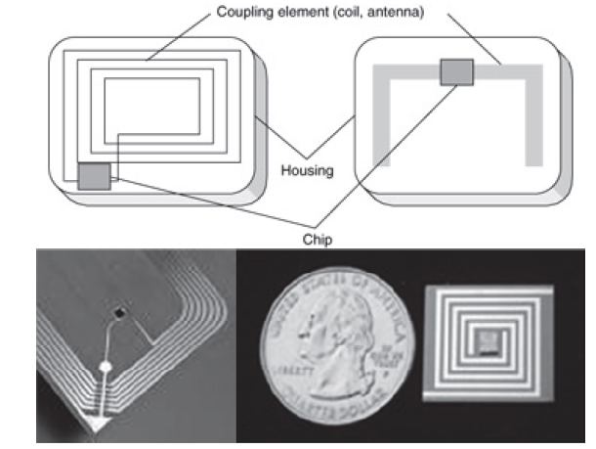
The structure and outside view of RFID tags
Introduction
Active Wireless Position Network
Active RFID
Conclusion

Slide 12
Types of RFID
Introduction
Active Wireless Position Network
Active RFID
Conclusion
Mostly the regular RFID systems for the civil use are classified into three types –
The passive,
The semi-passive and
The active RFID.

Slide 13
Types of RFID
Introduction
Active Wireless Position Network
Active RFID
Conclusion
The Passive tag
A passive tag is dormant until it is triggered by a signal from a RFID reader.
A passive tag does not have a built-in power supply, so it needs the radio frequency energy (electromagnetic wave) from the RFID reader.
These tags are particularly popular in use because they can draw the power wirelessly, such that the size and price can be reduced much.
Furthermore, these tags can be applied on almost everything because of the wide use of the wireless power supply

Slide 14
Types of RFID
Introduction
Active Wireless Position Network
Active RFID
Conclusion
The semi-passive tag
Contains a small battery to function an inner timer or random access memory.
The power supply does not actively communicate with a reader until it is requested.
When it is requested, it uses the radio wave power to transmit the information to the reader, which is the same as that of a passive one.

Slide 15
Types of RFID
Introduction
Active Wireless Position Network
Active RFID
Conclusion
The Active tag
An active tag has a more powerful small power source (a battery or other changeable DC source) built-in.
Unlike the semi-passive tags, it can actively communicate with the readers without the need of radio wave power.

Slide 16
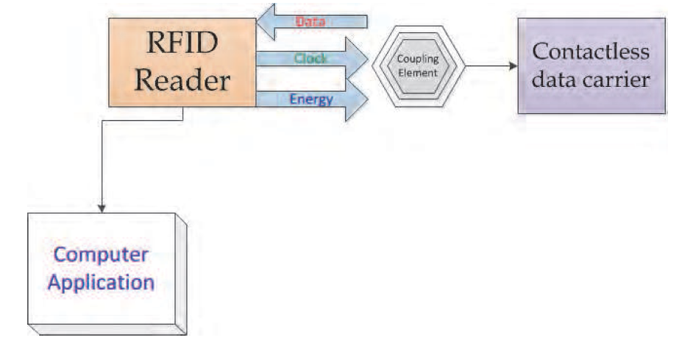
Simple passive RFID system diagram
Introduction
Active Wireless Position Network
Active RFID
Conclusion

Slide 17
RFID:SMART TAGS
Introduction
Active Wireless Position Network
Active RFID
Conclusion
A paper label with RFID inside
an antenna, printed, etched or stamped ...
… and a chip attached to it
… on a substrate
e.g. a plastic
foil ...
Source: www.rfidprivacy.org

Slide 18
Contents
Active RFID system

Slide 19
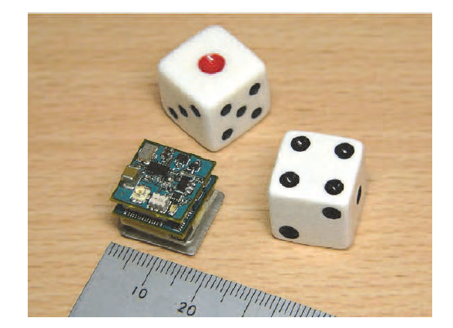
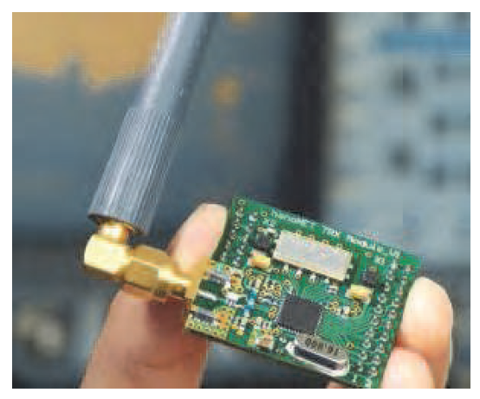
Active RFID tag
Introduction
Active RFID
Introduction
Active Wireless Position Network
Active RFID
Conclusion
A compacted active RFID tag
An active RFID tag with a changeable antenna

Slide 20
Why Active RFID ?
Introduction
Active Wireless Position Network
Active RFID
Conclusion
Limitations of Passive RFID tag
Weak two way complex communication.
Energy supply is not sufficient for a more complex computation.
It may not be possible to include sensors that can use electricity for power.

Slide 21
Classification of RFID tags
Introduction
Active Wireless Position Network
Active RFID
Conclusion

Slide 22
Introduction
Active Wireless Position Network
Active RFID
Conclusion
RFID application in CPS = active RFID system + wireless sensor + protocols + network
collaborative mechanism

Slide 23
Contents
Active Wireless Position Network

Slide 24
Active Wireless Positioning Network
Introduction
Active Wireless Position Network
Active RFID
Conclusion
Overcomes the limitations of GPS.
Independent of GPS.
Based on
an Active RFID system
the TOA (time of arrival) technology and related algorithms

Slide 25
Introduction
Active Wireless Position Network
Active RFID
Active RFID
The distributed node location service's algorithms and the systems can be categorized as
a self-node positioning
a target-node positioning.
A node in the network is recognized as
a beacon node
an unknown node

Slide 26
wireless sensor n/w positioning technology
Introduction
Active Wireless Position Network
Active RFID
Active RFID
Compared with the traditional wireless positioning technology, it provides new features below:
• Large scale;
• Low hardware resource requirement;
• Non-centralized Ad-hoc network;
• Low energy cost;
• Self-organizing;
• Dynamic topology;
• High positioning accuracy;
• Dynamic positioning supported;
• Communication and positioning

Slide 27
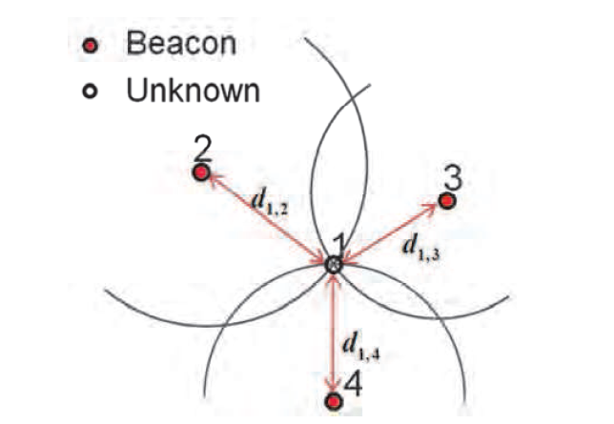
Estimation of the position of an unknown node by using the trilateration method
Introduction
Active Wireless Position Network
Active RFID
CONCLUSION

Slide 28
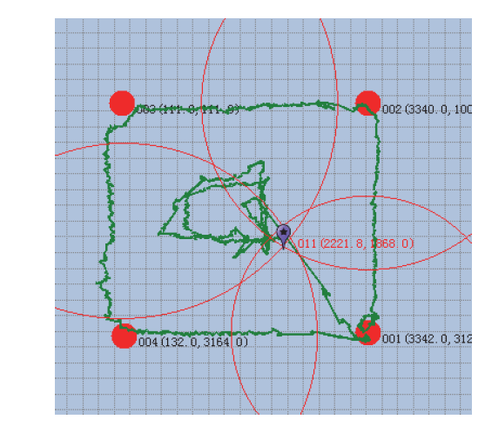
Experimental results of the bacon-based active position system
Introduction
Active Wireless Position Network
Active RFID
CONCLUSION

Slide 29
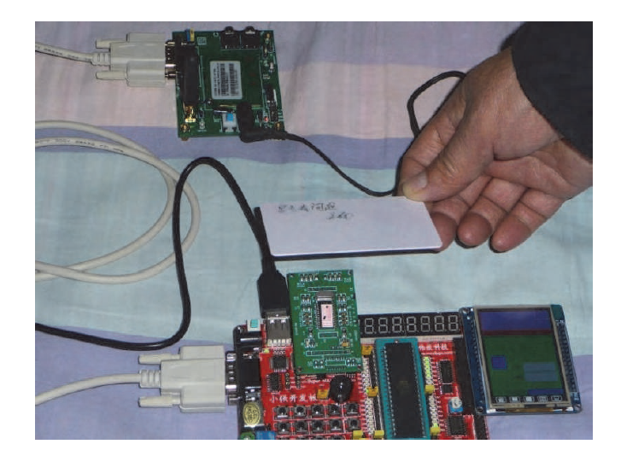
Experimental platform using RFID reader, tag and wireless transmitting system
Introduction
Active Wireless Position Network
Active RFID
CONCLUSION

Slide 30
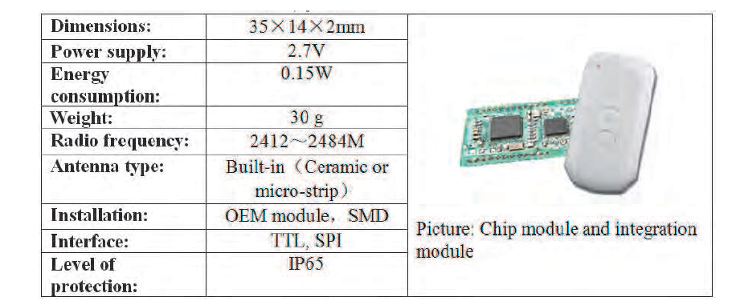
The compact-sized positioning active RFID tag
Introduction
Active Wireless Position Network
Active RFID
CONCLUSION

Slide 31
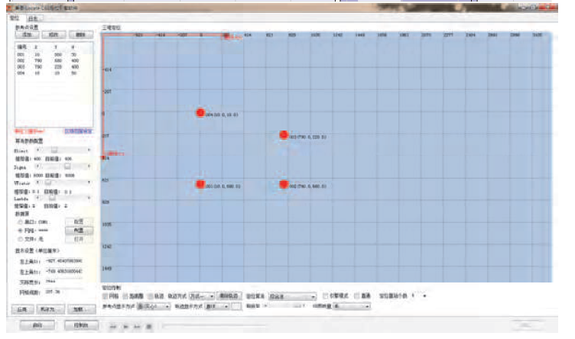
Introduction
Active Wireless Position Network
Active RFID
CONCLUSION
The related software running on the reader’s computer (in 2D mode, red spots
indicate the tags’ relative position and the blue shadow area is the error space in XY-plane)

Slide 32
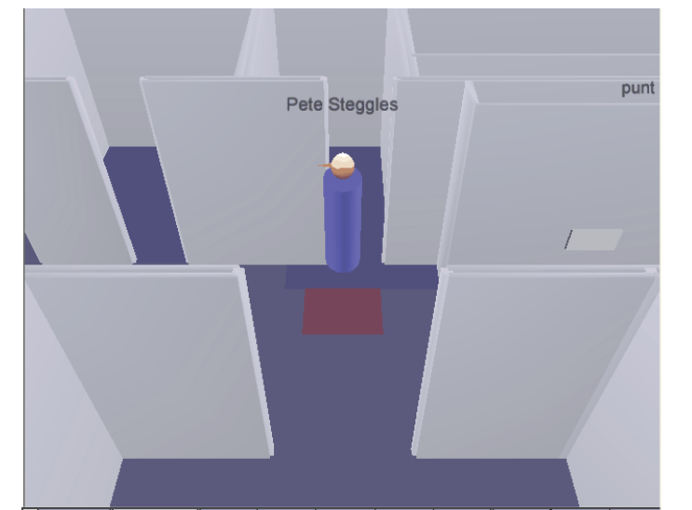
The compact-sized positioning active RFID tag
Introduction
Active Wireless Position Network
Active RFID
CONCLUSION
The related software running on the reader’s computer (in 3D and live-action
Modes)

Slide 33
Contents
Conclusion

Slide 34
Conclusion
Introduction
Active Wireless Position Network
Active RFID
CONCLUSION
Strengths:
Advanced Technology
Small size
Easy to use
Threats
Ethical threats concerning privacy life
Opportunities
Could replace the bar code
End-user demand for RFID systems is increasing
Huge market potential in many businesses

Slide 35
Reference
Nan Wu and Xiangdong Li (2011). RFID Applications in Cyber-Physical System, Deploying RFID - Challenges,Solutions, and Open Issues, Dr. Cristina Turcu (Ed.), ISBN: 978-953-307-380-4, InTech, Available from:
http://www.intechopen.com/books/deploying-rfid-challenges-solutions-and-open-issues/rfid-applications-incyber-physical-system
www.it.iitb.ac.in/~sri

Slide 36
Thank You !

