Slide 1
Introduction to Big Data
(ECE 693 Big Data Security)

Slide 2
Syllabus
20% Labs
20% 4 quizzes (each 15 minutes)
10% Homework (~7 of them)
40% 50-min in-class closed-book exams (4 of them; every 3-4 weeks)
10%: A self-chosen project on big data system security needs to be demonstrated.

Slide 3
What’s Big Data?
No single definition; here is from Wikipedia:
Big data is the term for a collection of data sets so large and complex that it becomes difficult to process using on-hand database management tools or traditional data processing applications.
The challenges include capture, curation, storage, search, sharing, transfer, analysis, and visualization.
The trend to larger data sets is due to the additional information derivable from analysis of a single large set of related data, as compared to separate smaller sets with the same total amount of data, allowing correlations to be found to "spot business trends, determine quality of research, prevent diseases, link legal citations, combat crime, and determine real-time roadway traffic conditions.”

Slide 4
Big data is 21st century oil
McKinsey summarized the values that big data could create:
if big data could be creatively and effectively utilized to improve efficiency and quality, the potential value of the U.S medical industry gained through data may surpass USD 300 billion, thus reducing the expenditure for the U.S. healthcare by over 8 %;
retailers that fully utilize big data may improve their profit by more than 60 %;
big data may also be utilized to improve the efficiency of government operations, such that the developed economies in Europe could save over EUR 100 billion (which excludes the effect of reduced frauds, errors, and tax difference).

Slide 5
Google handles BD well
The McKinsey report is regarded as prospective and predictive, while the following facts may validate the values of big data.
During the 2009 flu pandemic, Google obtained timely information by analyzing big data, which even provided more valuable information than that provided by disease prevention centers.
Nearly all countries required hospitals inform agencies such as disease prevention centers of the new type of influenza cases.

Slide 6
Data, Data
In 2008, Microsoft purchased Farecast, a sci-tech venture company in the U.S. Farecast has an airline ticket forecast system that predicts the trends and rising/dropping ranges of airline ticket price.
The system has been incorporated into the Bing search engine of Microsoft. By 2012, the system has saved nearly USD 50 per ticket per passenger, with the forecasted accuracy as high as 75 %.

Slide 7
Big data may come from IoT

Slide 8
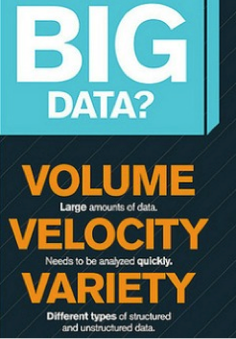
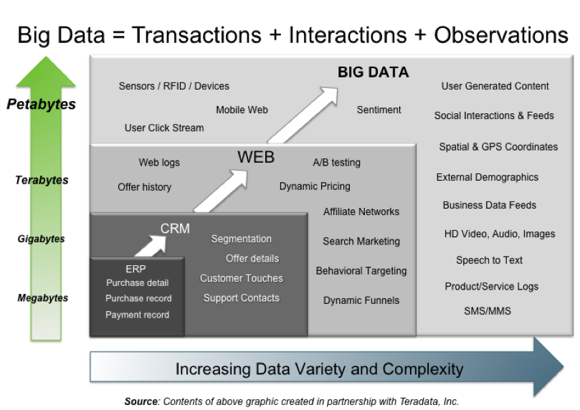
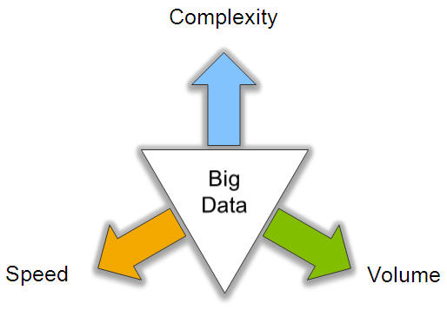
Big Data: 3V’s

Slide 9
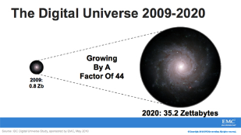
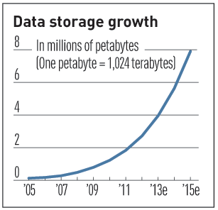

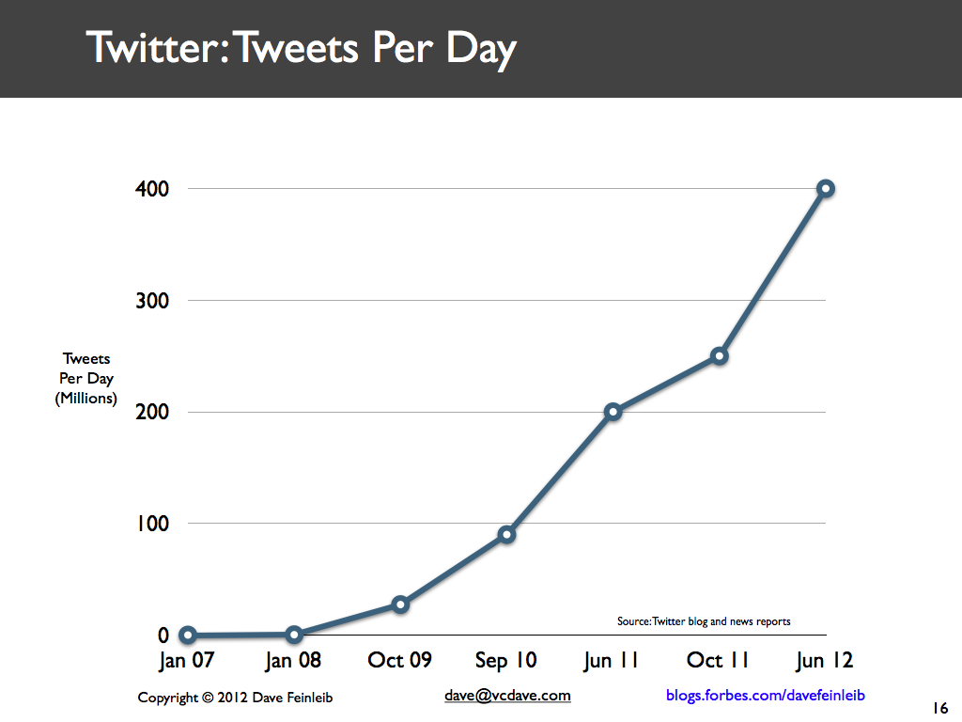
Volume (Scale)
Data Volume
  44x increase from 2009 to 2020
  From 0.8 zettabytes to 35zb
Data volume is increasing exponentially
Exponential increase in collected/generated data

Slide 11

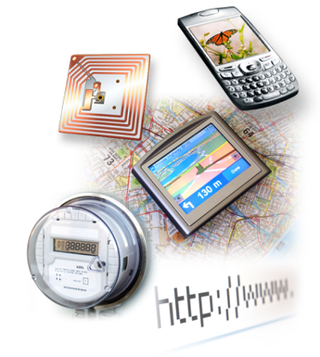
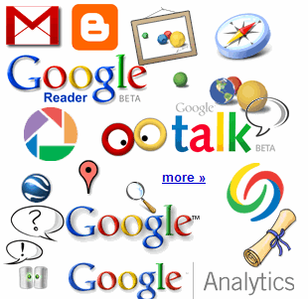


4.6 billion camera phones world wide
30 billion RFID tags today
(1.3B in 2005)
12+ TBs
of tweet data
every day
100s of millions of GPS enabled devices sold annually
? TBs of
data every day
25+ TBs of
log data every day
2+ billion people on the Web by end 2011
76 million smart meters in 2009…
200M by 2014

Slide 12
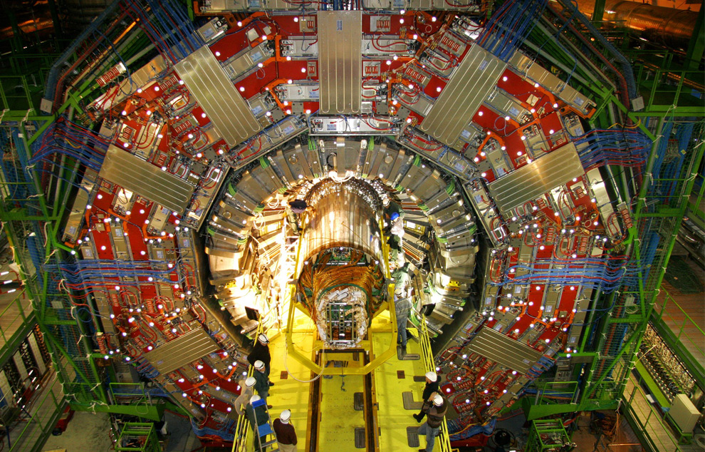
CERN’s Large Hydron Collider (LHC) generates 15 PB a year
Maximilien Brice, © CERN

Slide 13
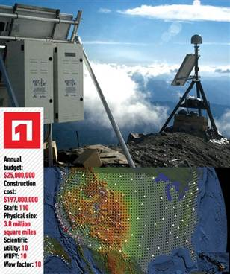
The Earthscope
1.
The Earthscope is the world's largest science project. Designed to track North America's geological evolution, this observatory records data over 3.8 million square miles, amassing 67 terabytes of data.
It analyzes seismic slips in the San Andreas fault, sure, but also the plume of magma underneath Yellowstone and much, much more. (http://www.msnbc.msn.com/id/44363598/ns/technology_and_science-future_of_technology/#.TmetOdQ--uI)

Slide 14
Big Data collection
3 common methods:
(1) Log files: For example, web servers record in log files number of clicks, click rates, visits, and other property records of web users.
(2) Sensors: Sensory data may be classified as
sound wave, voice, vibration, automobile, chemical, current, weather, pressure, temperature, etc.
(3) Internet traffic data: web crawler, word segmentation system, task system, and index system, etc.

Slide 15
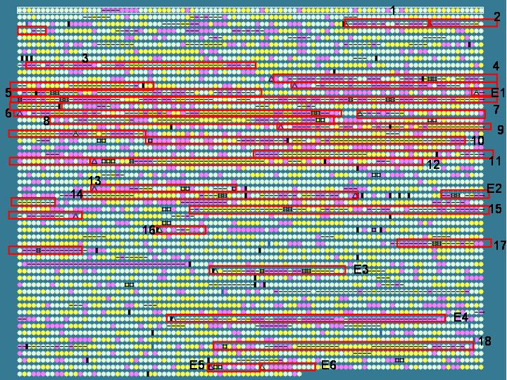
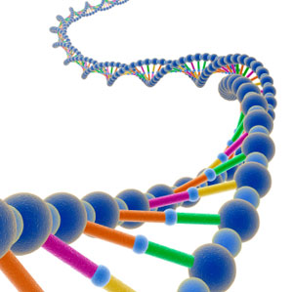
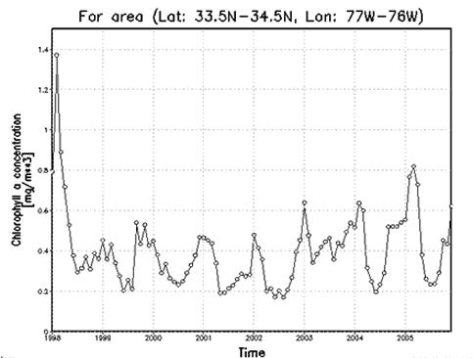

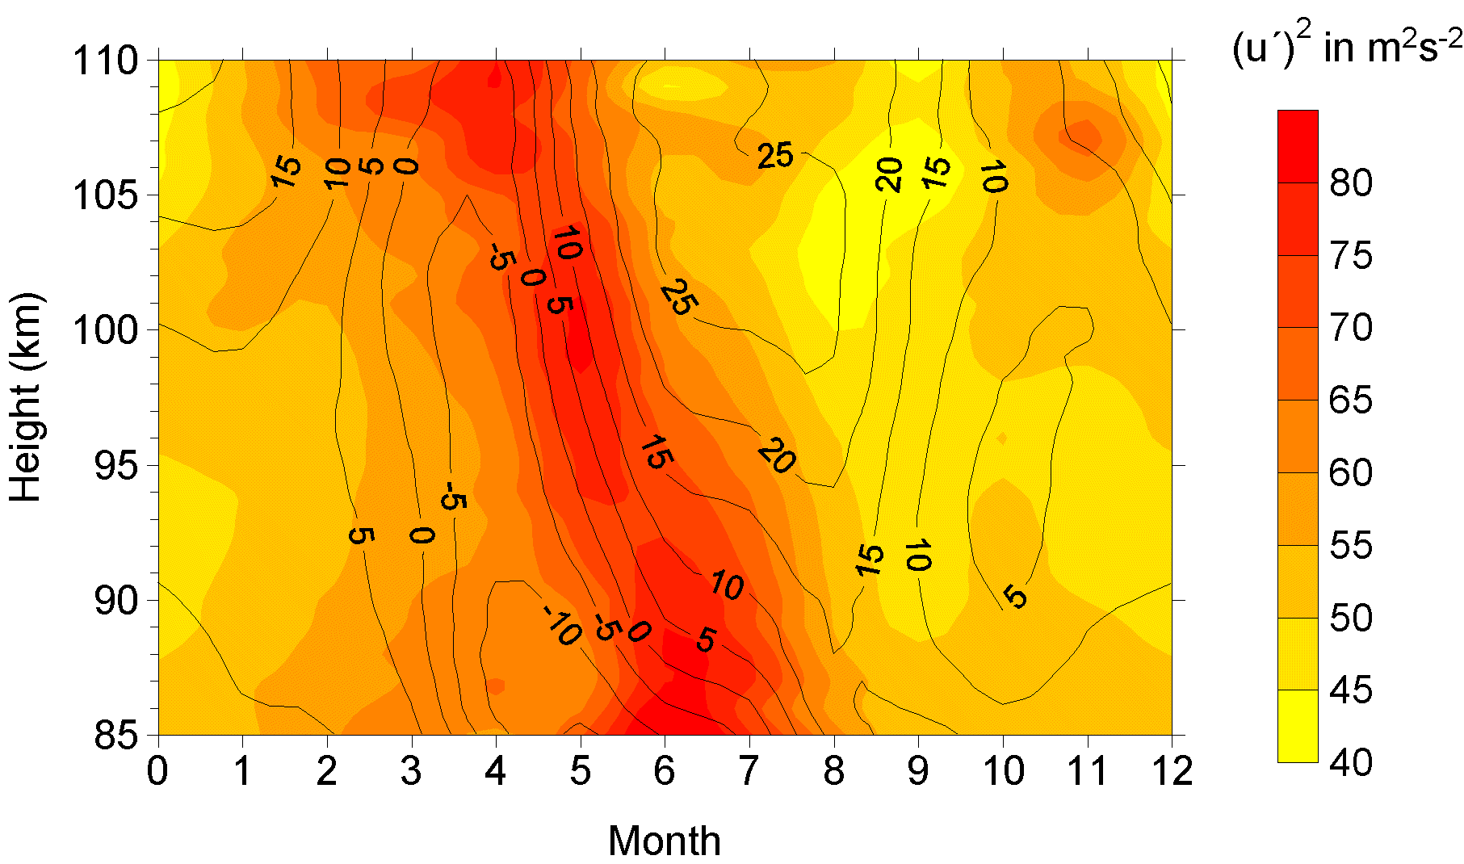

Variety (Complexity)
Relational Data (Tables/Transaction/Legacy Data)
Text Data (Web)
Semi-structured Data (XML)
Graph Data
  Social Network, Semantic Web (RDF), …
Streaming Data
  You can only scan the data once
A single application can be generating/collecting many types of data
Big Public Data (online, weather, finance, etc)
To extract knowledge➔ all these types of data need to linked together

Slide 16

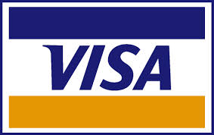















A Single View to the Customer
Social Media
Banking
Finance
Gaming
Our
Known
History
Customer
Entertain
Purchase

Slide 17

Velocity (Speed)
Data is generated fast and need to be processed fast
Online Data Analytics
Late decisions ➔ missing opportunities
Examples
  E-Promotions: Based on your current location, your purchase history, what you like ➔ send promotions right now for store next to you
  Healthcare monitoring: sensors monitoring your activities and body ➔ any abnormal measurements require immediate reaction

Slide 18
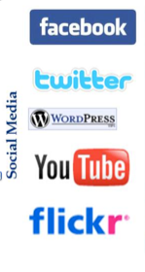
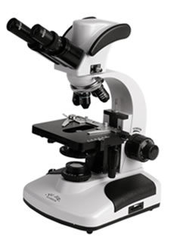
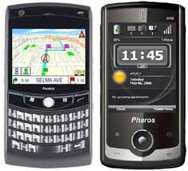
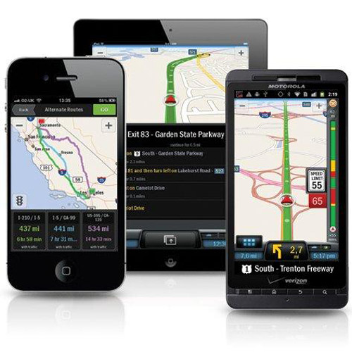

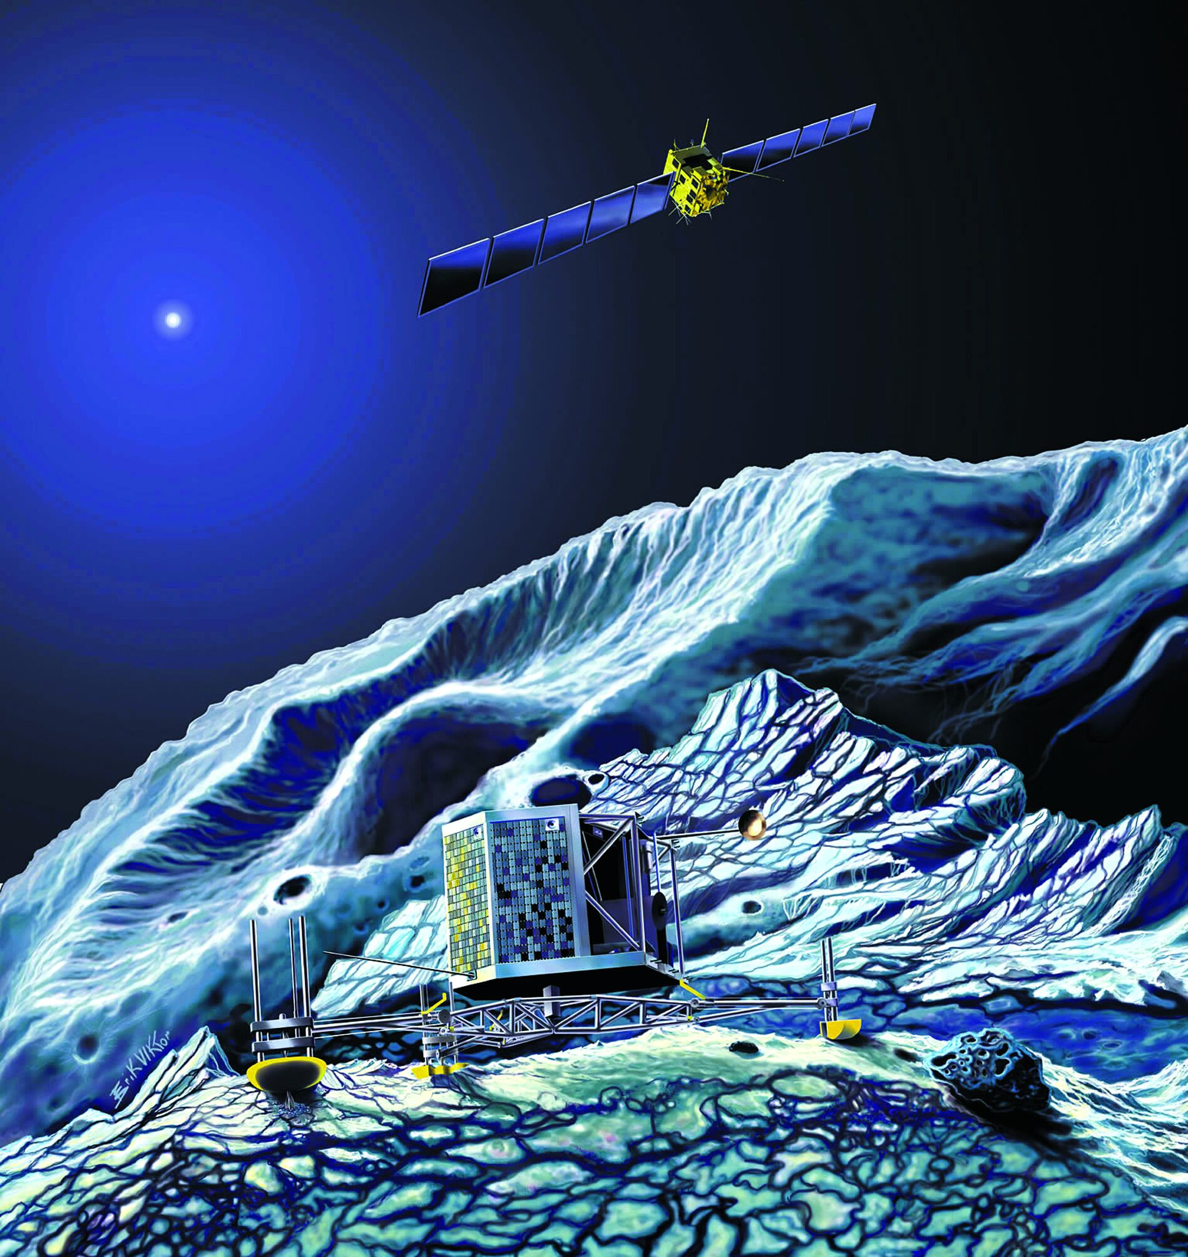
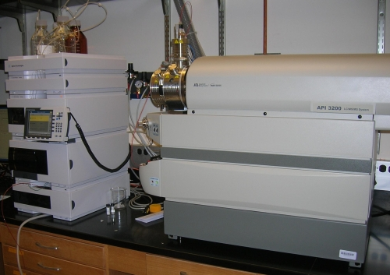
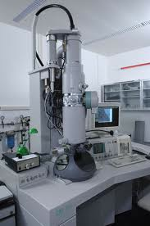
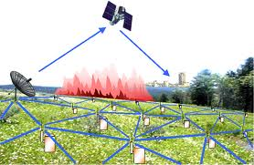
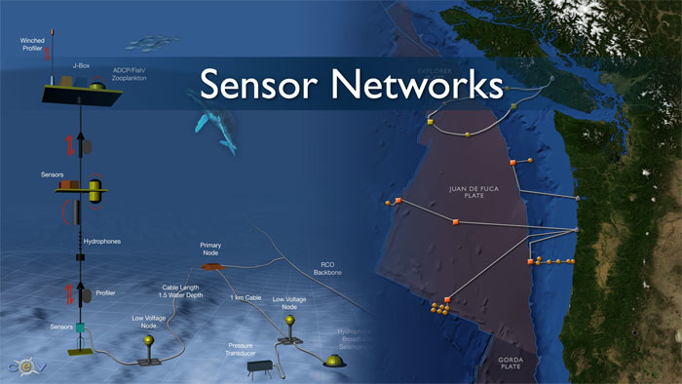
Real-time/Fast Data
Mobile devices
(tracking all objects all the time)
Social media and networks
(all of us are generating data)
Scientific instruments
(collecting all sorts of data)
Sensor technology and networks
(measuring all kinds of data)
The progress and innovation is no longer hindered by the ability to collect data
But, by the ability to manage, analyze, summarize, visualize, and discover knowledge from the collected data in a timely manner and in a scalable fashion

Slide 19
Why Velocity (Real-Time)?
Product
Recommendations
that are Relevant
& Compelling
Learning why Customers
Switch to competitors
and their offers; in
time to Counter
Influence
Behavior
Customer
Friend Invitations
to join a
Game or Activity
that expands
business
Improving the
Marketing
Effectiveness of a
Promotion while it
is still in Play
Preventing Fraud
as it is Occurring
& preventing more
proactively

Slide 20
Big Data storage
Various storage systems emerge to meet the demands of massive data.
Existing massive storage technologies can be classified as Direct Attached Storage (DAS) and network storage.
while network storage can be further classified into Network Attached Storage (NAS) and Storage Area Network (SAN).

Slide 21
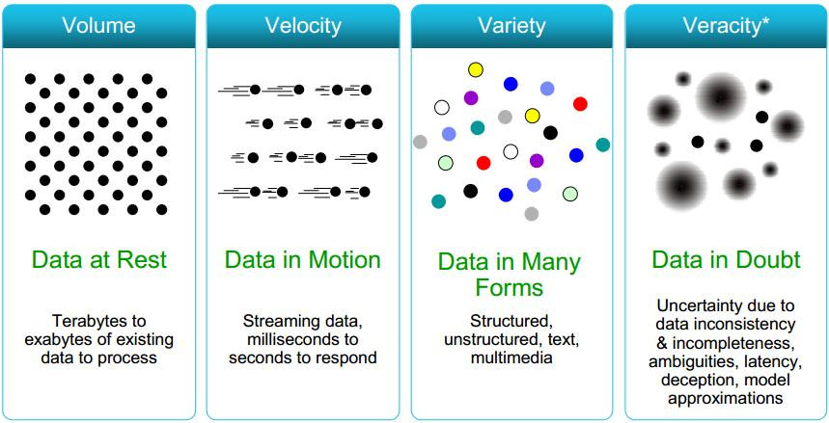
Some Make it 4V’s

Slide 23
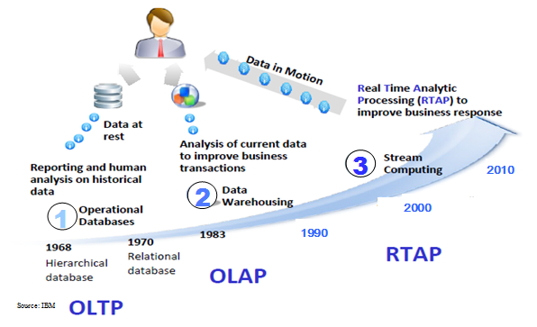
Harnessing Big Data
OLTP: Online Transaction Processing (DBMSs)
OLAP: Online Analytical Processing (Data Warehousing)
RTAP: Real-Time Analytics Processing (Big Data Architecture & technology)

Slide 24
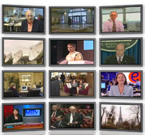

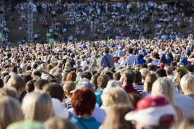

The Model Has Changed…
The Model of Generating/Consuming Data has Changed
Old Model: Few companies are generating data, all others are consuming data
New Model: all of us are generating data, and all of us are consuming data

Slide 25
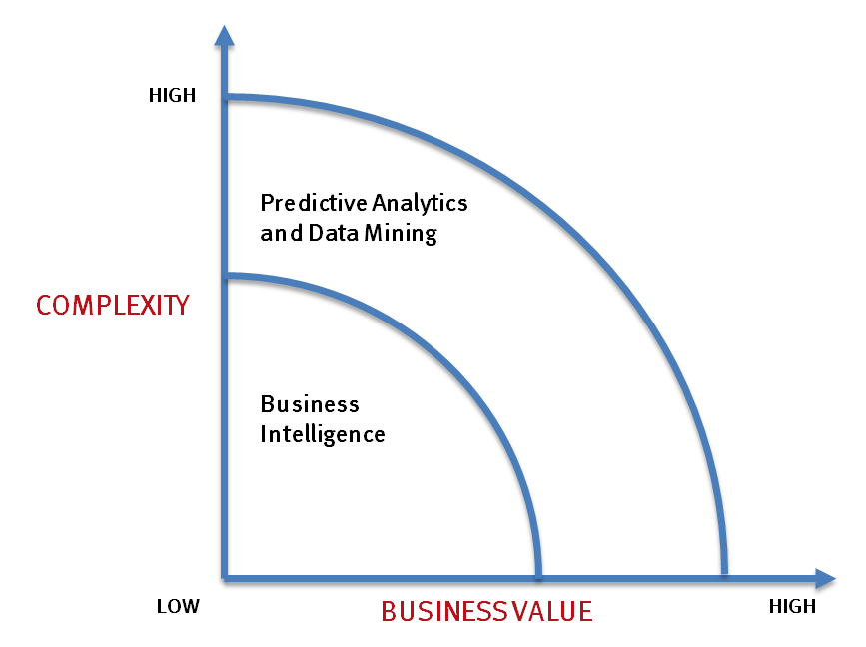
What’s driving Big Data
- Optimizations and predictive analytics
- Complex statistical analysis
- All types of data, and many sources
- Very large datasets
- More of a real-time
- Ad-hoc querying and reporting
- Data mining techniques
- Structured data, typical sources
- Small to mid-size datasets

Slide 26
The Evolution of Business Intelligence
Interactive Business Intelligence &
In-memory RDBMS
QliqView, Tableau, HANA
Big Data:
Real Time &
Single View
Graph Databases
Speed
Scale
BI Reporting
OLAP &
Dataware house
Business Objects, SAS, Informatica, Cognos other SQL Reporting Tools
Big Data:
Batch Processing &
Distributed Data Store
Hadoop/Spark; HBase/Cassandra
Scale
Speed
1990’s
2000’s
2010’s

Slide 27
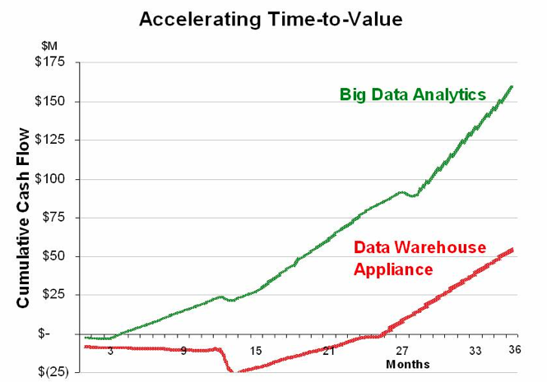
Big Data Analytics
Big data is more real-time in nature than traditional DW applications
Traditional DW architectures (e.g. Exadata, Teradata) are not well-suited for big data apps
massively parallel processing, scale out architectures are well-suited for big data apps

Slide 28
MapReduce
[Dean et al., OSDI 2004, CACM Jan 2008, CACM Jan 2010]
Overview:
  Data-parallel programming model
  An associated parallel and distributed implementation for commodity clusters
Pioneered by Google
  Processes 20 PB of data per day
Popularized by open-source Hadoop project
  Used by Yahoo!, Facebook, Amazon, and the list is growing …

Slide 29
Programming Framework
Raw Input: <key, value>
MAP
<K1, V1>
<K2,V2>
<K3,V3>
REDUCE

Slide 30
MapReduce Advantages
Automatic Parallelization:
  Depending on the size of RAW INPUT DATA ➔ instantiate multiple MAP tasks
  Similarly, depending upon the number of intermediate <key, value> partitions ➔ instantiate multiple REDUCE tasks
Run-time:
  Data partitioning
  Task scheduling
  Handling machine failures
  Managing inter-machine communication
Completely transparent to the programmer/analyst/user

Slide 31
MapReduce Experience
Runs on large commodity clusters:
  1000s to 10,000s of machines
Processes many terabytes of data
Easy to use since run-time complexity hidden from the users
1000s of MR jobs/day at Google (circa 2004)
100s of MR programs implemented (circa 2004)

Slide 32
The Need
Special-purpose programs to process large amounts of data: crawled documents, Web Query Logs, etc.
At Google and others (Yahoo!, Facebook):
  Inverted index
  Graph structure of the WEB documents
  Summaries of #pages/host, set of frequent queries, etc.
  Ad. Optimization
  Spam filtering
Notes:
In computer science, an inverted index (also referred to as postings file or inverted file) is an index data structure storing a mapping from content, such as words or numbers, to its locations in a database file, or in a document or a set of documents (named in contrast to a forward index, which maps from documents to content). The purpose of an inverted index is to allow fast full text searches, at a cost of increased processing when a document is added to the database. The inverted file may be the database file itself, rather than its index. It is the most popular data structure used in document retrievalsystems,^{[1]} used on a large scale for example in search engines. Additionally, several significant general-purpose mainframe-based database management systems have used inverted list architectures, including ADABAS, DATACOM/DB, and Model 204.

Slide 33
MapReduce Contributions
Simple & Powerful
Programming Paradigm
For
Large-scale Data Analysis
Run-time System
For
Large-scale Parallelism & Distribution

Slide 34
Takeaway
MapReduce’s data-parallel programming model hides complexity of distribution and fault tolerance
Key philosophy:
  Make it scale, so you can throw hardware at problems
  Make it cheap, saving hardware, programmer and administration costs (but requiring fault tolerance)
Hive and Pig further simplify programming
MapReduce is not suitable for all problems, but when it works, it may save you a lot of time

Slide 35
Map Reduce vs Parallel DBMS
[Pavlo et al., SIGMOD 2009, Stonebraker et al., CACM 2010, …]
 | Parallel DBMS | MapReduce
Schema Support | ✓ | Not out of the box
Indexing | ✓ | Not out of the box
Programming Model | Declarative (SQL) | Imperative (C/C++, Java, …) Extensions through Pig and Hive
Optimizations (Compression, Query Optimization) | ✓ | Not out of the box
Flexibility | Not out of the box | ✓
Fault Tolerance | Coarse grained techniques | ✓

Slide 36

MapReduce: A step backwards?
Don’t need 1000 nodes to process petabytes:
  Parallel DBs do it in fewer than 100 nodes
No support for schema:
  Sharing across multiple MR programs difficult
No indexing:
  Wasteful access to unnecessary data
Non-declarative programming model:
  Requires highly-skilled programmers
No support for JOINs:
  Requires multiple MR phases for the analysis

Slide 37
MapReduce VS Parallel DB: Our 2¢
Web application data is inherently distributed on a large number of sites:
  Funneling data to DB nodes is a failed strategy
Distributed and parallel programs difficult to develop:
  Failures and dynamics in the cloud
Indexing:
  Sequential Disk access 10 times faster than random access.
  Not clear if indexing is the right strategy.
Complex queries:
  DB community needs to JOIN hands with MR

Slide 38
Hadoop DB – A Hybrid Approach
[Abouzeid et al., VLDB 2009]
An architectural hybrid of MapReduce and DBMS technologies
Use Fault-tolerance and Scale of MapReduce framework like Hadoop
Leverage advanced data processing techniques of an RDBMS
Expose a declarative interface to the user
Goal: Leverage from the best of both worlds

Slide 39
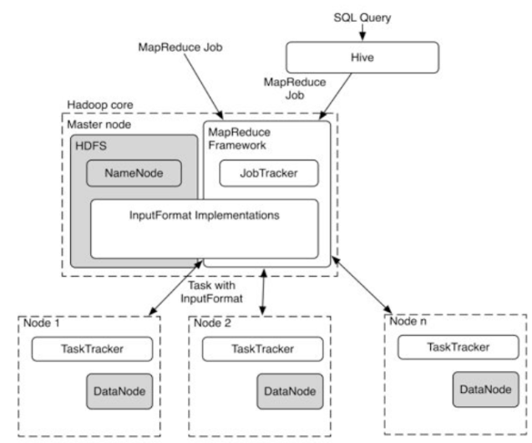
Architecture of HadoopDB

Slide 40
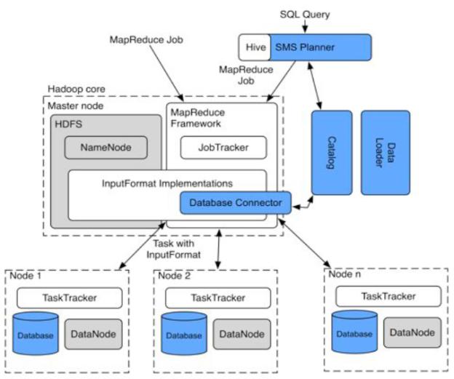
HadoopDB: add more components

Slide 41
Relationship between Hadoop and big data
Presently, Hadoop is widely used in big data applications in the industry, e.g., spam filtering, network searching, clickstream analysis, and social recommendation. In addition, considerable academic research is now based on Hadoop.
As declared in June 2012, Yahoo runs Hadoop in 42,000 servers at four data centers to support its products and services, e.g., searching and spam filtering, etc.
At present, the biggest Hadoop cluster has 4,000 nodes, but the number of nodes will be increased to 10,000 with the release of Hadoop 2.0.
In the same month, Facebook announced that their Hadoop cluster can process 100 PB data, which grew by 0.5 PB per day as in November 2012.
Some well-known agencies use Hadoop to conduct distributed computation.
In addition, many companies provide Hadoop commercial execution and/or support, including Cloudera, IBM, MapR, EMC, and Oracle.

Slide 42
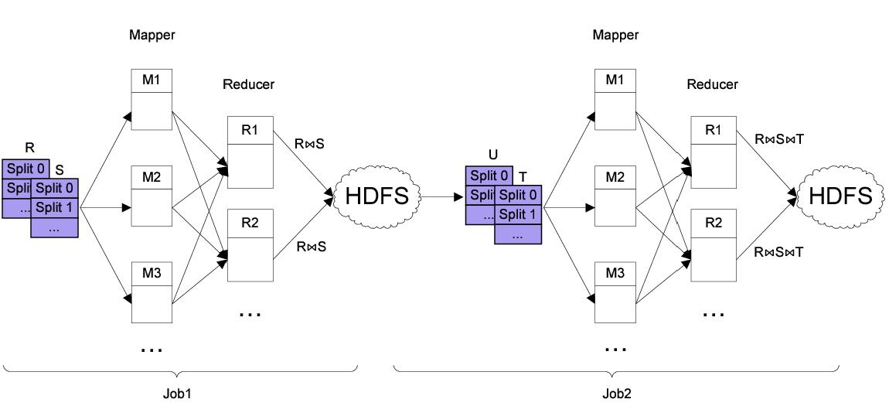
Two-way Joins
U

Slide 43
BLOG Wisdom
“If you want vast, on-demand scalability, you need a non-relational database.” Since scalability requirements:
  Can change very quickly and,
  Can grow very rapidly.
Difficult to manage with a single in-house RDBMS server.
RDBMS scale well:
  When limited to a single node, but
  Overwhelming complexity to scale on multiple server nodes.

Slide 44
The “NoSQL” movement
Initially used for: “Open-Source relational database that did not expose SQL interface”
Popularly used for: “non-relational, distributed data stores that often did not attempt to provide ACID guarantees”
Gained widespread popularity through a number of open source projects
  HBase, Cassandra, Voldemort, MongDB, …
Scale-out, elasticity, flexible data model, high availability

Slide 45
NoSQL has no relation with SQL
- Micheal Stonebraker [CACM Blog]
Term heavily used (and abused)
Scalability and performance bottleneck not inherent to SQL
  Scale-out, auto-partitioning, self-manageability can be achieved with SQL
Different implementations of SQL engine for different application needs
SQL provides flexibility, portability

Slide 46
No-SQL ➔ Not Only SQL
Recently renamed
Encompass a broad category of “structured” storage solutions
  RDBMS is a subset
  Key Value stores
  Document stores
  Graph database
The debate on appropriate characterization continues

Slide 47
NoSQL is good
The database technology has been evolving for more than 30 years. Various database systems are developed to handle
datasets at different scales and support various applications.
Traditional relational databases cannot meet the challenges
on categories and scales brought about by big data.
NoSQL databases (i.e., non traditional relational databases) are becoming more popular for big data storage.
NoSQL databases feature flexible modes, support for simple and easy copy, simple API, eventual consistency, and support of large volume data.
NoSQL databases are becoming the core technology for of big data.

